Slide 1
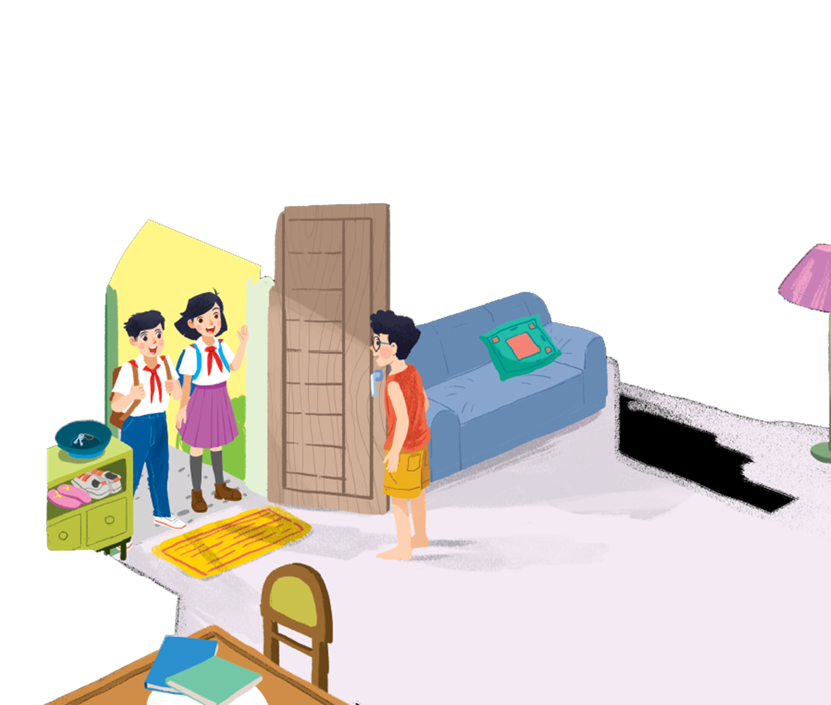
UNIT 1: MY NEW SCHOOL
LESSON 2: A CLOSER LOOK 1
English 6

Slide 2


Vocabulary
1
Listen and repeat the words.
2
Work in pairs. Put the words in 1 in the correct columns.
3
Put one of these words in each blank.
Pronunciation
/ɑ:/ and /ʌ/
4
Listen and repeat. Pay attention to the sounds /ɑ:/ and /ʌ/.
5
Listen and repeat. Then listen again and underline the words with the sounds /ɑ:/ and /ʌ/.

Slide 3



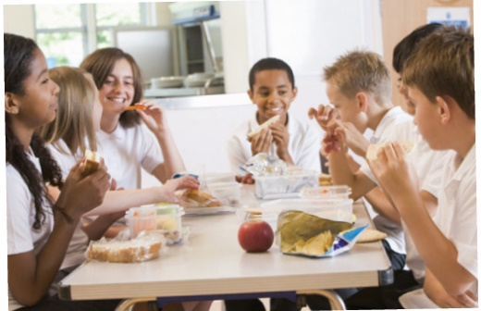


U1 L2
Vocabulary
‘exercise (n)
/ˈeksəsaiz/
bài tập
‘history (n)
/ˈhistri/
lịch sử
‘lesson (n)
/ˈlesn/
bài hoc
science (n)
/ˈsaiəns/
môn khoa học
school lunch (n)
/skuːl lʌntʃ/
bữa trưa ở trường

Slide 4
Rub out and remember
exercise (n)
bài tập
history (n)
lịch sử
lesson (n)
bài hoc
science (n)
môn khoa học
school lunch
bữa trưa ở trường

Slide 5

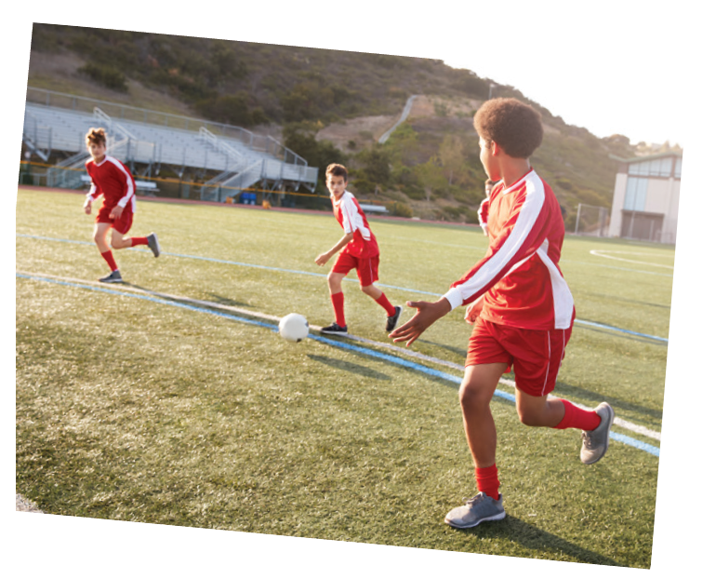
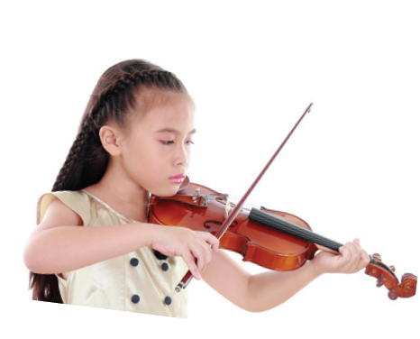


Listen and repeat the words.
1
Vocabulary
shool lunch
excercise
English
science
history
football
homework
lessons
music

Slide 6

Work in pairs. Put the words in 1 in the correct columns.
2
football
school lunch
history
football
school lunch
history
English
science
English
homework
science
homework
music
lessons
music
exercise
lessons
exercise
play | do | have | study
football
homework
school lunch
English
music
exercise
lessons
history
science
sports
housework
rest
new words
Can you add more
words to each column?

Slide 7
NOTES:
1. DO: Kết hợp với các danh từ chỉ các hoạt động giải trí hoặc các môn thể thao trong nhà, không liên quan tới trái bóng, thường mang tính cá nhân và không mang tính chiến đấu, ganh đua.
Ví dụ: do yoga, karate, judo, exercise…
2. PLAY: Kết hợp với các danh từ chỉ môn thể thao liên quan đến trái bóng hoặc một vật tương tự trái bóng như trái cầu/ quả cầu; nhạc cụ (musical instument). Ví dụ: play football, volleyball, tennis, guitar, piano…
3. STUDY: Đứng trước các danh từ chỉ một môn học, một lĩnh vực, một đề tài nghiên cứu.
Ví dụ: study Math, English, literature, chemistry…
4. HAVE: Trước các danh từ để diễn đạt sự sở hữu. Ví dụ: have a car, a book, a shirt, a house…

Slide 8
Put one of these words in each blank.
3
lessons
science
homework
football
exercise
homework
1.
Vy and I often do our after school.
Nick plays for the school team.
2.
football
lessons
3.
Mrs Nguyen teaches all my history .
They are healthy. They do every day.
4.
exercise
5.
I study maths, English and on Mondays.
science

Slide 9

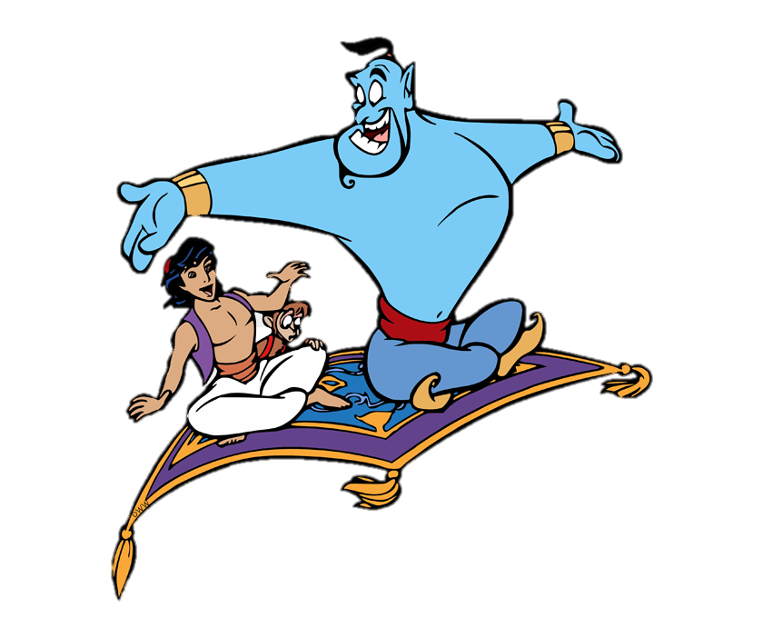

Slide 10
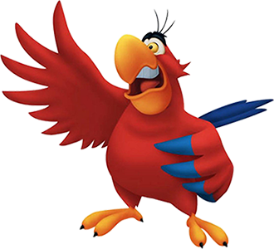

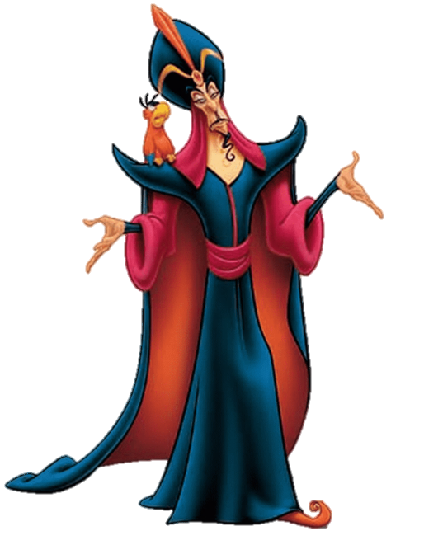
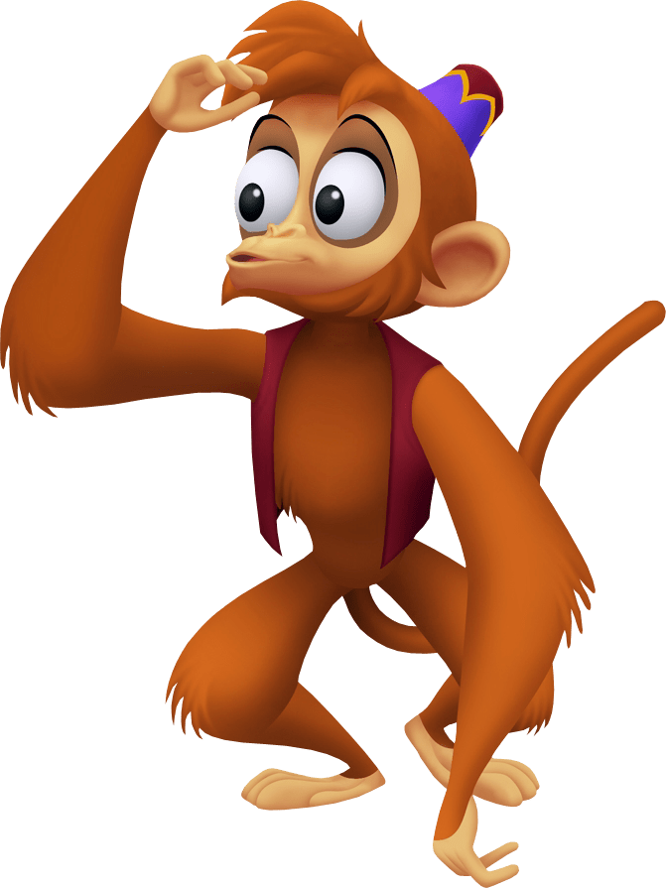
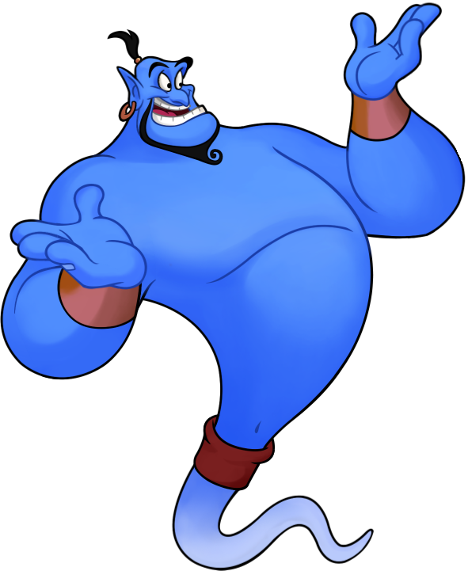

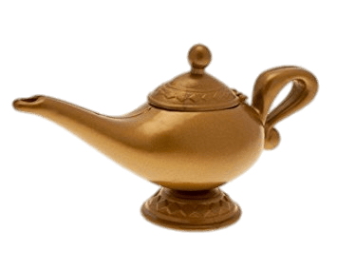
Points
10
10
unlucky
10
lucky
10
10

Slide 11
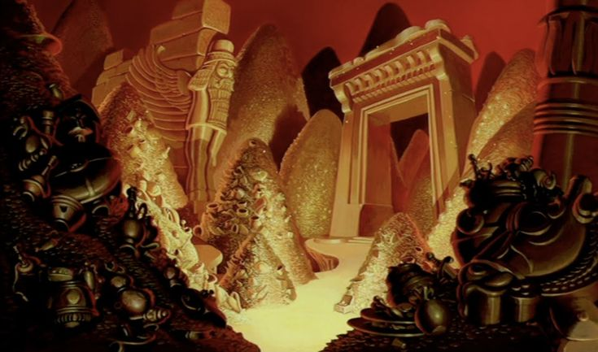
Team A
Team B
5
6
2
3
4
7
1
END

Slide 12
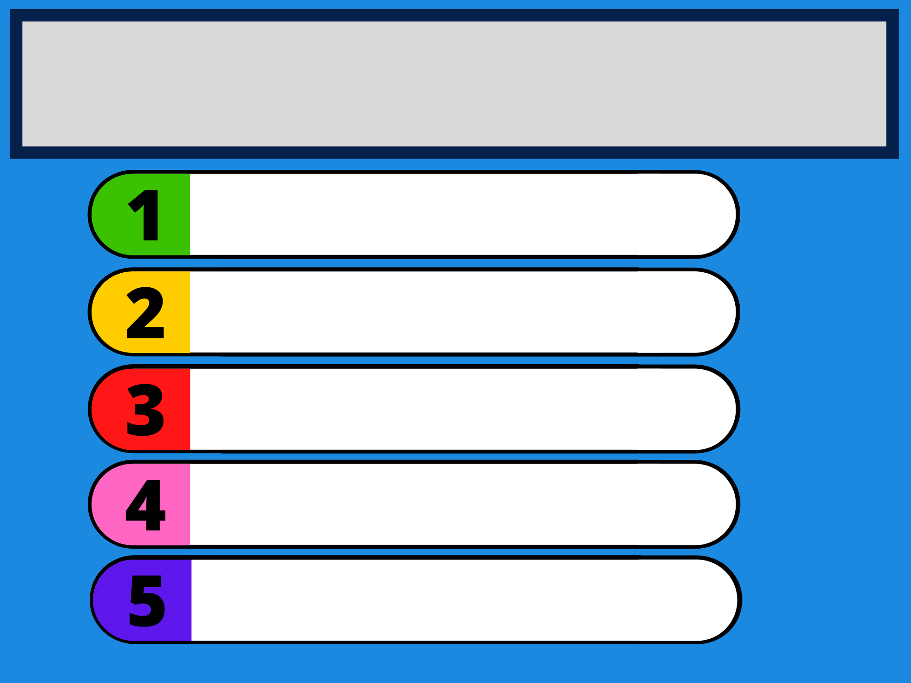

Vy and I often do our after school.
homework
lessons
science
homework
football
exercise

Slide 13
football
Nick plays for the school team.
lessons
science
homework
football
exercise

Slide 14
lessons
Mrs Nguyen teaches all my history .
lesson
science
homework
football
exercise

Slide 15
exercise
They are healthy. They do every day.
lesson
science
homework
football
exercise

Slide 16
science
I study maths, English and on Mondays.
lesson
science
homework
football
exercise

Slide 17
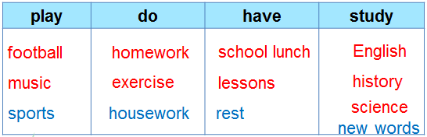
Extension: using the combinations in 2, write as many sentences as possible
Example
We have English lessons on Tuesday and Thursday

Slide 18
Listen and repeat. Pay attention to the sounds /ɑ:/ and /ʌ/.
4
Pronunciation
/ɑ:/ and /ʌ/
1
/ɑ:/
2
/ʌ/
smart
subject
art
study
carton
Monday
class
compass

Slide 19
Listen and repeat. Then listen again and underline the words with the sounds /ɑ:/ and /ʌ/.
5
1.
My brother has a new compass.
/ʌ/
/ʌ/
2.
Our classroom is large.
/a:/
/a:/
3.
They look smart on their first day at school.
/a:/
4.
The art lesson starts at nine o’clock.
/a:/
/a:/
5.
He goes out to have lunch every Sunday.
/ʌ/
/ʌ/

Slide 20

Write sentences about yourself using some verbs above.
Hi, everybody! I am Huy. I study at Tran Hung Dao Secondary School. At school I have many subjects: English, Maths, Physics, History, Science and Music. I love English and I study English well. I have English on Monday, Wednesday and Friday. When I have free time, I usually play football with my friends.

Slide 21

Homework
Practise saying words that have sounds /əʊ/ and /ʌ/
Rewrite all the sentences in WRITE-IT-UP at home.
Prepare the next lesson: A closer look 2

Slide 22


Pronunciation
/əʊ/

