Slide 1


TRƯỜNG THCS LONG BIÊN
BÀI GIẢNG ĐIỆN TỬ MÔN TIẾNG ANH 6
UNIT 4: My neighbourhood
Lesson 3 : A closer look 2
GV: Nguyễn Thị Hiền
Tổ Ngoại Ngữ - Năng khiếu

Slide 2
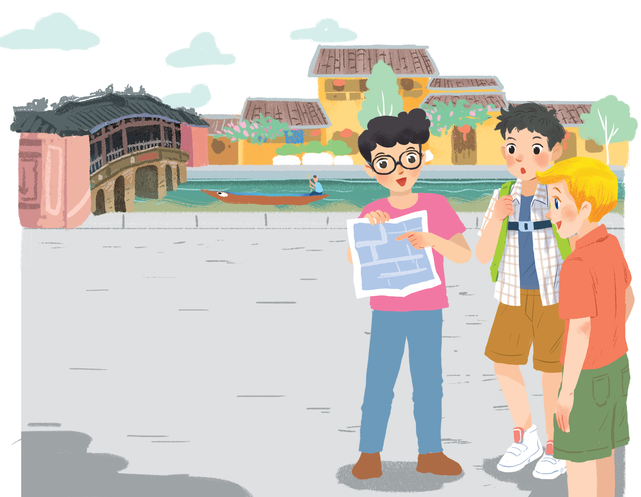
UNIT 4: MY NEIGHBOURHOOD
LESSON 3: A CLOLSER LOOK 2
English 6

Slide 3


Grammar
Comparative adjectives
1
Complete the following sentences with the comparative form of the adjectives in brackets. Number 1 is an example.
2
Use the correct form of the words in brackets to complete the letter.
3
Look at the pictures of the two neighbourhoods: Binh Minh and Long Son. Compare two neighbourhoods. You can use the adjectives below.
4
Work in pairs. Ask and answer questions about Binh Minh and Long Son neighbourhoods using the pictures in 3.

Slide 4

1
C
L
E
V
E
R
2
B
U
S
S
T
O
P
3
T
E
M
P
L
E
4
P
E
A
C
E
F
U
L
5
C
A
T
H
E
D
R
A
L
6
S
Q
U
A
R
E
7
N
O
I
S
Y
8
E
X
P
E
N
S
I
V
E
9
C
O
N
V
E
N
I
E
N
T
10
M
O
D
E
R
N

Slide 5
He always get good marks. He does exercises at school quickly. He is ______
A red bus is stopping at the _______
There are Ngoc Son _______ and Hoan Kiem lake in Hanoi City
Living in the country side is _________
________ is a church on Nha Chung Street in Hanoi City
Ba Dinh _______ is a very large place
The city is crowed. It is _______
We don’t have money to buy a big house in the city. It is very ________
I like living in the country. It is__________
________
clever
(> < stupid)
bus stop
B - S
temple
T
peaceful
(> < noisy)
Cathedral
C
square
S
noisy
(> < quiet)
expensive
(> < cheap)
convenient
(> < inconvenient)
modern
(> < historic, old)

Slide 6

Grammar
Comparative adjectives
We can use comparative adjectives to compare two people or things.

Slide 7
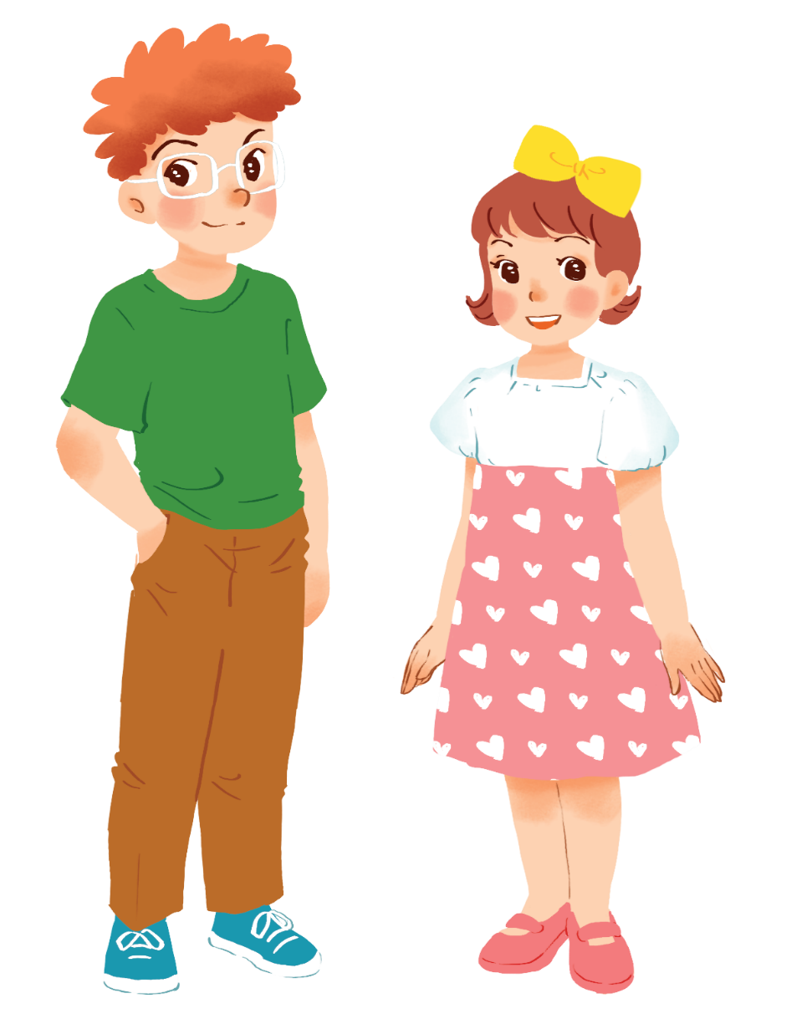
Example:
Tom is taller than Mary.

Slide 8
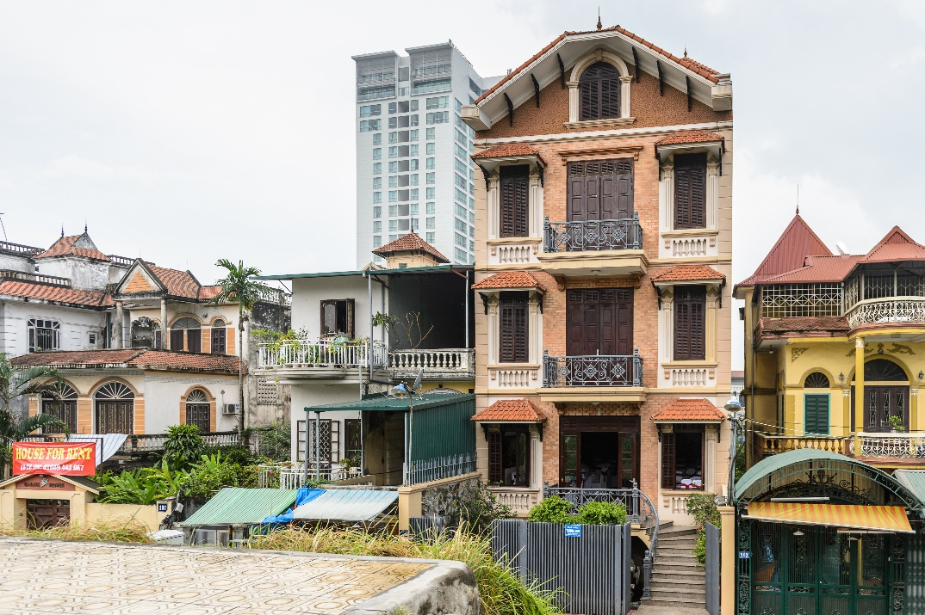
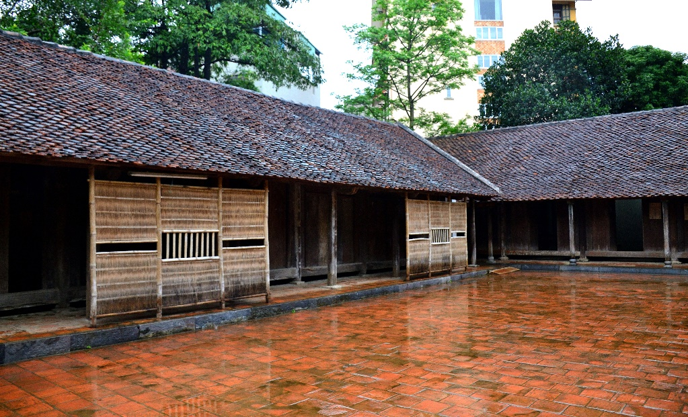
Example:
A house in a city is normally more expensive than a house in the countryside.

Slide 9
Form:
Comparative adjectives: (Cấp so sánh hơn của tính từ
Short Adj:
S + be + adj-ER + than + S’.
Long Adj:
S + be + MORE + adj + than + S’.

Slide 10
Note:
Syllable | Positive | Comparative | Rule
fast
faster
+ er
one
syllable
large
larger
+ r
big
bigger
+ ... er
two
syllables
noisy
noisier
y → ier
three or more syllables
expensive
more expensive
more + adj

Slide 11
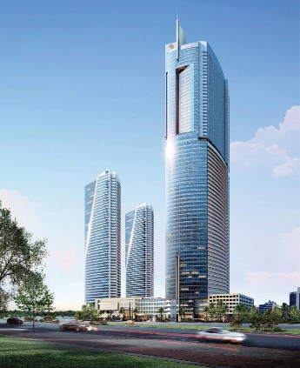
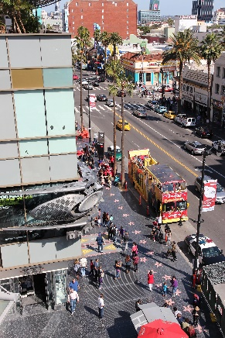
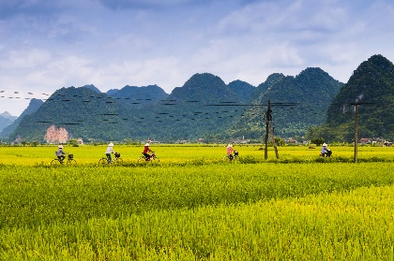
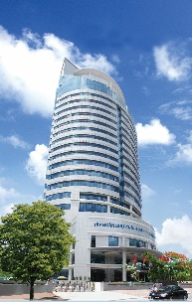
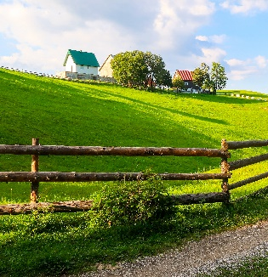
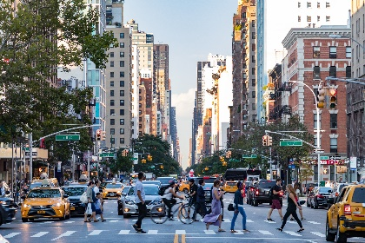
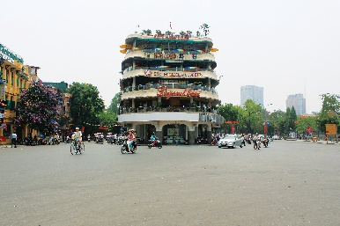
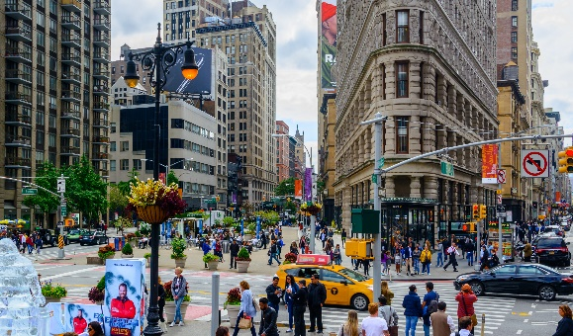
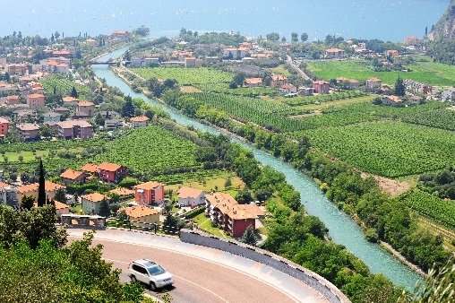
1
Complete the following sentences with the comparative form of the adjectives in brackets. Number 1 is an example.

Slide 12


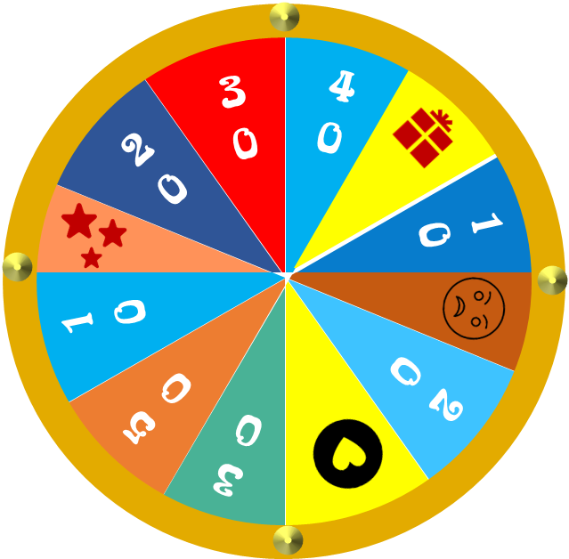







Q5
WHEEL OF ENGLISH
Q4
Q3
Q2
Q1
Mất lượt
Spin
Thêm lượt
Được quà
Chọn bất kì
Finish

Slide 13
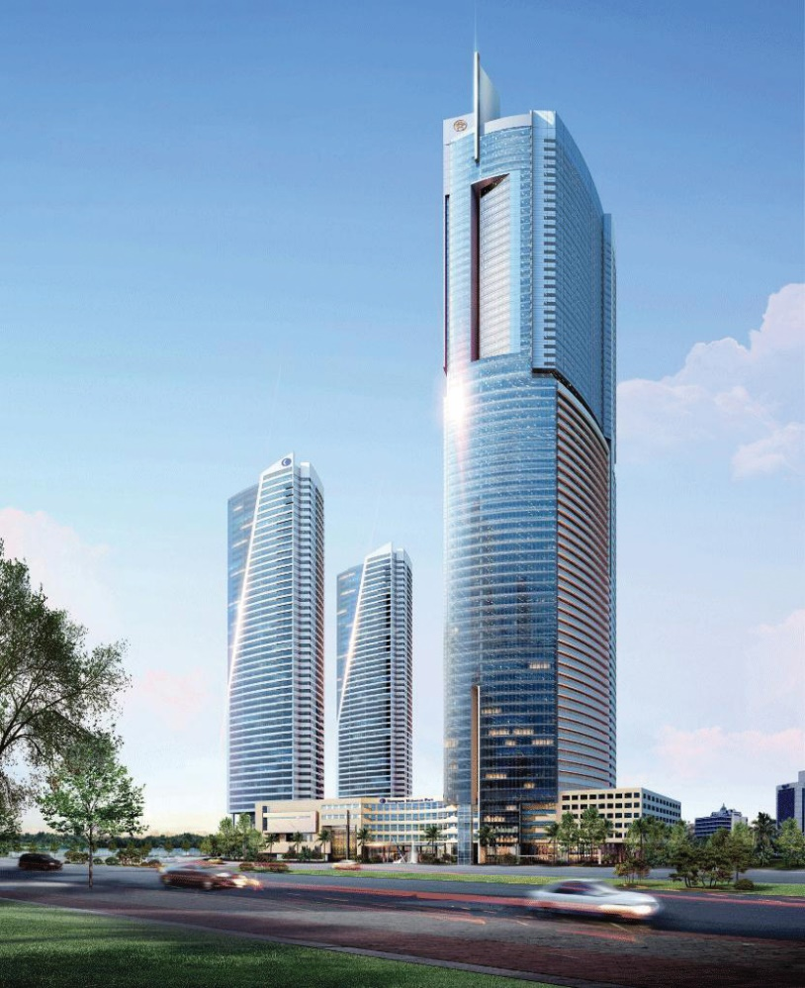


1.
This building is ______ than that building. (tall)
taller

Slide 14
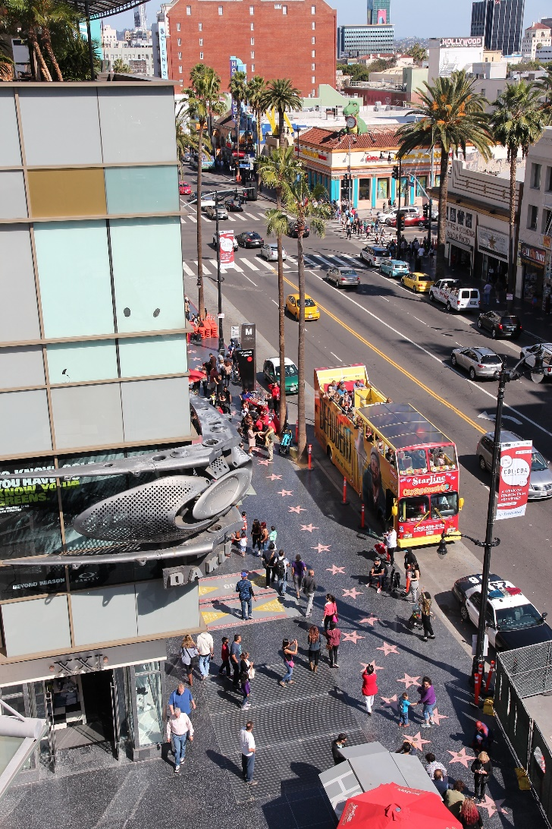

2.
noisier
My neighbourhood is than your neighbourhood. (noisy)

Slide 15

3.
bigger
The square in Ha Noi is than the square in Hoi An. (big)

Slide 16


more peaceful
4.
Living in the countryside is
in a city. (peaceful)
than living
than living

Slide 17
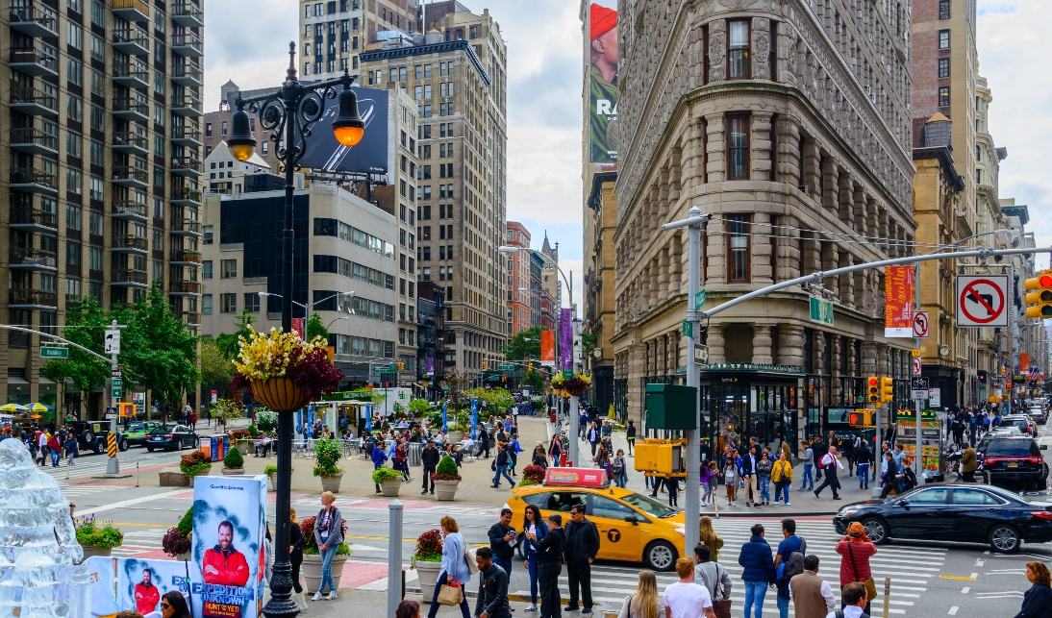

than living
than living
5.
more exciting
Is living in a city
in the countryside? (exciting)

Slide 18

2
Use the correct form of the words in brackets to complete the letter.
Dear Nick,
How are you?
Ha Noi is beautiful but it’s too busy for me. I’m having a great time at Cua Lo Beach now. The weather is (1. hot) hotter than that in Ha Noi. The houses and buildings are (2. small) _______ and (3. old) _______ than those in Ha Noi.
The streets are (4. wide) _______ with less traffic. the seafood here is (5. delicious) _______ and (6. cheap) _______ than the seafood in Ha Noi.
See you soon,
Vy

Slide 19
2
Use the correct form of the words in brackets to complete the letter.
Dear Nick,
How are you?
Ha Noi is beautiful but it’s too busy for me. I’m having a great time at Cua Lo Beach now. The weather is (1. hot) hotter than that in Ha Noi. The houses and buildings are (2. small) smaller and (3. old) older than those in Ha Noi.
The streets are (4. wide) wider with less traffic. the seafood here is (5. delicious) more delicious and (6. cheap) cheaper than the seafood in Ha Noi.
See you soon,
Vy

Slide 20
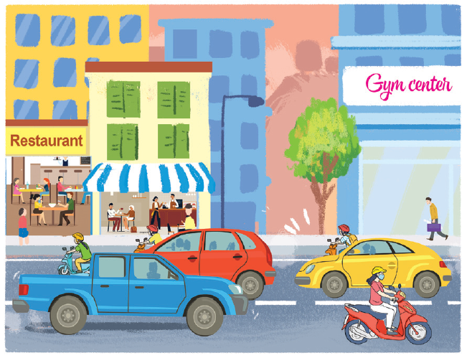
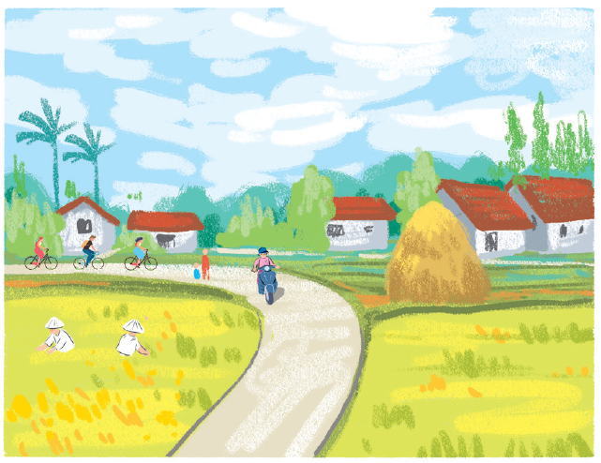
3
Look at the pictures of the two neighbourhoods Binh Minh and Long Son. Compare two neighbourhoods. You can use the adjectives below.
noisy
quiet
modern
boring
crowded
peaceful
busy
Example:
Binh Minh is noisier than Long Son.
Binh Minh
Long Son

Slide 21
4
Work in pairs. Ask and answer questions about Binh Minh and Long Son neighbourhoods using the pictures in 3.
noisy
quiet
modern
boring
crowded
peaceful
busy
Example:
A: Is Binh Minh noisier than Long Son?
B: Yes, it is.
A: Is Long Son more modern than Binh Minh?
B: No, it isn’t.

Slide 22

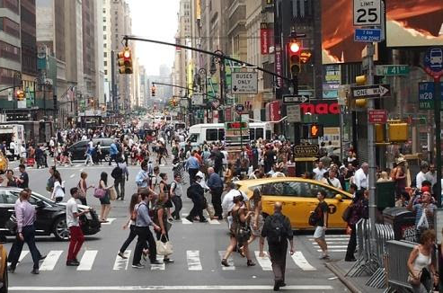
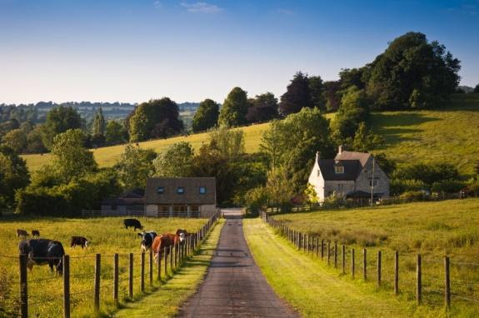
Compare life in the city with life in the country

Slide 23

Homework
Learn vocabulary and the structure by heart.
Do exercise in your work book
Prepare the next lesson: Communication

