Slide 1
Unit 9 Cities of the world
Lesson 3 A closer look 2

Slide 2
After this lesson, students will be able to:
Objectives
use possessive adjectives and possessive pronouns correctly in context.

Slide 3
01
Possessive adjectives

Slide 4

I have a dog.
This is my dog.
Possessive adjectives

Slide 5

Watch and fill in the blank
_____ mother
_____ hat
_____ father
_____ cake
_____ eyes
_____ friends
_____ grandfather
_____ daughter
My
Your
His
Her
Its
Our
Your
Their
Possessive adjectives + Noun

Slide 6

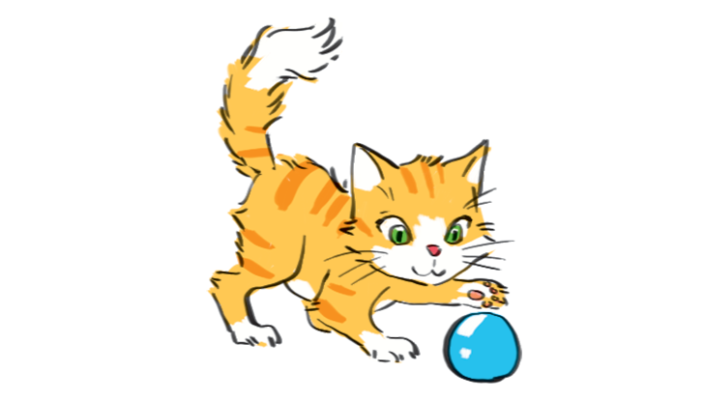
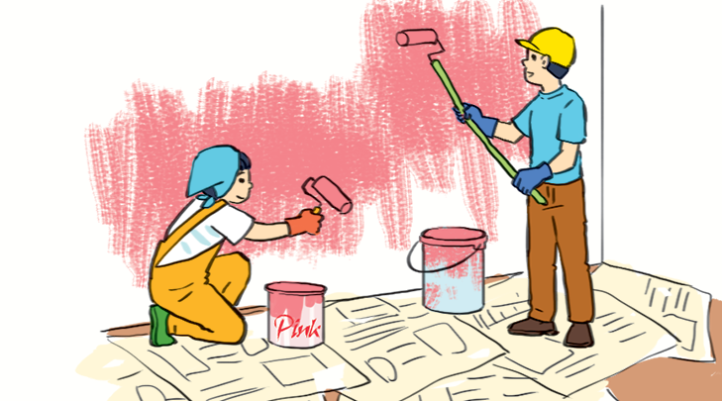
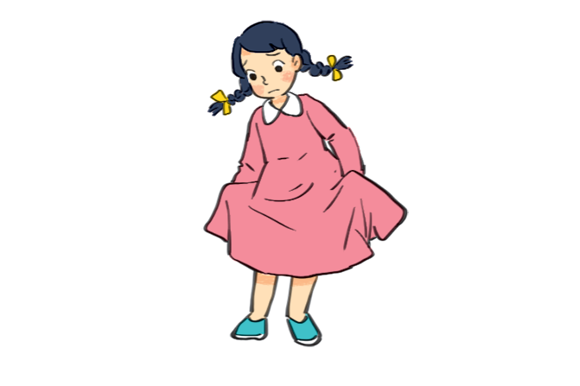
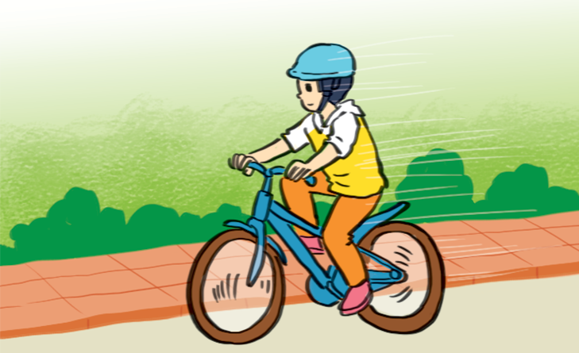
1. (p.29) Match the sentences with the pictures, paying attention to the underlined part in each sentence.
a
b
c
3. The cat is playing with its ball.
5. They are painting their room pink.
4. We love our school.
1. Sue doesn't like her new dress.
d
e
2. Billy is riding his bicycle.
3. The cat is playing with its ball.
4. We love our school.
1. Sue doesn't like her new dress.
2. Billy is riding his bicycle.
5. They are painting their room pink.
Notes:
2. Billy is riding his bicycle.
3. The cat is Playing with its ball.
4. We love our school.
5. They are painting their room pink.

Slide 7
2. (p.29) Complete the sentences with the correct possessive adjectives.
1. I love cartoons. _____ favourite cartoon is Dragon Balls.
2. This book has your name on it. Is it _____ book?
3. The lion has three cubs. _____ cubs are playing under a big tree.
4. Do you know my friend Anna? _____ house is close to the park.
5. We are from Switzerland. _____ country is famous for chocolate.
My
your
Its
Her
Our

Slide 8
02
Possessive pronouns

Slide 9
This is my dog.
Possessive adjectives + N
This dog is mine.
Possessive pronouns

Slide 10
3. (p.29) Complete the sentences with the correct possessive pronouns.
1. I have a new bike. The bike is _____.
2. These are Mai's and Lan's maps. These maps are _____.
3. This is a present for you. It’s _____.
4. My father has new shoes. They’re _____.
5. This is our new house. The house is _____.
mine
theirs
yours
his
ours
Notes:
0 1. I have a new bike. The bike is. These maps are 3. This is a present for you. It's 4. My father has new shoes. They're
2. These are Mai's and Lan's maps
5. This is our new house. The house is

Slide 11
4. (p.30) Underline the correct word in brackets to complete each sentence.
1. Australia is a strange country. All of (it's / its) big cities are along the coast.
2. Our city is very crowded. How about (your / yours)?
3. I love my football club. Does Phong like (his / him)?
4. (Our / Ours) street is short and narrow.
5. They cannot find (their / theirs) city map anywhere.

Slide 12





Slide 13










1/10
This is the car of Ben and Mary. It’s _________.
theirs

Slide 14
2/10
That is the bike he gave you. It’s _________.
yours

Slide 15
3/10
She bought this car last month. It’s _________.
hers

Slide 16
4/10
These are the books of Tom and me. They’re ________.
ours

Slide 17
5/10
Those are the toys of my dog. They’re ________.
its

Slide 18
6/10
Andy won this trophy last year. It’s ________.
his

Slide 19
7/10
These are the children’s sweets. They are _________.
theirs

Slide 20
8/10
Those are Mary’s rollerblades. They are _________.
hers

Slide 21
9/10
That is Ted’s raincoat. It’s ________.
his

Slide 22
10/10
EXIT
You gave me these sweets. They’re ________.
mine

Slide 23
PASS THE BOARD – EXERCISE 5 (pg. 30)
- Ss write the answer of Exercise 3 (pg 50) onto a miniboard/paper.
- Each student writes one answer.
- Pass to the student sitting behind
- Which team finishes with the correct answers will be the winners

Slide 24
5. (p.30) Choose the correct word to complete the sentences.
1. The book is _____, but you are welcome to read it.
A. my B. mine C. yours
2. _____ bike is dirty, and I can't tell what colour it is.
A. Your B. Yours C. You
3. Your country is much bigger than _____.
A. our B. ours C. their
4. _____ dog is so friendly. It never barks.
A. They B. Their C. Theirs
5. _____ not easy to find your way in a strange city.
A. It B. It’s C. Its

Slide 25
WRAP UP
1. What have we learnt today? Choose 2 options.
A. Possessive noun B. Possessive pronoun
C. Possessive adjective D. Possessive adverb
2. Rewrite the sentence.
These are my pencils.
These pencils are mine.

Slide 26
THANK FOR
WATCHING!

