Slide 1


TRƯỜNG THCS LONG BIÊN
BÀI GIẢNG ĐIỆN TỬ MÔN TIẾNG ANH 6
UNIT 8 : SPORTS AND GAMES
Lesson 3 : A closer look 1
GV: Nguyễn Thị Hiền
Tổ Ngoại Ngữ - Năng khiếu

Slide 2
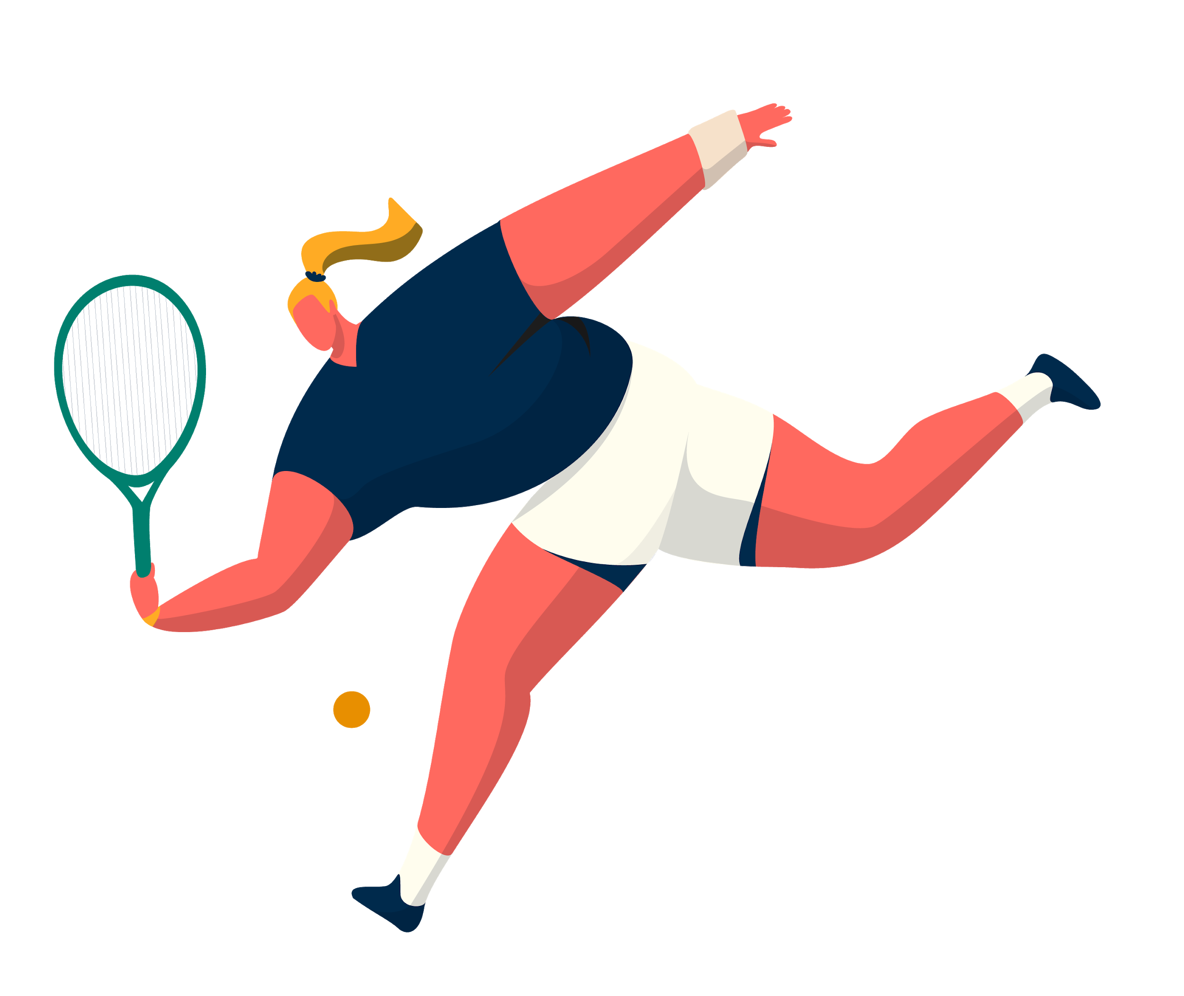
UNIT 8: Sports and games
Lesson 2:
A closer look 1

Slide 3
OBJECTIVES
By the end of the lesson, students will be able to:
□ Use the lexical items related to the topic “Sports and games“
□ Pronounce the sounds /e/ and /æ/ correctly in words and sentences.

Slide 4
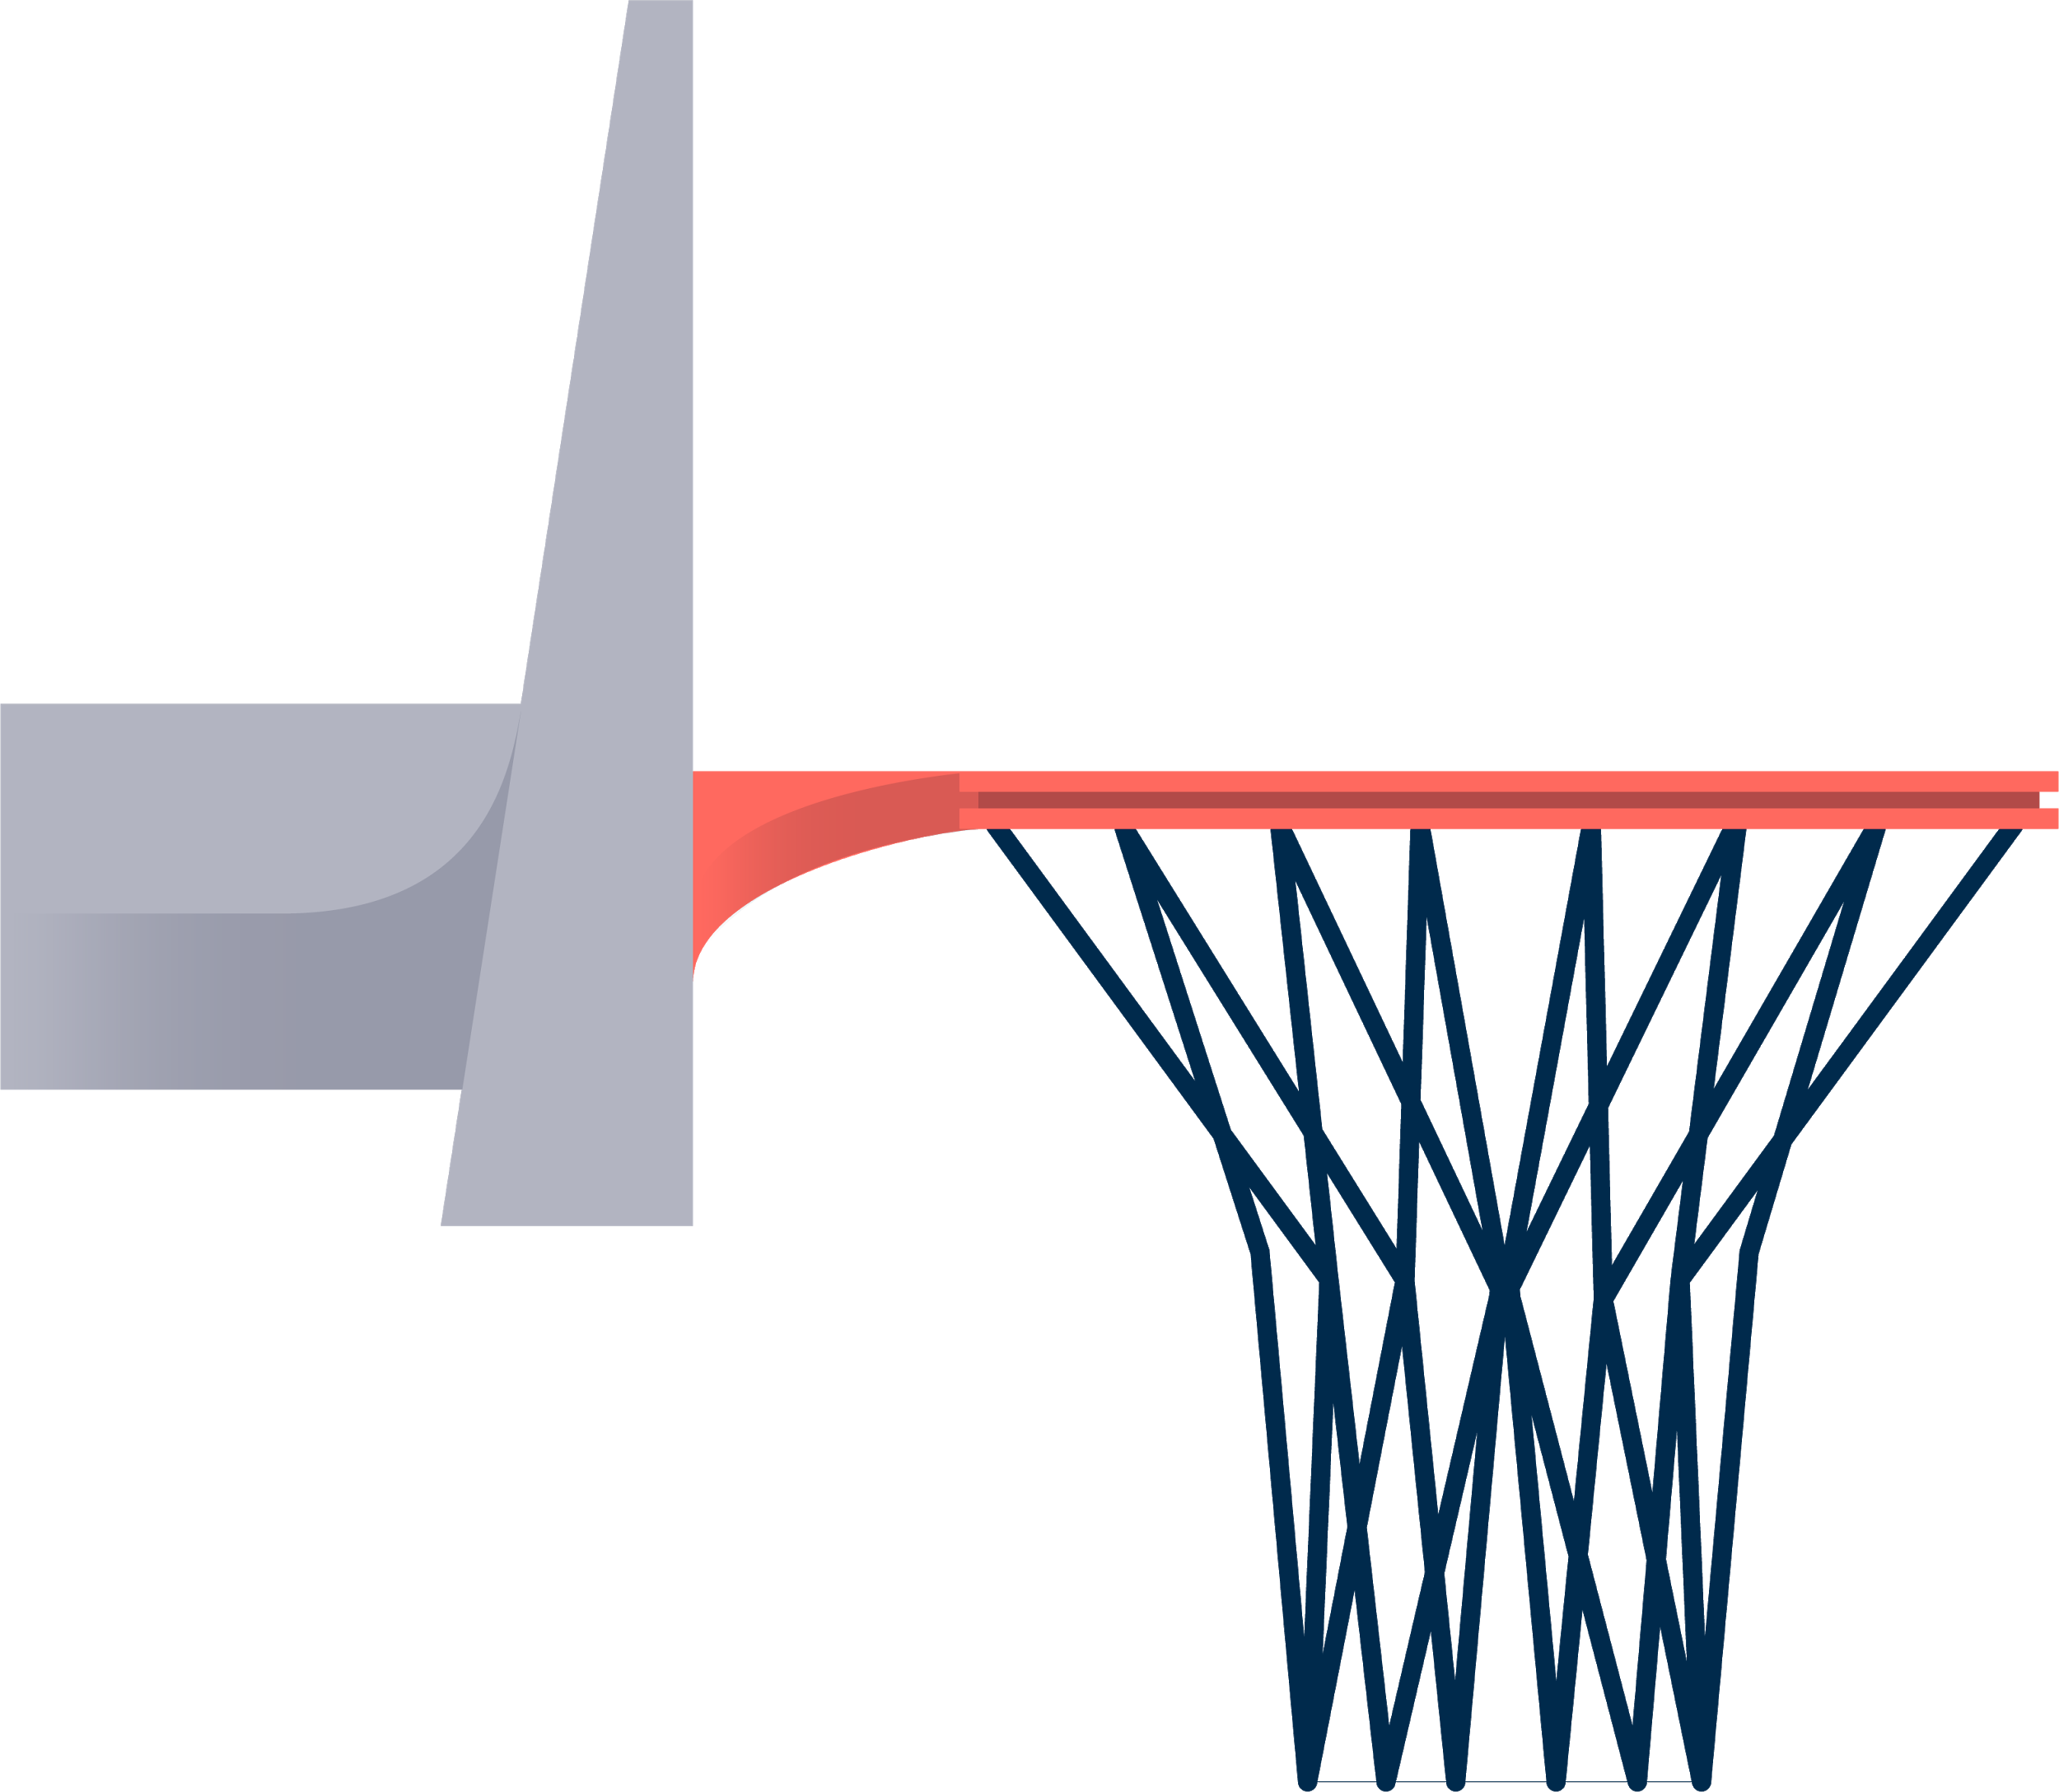
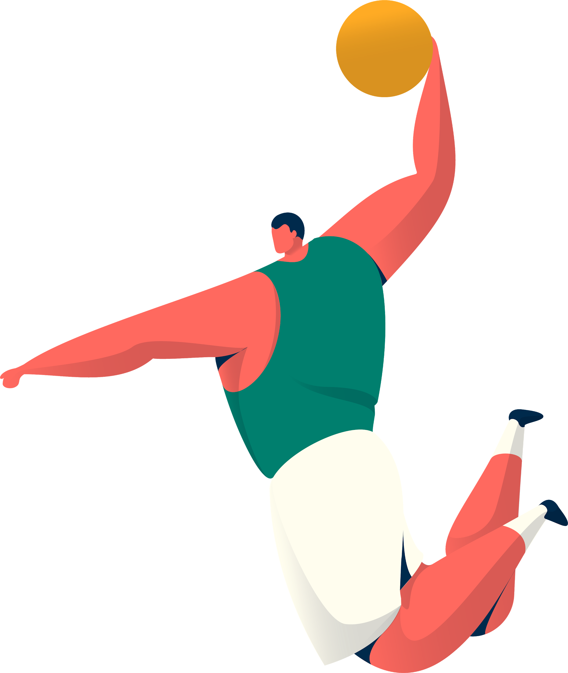
Hidden picture
Vocabulary
Look and guess.

Slide 5

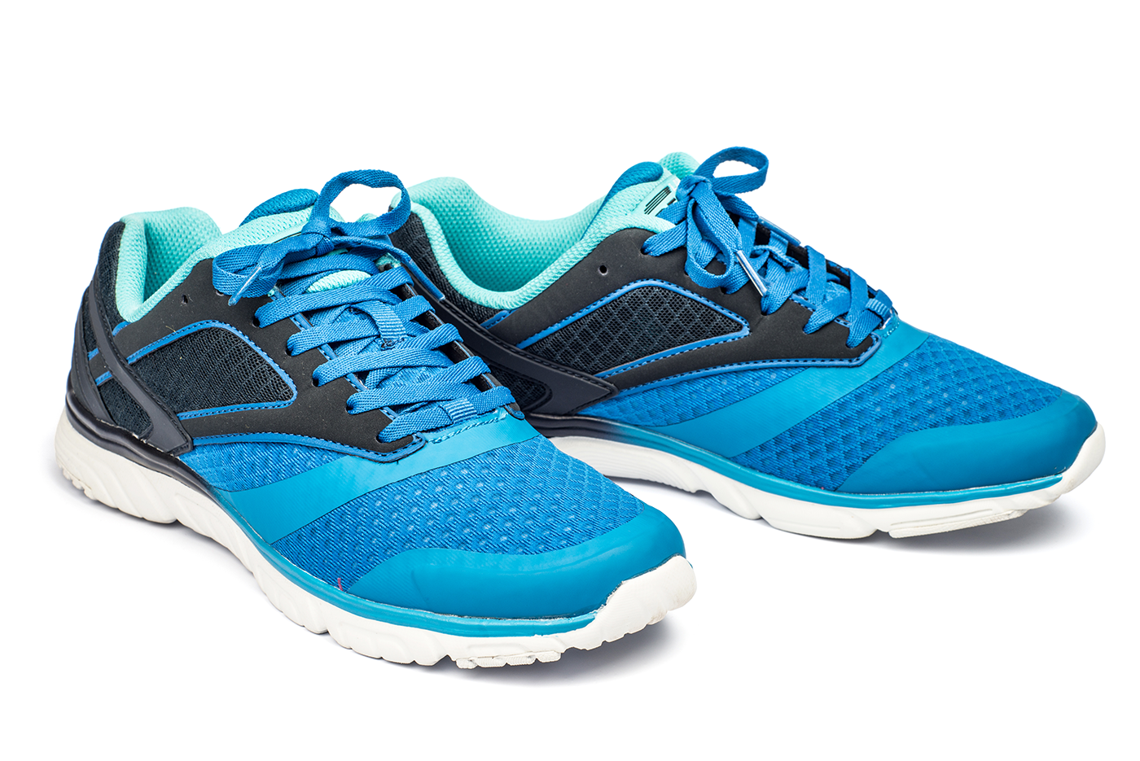
sports shoes
SHOW
KEY

Slide 6

boat
SHOW
KEY

Slide 7

ball
SHOW
KEY

Slide 8
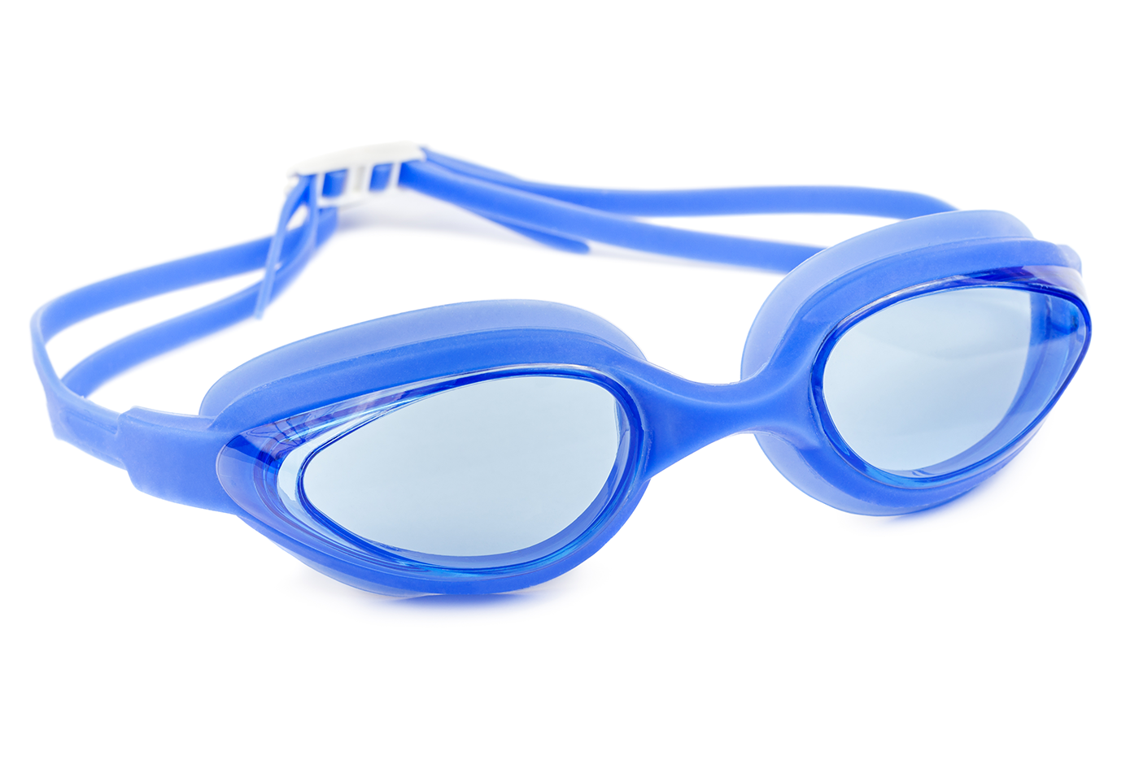
goggles
SHOW
KEY

Slide 9
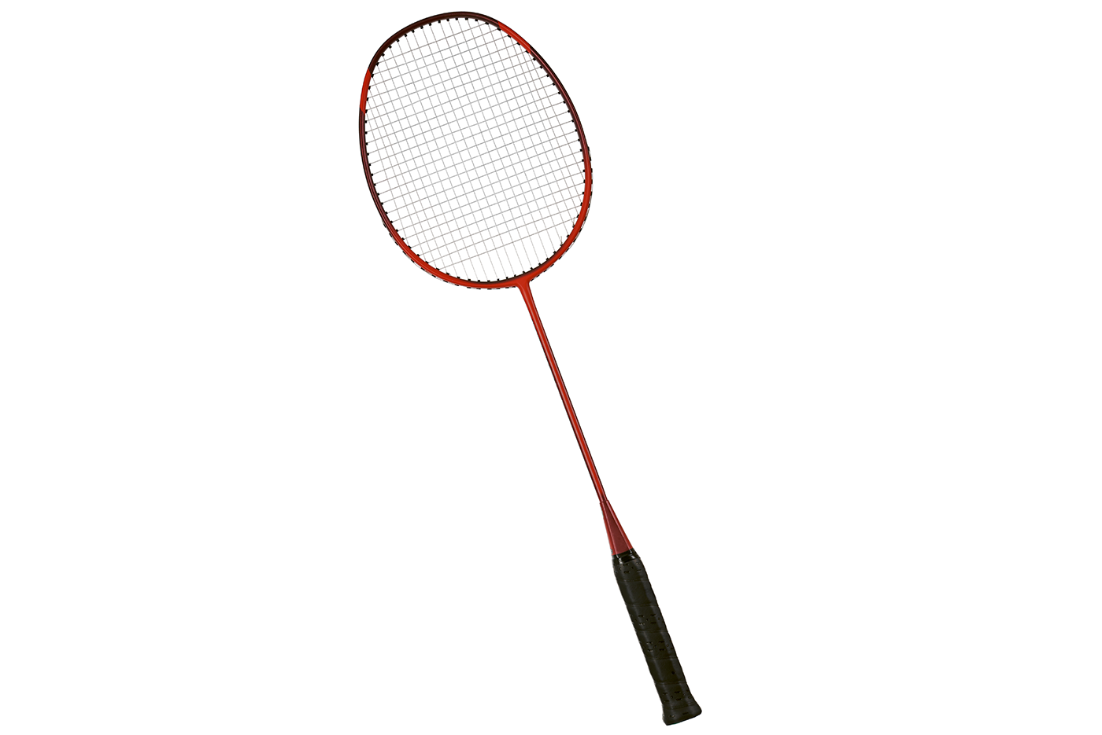
racket
SHOW
KEY

Slide 10
Vocabulary
Ex1 (p.18) Write the right words under the pictures.
ball boat racket googles sport shoes
ball
sport shoes
boat
1. _____________ 2. _____________ 3. _______________
racket
sport shoes
4. _____________ 5. _____________

Slide 11
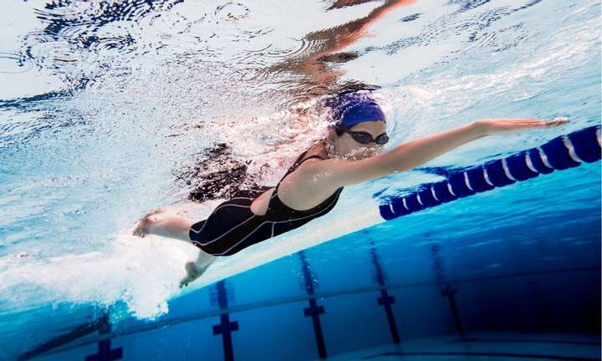
Vocabulary
What sports are these things for?
goggles
swimming

Slide 12
Vocabulary
Ex 2 (p.18) What sports are these things for? Match.
A
B
1. bicycle
a. boating
2. ball
b. swimming
3. boat
c. cycling
4. goggles
d. ball games
5. racket
e. badminton

Slide 13
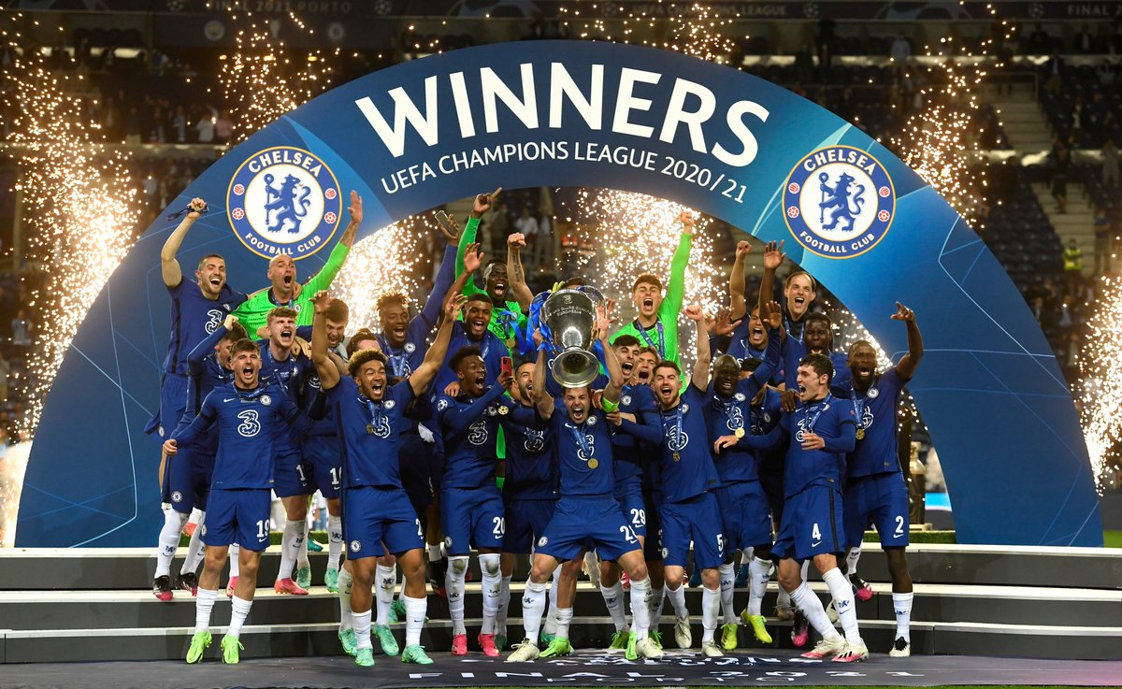
Vocabulary
1. champion
= winner

Slide 14
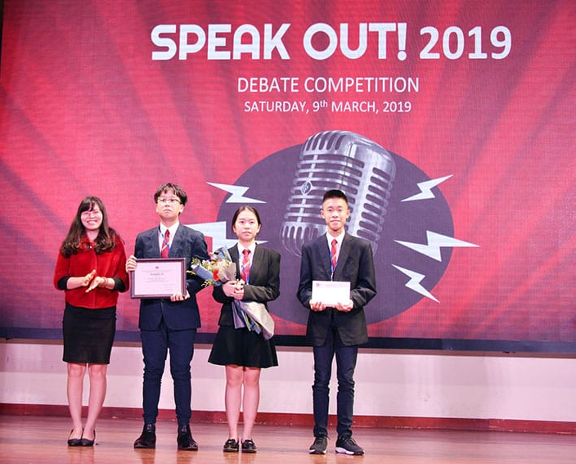

Vocabulary
1. champion
= winner
2. competition

Slide 15

Vocabulary
1. champion
= winner
3. congratulations
2. competition

Slide 16
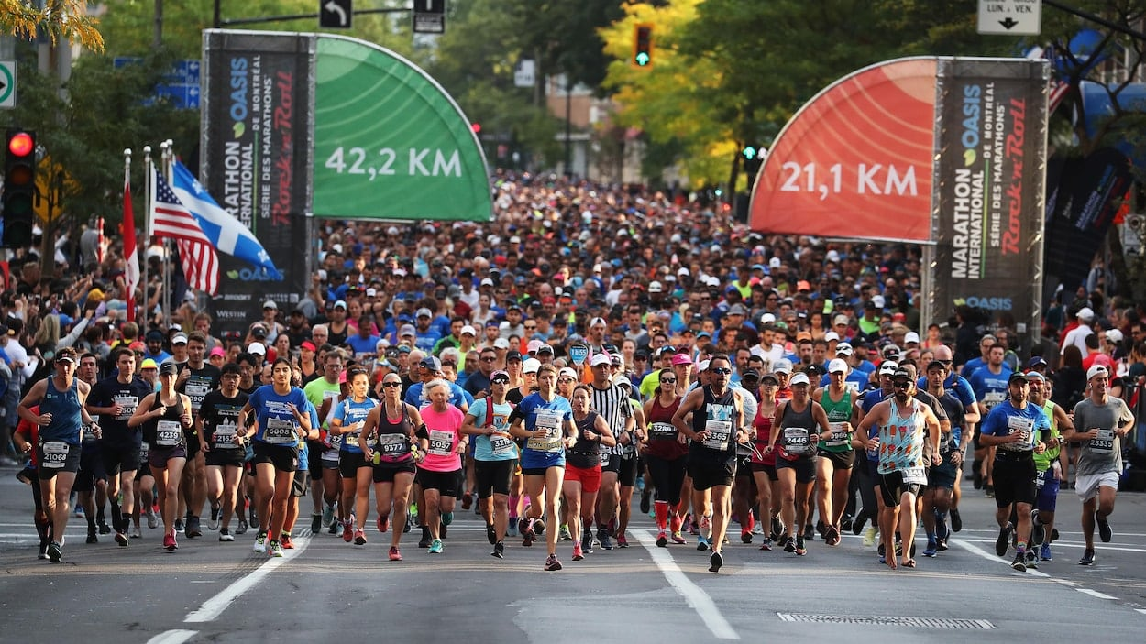
Vocabulary
1. champion
= winner
3. congratulations
2. competition
4. marathon
= long race of about 42 km

Slide 17
Vocabulary
Ex 3 (p.18) Fill in the blank.
champion competition sporty
marathon congratulations
competition
1. She won an international sports _________.
2. He became the world tennis ____________ when he was very young.
3. "Can you send my ______________ to the winner of the contest?"
4. My friend David is very _________. He does exercise every day.
5. The first _____________ took place in 1896.
champion
congratulations
sporty
marathon

Slide 18
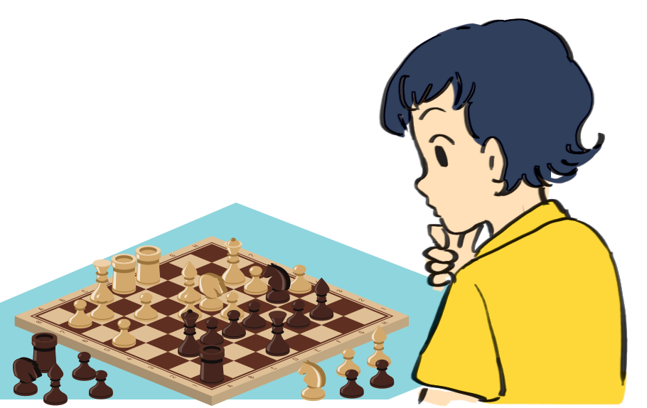
Guess the word.
Pronunciation
chess
racket
/e/
/æ/

Slide 19

/e/

Slide 20

/æ/

Slide 21
Ex 4 (p.17) Listen and repeat. Pay attention to the sounds /e/ and /æ/.
1. /e/
chess tennis exercise contest
Pronunciation
2. /æ/
racket match marathon active

Slide 22
Ex 5 (p.17) Listen and repeat. Underline the words having the sounds /e/ and /æ/.
1. They cannot take part in this contest.
2. They began the match very late.
3. Please get the racket for me.
4. We play chess every Saturday.
5. My grandpa is old, but he's active.
a
/æ/
Pronunciation
a
a
e
/æ/
/æ/
/e/
e
a
/e/
/æ/
e
e
a
/e/
/e/
/æ/
a
a
/æ/
/æ/

Slide 23
OBJECTIVES
By the end of the lesson, students have been able to:
☑ Use the lexical items related to the topic “Sports and games“
☑ Pronounce the sounds /e/ and /æ/ correctly in words and sentences.

