Slide 1
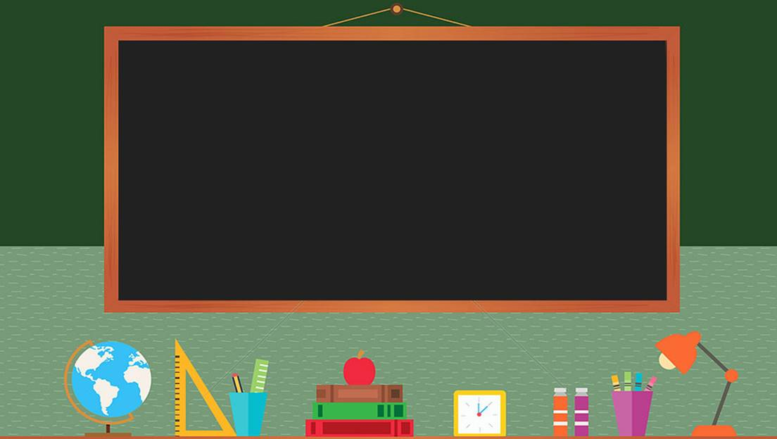

TRƯỜNG THCS LONG BIÊN
BÀI GIẢNG ĐIỆN TỬ MÔN TIẾNG ANH 6
UNIT 1: MY NEW SCHOOL
Period 5 : COMMUNICATION
GV: Nguyễn Thị Hiền
Tổ Ngoại Ngữ - Năng khiếu

Slide 2
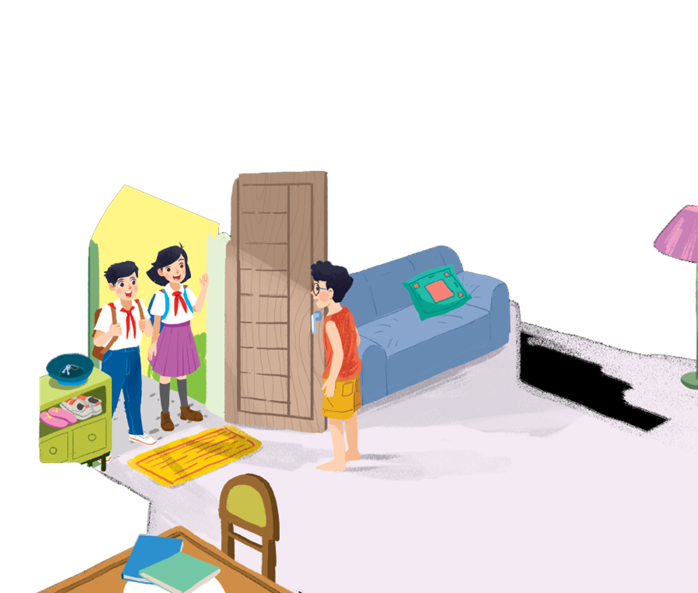
      UNIT 1: MY NEW SCHOOL
      LESSON 4: COMMUNICATION
English 6

Slide 3


Everyday English
Introducing someone
1
Listen and read the dialogue. Pay attention to the highlighted parts.
2
Work in groups. Practise introducing a friend to someone else.
New friends at school
3
Read and tick the questions you think are suitable to ask a new friend at school.
4
There is a quiz for students in the new school newsletter. Answer the questions.
5
Work in groups. Take turn to interview the others. Use the questions above.

Slide 4
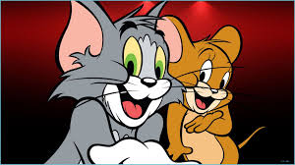
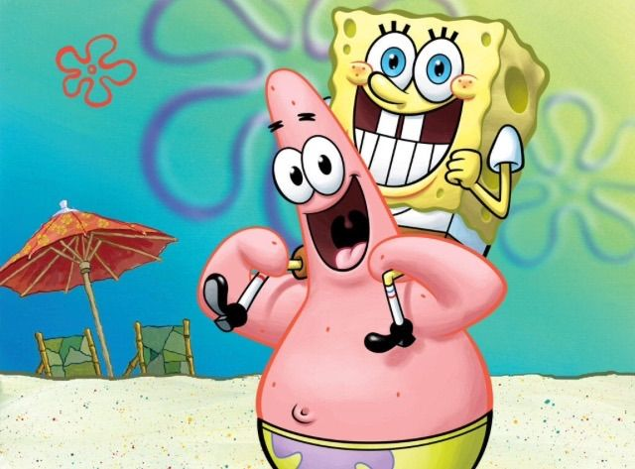
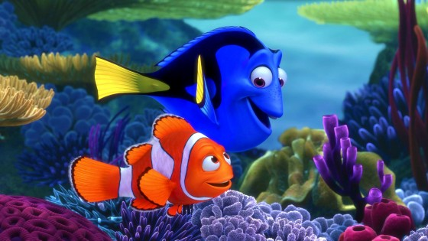

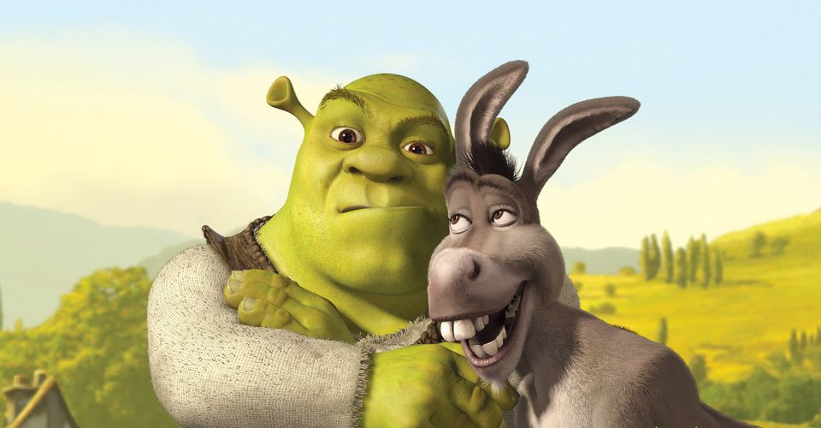
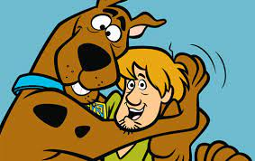
1
2
3
Tom & Jerry
SpongeBob and Patrick
Marlin and Dory
Who knows more?
(Name them)
4
5
6
Lilo and Stitch
Sherk and donkey
Shaggy and Scooby
Are people above good friends? Why?
Let’s find out what make a good friend in our lesson today.

Slide 5



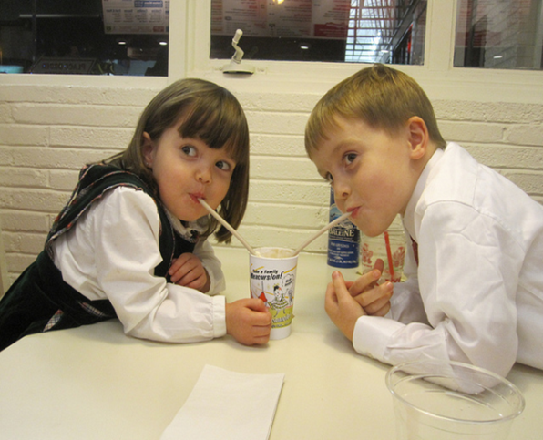
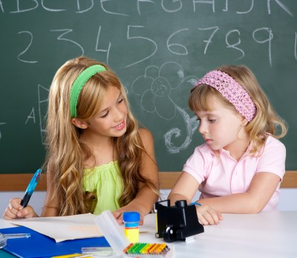
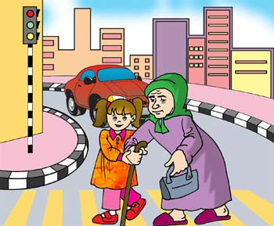
Vocabulary
re‘member (v)
help (v)
share (v)
‘classmate (n)
nhớ
giúp đỡ
chia sẻ
bạn cùng lớp

Slide 6
Rub out and remember
remember (v)
nhớ
help (v)
giúp đỡ
share (v)
chia sẻ
classmate (n)
bạn cùng lớp

Slide 7
Everyday English
Introducing someone

Slide 8

Listen and read the dialogue. Pay attention to the highlighted parts.
1
Vy: Phong, this is Duy, my new friend.
Phong: Hi, Duy. Nice to meet you.
Duy: Hi, Phong. Nice to meet you, too.
Notes:
Slide này không đúng.

Slide 9
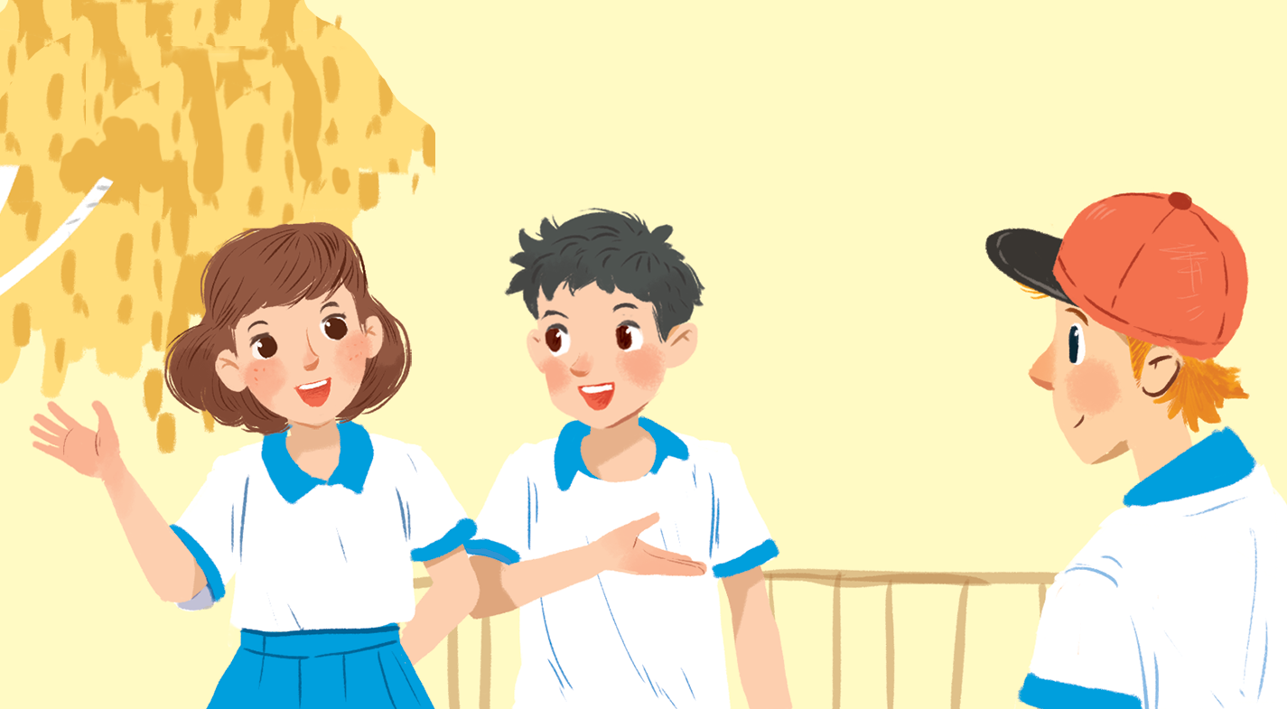
Work in groups. Practise introducing a friend to someone else.
2

Slide 10
New friends at school

Slide 11
Read and tick the questions you think are suitable to ask a new friend at school.
3
1.
Are you from around here?

2.
Do you like music?

3.
How much money do you get?
4.
What is your favourite subject at school?

5.
Are you hungry now?
6.
Do you play football?

7.
How do you go to school every day?

8.
Where do you often go shopping?
Notes:
City landmarks phải ở trên mục 3

Slide 12
Write one or two more questions on a piece of paper. Then share them with the class.
What time do you go to school?
What do you do when finishing your homework?

Slide 13

There is a quiz for students in the new school newsletter. Answer the questions.
4
Give qualities of a good friend at school
Friendly, generous, helpful, cheerful …..

Slide 14

1.
Do you remember all your new classmate’s names?
Yes

No

2.
Do you often listen to your friend’s advice?
Yes

No


Slide 15
3.
Do you share things with your classmates?
Yes

No

4.
Do you keep your friend’s secret?
Yes

No


Slide 16
5.
Do you play with your classmates at break time?
Yes

No

6.
Do you help your classmates with their homework?
Yes

No


Slide 17
7.
Do you go to school with your friends?
Yes

No

8.
Do you listen when your classmates are talking?
Yes

No


Slide 18
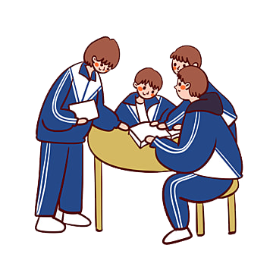
Work in groups. Take turn to interview the others. Use the questions above.
5
1. Do you remember all your new classmate’s names?
2. Do you often listen to your friend’s advice?
3. Do you share things with your classmates?
4. Do you keep your friend’s secret?
5. Do you play with your classmates at break time?
6. Do you help your classmates with their homework?
7. Do you go to school with your friends?
8. Do you listen when your classmates are talking?
Friends are forever

Slide 19

Homework
  Learn vocabulary by heart.
  Write about your best friend (his/her appearance, qualities of a good friend that he/she has)
  Prepare the next lesson: Skills 1

