Slide 1


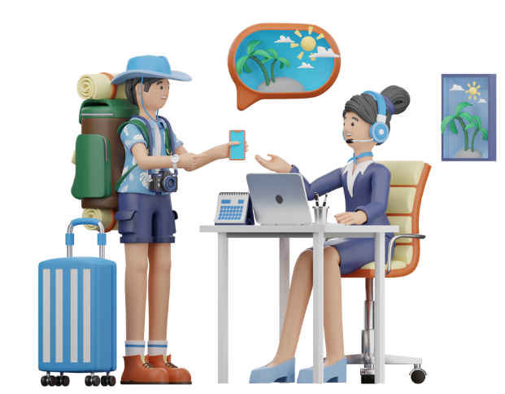
Unit
8
TOURISM
LESSON 7: LOOKING BACK & PROJECT
1

Slide 2
VOCABULARY
1
Choose the correct answer A, B, C, or D to complete each sentence.
1. If you are travelling abroad for the first time, it’s better to look for a good travel ______ to arrange everything for you.
A. budget B. agency
C. tourism D. homestay
2. Many ______ buildings have become UNESCO World Heritage Sites.
A. modern B. domestic
C. ruinous D. international
Notes:
1. B 2. C 3. C 4. D 5. A

Slide 3
VOCABULARY
1
Choose the correct answer A, B, C, or D to complete each sentence.
3. Young people are usually good at ______ for cheap transportation and accommodation.
A. buying B. booking
C. hunting D. applying
4. Nowadays, people can travel on their own to new places by using ______.
A. tours B. earphones
C. entrance tickets D. Google Maps
5. ______ is for people who love trying different local dishes.
A. Food tourism B. Domestic tourism
C. Ecotourism D. Shopping tourism
Notes:
1. B 2. C 3. C 4. D 5. A

Slide 4
VOCABULARY
2
Fill in each blank with a suitable word or phrase. The first letter has been given.
omestic
1. Would you like to go on an international or a d__________ tour?
2. – Can I make a small change to this itinerary?
– I’m afraid not. It’s f______.
3. Thanks to her skills with a______, she was able to buy cheap tickets to Quy Nhon.
4. They are not experienced enough to go on a s____________ tour. They need an adult to go with them.
5. – What did you enjoy most on your tour to Sa Pa?
– The n______ beauty of the mountains and valleys.
ixed
pps
elf-guided
atural
Notes:
1. domestic 2. fixed 3. apps 4. self-guided 5. natural

Slide 5
GRAMMAR
3
Use a relative pronoun which, who, or whose to complete each sentence.
1. Excuse me, could you show me a souvenir shop ______ sells small-size
paintings of this city?
2. We can ask my uncle ______ has a lot of experience in organising tours.
3. A visa is a stamp or mark in your passport ______ allows you to enter or leave a foreign country.
4. I’m lost. The hotel I’m staying in is a white multi-storey one ______ name is Islander Hotel.
5. The police officer is talking to the tourist ______ passport is missing.
which
who
which
whose
whose
Notes:
1. which 2. who 3, which 4. whose 5. whose

Slide 6
GRAMMAR
4
Combine each pair of sentences, using a suitable relative pronoun which, who, or whose.
1. My family spent four days in India. Its culture is unique.
2. Organising self-guided tours helps develop personal skills. They are important for everybody.
3. Russel stayed in a hotel in Bui Vien Street. It is one of the best streets for foreign tourists.
4. After the Muay Thai Show, my sons talked to the artists. They admired their performance so much.
5. We participated in a lot of activities with the local people. They were friendly and helpful.

Slide 7
GRAMMAR
4
Combine each pair of sentences, using a suitable relative pronoun which, who, or whose.
1. My family spent four days in India. Its culture is unique.
2. Organising self-guided tours helps develop personal skills. They are important for everybody.
3. Russel stayed in a hotel in Bui Vien Street. It is one of the best streets for foreign tourists.
My family spent four days in India, whose cultural life is unique.
Organising self-guided tours helps develop personal skills which are important for anybody.
Russel stayed in a hotel in Bui Vien Street, which is one of the best streets for foreign tourists.
Notes:
1. My family spent four days in India, whose cultural life is unique.
2. Organising self-guided tours helps develop personal skills which are important for anybody.
3. Russel stayed in a hotel in Bui Vien Street, which is one of the best streets for foreign tourists.
4. After the show, my sons talked to the Muoi artists whose performance they admired so much.
5. We participated in a lot of activities with the local people who were friendly and helpful.

Slide 8
GRAMMAR
4
Combine each pair of sentences, using a suitable relative pronoun which, who, or whose.
4. After the Muay Thai Show, my sons talked to the artists. They admired their performance so much.
5. We participated in a lot of activities with the local people. They were friendly and helpful.
After the show, my sons talked to the Muoi artists whose performance they admired so much.
We participated in a lot of activities with the local people who were friendly and helpful.
Notes:
1. My family spent four days in India, whose cultural life is unique.
2. Organising self-guided tours helps develop personal skills which are important for anybody.
3. Russel stayed in a hotel in Bui Vien Street, which is one of the best streets for foreign tourists.
4. After the show, my sons talked to the Muoi artists whose performance they admired so much.
5. We participated in a lot of activities with the local people who were friendly and helpful.

Slide 9
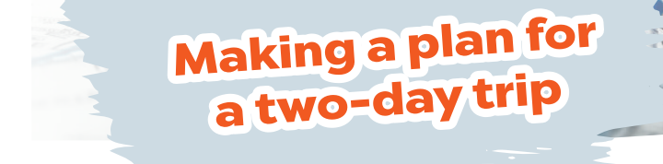
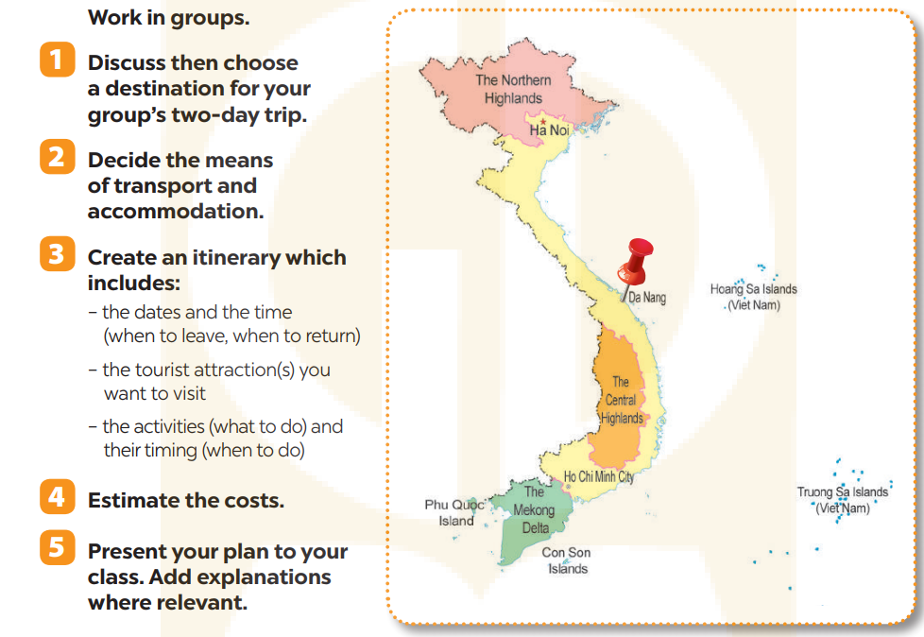
PROJECT
4
Notes:
1. shouldn’t 2. might 3. can 4. must 5. can

Slide 10

CONSOLIDATION
1
Wrap-up
What have we learnt in this lesson?
revise the vocabulary items learnt in the unit
revise uses of relative pronouns
plan their own trip

Slide 11

CONSOLIDATION
2
Homework
Do exercises in the workbook.
.

