Slide 1
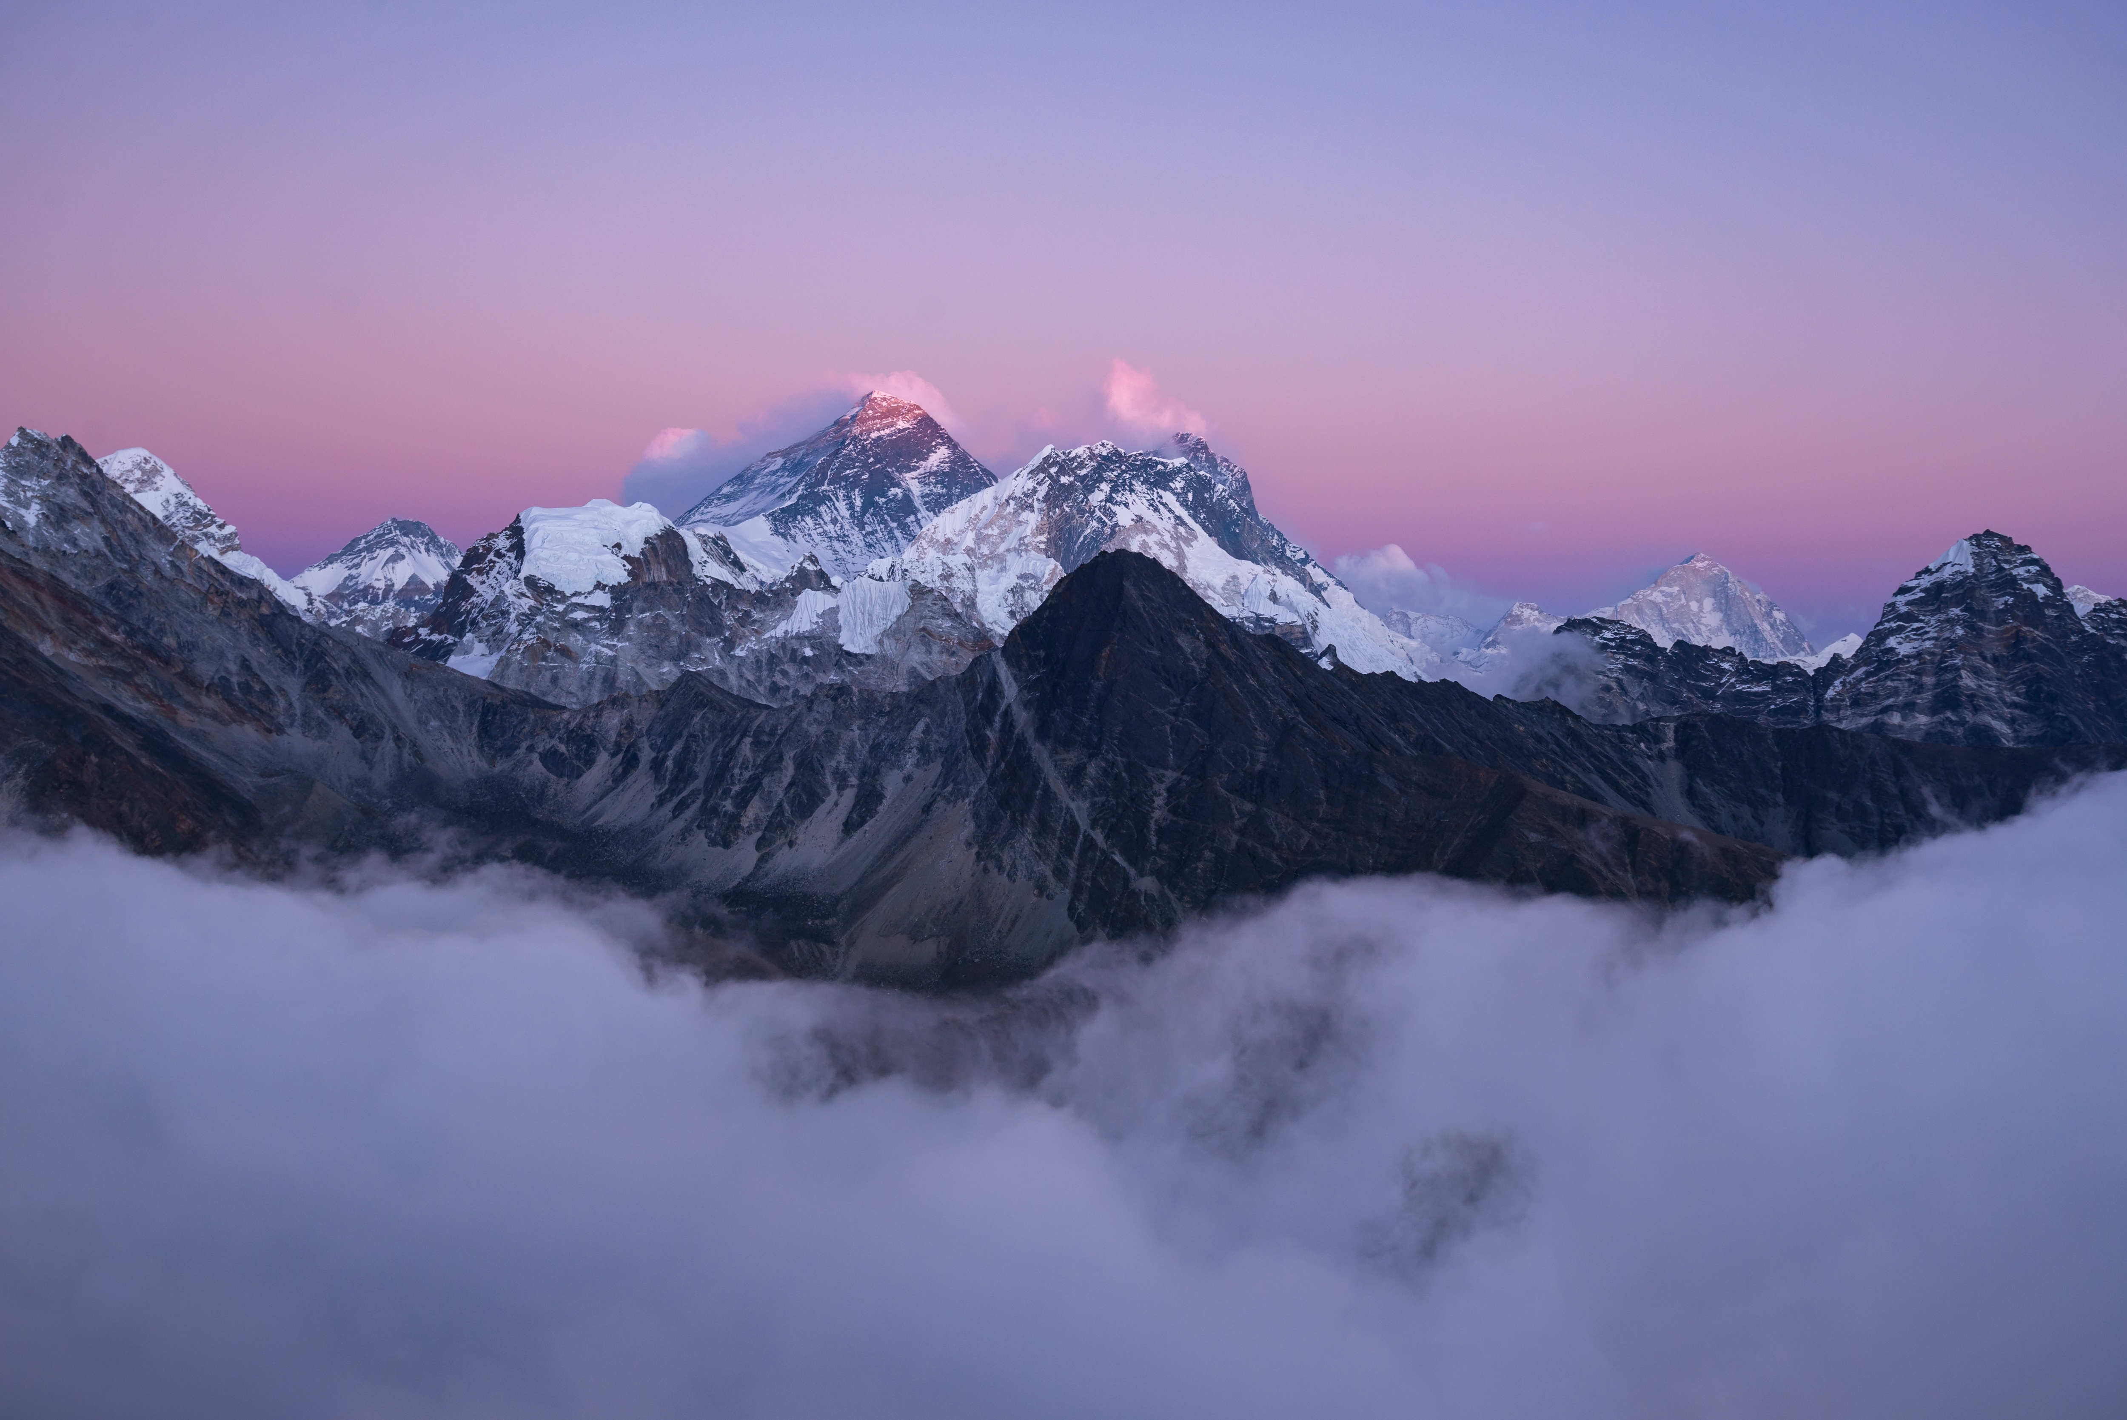


NATURAL WONDERS OF THE WORLD
Unit
7
LESSON 1: GETTING STARTED
Meeting on the corridor

Slide 2

OBJECTIVES
By the end of the lesson, students will be able to:
Use the words related to natural wonders of the world
Gain vocabulary to talk about natural wonders of the world

Slide 3
PRESENTATION
crazy (adj) about so/sth
like so/sth very much
Ex: I was crazy about baseball when I was seven.
/ˈkreɪzi/
thích mê

Slide 4
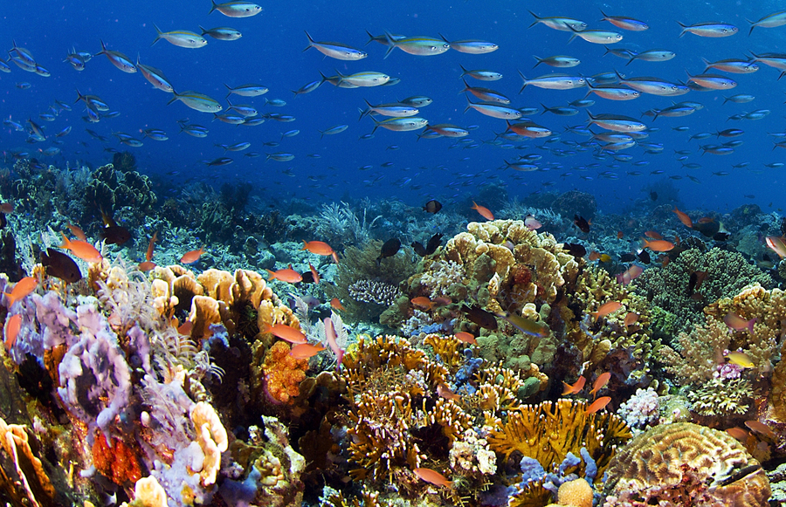
PRESENTATION
a substance like rock, formed in the sea by groups of particular types of small animal, often used in jewelry.
coral (n,adj)
/ˈkɒrəl/
san hô

Slide 5
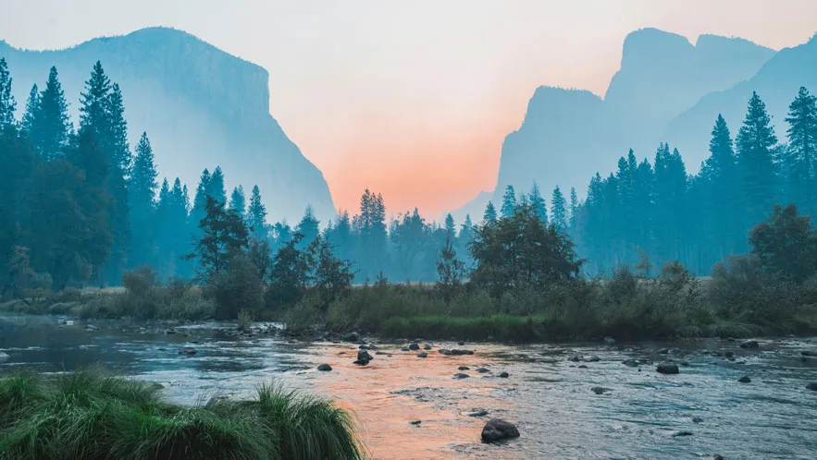
PRESENTATION
a view or picture of the countryside, or the art of making such pictures.
landscape (n)
/ˈlænd.skeɪp/
phong cảnh

Slide 6
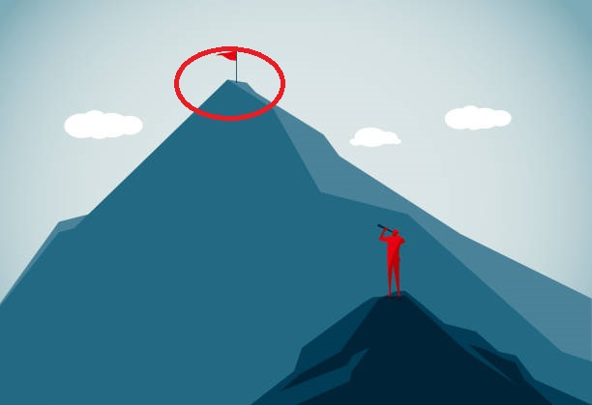
PRESENTATION
the highest point
peak (n)
/piːk/
đỉnh, đỉnh núi

Slide 7
PRESENTATION
pleasant and attractive
charming (adj)
/ˈtʃɑː.mɪŋ/
Ex: What a charming street this is.
đẹp

Slide 8
PRESENTATION
able to be maintained or continued
sustainable (adj)
Ex: The website encourages sustainable fashion through swapping.
/səˈsteɪnəbl/
đẹp

Slide 9

PRESENTATION
a place or position
location (n)
/ləʊˈkeɪʃn/
địa điểm, nơi chốn

Slide 10
PRESENTATION
to have or own sth
possess (v)
Ex: I don't possess a single DVD (= I don't have even one DVD).
/pəˈzes/
có, sở hữu

Slide 11
PRACTICE
- Answer the questions:
+ Have you ever been to Ha Long Bay?
+ Do you know that it is a famous natural wonder of the world?
+ Have you heard of / read about other wonders: Mt. Everest, the Dead Sea, …?

Slide 12
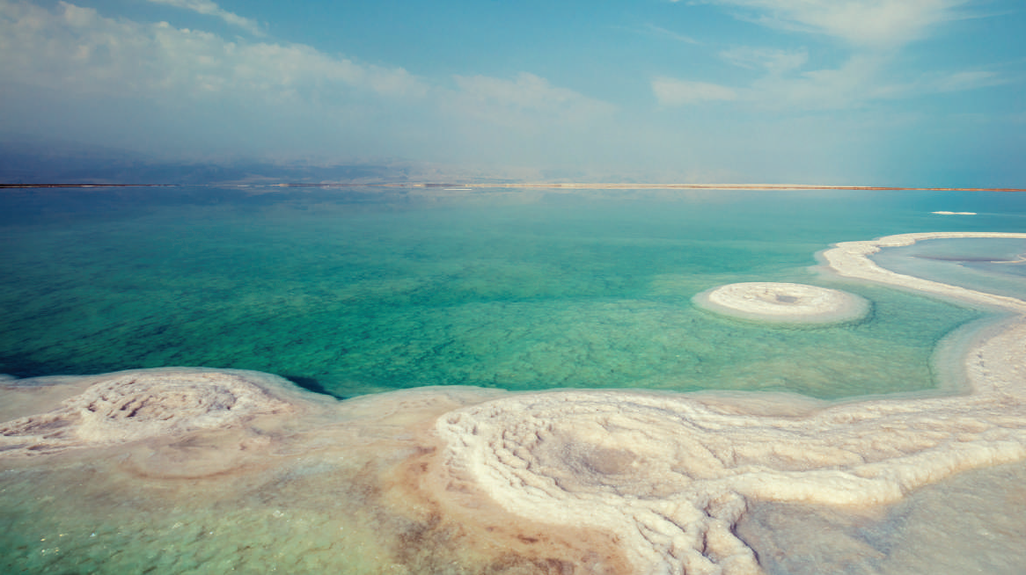
PRACTICE
Look at the pictures on pages 72 and answer:
What the conversation between Lan and Tom is about?

Slide 13


PRACTICE
Task 1: Listen and read (p.72)
Lan: Hi, Tom. I hear that you’ve won second prize in the Natural Wonders Contest. Congratulations!
Tom: Thanks, Lan. I like exploring the wonders of nature. I’m crazy about them.
Lan: What did you talk about in the contest?
Tom: I talked about some natural wonders like Mount Everest, the Great Barrier Reef, and the Dead Sea.
Lan: Wonderful! I’m interested in them too.
Tom: Well, you know our planet has so many beautiful landscapes, from snow-covered peaks to charming rivers, lakes, and other natural places that we can’t help admiring. So that’s what I talked about.

Slide 14
PRACTICE
Task 1: Listen and read (p.72)
Lan: Oh yeah … And what else did you mention?
Tom: Well, I mentioned the risk of us, humans, destroying natural wonders,
and I suggested ways to preserve them and support sustainable development.
Lan: Sounds interesting. Do you want to visit any of these places?
Tom: The host also asked me if I wanted to visit those places, and I answered that I wanted to see two of them: the Grand Canyon and Ha Long Bay.
Lan: I’d love to visit them too.

Slide 15
PRACTICE
Questions:
1. Which prize did Tom win?
2. Which natural wonders did Tom talk about?
3. Which risks did Tom mention?
4. Where will Tom visit?
the second prize in the Natural Wonders Contest
Mount Everest, the Great Barrier Reef, and the Dead Sea
humans, destroying natural wonders.
the Grand Canyon and Ha Long Bay.
 | T | F
1. Tom took part in the Natural Wonders Contest.
2. Lan is not keen on natural wonders.
3. Tom suggested ways to preserve natural wonders.
4. Tom asked the host if he wanted to go to Ha Long Bay.

Slide 16
PRACTICE
2
Read the conversation again and tick (√) T (True) of F (False) for each sentence.
 | T | F
1. Tom took part in the Natural Wonders Contest.
2. Lan is not keen on natural wonders.
3. Tom suggested ways to preserve natural wonders.
4. Tom asked the host if he wanted to go to Ha Long Bay.
√
√
√
√

Slide 17
PRACTICE
3
Complete the sentences with the words from the box.
explore
couldn’t help
landscape
support
development
1. A _____________________ is everything you can see in a large area of land, especially in the countryside.
2. It was risky for him to climb the peak, but we ______________ admiring his courage.
3.The best way to _____________ the Trang An Landscape Complex is by boat.

Slide 18
PRACTICE
3
Complete the sentences with the words from the box.
explore
couldn’t help
landscape
support
development
4. Environmentalists strongly ______________ measures to save these heritage trees.
5.Sustainable ________________ goals will guide us to create a more sustainable future for all.

Slide 19
PRACTICE
4
Underline the correct answer to complete each sentence.
1. Charles is crazy / interested about football. He follows all the World Cup matches.
matches.
2. When you go to Mui Ne, you can see the unique location / landscape of a desert.
3. The children were very eager to explore/ possess the surrounding countryside.
4. Can you suggest / discover ways of boosting our local tourism?
5. Tourism develops / contributes millions of dollars to our country’s economy.

Slide 20
PRODUCTION
GAME: Natural Wonders Knowledge.
Work in groups. List some natural wonders and say where they are located. The group that has the most correct answers wins.
5

Slide 21
PRODUCTION
SUGGESTED ANSWERS:
- The Grand Canyon, USA
- The Great Barrier Reef, Australia
- Ha Long Bay, Vietnam
- Northern Lights, Arctic and Antartic.

Slide 22
CONSOLIDATION
2
Homework
- Prepare for the Project of the unit
- Open book p.81, look at the picture and say what the topic of the project is
- Work in groups to design a poster.
- You will show and present in Lesson 7 – Looking back and Project.

