Slide 1
Unit 3: Healthy living for teens
LESSON 6: SKILL 2

Slide 2
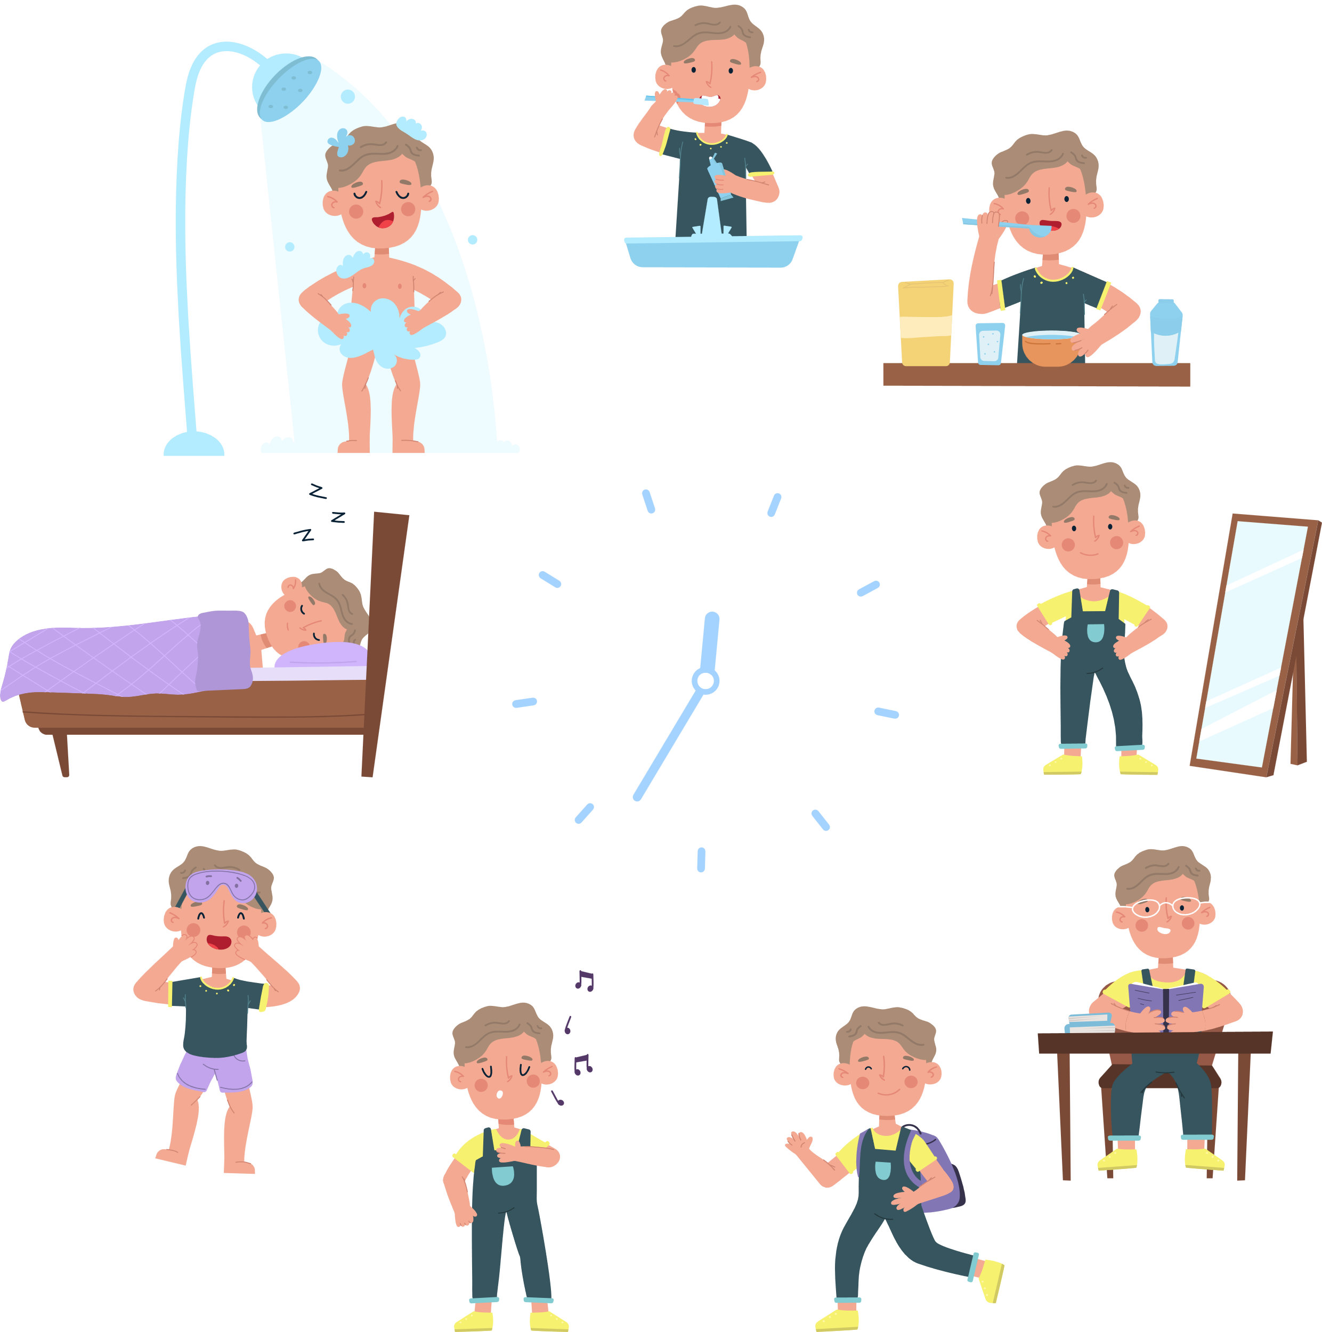
Vocabulary
routine (n)
/ruːˈtiːn/
việc thường làm (hàng ngày)

Slide 3

Vocabulary
submit (v)
/səbˈmɪt/
nộp, đệ trình

Slide 4

Vocabulary
minimize (v)
/ˈmɪn.ɪ.maɪz/
giảm đến mức tối thiểu

Slide 5

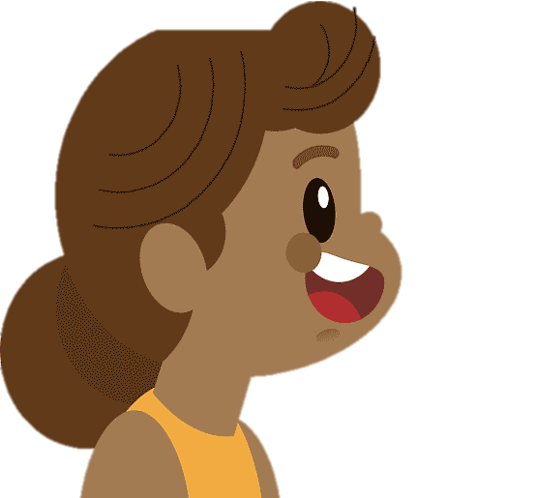
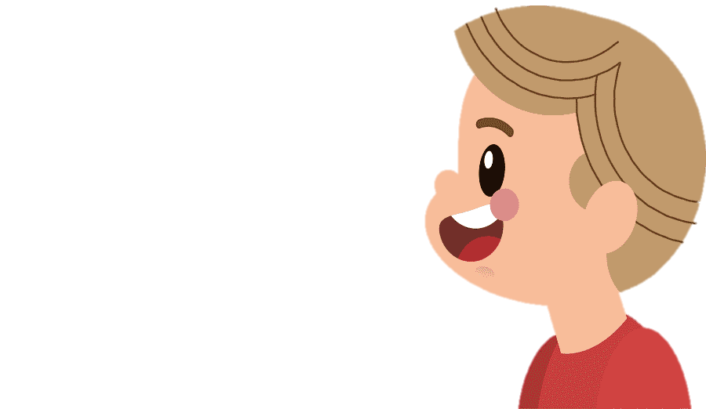
01. Work in pairs. Discuss the following question.
How do you make time for study and other activities?

Slide 6
02. You will hear Trang, Phong, and Tom talking about how to manage their time effectively. For each student (1 – 3), choose the opinion (A – C) each of them expresses.
A. I don’t let things distract me from the schoolwork that I have to do.
1. Trang
B. Using a calendar to plan my work ahead helps me manage my time effectively.
2. Phong
C. I try not to delay doing my homework and working on my projects and coming tests.
3. Tom

Slide 7
02. You will hear Trang, Phong, and Tom talking about how to manage their time effectively. For each student (1 – 3), choose the opinion (A – C) each of them expresses.
1. Trang
B. Using a calendar to plan my work ahead helps me manage my time effectively.
“I use a calendar to plan my work ahead. At the beginning of each term, I take a broad view of what I have to do by entering the due dates and test dates into a calendar. I often do these with different colours, for example, red for deadlines, green for exams ...”

Slide 8
02. You will hear Trang, Phong, and Tom talking about how to manage their time effectively. For each student (1 – 3), choose the opinion (A – C) each of them expresses.
2. Phong
A. I don’t let things distract me from the schoolwork that I have to do.
“I try to minimise distractions. Besides cell phones, social media, and friends, there are a lot of activities that can take my attention away from my schoolwork. When it’s time to start my work, I turn off my cell phone and sign out of social media accounts.”

Slide 9
02. You will hear Trang, Phong, and Tom talking about how to manage their time effectively. For each student (1 – 3), choose the opinion (A – C) each of them expresses.
3. Tom
C. I try not to delay doing my homework and working on my projects and coming tests.
“I never leave homework until the day before it’s due. I review my projects and coming tests and add them to my schedule. I arrange to start working on them well before they’re due, so I’m not stressed out to meet the due dates.”

Slide 10
3. Listen again and choose the correct answer A, B, or C.
1. Trang enters what she has to do into a ______ at the beginning of each term.
A. poster B. routine C. calendar
2. Trang often uses ______ colours to mark project due dates and exam times on her calendar.
A. different B. the same C. similar
3. Phong turns off his cell phone and signs out of social media ______ when he starts his work.
A. accounts B. networks C. websites
4. Tom tries not to ______ homework until just before the due date.
A. leave B. complete C. submit.
5. Tom ______ his projects and coming tests and adds them to his schedule.
A. prepares B. reviews C. revises

Slide 11
3. Listen again and choose the correct answer A, B, or C.
1. Trang enters what she has to do into a ______ at the beginning of each term.
A. poster B. routine C. calendar
Giải thích: “I use a calendar to plan my work ahead”
2. Trang often uses ______ colours to mark project due dates and exam times on her calendar.
A. different B. the same C. similar
Giải thích: “I often do these with different colours, for example, red for deadlines, green for exams”
what she has to do into a
colours

Slide 12
3. Listen again and choose the correct answer A, B, or C.
3. Phong turns off his cell phone and signs out of social media ______ when he starts his work.
A. accounts B. networks C. websites
Giải thích: “I turn off my cell phone and sign out of social media accounts”
4. Tom tries not to ______ homework until just before the due date.
A. leave B. complete C. submit.
Giải thích: “I never leave homework until the day before it’s due”
5. Tom ______ his projects and coming tests and adds them to his schedule.
A. prepares B. reviews C. revises
“I review my projects and coming tests and add them to my schedule.”
social media
tries not to
homework
his projects and coming tests

Slide 13
4. Match the time management tips in column A with the explanations and / or reasons in column B.

Slide 14
4. Match the time management tips in column A with the explanations and / or reasons in column B.
A
B
1. Making a plan or schedule for things you need to do, including appointments, projects, homework and tests
decide which is the most urgent
Making a plan or schedule
a. You should decide which is the most urgent and important task so that you can concentrate on it first. By doing this, you may not be at a loss to deal with too much work at the same time.
b. An effective routine can help you accomplish the things you need to do. The more you follow a daily routine, the less you will worry or get stressed.
c. You can plan your work ahead by using a calendar, a diary, or a mobile app. It helps you remember what you need to accomplish and when you should do it.
and important task
priority to the most
2. Giving priority to the most important task
An effective routine
important task
3. Building an effective daily routine
effective daily routine
plan your work ahead

Slide 15
5. Write a paragraph (about 100 words) about how to manage your time effectively. Use the tips in 4 or your own ideas.
1. Making a plan or schedule for things you need to do, including appointments, projects, homework and tests
2. Giving priority to the most important task
3. Building an effective daily routine
There are many things we should do to manage our time effectively. Firstly,

Slide 16
Example:
There are many things we should do to manage our time effectively. Firstly, we should set specific goals and priorities them according to their importance level. This will help us keep focused on our most important tasks and avoid wasting time on tasks that do not contribute to our goals. Secondly, creating a schedule or to-do list can help us manage our time efficiently by breaking down our day into manageable chunks. We should also be realistic about how long each task will take and build in extra time for unexpected interruptions or delays. Thirdly, it is essential to eliminate distractions and time-wasting activities, such as social media or unnecessary meetings, which can reduce our productivity. By following these tips, you we can effectively manage your time and achieve success in all aspects of your life.

Slide 17
SWAP AND CHECK
Check for spelling
Do the words spell correctly?
Check for ideas
Do you write about how to manage your time effectively?
Check for comprehension
Does the writing make sense?
Check for grammar
Does the writing use the correct tenses and structures?

Slide 18
Wrap-up
What have you learnt in this lesson?
01. Listening for specific information about how some students manage their time.
02. Writing a paragraph about how to manage their time effectively, using the given tips or their own ideas.

Slide 19
Thanks!
DO YOU HAVE ANY QUESTIONS?

