Slide 1

UNIT 7 ENVIRONMENTAL PROTECTION
Lesson 1: Getting stated

Slide 2
Vocabulary

Slide 3
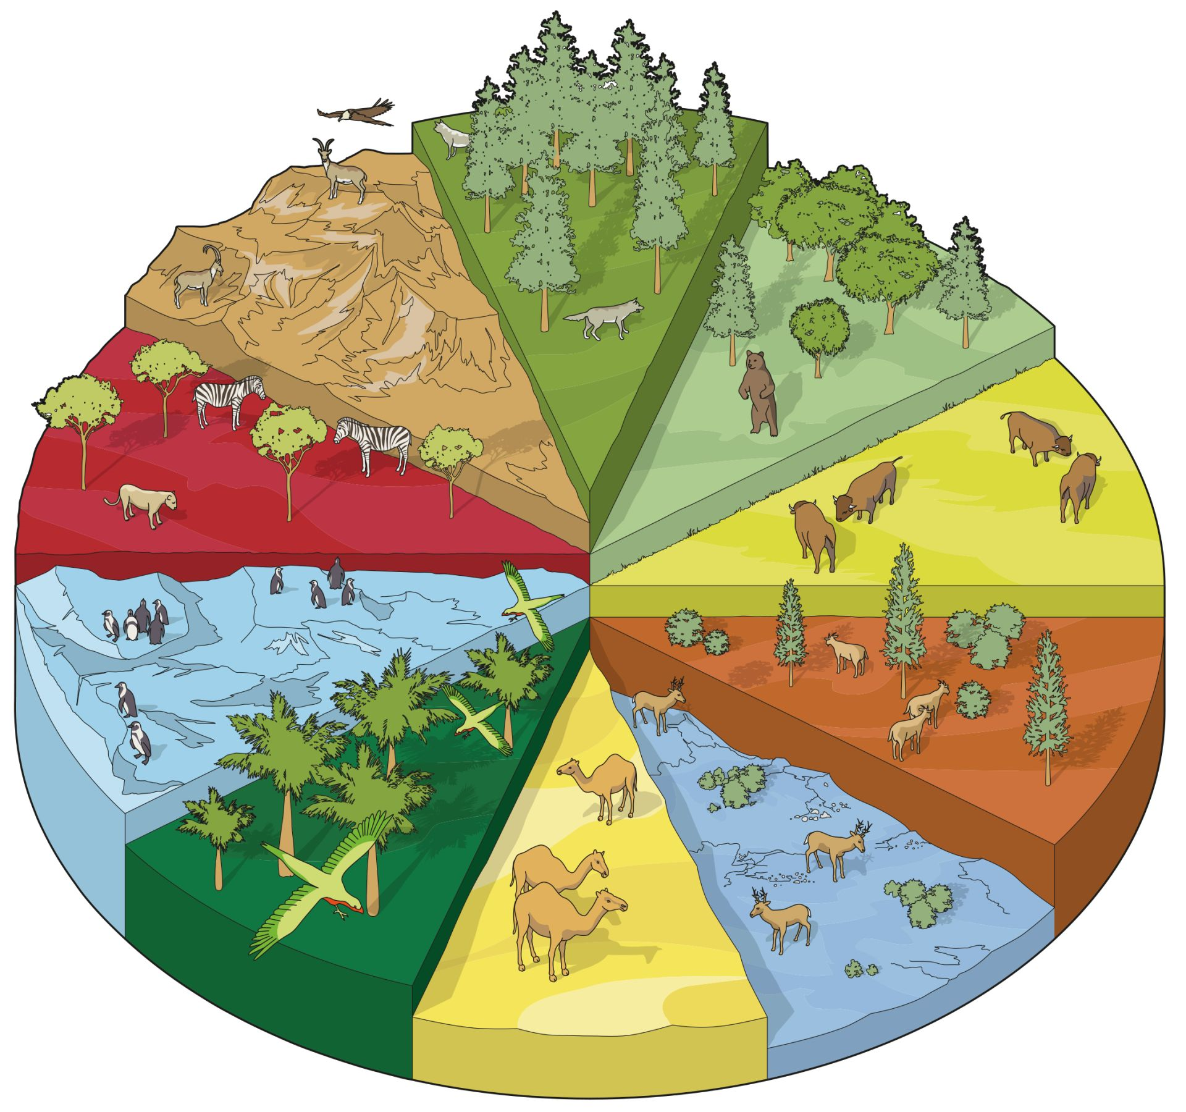
Extra vocabulary
habitat (n)
/ˈhæbɪtæt/
môi trường sống

Slide 4
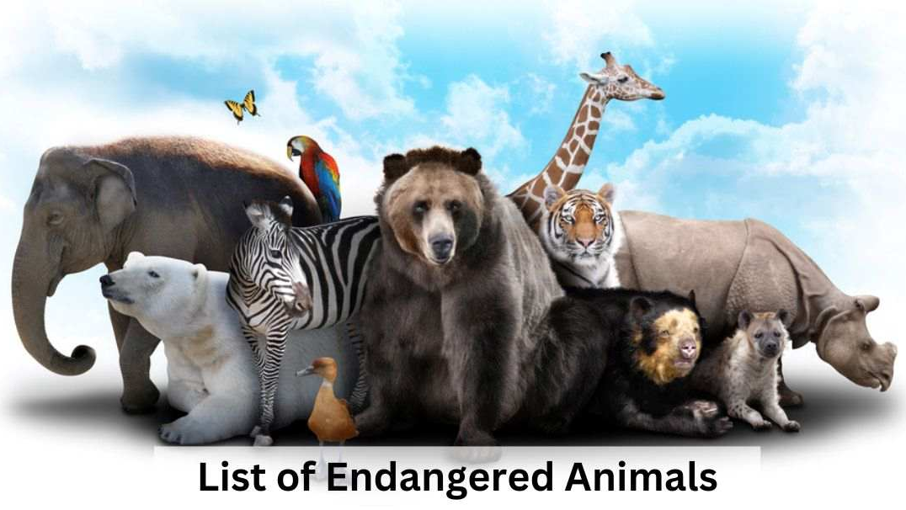
Extra vocabulary
endangered species (n)
/ɪnˈdeɪndʒəd ˈspiːʃiːz/
động vật sách đỏ

Slide 5
Extra vocabulary
carbon footprint (n)
/ˌkɑːbən ˈfʊtprɪnt/
dấu chân các bon

Slide 6
Extra vocabulary
release (v)
/rɪˈliːs/
thải ra

Slide 7
Extra vocabulary
single-use (adj)
/ˌsɪŋɡl ˈjuːs/
dùng một lần

Slide 8


Ex 1 Listen and choose the correct answers.
What's the most serious environmental problem in their neighbourhood?
A. pollution
B. overpopulation
C. habitat loss
D. endangered species loss
E. global warming
Ann
Club leader
Nam

Slide 9
Ex 1 Listen and choose the correct answers.
What's the most serious environmental problem in their neighbourhood?
A. pollution
B. overpopulation
C. habitat loss
D. endangered species loss
E. global warming
Club leader: Hello. Welcome back. Today we’re discussing environmental problems and environmental protection. What are our serious environmental problems now? Nam: Pollution and habitat loss, I think. Ann: I agree. The air and water quality are getting worse and worse. Club leader: Any others? Ann: Yes, I can think of some like global warming, endangered species loss, …

Slide 10
Ex 1 Listen and match the two halves in the two columns.
To protect the environment, we should
Nam: So what should we do to help protect our environment? Club leader: We can reduce our carbon footprint even in our homes. … Ann: I see. So we can do things like turning off devices when we’re not using them. … Nam: We can plant more trees in our neighbourhood too. Ann: And try to avoid using single-use products, like plastic bags, and stop littering.
1. reduce
a. using single-use products
2. turn off
b. littering
3. plant
c. our carbon footprint
4. avoid
d. devices when we're not using them
5. stop
e. more trees in our neighbourhood

Slide 11
Ex 3 Complete each sentence with one word or phrase from the box.
reduce
single-use
pollution
carbon footprint
environment programme
1. _______________ is a serious problem everywhere.
2. We should avoid dumping waste into lakes and rivers to _______ water pollution.
3. We shouldn’t throw away _________ products but recycle them.
4. ______________ is the amount of carbon dioxide we release into the environment.
5. We hope a lot more people join our _______________.
1. _______________ is a serious problem everywhere.
2. We should avoid dumping waste into lakes and rivers to _______ water pollution.
3. We shouldn’t throw away _________ products but recycle them.
4. ______________ is the amount of carbon dioxide we release into the environment.
5. We hope a lot more people join our _______________.
Pollution
reduce
single-use
Carbon footprint
environment programme

