Slide 1
UNIT 3 TEENAGERS
Lesson 1: Getting started

Slide 2
OBJECTIVES
01
02
After this lesson, students will be able to:
Have an overview about the topic TEENAGERS
use lexical items related to TEENAGERS

Slide 3
01
EXTRA VOCABULARY

Slide 4
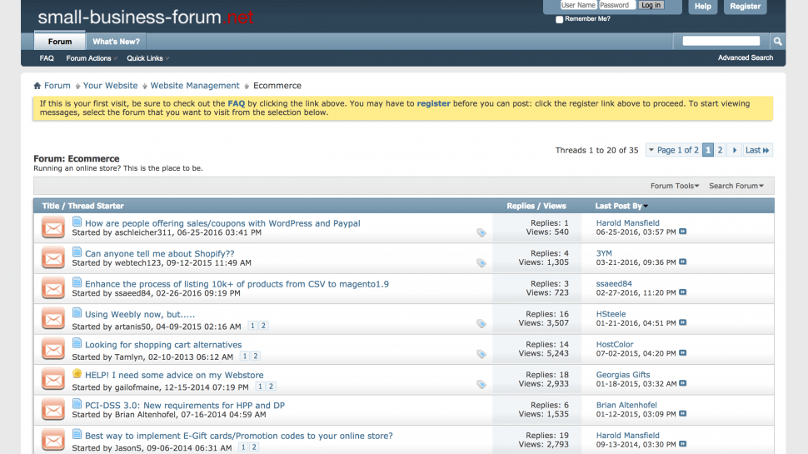
EXTRA VOCABULARY
forum (n)
/ˈfɔːrəm/
diễn đàn

Slide 5
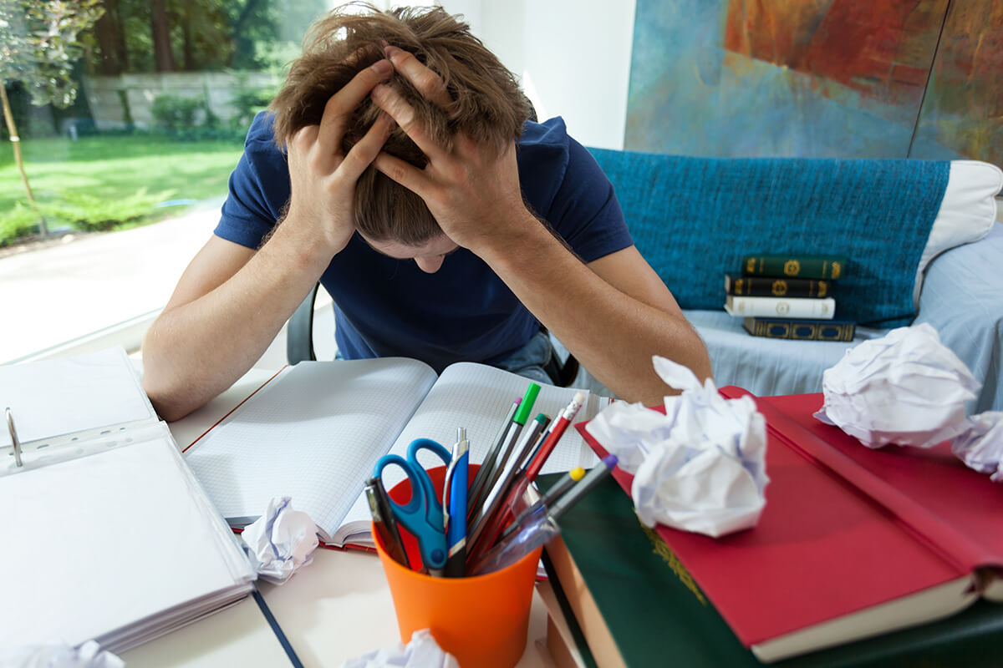
EXTRA VOCABULARY
stress (n)
/stres/
sự căng thẳng
stressful (adj)
/ˈstresfl/
căng thẳng, tạo áp lực

Slide 6
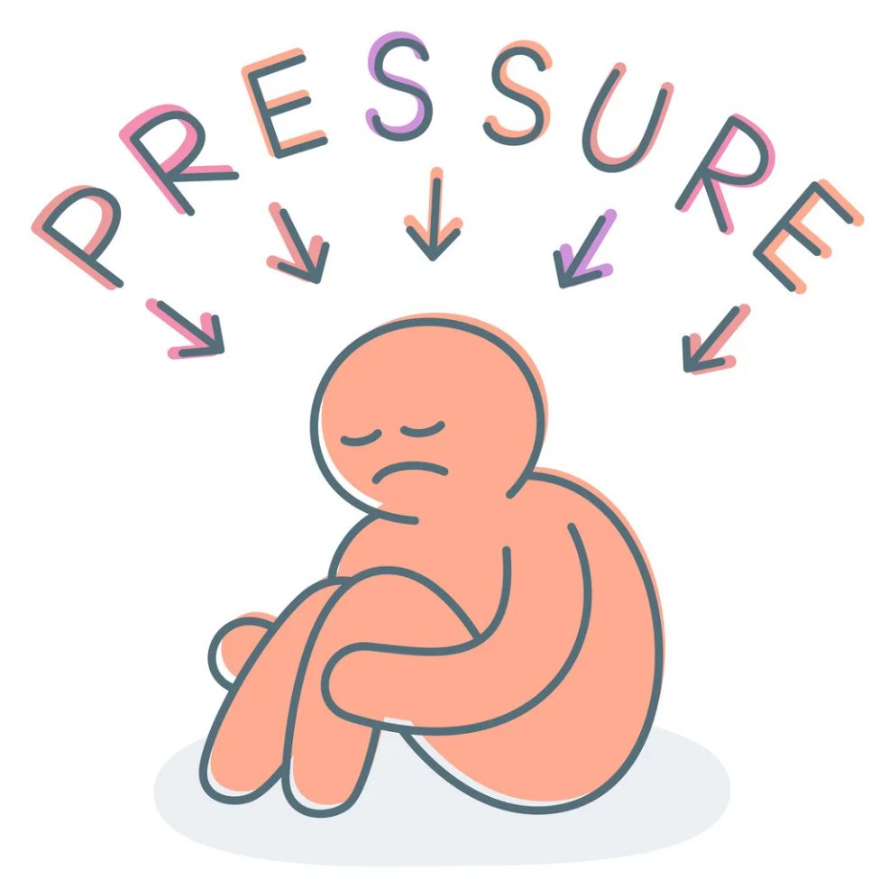
EXTRA VOCABULARY
pressure (n)
/ˈpreʃə(r)/
áp lực

Slide 7

EXTRA VOCABULARY
user-friendly (adj)
/ˈjuːzə-ˈfrendli/
thân thiện với người dùng

Slide 8
02
READING
& listening

Slide 9
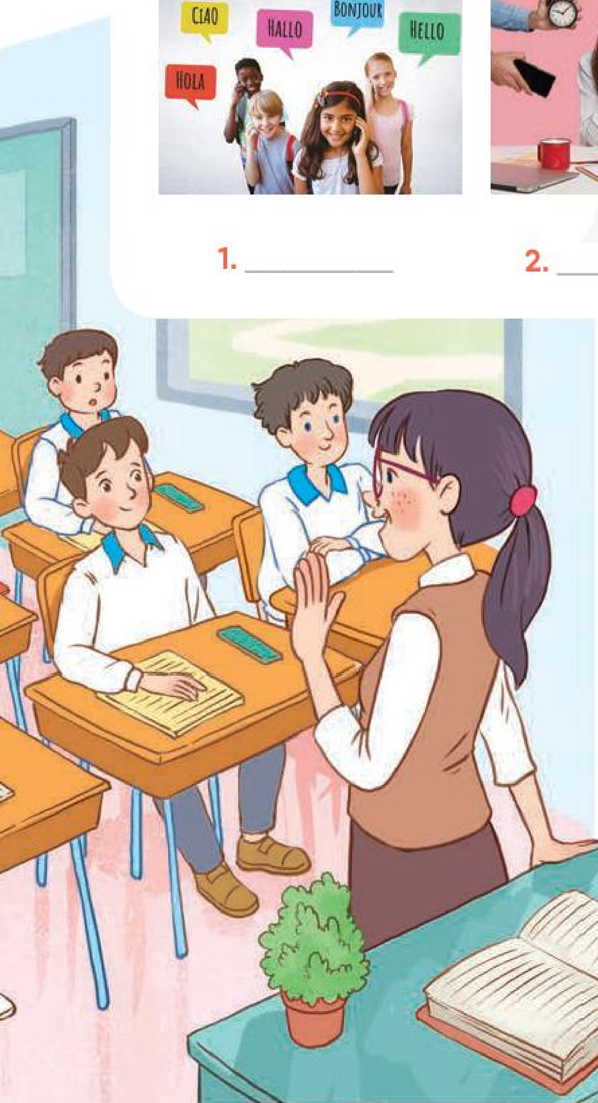
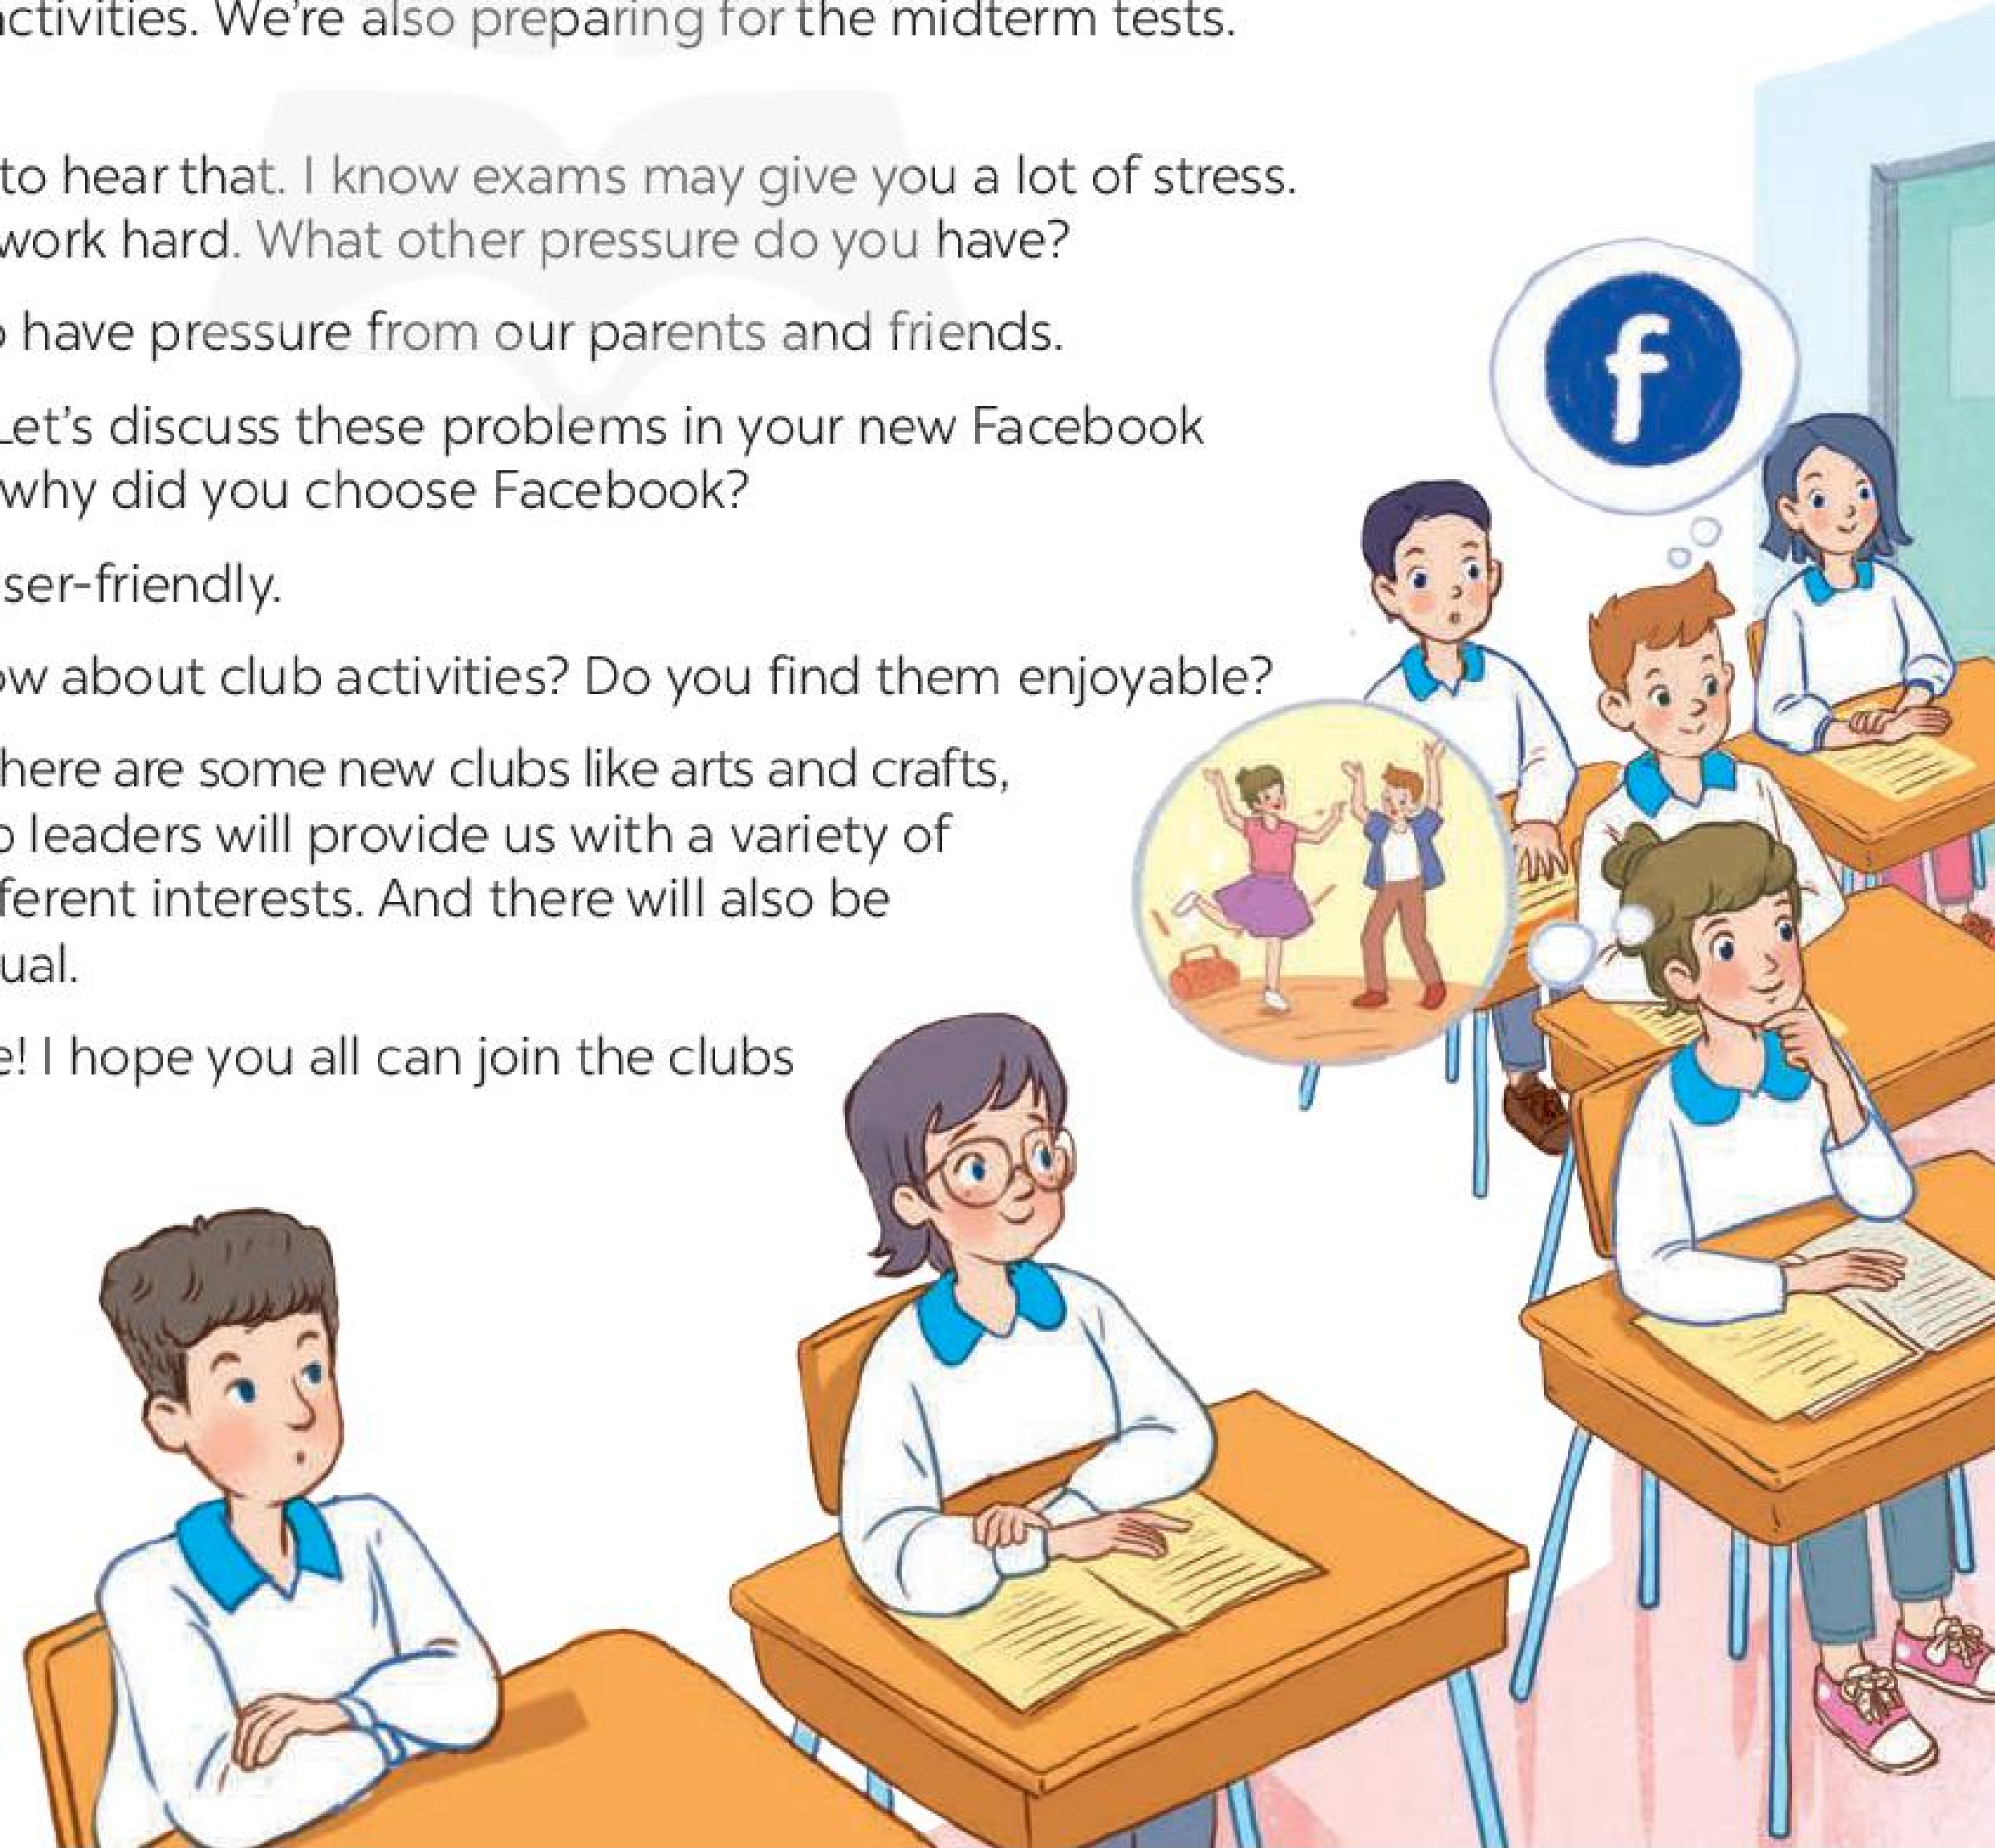
Look AND GUESS.
Who are these people?
Teacher and students.
What might be they talking about?
A. Class forum
B. School subject
C. Club activities
D. Their problems
Minh
teacher
LISTEN AND CHECK.
Ann

Slide 10
2. Read the conversation again and write T (true) or F (False).
Sentences | T | F
1. The students finished their midterm tests
2. Minh mentions the different types of pressure they are facing.
3. The teacher tells them to stay calm and work hard.
4. The class will discuss their problems offline.
5. The school has different clubs for its students.

Slide 11
2. Read the conversation again and write T (true) or F (False).
Teacher: It’s great to see you again, class. What’s going on? Minh: We’ve decided to use Facebook for our class forum, and we joined some school club activities. We’re also preparing for the midterm tests. It’s really stressful. Teacher: I’m sorry to hear that. I know exams may give you a lot of stress. But stay calm and work hard. What other pressure do you have? Minh: Well, we also have pressure from our parents and friends. Teacher: Do you? Let’s discuss these problems in your new Facebook group. By the way, why did you choose Facebook? Ann: Because it’s user-friendly. Teacher: Good! How about club activities? Do you find them enjoyable? Ann: Yes. This year there are some new clubs like arts and crafts, and music. The club leaders will provide us with a variety of activities to suit different interests. And there will also be competitions as usual. Teacher: Awesome! I hope you all can join the clubs you like.

Slide 12
2. Read the conversation again and write T (true) or F (False).
Sentences | T | F
1. The students finished their midterm tests
✓
Teacher: It’s great to see you again, class. What’s going on? Minh: We’ve decided to use Facebook for our class forum, and we joined some school club activities. We’re also preparing for the midterm tests.

Slide 13
2. Read the conversation again and write T (true) or F (False).
Sentences | T | F
2. Minh mentions the different types of pressure they are facing.
✓
Minh: … It’s really stressful.
Teacher: I’m sorry to hear that. I know exams may give you a lot of stress. But stay calm and work hard. What other pressure do you have? Minh: Well, we also have pressure from our parents and friends.

Slide 14
2. Read the conversation again and write T (true) or F (False).
Sentences | T | F
3. The teacher tells them to stay calm and work hard.
✓
Minh: … It’s really stressful.
Teacher: I’m sorry to hear that. I know exams may give you a lot of stress. But stay calm and work hard. What other pressure do you have?

Slide 15
2. Read the conversation again and write T (true) or F (False).
Sentences | T | F
4. The class will discuss their problems offline.
✓
Teacher: Do you? Let’s discuss these problems in your new Facebook group. By the way, why did you choose Facebook? Ann: Because it’s user-friendly.

Slide 16
2. Read the conversation again and write T (true) or F (False).
Sentences | T | F
5. The school has different clubs for its students.
✓
Teacher: Good! How about club activities? Do you find them enjoyable? Ann: Yes. This year there are some new clubs like arts and crafts, and music. The club leaders will provide us with a variety of activities to suit different interests. And there will also be competitions as usual.

Slide 17
2. Read the conversation again and write T (true) or F (False).
Sentences | T | F
1. The students finished their midterm tests
2. Minh mentions the different types of pressure they are facing.
3. The teacher tells them to stay calm and work hard.
4. The class will discuss their problems offline.
5. The school has different clubs for its students.
✓
✓
✓
✓
✓

Slide 18


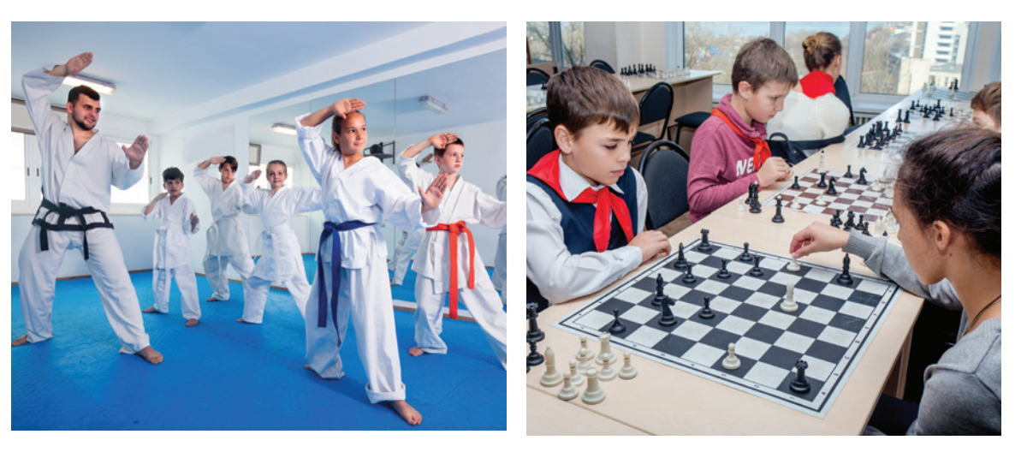
3. Write a word or phrases from the box under the correct pictures.
chess club / forum /language club /sports club /arts and crafts club/ pressure
language club
pressure
arts and crafts club
1. _______________
2. _______________
3. _______________
forum
sports club
chess club
4. _______________
5. _______________
6. _______________

Slide 19
4. Complete each of the sentences with a word or phrase in 3. There is one extra word or phrase.
chess club / forum /language club /sports club /arts and crafts club/ pressure
arts and crafts club
1. Minh is a member of our ________________. The greeting cards he makes are really creative.
2. Students can discuss their problems in their class ______.
3. We share the essays and stories that we write in English in our _____________.
4. She is not feeling very well this weekend because of all the _______
from her school work.
5. The coach of our _____________ tells us to drink plenty of water during our practice sessions.
1. Minh is a member of our ________________. The greeting cards he makes are really creative.
2. Students can discuss their problems in their class ______.
3. We share the essays and stories that we write in English in our _____________.
4. She is not feeling very well this weekend because of all the _______
from her school work.
5. The coach of our _____________ tells us to drink plenty of water during our practice sessions.
forum
language club
pressure
sports club

Slide 20
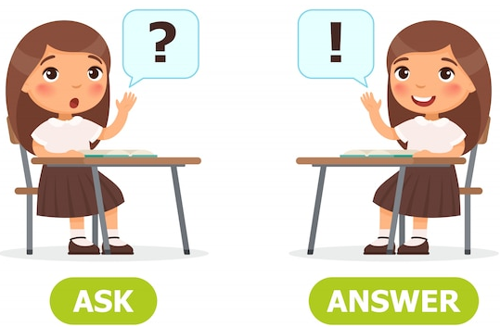
5. Work in pairs. Ask and answer the questions below.
What types of social media do you use?
What kinds of pressure do you have?
What clubs do you participate in?
Why do you choose to participate in that club?

Slide 21
WRAP UP
After this lesson, students will be able to:
✓
□ Have an overview about the topic TEENAGERS
✓
□ use lexical items related to TEENAGERS

