Slide 1
OUR TET HOLIDAY
LESSON 2: A CLOSER LOOK 1
Notes:
Dạy vocab kèm ví dụ
Practice pronun – chinese whisper

Slide 2
Act 2 (p.60). In pairs, match the verbs with the nouns. Write your answer into your notebooks.
1. have
2. visit
3. give
4. make
5. clean
6. watch
fun
A. a wish
relatives
B. fireworks
lucky money
Tet activities
C. the furniture
a wish
D. lucky money
the furniture
E. relatives
fireworks
F. fun
Notes:
What are those activities called? Tet activities

Slide 3
What else do we do at Tet?
Complete the sentences (Act 3, page 60)
shopping
clean
peach
celebrate
food
1. In Viet Nam, we _________ Tet in January or February.
2. At Tet, we decorate our houses with _________ flowers.
3. Children should help their parents to _________ their houses.
4. People do a lot of __________ before Tet.
5. My mother usually cooks special ________ during Tet.

Slide 4
Can you pronounce these words?
/∫/
/s/
wish
rice
Are they the same?

Slide 5
Listen and repeat (Act 4 p.60)
Put them in the correct column
shopping
special
rice
wish
celebrate
special
spring
/∫/ | /s/
Notes:
Special: s: /s/; c /∫/

Slide 6
Listen and repeat the poem (Act 5 p.60)
Pay attention to the sounds /s/ and /∫/ in the underlined words.
Spring is coming!
Tet is coming!
She sells peach flowers.
Her cheeks shine.
Her eyes smile.
Her smile is shy.
She sells peach flowers.

Slide 7
What have we learned today?

Slide 8
Extra activities

Slide 9
Minimal pairs
C she
sea she
seat sheet
see she
sock shock
boss bosh
save shave
seal she’ll
so show
sofa chauffeur
sore sure
sort short

Slide 10
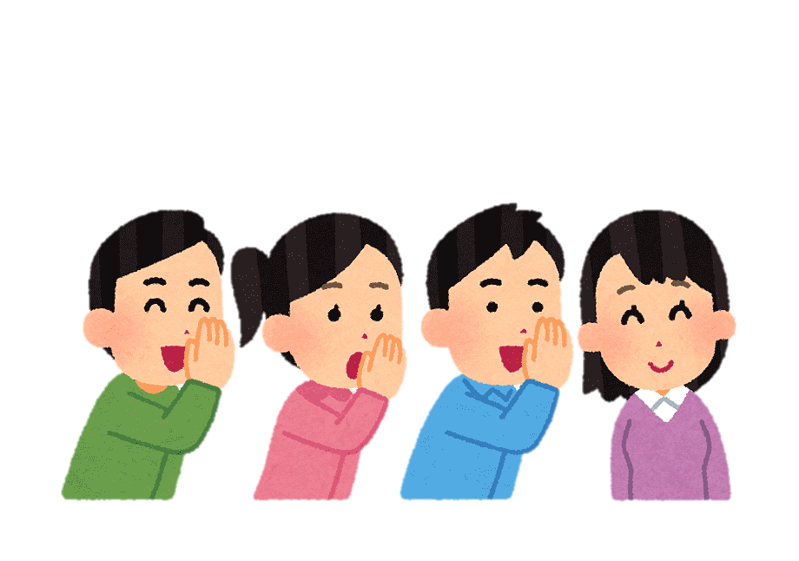
Chinese whisper
Step 1: Players form 2 lines (2 teams).
Step 2: Teacher give the first player of each team a sentence.
Step 3: The 1st player whispers the sentence to the 2nd player and so on.
Step 4: The last player runs to the board and write it down. If the sentence is correct, the team gets 1 point.
Step 5: If the last player can read the sentence with correct pronunciation, the team gets 1 more point.

Slide 11
Sentence 1
She sells sea shells by the sea shore.

Slide 12
Sentence 2
The shells she sells are surely seashells.

Slide 13
Sentence 3
If she sells shells on the seashore,
I'm sure she sells seashore shells.

Slide 14
What have we learned today?

