Slide 1
Unit 7: TELEVISION
Lesson 5: Skills 1

Slide 2
OBJECTIVES
01
02
By the end of this lesson, students will be able to:
READING
Read for specific information about television
SPEAKING
Talk about one’s favourite TV program, the reasons for that

Slide 3
What programmes can you remember?

Slide 4
01
READING

Slide 5
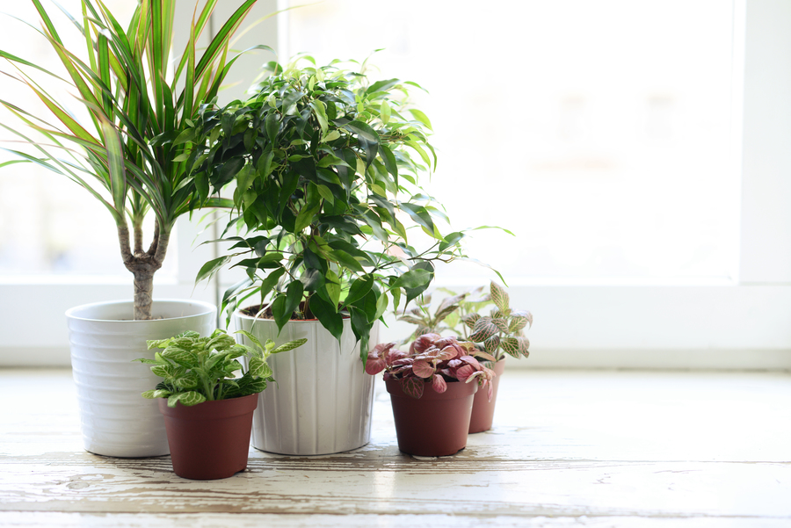
plant
/plɑːnt/
thực vật

Slide 6
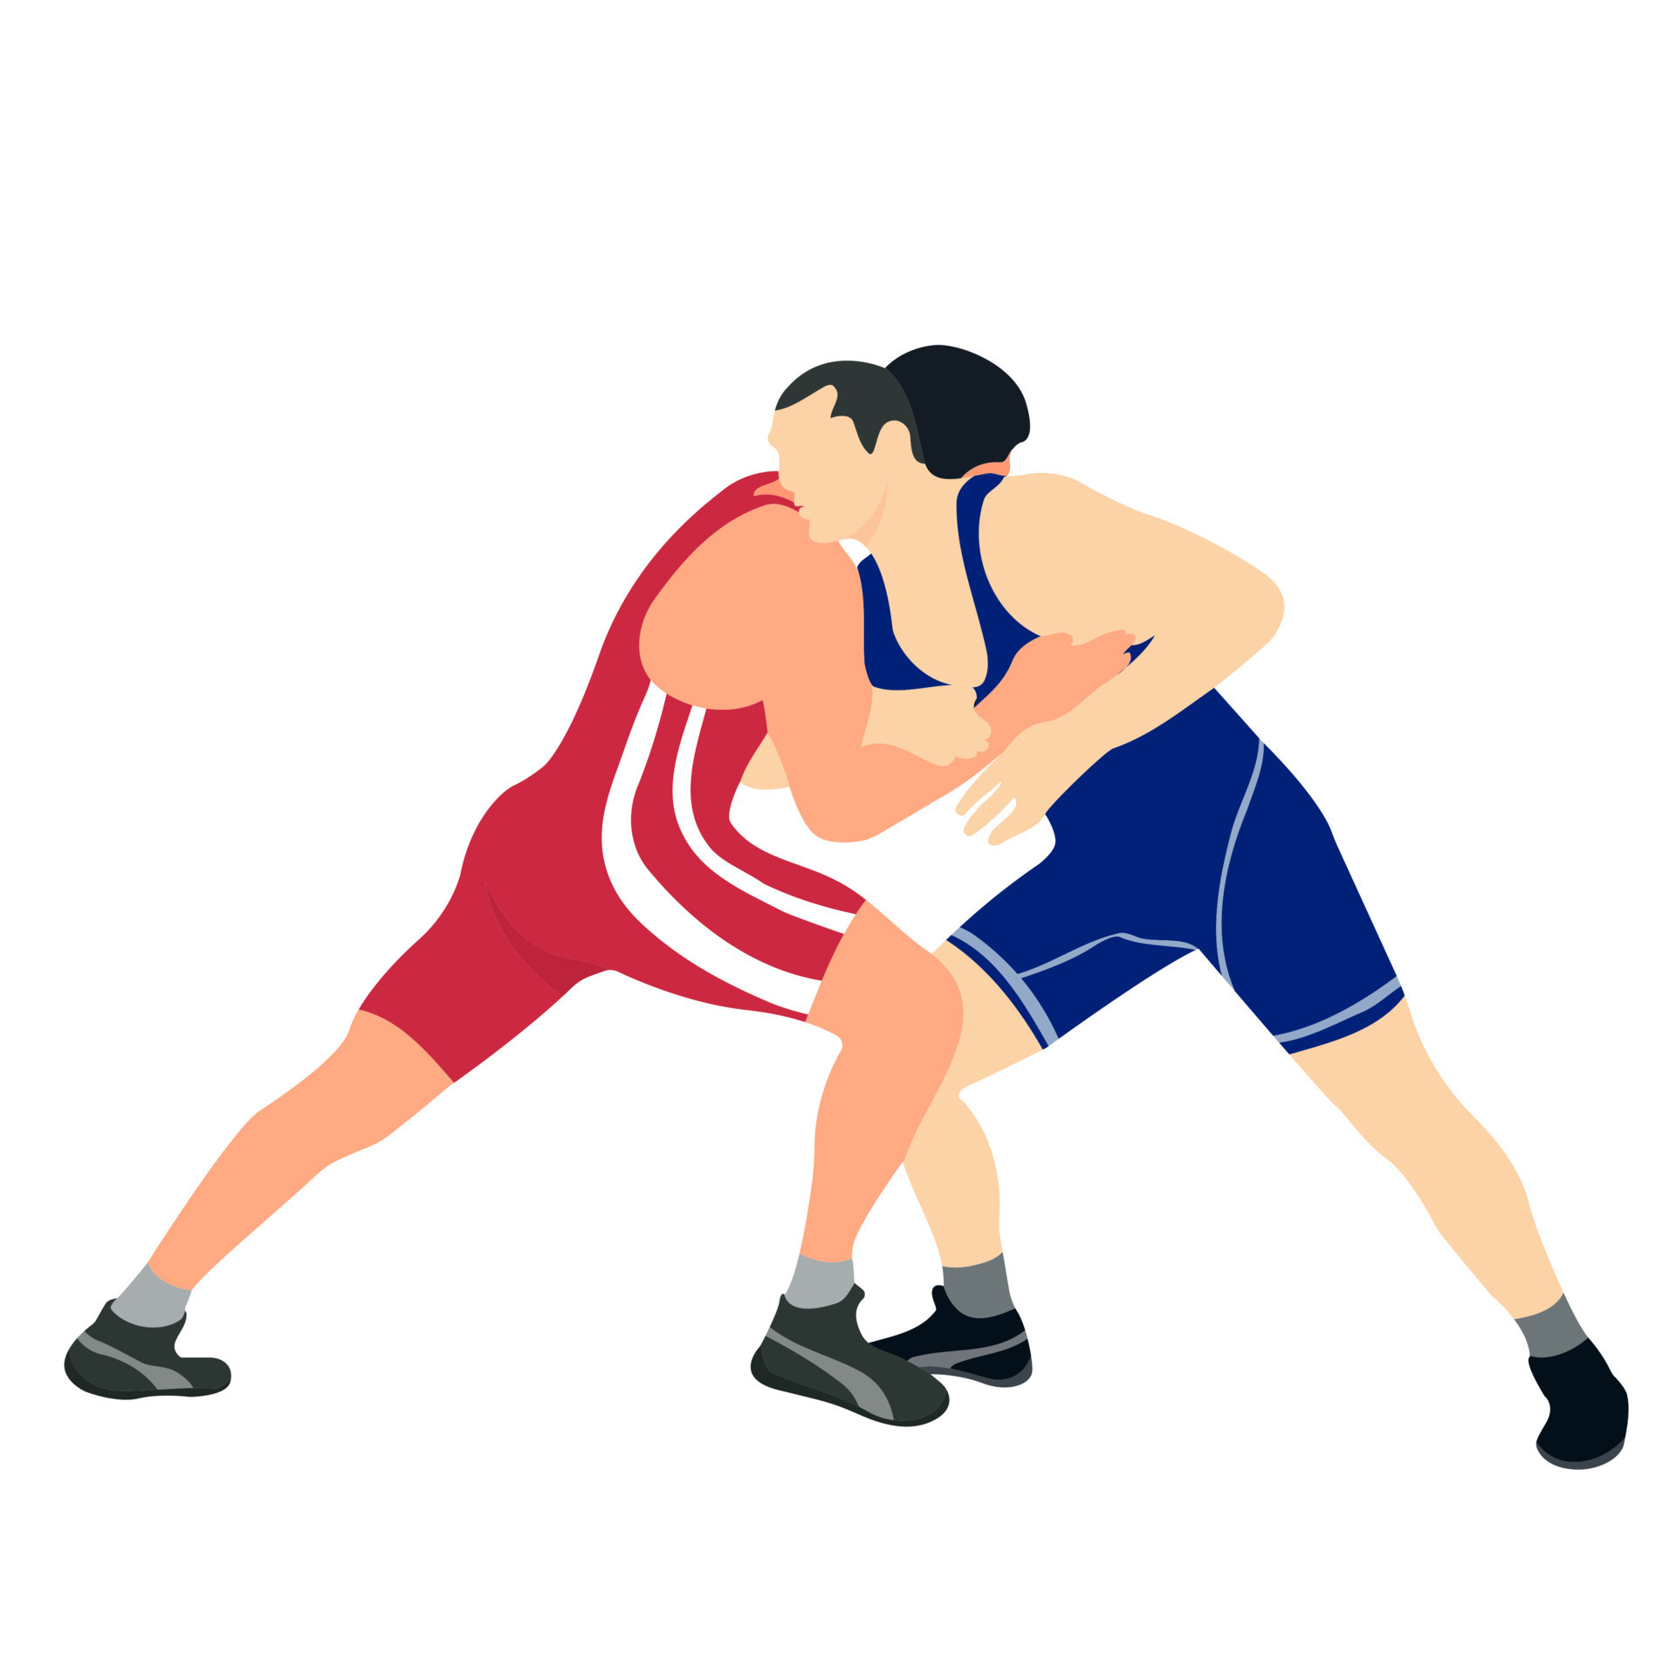
compete
/kəmˈpiːt/
cạnh tranh, ganh đua

Slide 7
Ex 1. Read the TV guide and answer. (P.12)
TIME | PROGRAMME | DESCRIPTION
8.00 | Wildlife: Cuc Phuong Forest | Watch the colourful world of plants, ﬂowers, and animals in their real life.
9.00 | Comedy: The Fox Teacher | Have a lot of fun with a fox teacher and his students on their first day at school.
10.30 | Sports: The Pig Race | Watch the cute pigs compete in the most exciting races. Who wins?
11.00 | Game show: Children are Always Right | Join this game show today and try to answer interesting questions about pets.
12.15 | Science: The Dolphins | Watch funny and interesting clips of intelligent dolphins in their natural life - the sea.

Slide 8
Answer the questions.
1.
What’s in the Wildlife programme?
2.
Is The Fox Teacher a comedy?
3.
What time is the Sports programme?
4.
Can we watch a game show at 10.30?
5.
What is the topic of the Science programme?

Slide 9
Answer the questions.
1.
What’s in the Wildlife programme?
It’s Cuc Phuong Forest.
TIME | PROGRAMME | DESCRIPTION
8.00 | Wildlife: Cuc Phuong Forest | Watch the colourful world of plants, ﬂowers, and animals in their real life.
9.00 | Comedy: The Fox Teacher | Have a lot of fun with a fox teacher and his students on their first day at school.
10.30 | Sports: The Pig Race | Watch the cute pigs compete in the most exciting races. Who wins?
11.00 | Game show: Children are Always Right | Join this game show today and try to answer interesting questions about pets.
12.15 | Science: The Dolphins | Watch funny and interesting clips of intelligent dolphins in their natural life - the sea.
Notes:
Underline key words => Explain

Slide 10
Answer the questions.
2.
Is The Fox Teacher a comedy?
Yes, it is.
TIME | PROGRAMME | DESCRIPTION
8.00 | Wildlife: Cuc Phuong Forest | Watch the colourful world of plants, ﬂowers, and animals in their real life.
9.00 | Comedy: The Fox Teacher | Have a lot of fun with a fox teacher and his students on their first day at school.
10.30 | Sports: The Pig Race | Watch the cute pigs compete in the most exciting races. Who wins?
11.00 | Game show: Children are Always Right | Join this game show today and try to answer interesting questions about pets.
12.15 | Science: The Dolphins | Watch funny and interesting clips of intelligent dolphins in their natural life - the sea.
Notes:
Underline key words => Explain

Slide 11
Answer the questions.
3.
What time is the Sports programme?
It’s on at 10.30.
TIME | PROGRAMME | DESCRIPTION
8.00 | Wildlife: Cuc Phuong Forest | Watch the colourful world of plants, ﬂowers, and animals in their real life.
9.00 | Comedy: The Fox Teacher | Have a lot of fun with a fox teacher and his students on their first day at school.
10.30 | Sports: The Pig Race | Watch the cute pigs compete in the most exciting races. Who wins?
11.00 | Game show: Children are Always Right | Join this game show today and try to answer interesting questions about pets.
12.15 | Science: The Dolphins | Watch funny and interesting clips of intelligent dolphins in their natural life - the sea.
Notes:
Underline key words => Explain

Slide 12
Answer the questions.
4.
Can we watch a game show at 10.30?
No, we can’t.
TIME | PROGRAMME | DESCRIPTION
8.00 | Wildlife: Cuc Phuong Forest | Watch the colourful world of plants, ﬂowers, and animals in their real life.
9.00 | Comedy: The Fox Teacher | Have a lot of fun with a fox teacher and his students on their first day at school.
10.30 | Sports: The Pig Race | Watch the cute pigs compete in the most exciting races. Who wins?
11.00 | Game show: Children are Always Right | Join this game show today and try to answer interesting questions about pets.
12.15 | Science: The Dolphins | Watch funny and interesting clips of intelligent dolphins in their natural life - the sea.
Notes:
Underline key words => Explain

Slide 13
Answer the questions.
5.
What is the topic of the Science programme?
It’s about dolphins.
TIME | PROGRAMME | DESCRIPTION
8.00 | Wildlife: Cuc Phuong Forest | Watch the colourful world of plants, ﬂowers, and animals in their real life.
9.00 | Comedy: The Fox Teacher | Have a lot of fun with a fox teacher and his students on their first day at school.
10.30 | Sports: The Pig Race | Watch the cute pigs compete in the most exciting races. Who wins?
11.00 | Game show: Children are Always Right | Join this game show today and try to answer interesting questions about pets.
12.15 | Science: The Dolphins | Watch funny and interesting clips of intelligent dolphins in their natural life - the sea.
Notes:
Underline key words => Explain

Slide 14
Answer the questions.
1.
What’s in the Wildlife programme?
It’s Cuc Phuong Forest.
2.
Is The Fox Teacher a comedy?
Yes, it is.
3.
What time is the Sports programme?
It’s on at 10.30.
4.
Can we watch a game show at 10.30?
No, we can’t.
5.
What is the topic of the Science programme?
It’s about dolphins.
Notes:
Underline key words => Explain

Slide 15
Ex 2. Work in pairs. Choose the best programme for each person.
People | Programmes
1. Phong wants to know more about dogs and cats.
2. Bob likes programmes that make him laugh.
3. Nga loves learning about plants and animals.
4. Minh likes watching races.
5. Linh is interested in sea animals.
Children are Always Right
The Fox Teacher
Cuc Phuong Forest
The Pig Race
The Dolphins

Slide 16
SPEAKING
02

Slide 17
Ex 3. In pairs. Share your table in ex 2.
People | Programmes
1. Phong wants to know more about dogs and cats. | Children are Always Right
2. Bob likes programmes that make him laugh. | The Fox Teacher
3. Nga loves learning about plants and animals. | Cuc Phuong Forest
4. Minh likes watching races. | The Pic Race
5. Linh is interested in sea animals. | The Dolphins
Example
I think the best programme for Phong is the game show Children are Always Right
I agree. He wants to know more about pets.

Slide 18
Ex 4. Talk about your favorite TV programme.
Group name?
Leader?
Drawers?
Presenters
the name of the programme
Groups of 6.
the channel it is on
the content of the programme
Think of your favorite TV programme.
You can use these suggestions.
the reason you like it

Slide 19
Talk about your favorite TV programme.
5 minutes (group work)
Present

Slide 20
RECAP
SKILLS 1
READING
SPEAKING
Read for specific information about television
Talk about one’s favourite TV program, the reasons for that

