Slide 1



Unit
9
FESTIVALS AROUND THE WORLD
LESSON 2: A CLOSER LOOK 1
VOCABULARY
PRONUNCIATION
Unit
HOBBIES

Slide 2

OBJECTIVES
By the end of the lesson, students will be able to gain:
- Vocabulary: types of festivals and festival activities
- Pronunciation: pronounce two-syllable words with correct stress

Slide 3

VOCABULARY
Cannes Film Festival
/kæn fɪlm festɪvl/
Liên hoan phim Cannes

Slide 4
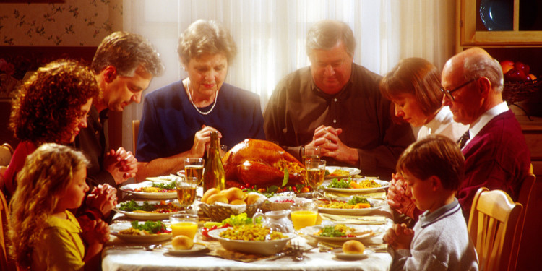
VOCABULARY
Thanksgiving
/ˌθæŋksˈɡɪvɪŋ/
Lễ Tạ ơn

Slide 5
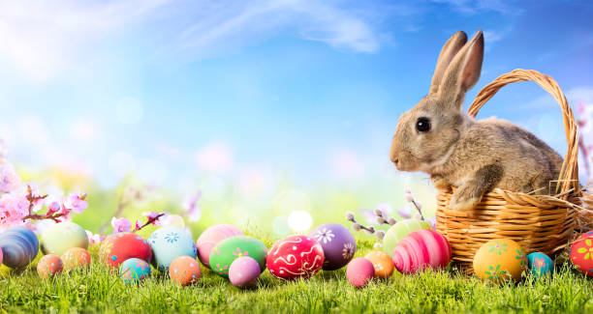
VOCABULARY
Easter (n)
/ˈiːstər/
Lễ Phục sinh

Slide 6
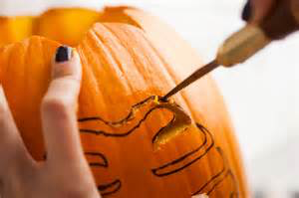
VOCABULARY
carve (v)
/kɑːv/
chạm, khắc

Slide 7
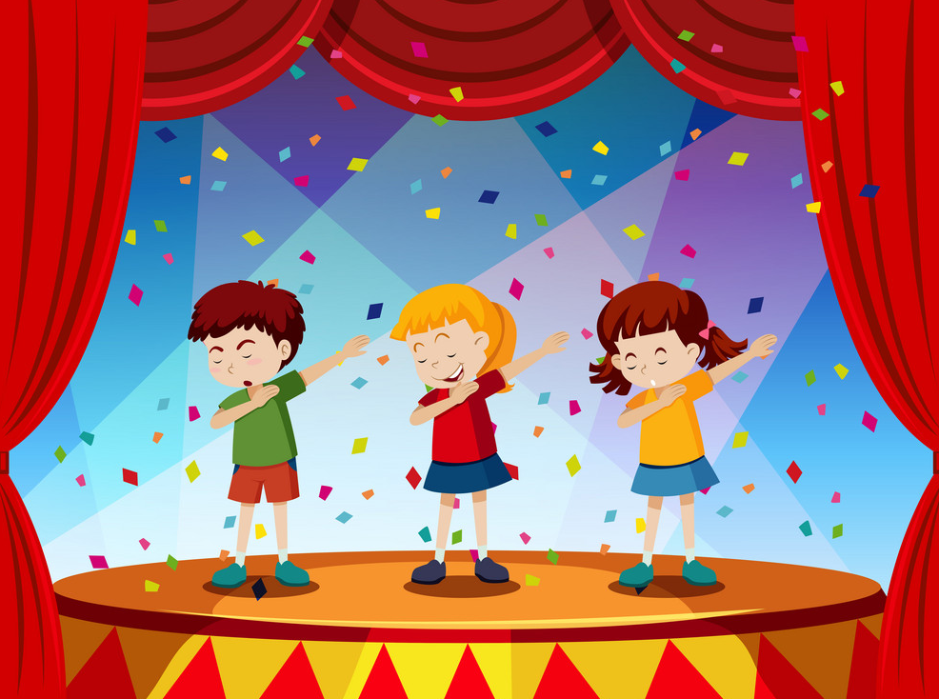
VOCABULARY
perform (v)
/pəˈfɔːm/
biểu diễn

Slide 8
VOCABULARY
Form | Pronunciation | Meaning
1. Cannes Film Festival | /kæn fɪlm festɪvl/ | Liên hoan phim Cannes
2. Thanksgiving (n) | /ˌθæŋksˈɡɪvɪŋ/ | Lễ Tạ ơn
3. Easter (n) | /ˈiːstər/ | Lễ Phục sinh
4. carve (v) | /kɑːv/ | chạm, khắc
5. perform (v) | /pəˈfɔːm/ | biểu diễn

Slide 9
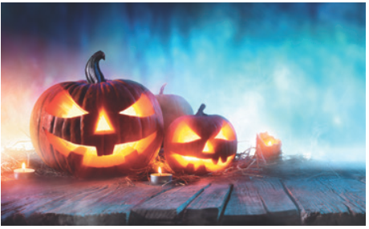
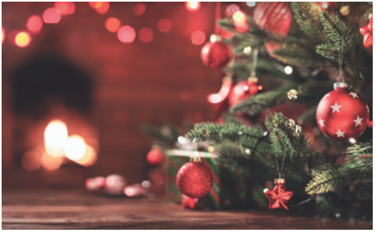
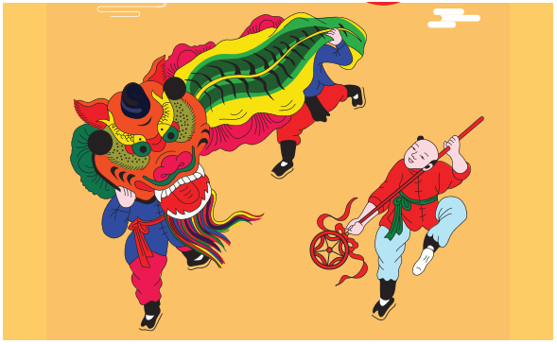
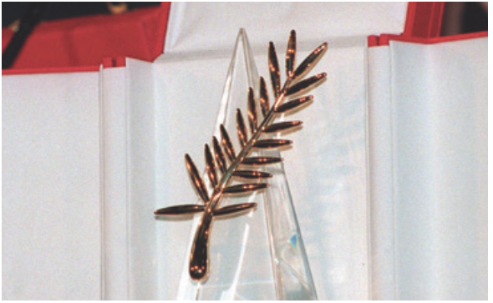
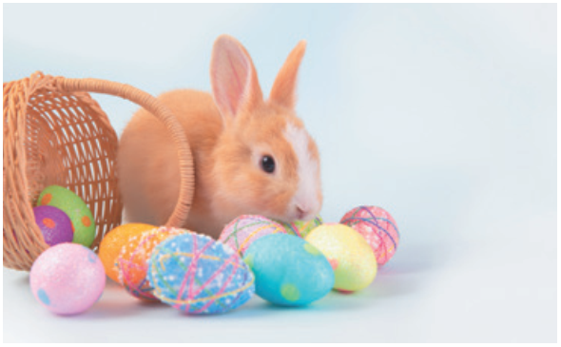
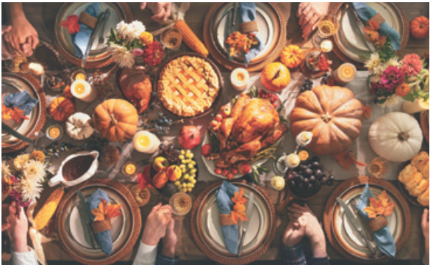
VOCABULARY
1
Write under each picture a festival name from the box.
Cannes Film Festival Mid-Autumn Festival Thanksgiving Christmas Halloween Easter
2. _________
3. _________________
Halloween
Christmas
Mid-Autumn Festival
1. ___________
4. _________________
5. _______
6. _____________
Cannes Film Festival
Easter
Thanksgiving

Slide 10
VOCABULARY
2
Complete the table below with the phrases from the box.
having a feast moon cakes chocolate eggs candy apples turkey painting eggs carving pumpkins performing a lion dance
Festival | Food | Activity
Easter
Halloween
Mid-Autumn Festival
Thanksgiving
chocolate eggs
painting eggs
candy apples
carving pumpkins
moon cakes
performing a lion dance
turkey
having a feast

Slide 11
VOCABULARY
3
Fill in blank with a word/ phrase from the box.
painting eggs Christmas Mid-Autumn Festival candy apples Cannes Film Festival turkey
1. At ______________, people give gifts to each other.
2. My children love ______________ at Easter.
3. How many ______________ do you need for the Halloween party?
4. At the _________________, there are many interesting films.
5. Performing lion dances is one of the activities at the __________________.
6. Bill’s mum is cooking a ___________ for Thanksgiving.
Christmas
painting eggs
candy apples
Cannes Film Festival
Mid-Autumn Festival
turkey

Slide 12

PRONUNCIATION
Stress in two-syllable words
Aims of the stage:
To let students identify how to pronounce two-syllable words with correct stress
To let students practise pronouncing two-syllable words with correct stress in sentences

Slide 13

PRONUNCIATION
4
Listen and repeat. Then underline the stressed syllable in each word.
Nouns and Adjectives | Verbs
costume fireworks turkey happy | enjoy decide discuss prepare

Slide 14
PRONUNCIATION
5
Listen and repeat the sentences. Underline the stressed syllables in the bold words.
1. We’re going to attend an Easter party at Nick’s house.
2. The dancers will perform traditional dances at the festival.
3. At Christmas, people usually buy presents for their family.
4. Did you go to the Da Lat Flower Festival with your parents?
5. My aunt is clever and patient.

Slide 15
CONSOLIDATION
1
WRAP-UP
VOCABULARY
PRONUNCIATION

Slide 16

CONSOLIDATION
2
HOMEWORK
Do exercises in workbook.

