Slide 1
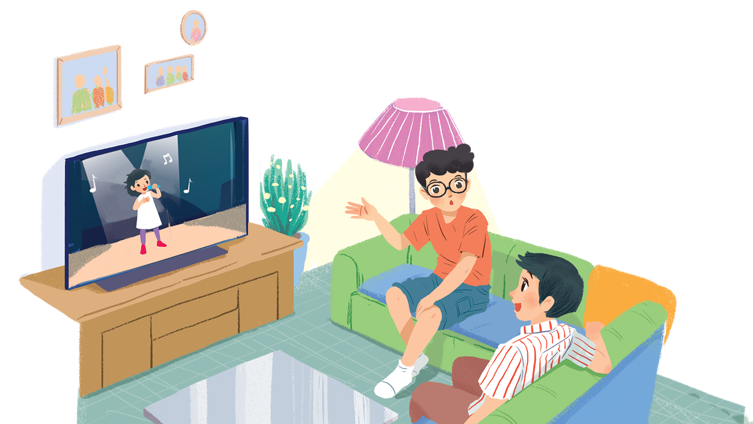
      UNIT 7: TELEVISION
      LESSON 4: COMMUNICATION
English 6

Slide 2


Everyday English
Asking for and giving information about TV programmes
1
Listen and read the conversation. Pay attention to the highlighted words.
2
Work in pairs. Make a similar conversation about your favourite TV programme.
TV progammes
3
Work in groups. Discuss and complete the facts with the countries in the box.
4
Read about the two TV programmes and tick () the correct programme in the table. You may tick both.
5
Work in groups. Tell your group which programme in 4 you prefer and why.

Slide 3

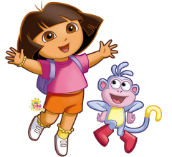




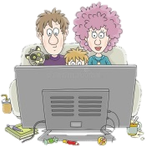

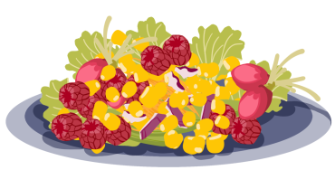





What
Why
What time
1. ______ is your favourite TV programme?
2. _______ do you like it?
3. _______ is it on?
WH – Questions
Where
How many
How often
6. ________ is Disney Channel from?
5. _________ viewers does the cartoon have?
4. _________ do you watch it a week?
Who
7. ______ likes cartoon today?
Help the Turkey get a gift
When
Which
8. _____ do your parents permit you to watch the educational TV programme?
9. _____ gift should I get? a pie or corn salad

Slide 4
Everyday English
Asking for and giving information about TV programmes

Slide 5

1
Listen and read the conversation. Pay attention to the highlighted words.
A: What’s your favourite TV programme?
B: The animal programme.
A: Why do you like it?
B: Because I can see the animals in their real life.

Slide 6
2
Work in pairs. Make a similar conversation about your favourite TV programme.
A: What’s your favourite TV programme?
B: The sports programme.
A: Why do you like it?
B: Because I am a big fan of sports.
A: What time is it on?
B: It’s on at 7:30 p.m. on VTV3.
A: How often do you watch it?
B: I watch it every weekend.

Slide 7
TV progammes

Slide 8
3
Work in groups. Discuss and complete the facts with the countries in the box.
The USA
Viet Nam
Japan
Iceland
Facts
1.
Pokemon cartoons are from
_______.
Japan.
2.
Bibi in
_______ shows international and Vietnamese cartoons.
Viet Nam shows international and Vietnamese cartoons.
3.
In
_______, there was no TV on Thursdays before 1986.
Iceland, there was no TV on Thursdays before 1986.
4.
Discovery Channel makes education fun for children in
the USA.
_______.

Slide 9
  Pokemon cartoons: Japanese television animation series, typically aimed at adults as well as children.
  Iceland: Before 1981, there was no TV in July; before 1986, there was no TV on Thursday.
  It comes from the opinion that you could do without TV once a week! Spend it with your family. Spend it outdoors.
Discovery Channel:
an American pay television network.
It creates the highest quality content and remains one of the most dynamic media companies in the world.

Slide 10


4
Read about the two TV programmes and tick () the correct programme in the table. You may tick both.
Let’s Learn is an educational TV programme. It makes learning fun. Children love it. It has cute characters and fun songs. People in 80 countries watch it today. Both children and their parents like it.
Hello Fatty is a popular TV cartoon. It’s about a clever fox called Fatty and his friend. Together they go to different places. Children around the world enjoy this programme. It’s
funny and educational.
Notes:
City landmarks phải ở trên mục 3

Slide 11
 | Let’s Learn | Hello Fatty
1. It’s educational.
2. It has viewers from 80 countries.
3. Its main character is a clever fox.
4. Both parents and children enjoy it.
5. It’s a cartoon.







Slide 12
5
Work in groups. Tell your group which programme in 4 you prefer and why.
Example:
I like Let’s Learn because it has cute characters and fun songs.

Slide 13

Homework
  Learn vocabulary and the structure by heart.
  Do exercise … in your work book
  Prepare the next lesson: Skills 1
  Write a paragraph to describe a programme you prefer in your note-book.

