Slide 1
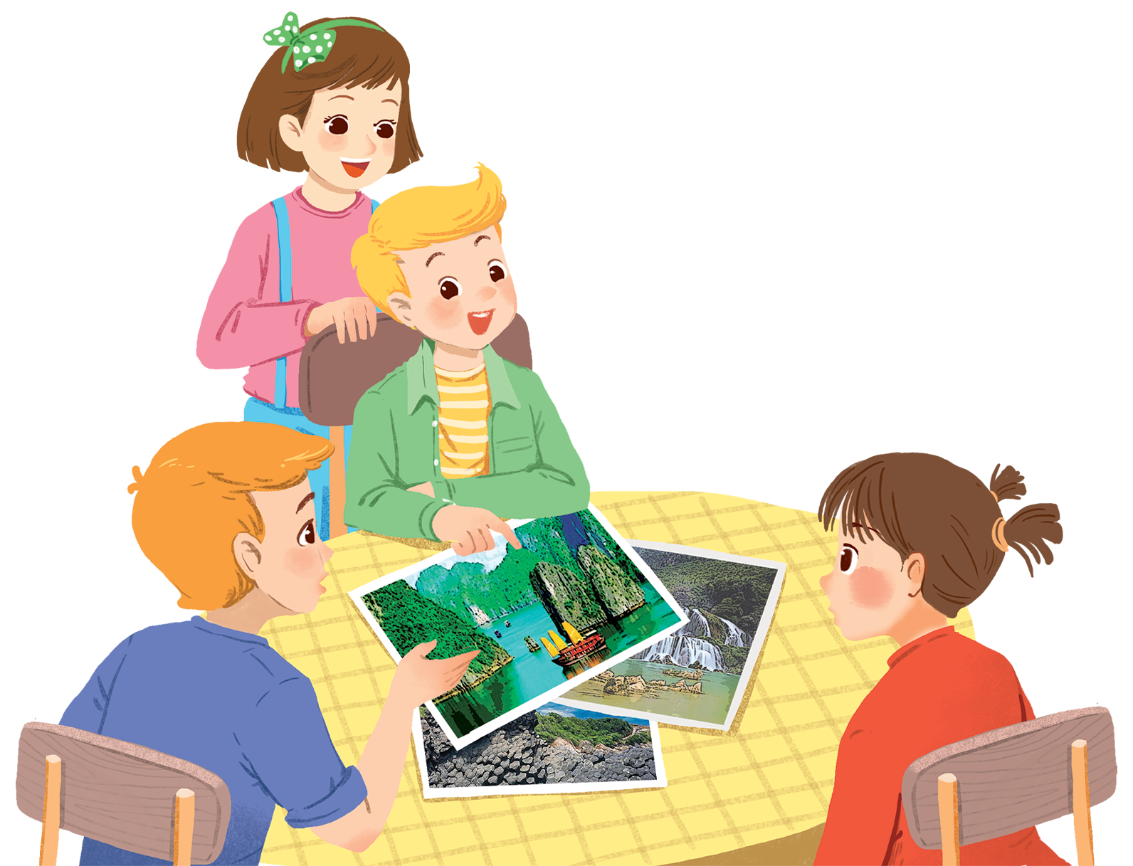
      UNIT 5: NATURAL WONDERS OF VIETNAM
      LESSON 5: SKILLS 1
English 6

Slide 2


Reading
1
Before you read, look at the pictures below. Make predictions about the reading. Then read and check your ideas.
2
Complete the sentences, using the words from the box.
mặc vào
3
Read the text again. Answer the following questions.
Speaking
4
Work in pairs. Make notes about one of the places in the reading. You can add your own ideas.
5
Some foreign visitors are visiting your city / town / area. You are their tour guide. Tell them some interesting things about the place as well as what they must and mustn’t do there.

Slide 3
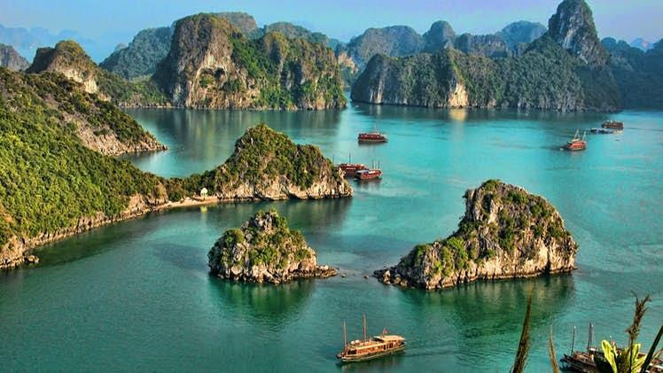
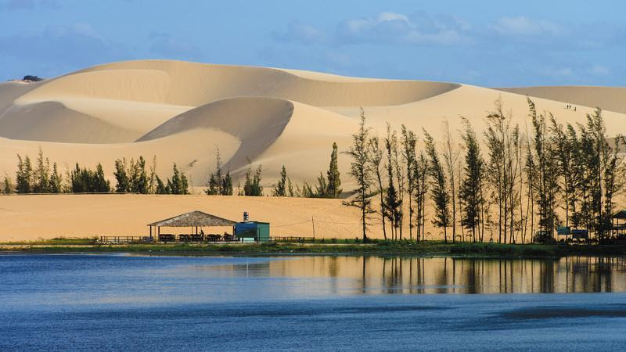
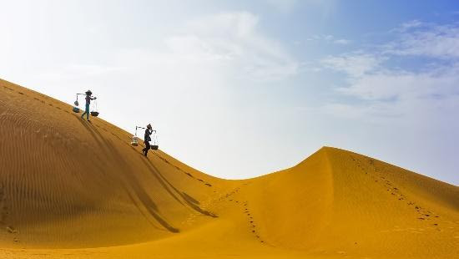
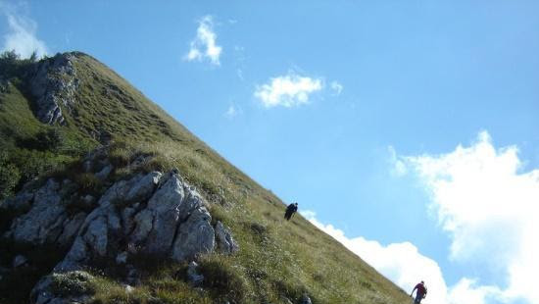
Chatting
1. What are the places?
2. What do you know about these places?
3. Have you ever been to these places?”

Slide 4


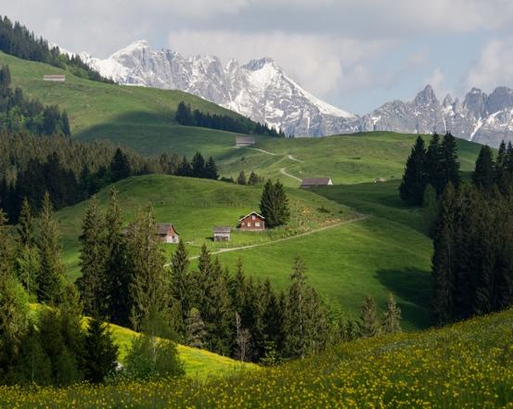


Vocabulary
tourist attraction (n)
wonder (n)
popular (adj)
landscape (n)
slope (n)
sand dune (n)
điểm thu hút khách du lịch
kỳ quan
phổ biến
phong cảnh
dốc, sườn
cồn cát

Slide 5
Rub out and remember
tourist attraction (n)
điểm thu hút khách du lịch
wonder (n)
kỳ quan
popular (adj)
phổ biến
landscape (n)
phong cảnh
slope (n)
dốc, sườn
sand dune (n)
cồn cát

Slide 6
Reading

Slide 7
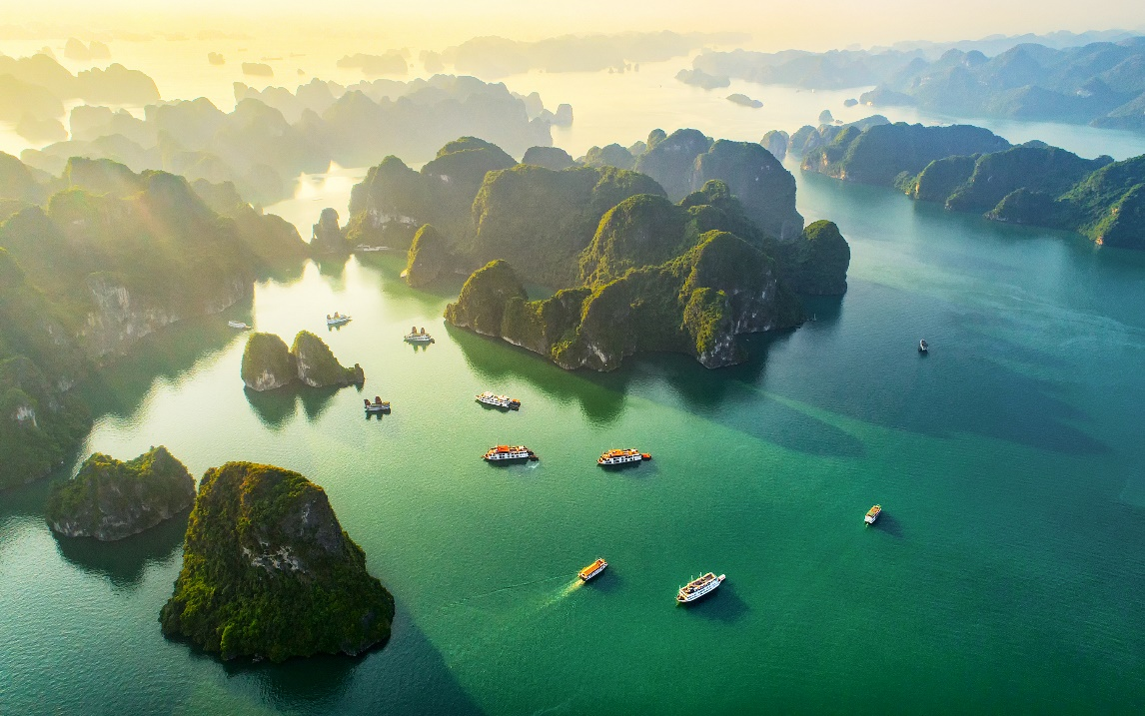
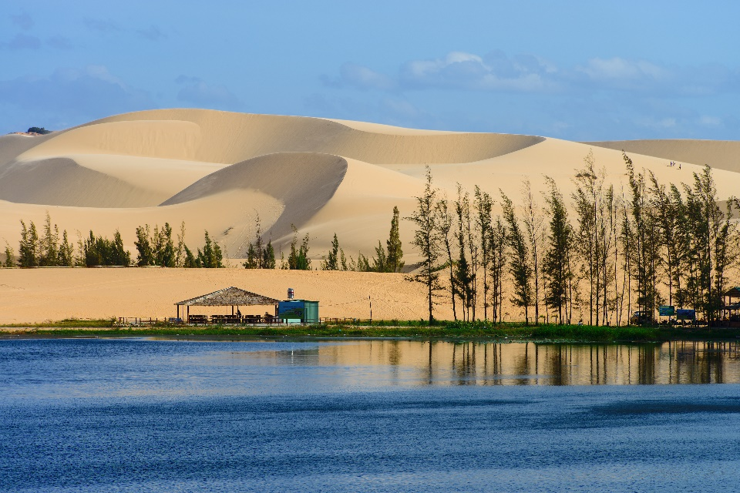
1
Before you read, look at the pictures below. Make predictions about the reading. Then read and check your ideas.
1.
What is the reading about?
2.
What do you know about these places?

Slide 8

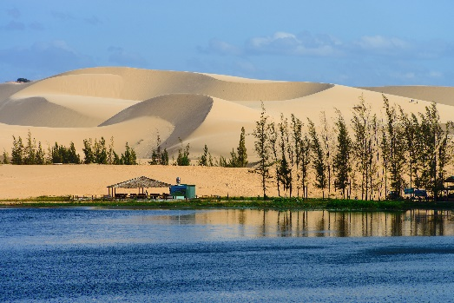

Ha Long Bay is in Quang Ninh. It has many islands and caves. Tuan Chau, with its beautiful beaches, is a popular tourist attraction in Ha Long Bay. There you can enjoy great seafood. And you can join in exciting activities. Ha Long Bay is Viet Nam’s best natural wonder.
Mui Ne is popular for its amazing landscapes. The sand has different colours: white, yellow, red ... It’s like a desert here. You can ride a bike down the slopes. You can also fly kites, or have a picnic by the beach. The best time to visit the Mui Ne Sand Dunes is early morning or late afternoon. Remember to wear suncream and bring water.

Slide 9
1
Before you read, look at the pictures below. Make predictions about the reading. Then read and check your ideas.
Note:
Tuan Chau: a large island in Ha Long Bay, a popular tourist destination
Mui Ne: a tourist attraction in Binh Thuan Province

Slide 10
2
Complete the sentences, using the words from the box.
desert
visit
wonder
islands
remember
island
1.
Ha Long Bay is the famous for its beautiful .
wonder
2.
Ha long Bay is the number one natural in Viet Nam.
desert
3.
A is a large area of land with very little water.
Remember to bring an umbrella, as it often rains there.
4.
to bring an umbrella, as it often rains there.
5.
A lot of people Ly Son Island in the summer.
visit

Slide 11





1
2
3
4
5
6
7
8
END

Slide 12





LUCKY NUMBER

Slide 13


Unlucky number

Slide 14
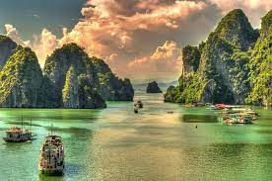
0
1
2
3
4
5
6
7
8
9
10
island
Ha Long Bay is the famous for its beautiful .
desert
visit
wonder
islands
remember

Slide 15
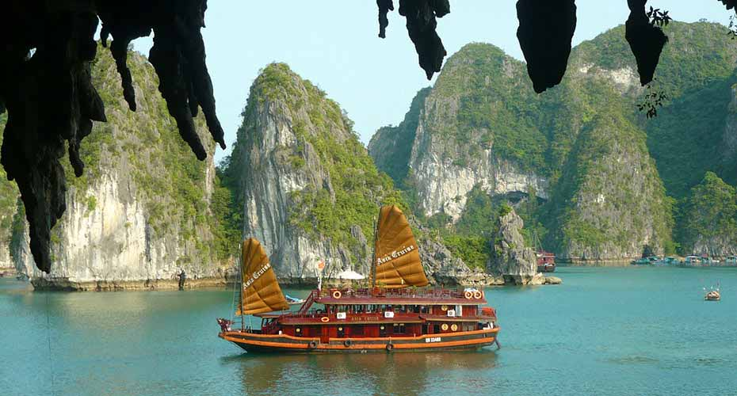
0
1
2
3
4
5
6
7
8
9
10
wonder
Ha long Bay is the number one natural in Viet Nam.
desert
visit
wonder
islands
remember

Slide 16
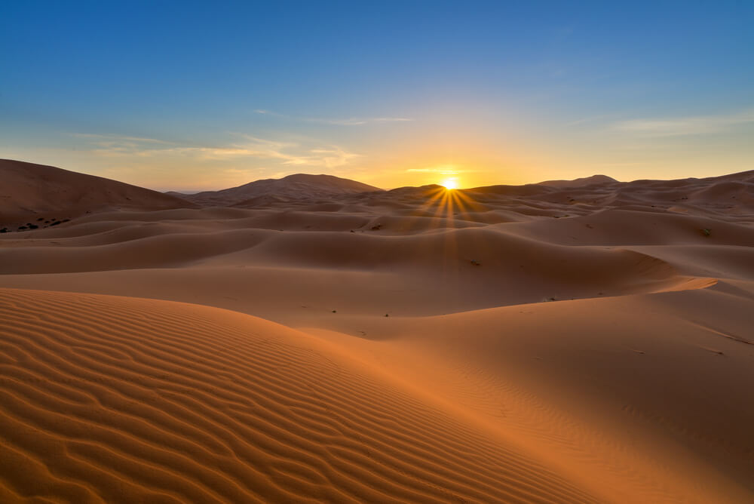
0
1
2
3
4
5
6
7
8
9
10
desert
A is a large area of land with very little water.
desert
visit
wonder
islands
remember

Slide 17

0
1
2
3
4
5
6
7
8
9
10
Remember
to bring an umbrella, as it often rains there.
desert
visit
wonder
islands
remember

Slide 18
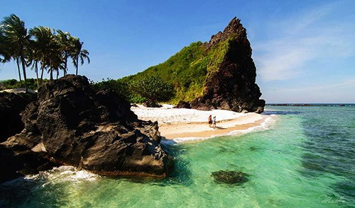
0
1
2
3
4
5
6
7
8
9
10
A lot of people Ly Son Island in the summer.
visit
desert
visit
wonder
islands
remember

Slide 19
3
Read the text again. Answer the following questions.
1.
Where is Ha Long Bay?
It is in Quang Ninh.
2.
What can you do at Ha Long Bay?
We can enjoy (great) seafood and join in exciting activities.
3.
Is there a desert in Mui Ne?
No, there isn’t.
4.
Where can you have a picnic in Mui Ne?
By the beach.
5.
What is the best time to visit the Mui Ne Sand Dunes?
Early morning or late afternoon.

Slide 20
Speaking

Slide 21
Work in pairs. Make notes about one of the places in the reading. You can add your own ideas.
4
Ha Long Bay | Mui Ne
interesting islands
a beautiful place
Then tell your partner about the place.
Example:
Ha Long Bay has a lot of interesting islands. It …

Slide 22
5
Some foreign visitors are visiting your city / town / area. You are their tour guide. Tell them some interesting things about the place as well as what they must and mustn’t do there.
Example:
You must follow all the rules.
You mustn’t take photos when you are in the City Museum.

Slide 23

Homework
  Learn vocabulary and the structure by heart.
  Do exercise in your work book
  Prepare the next lesson: Skills 2

Slide 24
