Slide 1

PERIOD 4-UNIT 1-MY NEW SCHOOL
LESSON 3-A CLOSER LOOK 2

Slide 2


The present simple tense: (Thì hiện tại đơn giản)
Form: S + V (s/es)
- Affirmative
(Thể khẳng định)
- I/we /you/ they/ (DT số nhiều) + V-infinitive (ng.thể)
have
has
- He/she /it / (DT số ít) + V-s/es
(Note: (V) - ch, ss, sh, x, o + es)
- Negative
(Thể phủ định)
- I/we /you/ they/ (DT số nhiều) don't + V-infinitive (nguyên thể)
- He/she /it / (DT số ít) doesn't + V-infinitive (nguyên thể)
- Question
(Câu hỏi)
Do + I/we /you/ they/ (DT số nhiều) + V-infinitive ?
(Wh)
Does + He/she /it / (DT số ít) + V-infinitive ?
Remember! We use the present simple to talk about actions or events that often happen, or are fixed.(Chúng ta sử dụng thì hiện tại đơn để nói về các hành động hoặc sự kiện thường xảy ra hoặc cố định.)
Examples:
- We usually go to school by bus.
Remember!
The present simple verbs with
- he / she / it need an s /es.
- I don't like school lunch very much.

Slide 3


Choose the correct answer A, B, or C.
1.
We new subjects for this school year.
A.
B.
has
C.
having
have
2.
Duy to school every day.
A.
cycling
B.
cycle
C.
cycles
3.
My new school in the centre of the village.
B.
C.
doesn’t
A.
not
isn’t
4.
I live near here. Where live?
A.
B.
you
C.
are you
do you
5.
My friend has a sister, but she a brother.
A.
B.
don’t have
C.
doesn’t have
not has

Slide 4

Miss Nguyet is interviewing Duy for the school newsletter. Write the correct form of the verbs.
Miss Nguyet: Tell us about your new school, Duy.
has
Duy: Sure! My school (1.have) a large playground.
Do
have
Mis Nguyet: you (2. have) any new friends?
like
Duy: Yes. And I (3. like) my new friends, Vy and Phong.
Does
walk
Mis Nguyet: Vy (4. walk) to school with you?
ride
Duy: Well, we often (5. ride) our bicycles to school.
Mis Nguyet: What time do you go home?
Duy: I (6. go) home at 4 p.m. every day.
go
Mis Nguyet: Thank you!

Slide 5
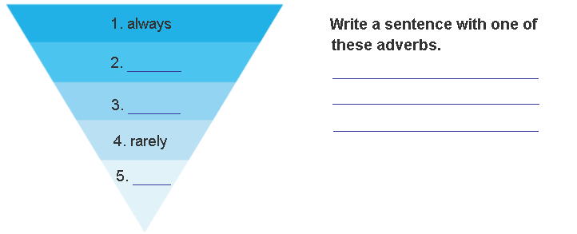
Unit 1: My New School - A closer look 2
3. Fill the blanks with usually, sometimes or never.
Adverbs of frequency (Trạng từ thường xuyên)
Luôn luôn
+ Examples:
Tom usually takes the bus to school.
They don't always go to the cinema.
We are never late for school
usually
Thường xuyên
sometimes
Thỉnh thoảng
Hiếm khi
never.
Không bao giờ
The adverbs of frequency place before V and after tobe ( Trạng thừ thường xuyên luôn đứng trước động từ thường và sau tobe )

Slide 6

Choose the correct answer A or B to complete each sentence.
1.
I late on Saturdays.
A.
get up usually
B.
usually get up
2.
My mum to work late.
A.
rarely goes
B.
goes rarely
3.
at weekends?
A.
Do you often travel
B.
Often do you travel
4.
What kind of music ?
A.
Usually does Susan listen to
B.
does Susan usually listen to?
5.
When go on holiday each year?
A.
do you usually
B.
you usually

Slide 7

Choose the correct word to complete the sentences.
1.
you / often / ride your bicycle / to school
Do you often ride your bicycle to school?
2.
you / sometimes / study / in the school libraby
Do you sometimes study in the school library?
3.
you / like / your new school
Do you like your new school?
4.
your friends / always / go to school / with you
Do your friends always go to school with you?
5.
you / usually / do homework / after school
Do you usually do homework after school?

Slide 8


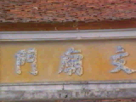
HOMEWORK
Learn by heart the lesson.
Give more examples with present simple.
Do exercises in Work book, unit 1.
Prepare Unit 1-Lesson 4-Communication.
+

