Slide 1

PERIOD 2-UNIT 1-MY NEW SCHOOL-
LESSON 1-GETTING STARTED

Slide 2
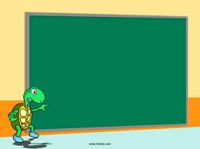


LESSON 1:
A special day

Slide 3


Listen and read.
A special day
(Loud knock)
Phong: Hi, Vy.
Vy: Hi, Phong. Are you ready?
Phong: Just a minute.
Vy: Oh, this is Duy, my new friend.
Phong: Hi, Duy. Nice to meet you.
Duy: Hi, Phong. I live near here, and we go to the same school!
Phong: Good. Hmm, your school bag looks heavy.
Duy: Yes! I have new books, and we have new subjects to study.
Phong: And a new uniform, Duy! You look smart!
Duy: Thanks, Phong. We always look smart in our uniforms.
Phong: Let me put on my uniform. Then we can go.

Slide 4


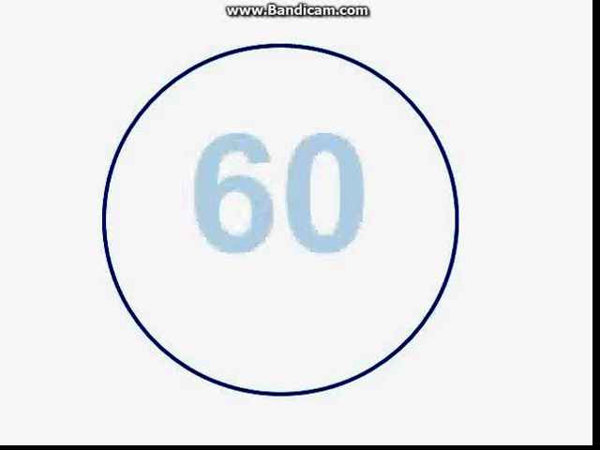
Read the conversation again and tick () T (True) or F (False).
 |  | T | F
1. | Vy, Phong, and Duy go to the same school.
2. | Duy is Phong’s friend.
3. | Phong says Duy looks smart in his uniform.
4. | They have new subjects to study
5. | Phong is wearing a school uniform.
✓
✓
✓
✓
✓
(9) Phong: And a new uniform, Duy! You look smart!
What do they do next?
=> They ………………………
(8) Duy: Yes! I have new books, and we have new subjects to study.
(11) Phong: Let me put on my uniform. Then we can go.
(4) Vy: Oh, this is Duy, my new friend.
(6) Duy: Hi, Phong. I live near here, and we go to the same school!
go to school

Slide 5

Write ONE word from the box in each gap.
go
subjects
has
wear
uniforms
wear
1. Students ______ their uniforms on Monday.
2. Vy ____ a new friend, Duy.
has
go
3.- Do Phong, Vy, and Duy ___ to the same school?
- Yes, they do.
4. Students always look smart in their__________.
uniforms
subjects
5.- What _______ do you like to study?
- I like to study English and history.

Slide 6

Match the words with the school things.
(a) pencil sharpener
4
(b)compass
1
(c) school bag
5
(d)calculator
2
(e) rubber
3
(f)pencil case
6

Slide 7

Look around the class. Write the names of the things you see in your notebook.
Book,
Notebook,
pen
Pencil,
board

Slide 8


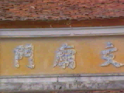
HOMEWORK
- Practice the conversation
- Learn by heart vocabulary “school things”.
- Do exercise 5 in your books. Look around your studying corner. Write the names of the things you see in your notebook.
+

