Slide 1
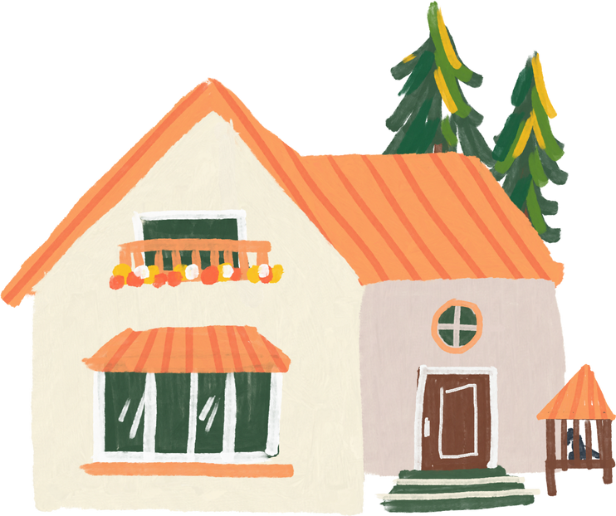
UNIT 2
MY HOUSE
Lesson 2
A closer look 2
School year 2022 - 2023

Slide 2

Objectives
By the end of this lesson, students will be able to:
use the words for rooms and furniture
pronounce the final sounds /s/ and /z/ correctly

Slide 3

01
VOCABULARY
use the words for rooms and furniture

Slide 4

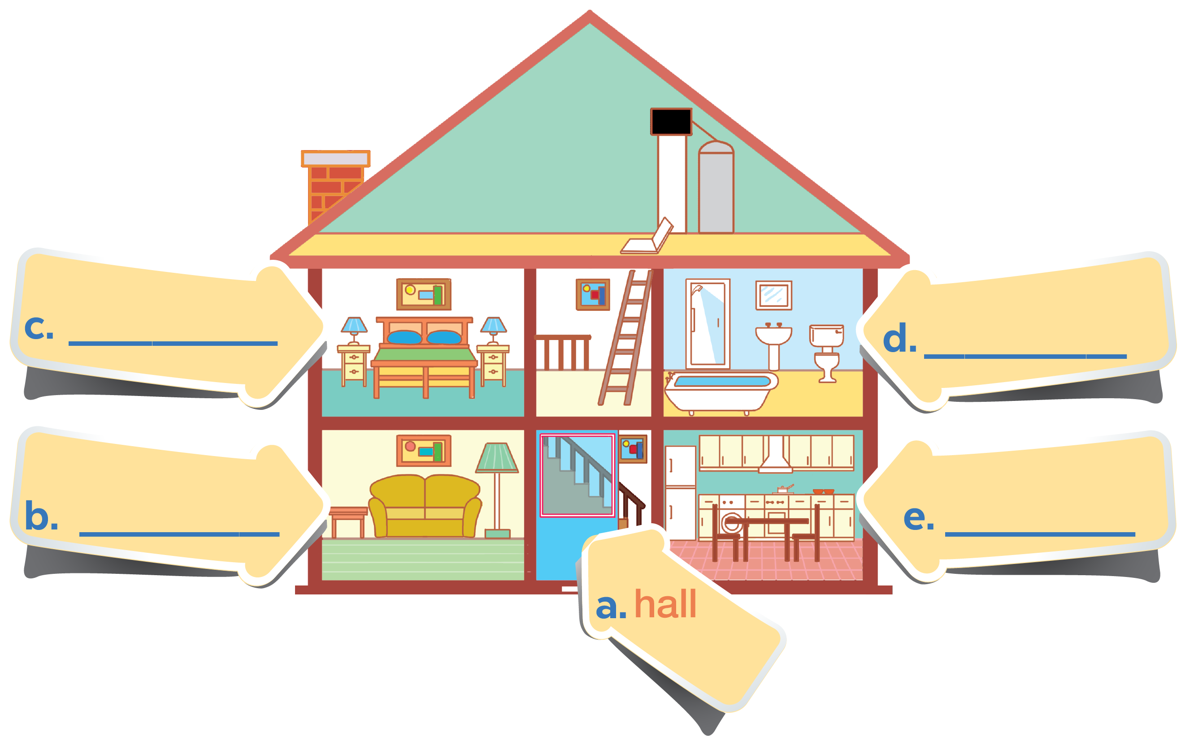
In 3 minutes. Put these things in each room.
(You may use a word more than one)
lamp
picture
chest of drawers
sofa
fridge
cupboard
dishwasher
sink
bath
toilet

Slide 5


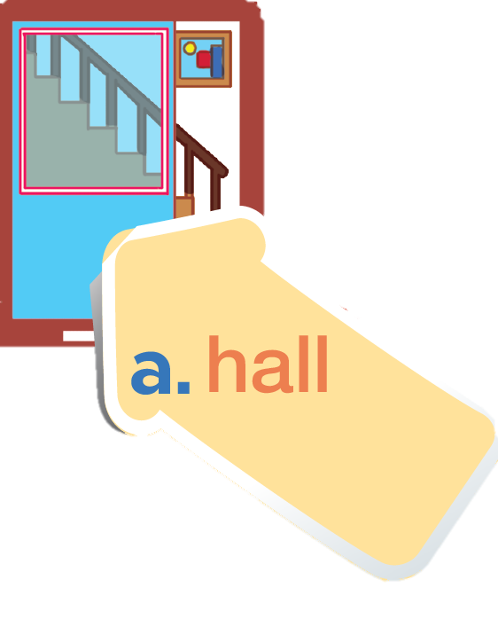

Check your answer
picture

Slide 6

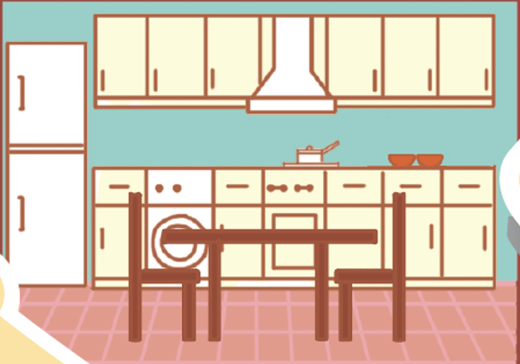
dishwasher
fridge
cupboard
kitchen

Slide 7
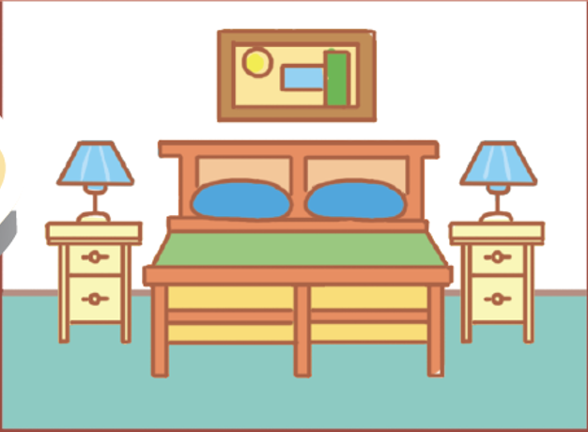
picture
lamp
chest
of drawers
bedroom

Slide 8
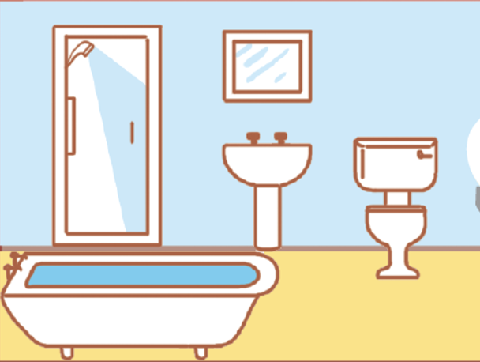
sink
bath
toilet
bathroom

Slide 9
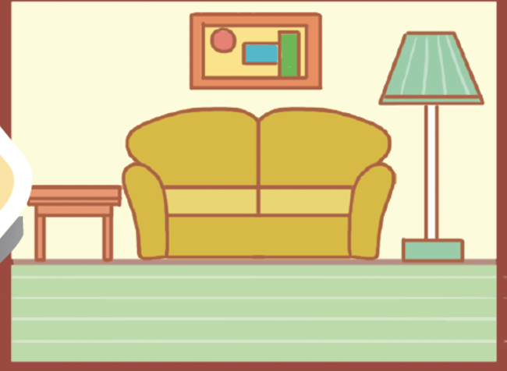
picture
sofa
lamp
living room

Slide 10
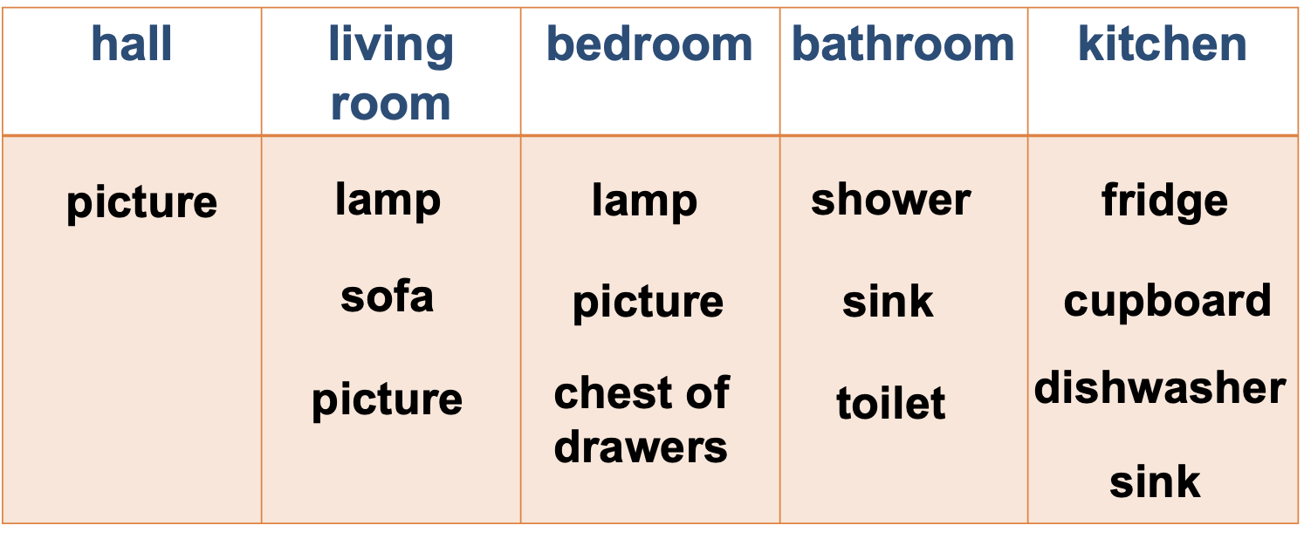
Check your answer
hall | kitchen | bedroom | bathroom | living room
picture
fridge
picture
sink
sofa
dishwasher
chest of drawers
bath
picture
cupboard
lamp
toilet
lamp

Slide 11
In groups, add more things for each room
hall | kitchen | bedroom | bathroom | living room
picture
fridge
picture
sink
sofa
dishwasher
chest of drawers
bath
picture
cupboard
lamp
toilet
lamp

Slide 12

02
PRONUNCIATION
pronounce the final sounds /s/ and /z/ correctly

Slide 13
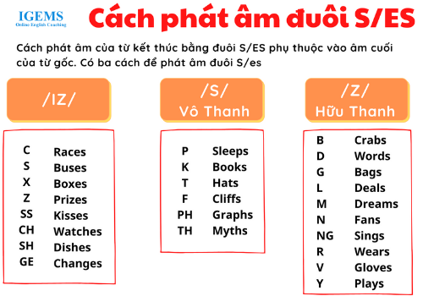

Slide 14


Ex 4. Listen and repeat the words.
Pay attention to the final -s sounds.
lamps
cupboards
sinks
sofas
flats
kitchens
toilets
rooms

