Slide 1

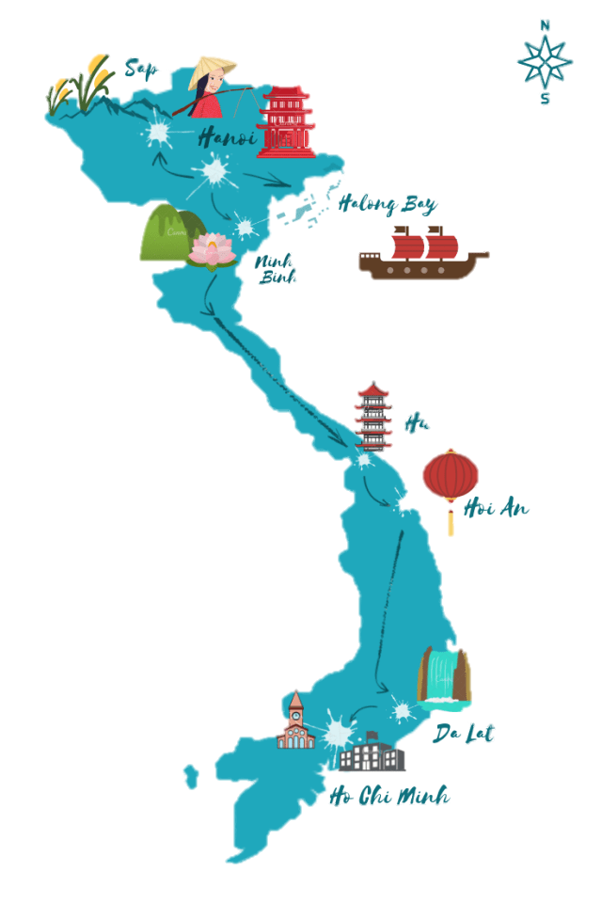

Unit 5
NATURAL WONDERS OF VIETNAM

Slide 2

Table of contents
01
Lesson 1
03
Lesson 3
05
Lesson 5
02
Lesson 2
Getting Started
A Closer Look 1
A Closer Look 2
04
Lesson 4
Skills 1
Skills 2
Communication
Looking Back

Slide 3


Skills 1
Lesson 3:

Slide 4
WARM-UP
VIDEO WATCHING
Link video:
Mui Ne: https://youtu.be/kTOtS_q0CIY?si=MlsTf56qurqdW88N
Ha Long Bay: https://youtu.be/SpOWgms2uto?si=eyQ2YKriSw4MR_Bl

Slide 5
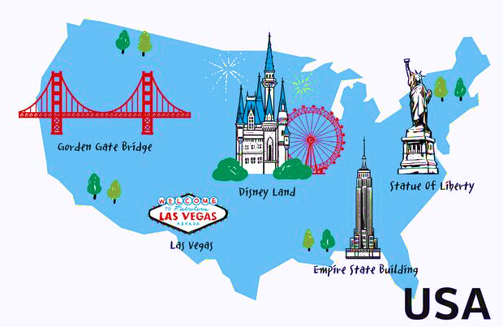

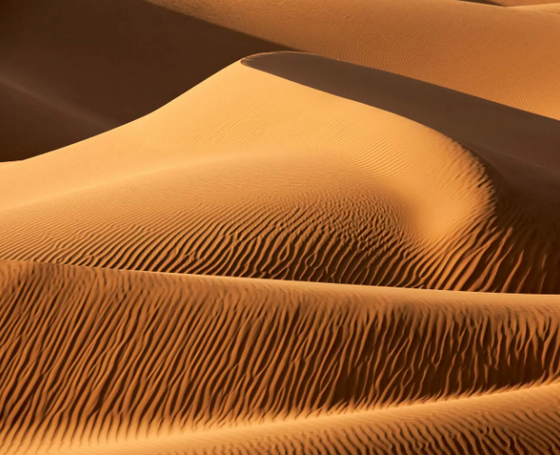
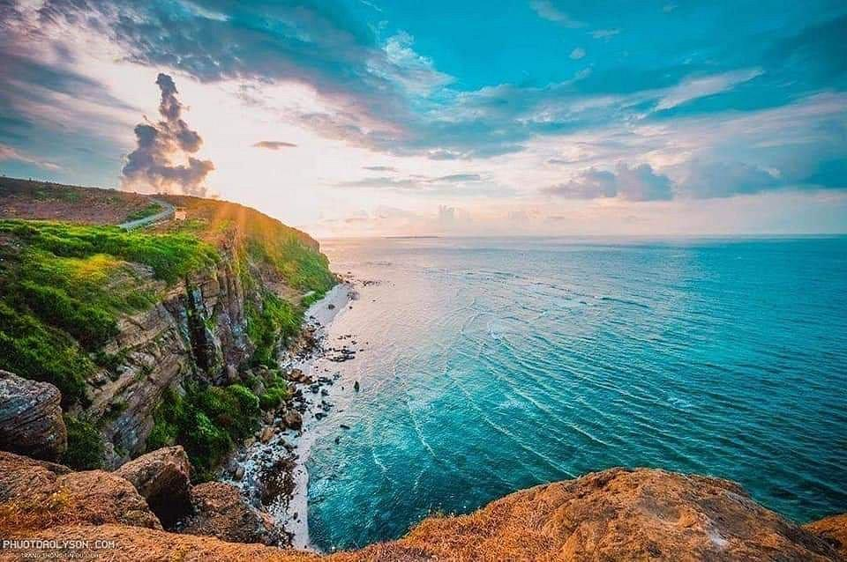
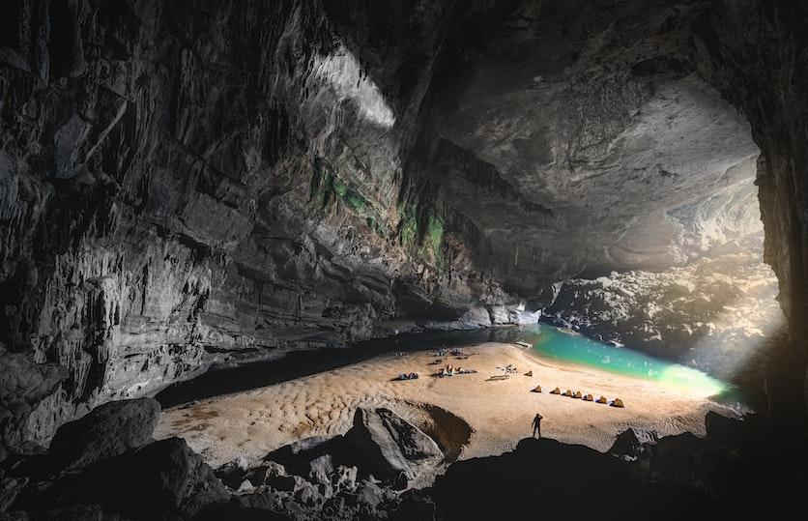
Vocabulary
attraction
/əˈtræk.ʃən/
sand dune
/ˈsænd ˌdjuːn/
landscape
/ˈlænd.skeɪp/
cave
/keɪv/

Slide 6
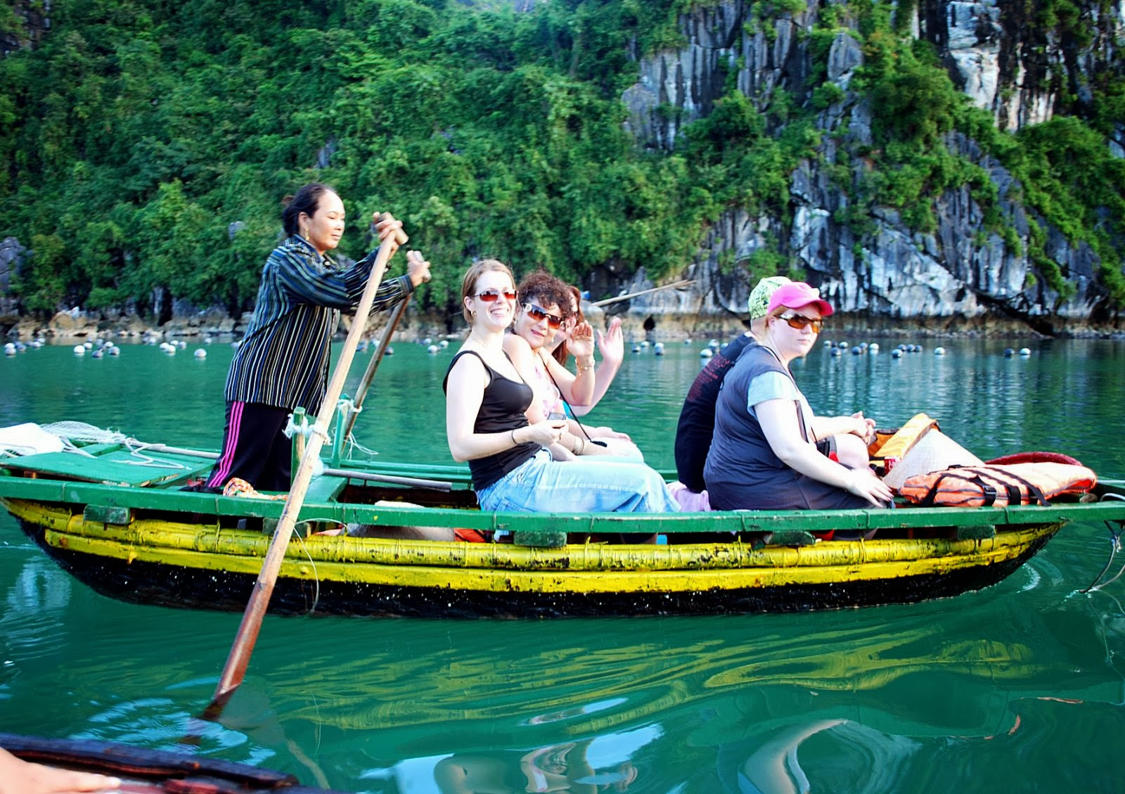


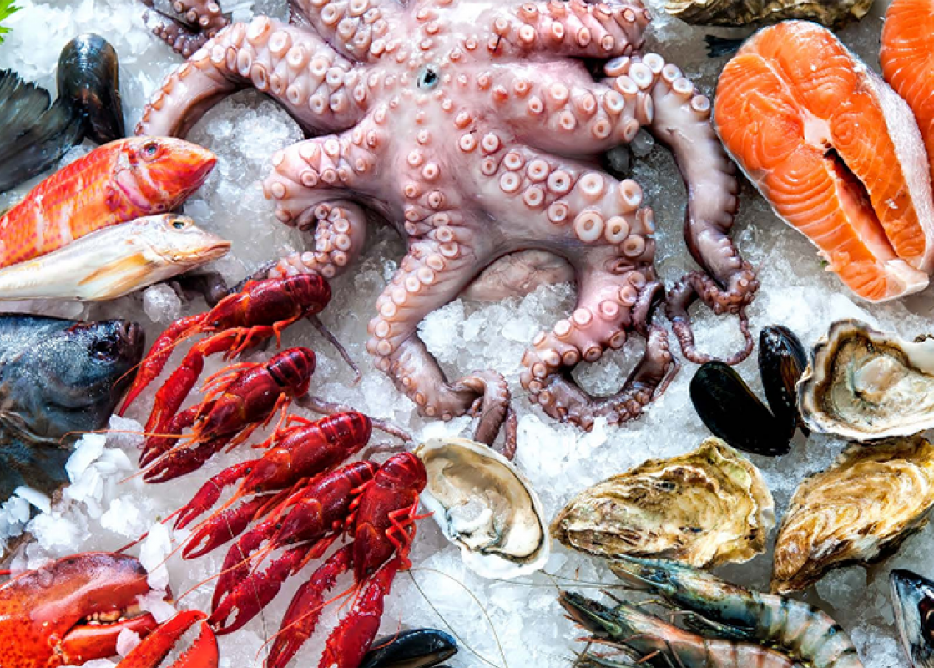
Vocabulary
tourist
/ˈtʊə.rɪst/
popular
/ˈpɒp.jə.lər/
slope
/sləʊp/
seafood
/ˈsiː.fuːd/

Slide 7
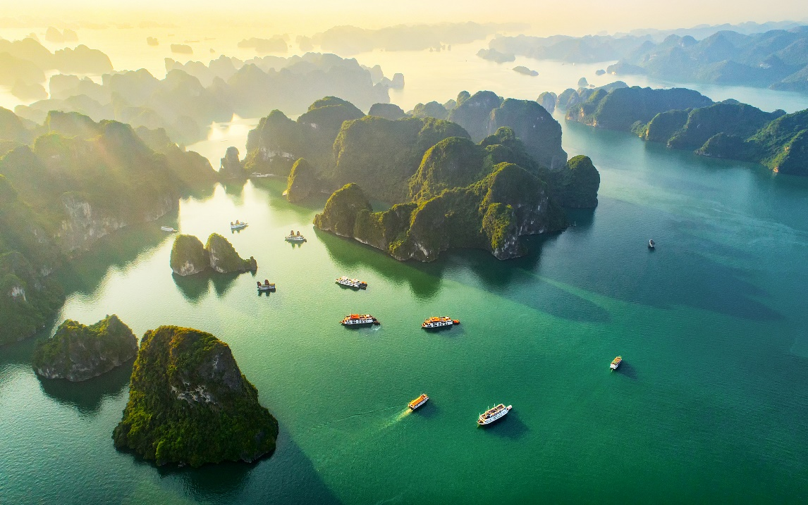
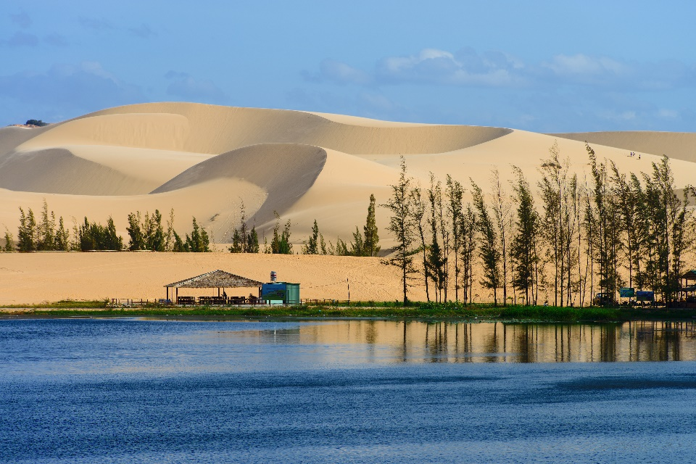
Before you read, look at the pictures below.
Make predictions about the reading. Then read and check your ideas.
1.
1.
What is the reading about?
2.
What do you know about these places?

Slide 8

Ha Long Bay is in Quang Ninh. It has many islands and caves. Tuan Chau, with its beautiful beaches, is a popular tourist attraction in Ha Long Bay. There you can enjoy great seafood. And you can join in exciting activities. Ha Long Bay is Viet Nam’s best natural wonder.
Mui Ne is popular for its amazing landscapes. The sand has different colours: white, yellow, red ... It’s like a desert here. You can ride a bike down the slopes. You can also fly kites, or have a picnic by the beach. The best time to visit the Mui Ne Sand Dunes is early morning or late afternoon. Remember to wear suncream and bring water.

Slide 9
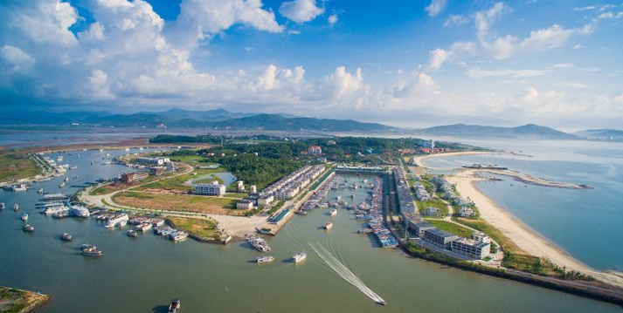
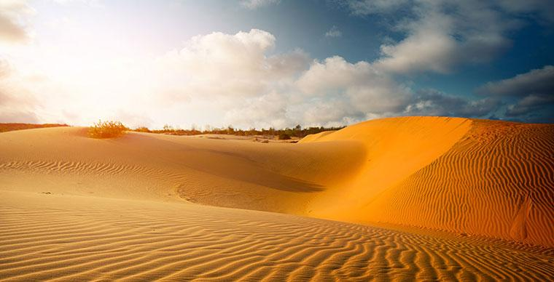
Before you read, look at the pictures below.
Make predictions about the reading. Then read and check your ideas.
1.
Note:
- Tuan Chau: a large island in Ha Long Bay, a popular tourist destination
- Mui Ne: a tourist attraction in Binh Thuan Province

Slide 10
Complete the sentences, using the words from the box.
2.
desert
visit
wonder
islands
remember
islands
1.
Ha Long Bay is the famous for its beautiful .
Ha long Bay is the number one natural in Viet Nam.
2.
wonder
A is a large area of land with very little water.
3.
desert
4.
Remember
to bring an umbrella, as it often rains there.
5.
A lot of people Ly Son Island in the summer.
visit

Slide 11
Read the text again. Answer the following questions.
3.
1.
Where is Ha Long Bay?
2.
What can you do at Ha Long Bay?
3.
Is there a desert in Mui Ne?
4.
Where can you have a picnic in Mui Ne?
5.
What is the best time to visit the Mui Ne Sand Dunes?

Slide 12
READING
1.
Where is Ha Long Bay?
It is in Quang Ninh.
Ha Long Bay is in Quang Ninh. It has many islands and caves.

Slide 13
READING
2.
What can you do at Ha Long Bay?
We can enjoy (great) seafood and join in exciting activities.
There you can enjoy great seafood. And you can join in exciting activities. Ha Long Bay is Viet Nam’s best natural wonder.

Slide 14
READING
3.
Is there a desert in Mui Ne?
No, there isn’t.
Mui Ne is popular for its amazing landscapes. The sand has different colours: white, yellow, red ... It’s like a desert here. You can ride a bike down the slopes.

Slide 15
READING
4.
Where can you have a picnic in Mui Ne?
By the beach.
You can also fly kites, or have a picnic by the beach. The best time to visit the Mui Ne Sand Dunes is early morning or late afternoon. Remember to wear sun cream and bring water.

Slide 16
READING
5.
What is the best time to visit the Mui Ne Sand Dunes?
Early morning or late afternoon.
You can also fly kites, or have a picnic by the beach. The best time to visit the Mui Ne Sand Dunes is early morning or late afternoon. Remember to wear sun cream and bring water.

Slide 17
Read the text again. Answer the following questions.
3.
1.
Where is Ha Long Bay?
It is in Quang Ninh.
2.
What can you do at Ha Long Bay?
We can enjoy (great) seafood and join in exciting activities.
3.
Is there a desert in Mui Ne?
No, there isn’t.
4.
Where can you have a picnic in Mui Ne?
By the beach.
5.
What is the best time to visit the Mui Ne Sand Dunes?
Early morning or late afternoon.

Slide 18

Work with teacher. Make notes about one of the places in the reading. You can add your own ideas.
4.
Ha Long Bay | Mui Ne
interesting islands
a beautiful place
Then tell your partner about the place.
Example:
Ha Long Bay has a lot of interesting islands. It …

Slide 19

Some foreign visitors are visiting your city / town / area. You are their tour guide.
Tell them some interesting things about the place as well as what they must and mustn’t do there.
5.
Example:
You must follow all the rules.
You mustn’t take photos when you are in the City Museum.

Slide 20

See you later!

