Slide 1

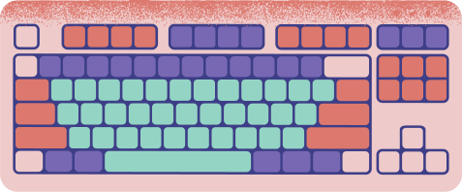








UNIT 10: OUR HOUSES IN THE FUTURE
A CLOSER LOOK 2
Teacher: Luong Thi Phuong Thao

Slide 2

WARM-UP

Slide 3
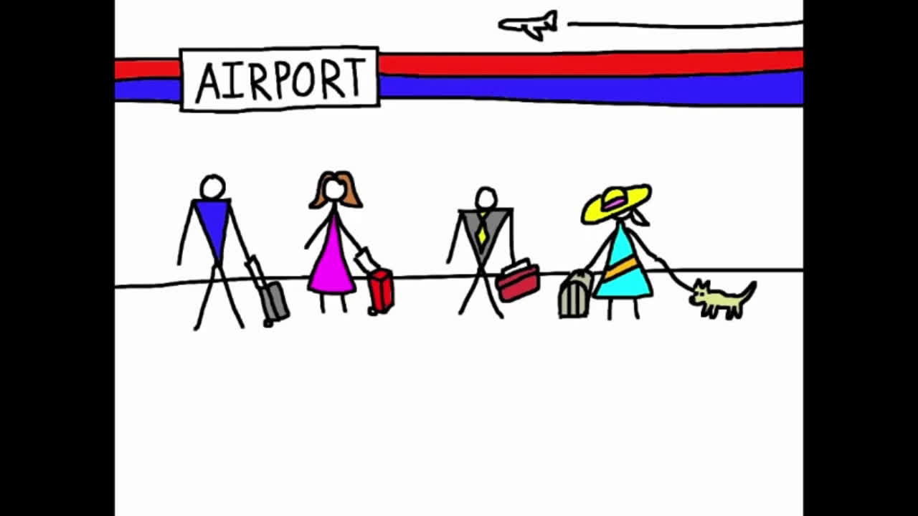

Slide 4


I will fly.
And you will fly too.
He will fly in business class.
She will fly in first class.
It will fly below a seat.
We will fly over the sea.
You will fly.
And they will fly too.
We will fly.
What is similar among these sentences?

Slide 5
I will fly.
And you will fly too.
He will fly in business class.
She will fly in first class.
It will fly below a seat.
We will fly over the sea.
You will fly.
And they will fly too.
We will fly.

Slide 6
GRAMMAR
THE FUTURE SIMPLE

Slide 7
THE FUTURE SIMPLE
USE
We use the future simple tense to talk about an action that happens in the future
FORM
Positive, Negative, Question

Slide 8

THE FUTURE SIMPLE
Positive
My father will travel to the Moon in a supercar in the future.
We’ll live in that cottage in the future. (’ll is the short form of will.)
S + will + V
(S: I / We / You / They / He / She / It/ Singular noun/ Plural noun)

Slide 9
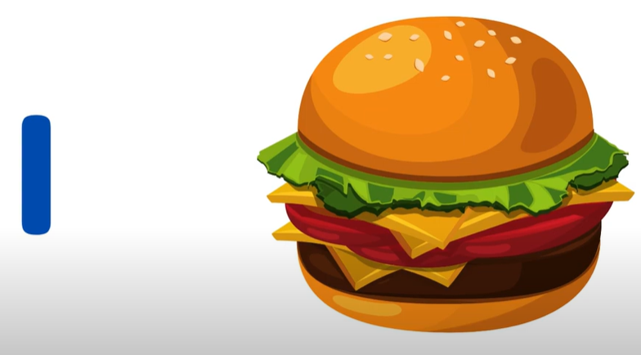
THE FUTURE SIMPLE
Positive
S + will + V
(S: I / We / You / They / He / She / It/ Singular noun/ Plural noun)
have

Slide 10
THE FUTURE SIMPLE
Positive
S + will + V
(S: I / We / You / They / He / She / It/ Singular noun/ Plural noun)
I will have a hamburger.
have

Slide 11
THE FUTURE SIMPLE
Negative
We won’t live in that cottage in the future.
(won’t is the short form of will not.)
S + will not (won‘t) + V
(S: I / We / You / They / He / She / It/ Singular noun/ Plural noun)

Slide 12
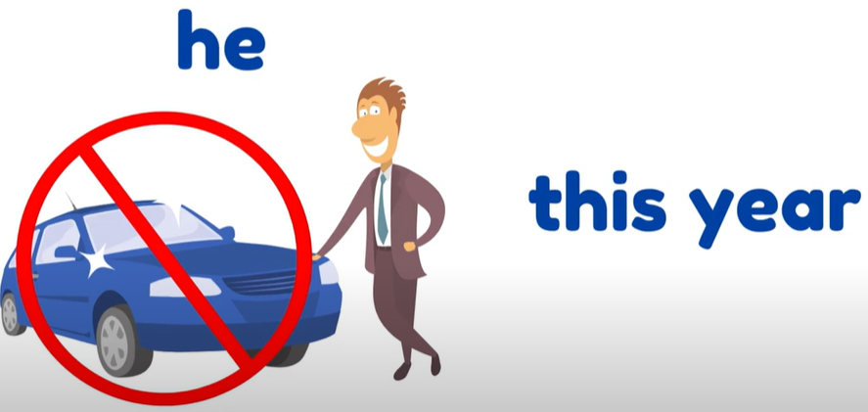
THE FUTURE SIMPLE
Negative
S + will not (won‘t) + V
(S: I / We / You / They / He / She / It/ Singular noun/ Plural noun)
buy

Slide 13
THE FUTURE SIMPLE
Negative
S + will not (won‘t) + V
(S: I / We / You / They / He / She / It/ Singular noun/ Plural noun)
buy
He won’t buy a car this year.

Slide 14
THE FUTURE SIMPLE
Questions (Yes/No) and short answers
Will they live on the Moon?
Yes, they will.
No, they won’t.
Will + S+ V?
Yes, S will./ No, S won‘t.

Slide 15

THE FUTURE SIMPLE
Will + S+ V?
Yes, S will./ No, S won‘t.
travel

Slide 16
THE FUTURE SIMPLE
Will + S+ V?
Yes, S will./ No, S won‘t.
Will we travel this summer?
travel

Slide 17
THE FUTURE SIMPLE
Wh-questions
What will you do tomorrow?
I will go to the cinema.
Wh-words (What/ When/ Where/ Who/ How) + will + S + V?
→ S will ….

Slide 18
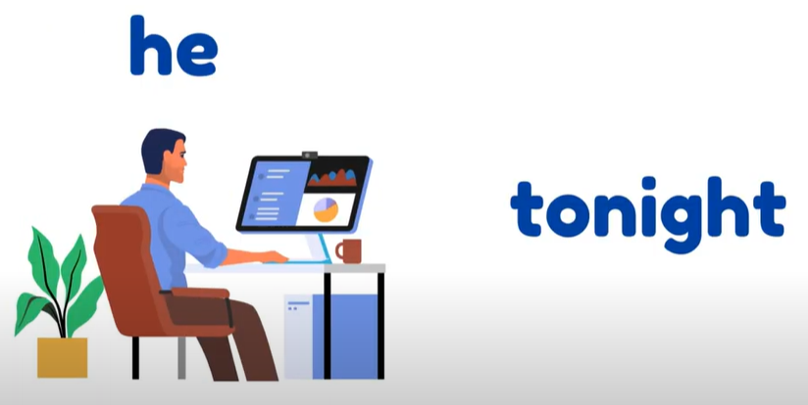

THE FUTURE SIMPLE
Wh-questions
Wh-words (What/ When/ Where/ Who/ How) + will + S + V?
→ S will ….
Where
work

Slide 19
THE FUTURE SIMPLE
Wh-questions
Wh-words (What/ When/ Where/ Who/ How) + will + S + V?
→ S will ….
Where
work
Where will you work tonight?

Slide 20
THE FUTURE SIMPLE
Positive | S will V (sẽ làm gì) | My father will travel to the Moon in a supercar in the future.
Negative | S will not (won’t) V (sẽ không làm gì) | We won’t live in that cottage in the future.
Question | Will + S + V? Yes, S will./ No, S won’t. Wh-words + will + S + V? S will V .... | Will they live on the Moon? Yes, they will. No, they won’t. What will you do tomorrow? I will go to the cinema.

Slide 21

practice

Slide 22

Fill the blanks with will ('ll) or won’t to make the sentences true for you.
Example: I think I’ll listen to music in the afternoon.
I think I _______ stay at home tonight.
My friends _______ go to the library this afternoon.
My mum _______ make a cake today.
I _______ have an English test tomorrow.
Our family _______ move to the new house next week.

Slide 23

Complete the conversation with will ('ll) or won’t.
A: Oh, no. The dog ran away again!
B: Don’t worry – he (1)________ come back.
A: Are you sure he (2) ______?
B: OK, he might not come back today. But I’m sure he (3) ______ come back tomorrow.
A: I don’t believe you! He (4) _______ come back. We (5) ______ never see him again. I’m sure.
B: Oh, look ... Here he is!

Slide 24
Complete the conversation with will ('ll) or won’t.
A: Oh, no. The dog ran away again!
B: Don’t worry – he (1)________ come back.
A: Are you sure he (2) ______?
B: OK, he might not come back today. But I’m sure he (3) ______ come back tomorrow.
A: I don’t believe you! He (4) _______ come back. We (5) ______ never see him again. I’m sure.
B: Oh, look ... Here he is!
will/ ‘ll
will
will/ ‘ll
won’t
will/ ‘ll

Slide 25

Write sentences, using will ('ll) or won't and the words given.
1. computer / do / housework
-->
2. robot / water / ﬂowers
-->
3. smart TV / cook / meals
-->
4. washing machine / iron / clothes
-->
5. smartphone / take care / children
-->

Slide 26
Write sentences, using will ('ll) or won't and the words given.
1. computer / do / housework
-->
2. robot / water / ﬂowers
-->
3. smart TV / cook / meals
-->
4. washing machine / iron / clothes
-->
5. smartphone / take care / children
-->
A computer will / won’t help me to do my housework.
A robot will help me to water the flowers.
A smart TV won’t help me to cook meals.
A washing machine will / won’t help me to iron the clothes.
A smartphone won’t help me to take care of the children.

Slide 27

GRAMMAR
might for future possibility

Slide 28
might for future possibility
USE
We use might + V to talk about actions that are possible in the future - we are not sure if the actions will happen or not
FORM
Positive, Negative

Slide 29
might for future possibility
Positive
We might live in a UFO.
S + might + V
(S: I / We / You / They / He / She / It/ Singular noun/ Plural noun)

Slide 30
might for future possibility
Negative
They might not travel in cars.
S + might not + V
(S: I / We / You / They / He / She / It/ Singular noun/ Plural noun)

Slide 31
might for future possibility
Positive | S might V (có thể sẽ) | We might live in a UFO.
Negative | S might not V (có thể sẽ không) | They might not travel in cars.

Slide 32


practice

Slide 33

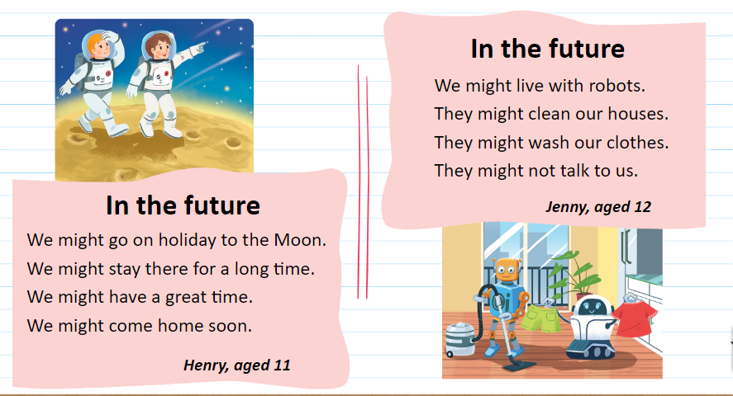
Read the two poems.

Slide 34
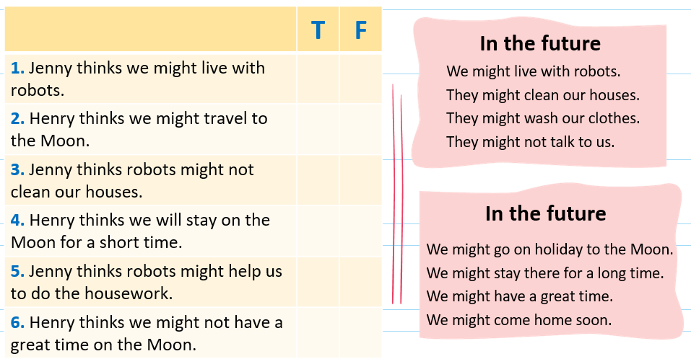
Read the two poems. Tick (✓) T (True) or F (False).

Slide 35

Read the two poems. Tick (✓) T or F..

Slide 36

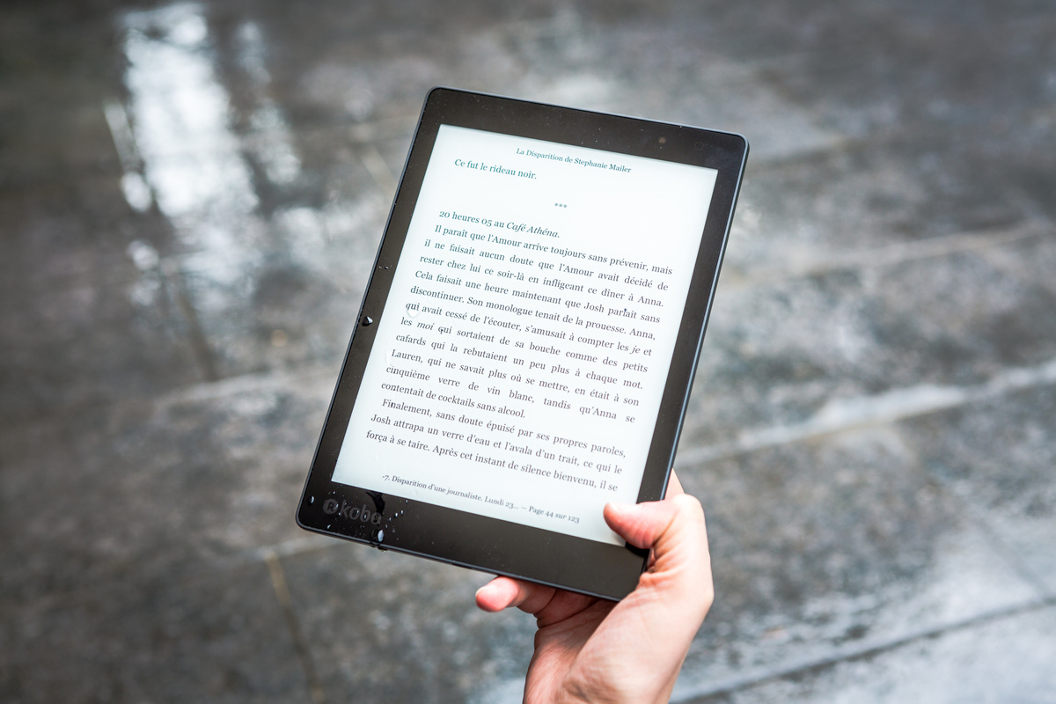
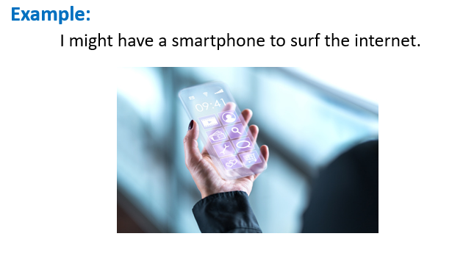

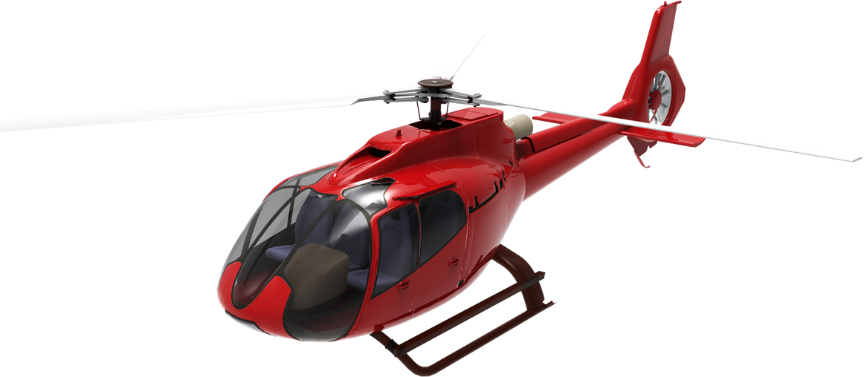

Work in groups. Think about what you might do or have in the future. Share your ideas with the class.

Slide 37

Work in pairs.
Do the worksheet in 3 minutes.

Slide 38
GAME
Notes:
https://www.baamboozle.com/game/2216059

Slide 39

wrap-up
Future simple tense
Might for future possibility
S will V (‘ll)
S will not V (won’t)
Will + S + V?
Not sure => might
S might V
S might not V

Slide 40
Thank you!
See you next time

