Slide 1


Unit 9: Cities of the world

Slide 2


Lesson 3
Skills 1

Slide 3
Unit 9 – Skills 1
01
Warm-up
Game: Let’s guess
Reading
02
Exercise 1,2,3
Speaking
03
Exercise 4,5
04
Wrap-up

Slide 4
Warm-up
Let’s guess
- Look at the blurred picture.
- Guess the name of the city.

Slide 5

What city is it?

Slide 6
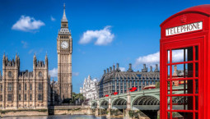
London

Slide 7

What city is it?

Slide 8
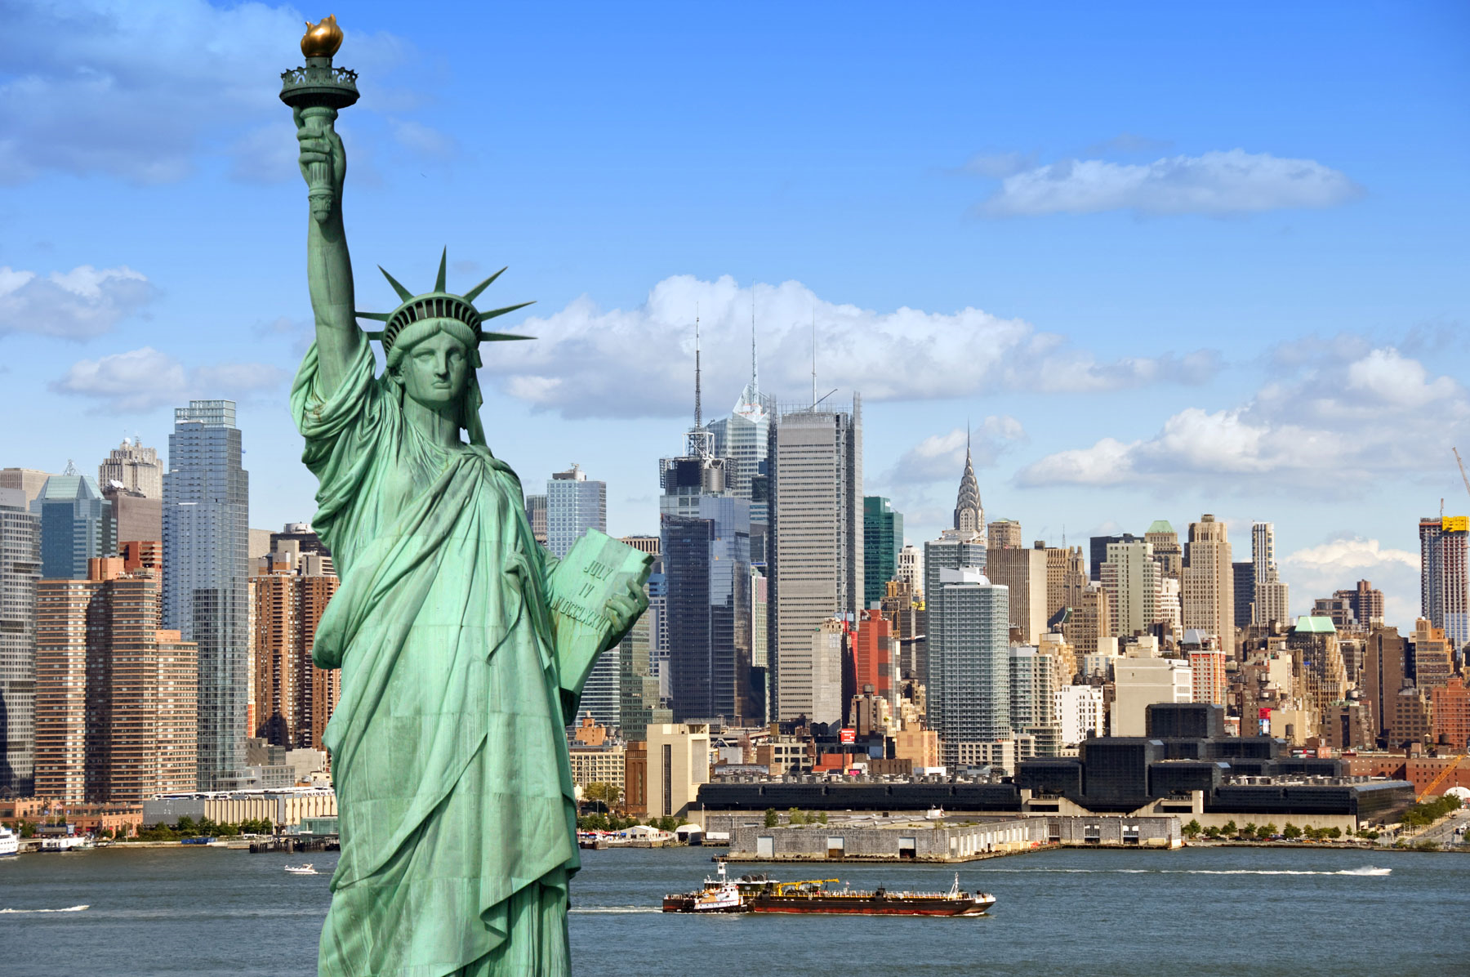
New York

Slide 9

What city is it?

Slide 10
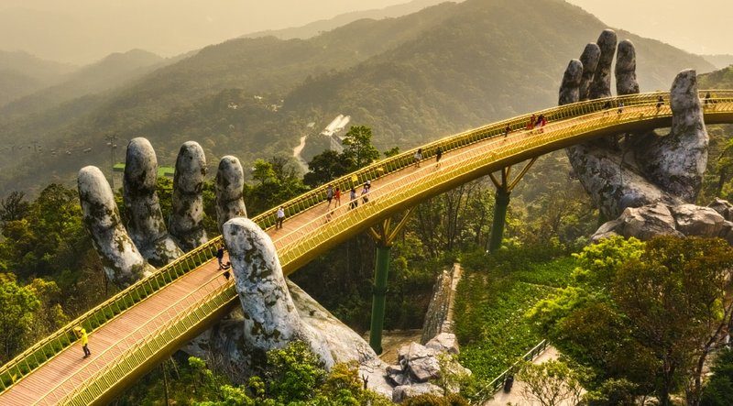
Da Nang

Slide 11

What city is it?

Slide 12
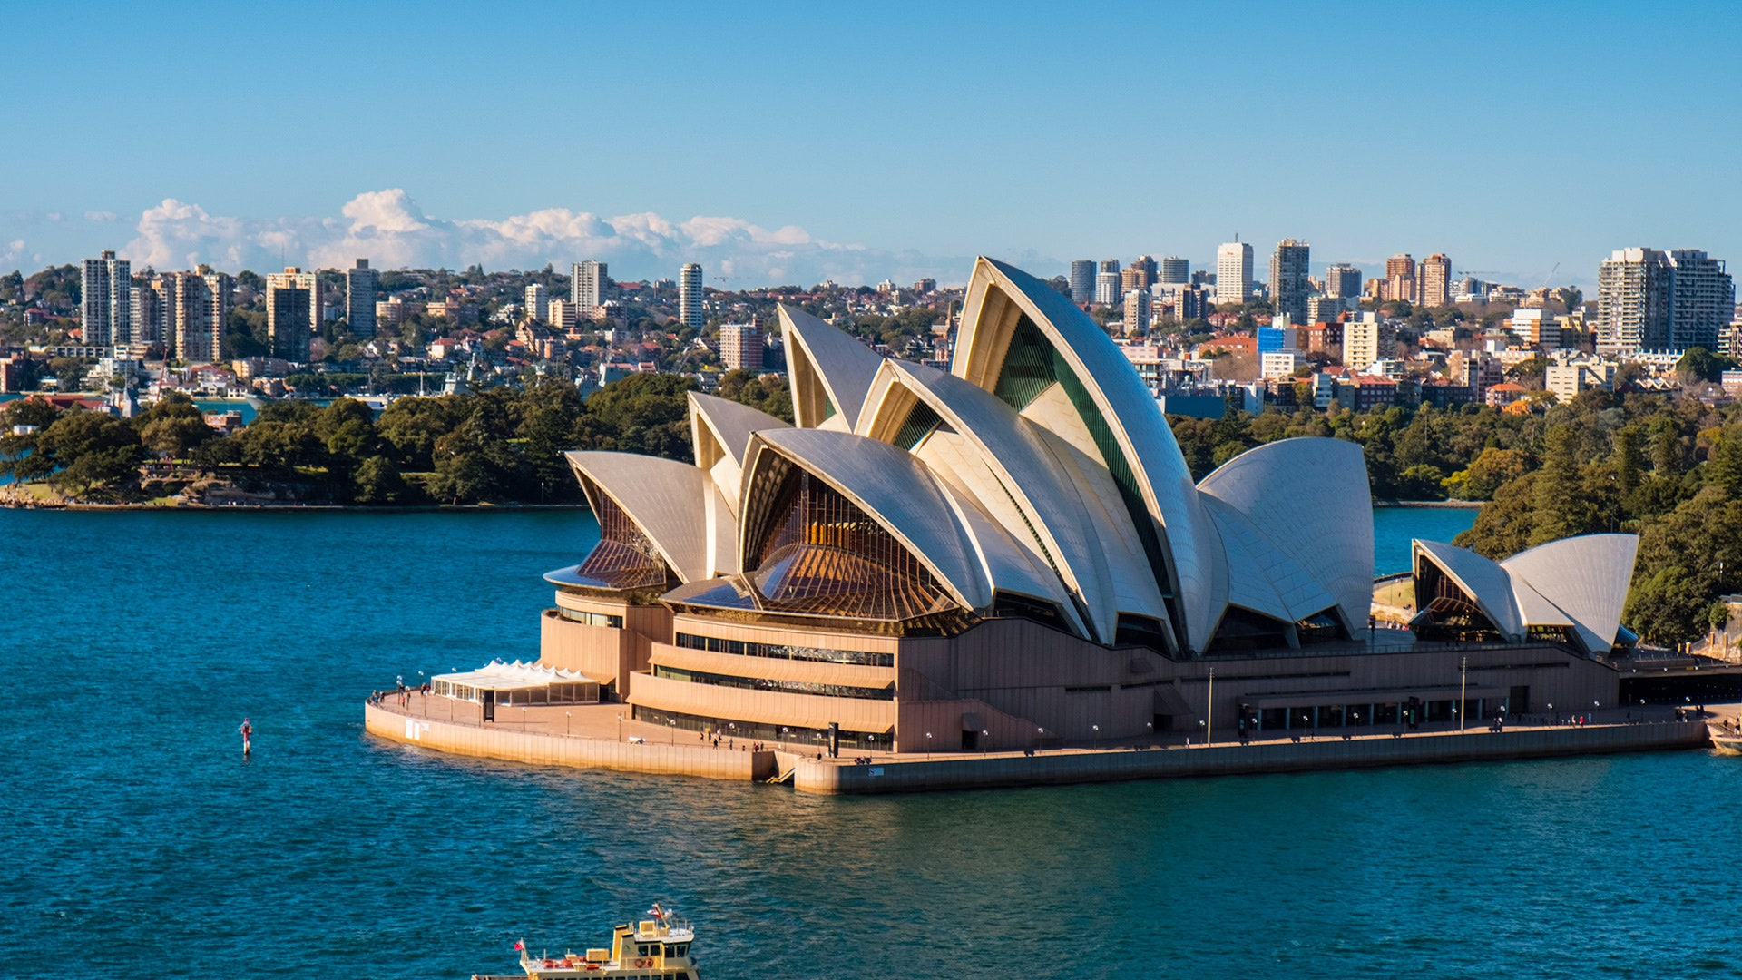
Sydney

Slide 13
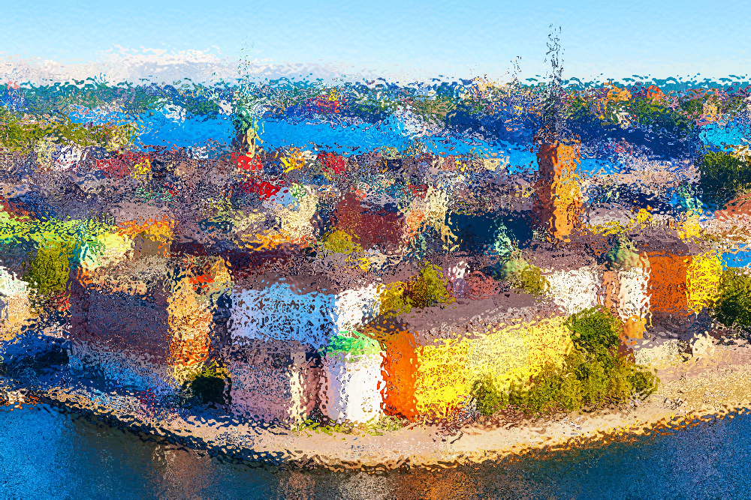
What city is it?

Slide 14

Stockholm

Slide 15
Reading

Slide 16
Discussion

Slide 17
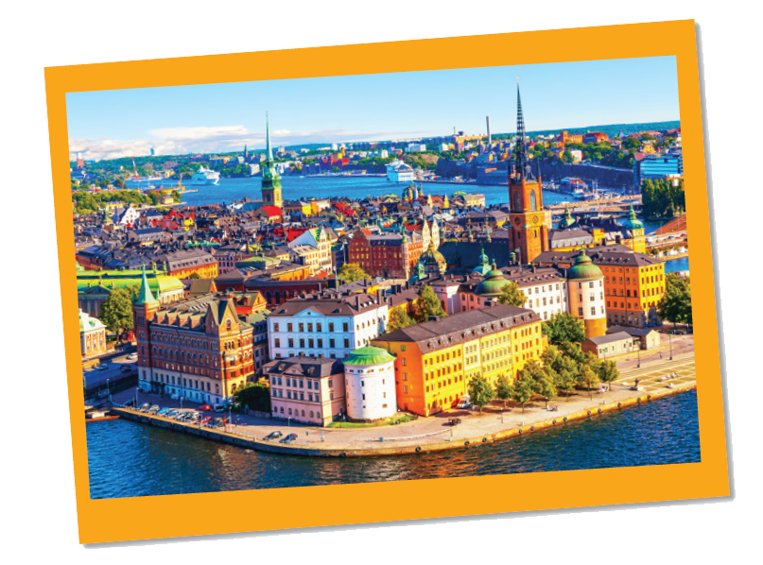
1
Look at the postcard and discuss.
Reading
Love from Sweden

Slide 18
Work in groups of 4
Time: 2 minutes
Discuss 2 questions
1.
When do people write a postcard?
2.
What do they often write on a postcard?

Slide 19
Vocabulary

Slide 20


Another way to say “Great”
fantastic
/fænˈtæs.tɪk/

Slide 21
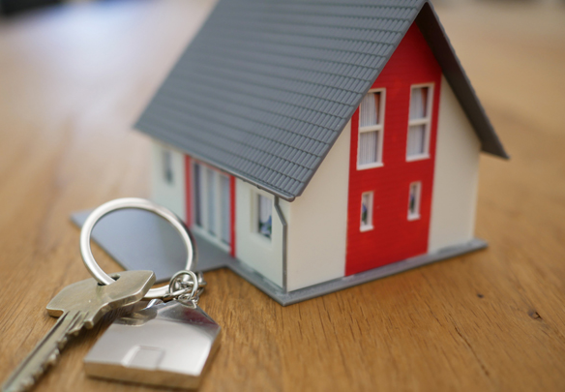

Vocabulary
rent
/rent/
pay money to use something

Slide 22
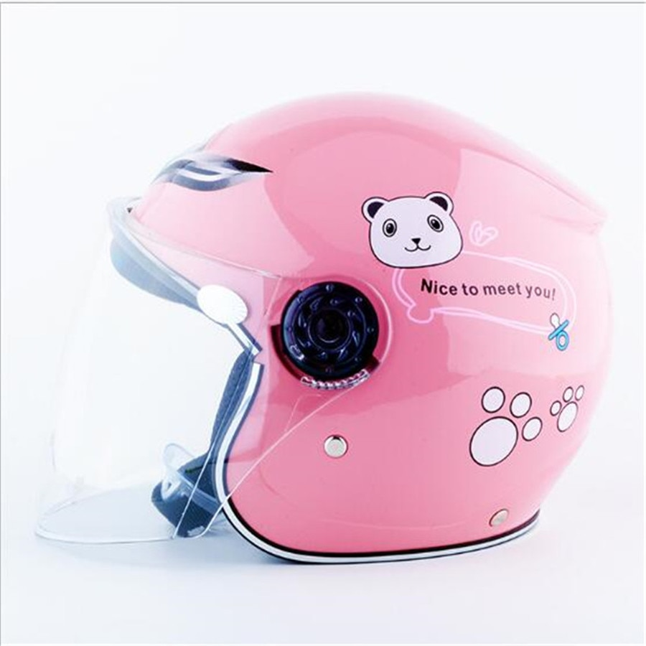
Vocabulary
helmet
/ˈhelmɪt/

Slide 23
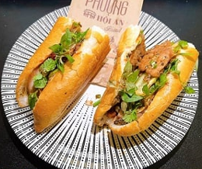
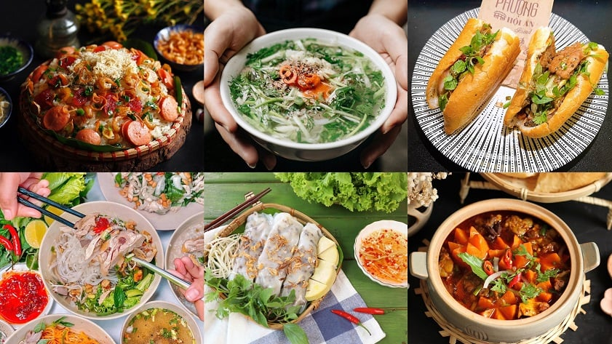
Vocabulary
traditional
/trəˈdɪʃənl/

Slide 24
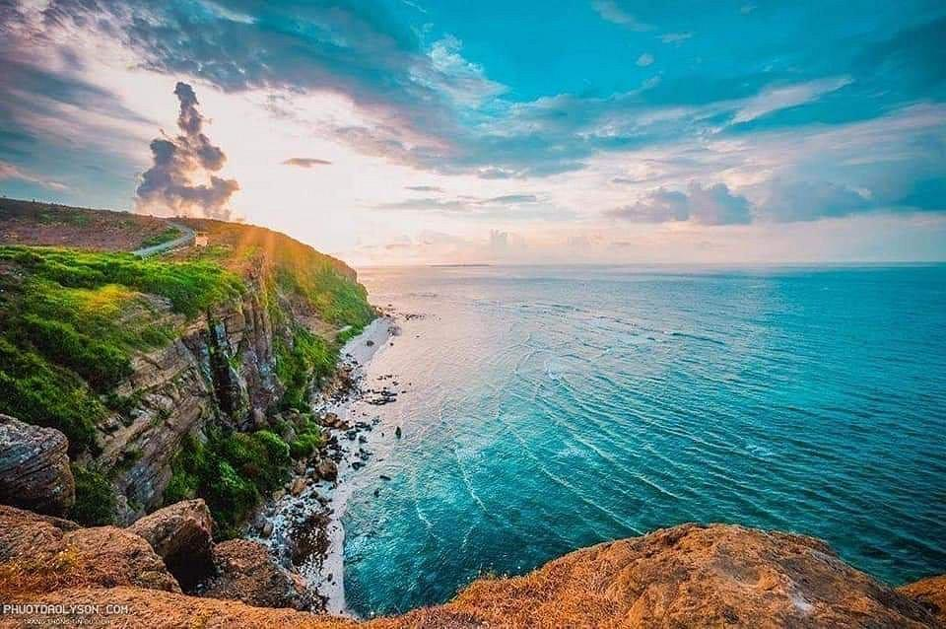
Vocabulary
landscape
/ˈlænd.skeɪp/

Slide 25
Vocabulary
fantastic (adj) | /fænˈtæs.tɪk/ | tuyệt vời
rent (v) | /rent/ | thuê
helmet (n) | /ˈhelmɪt/ | mũ bảo hiểm
traditional (adj) | /trəˈdɪʃənl/ | mang tính truyền thống
landscape | /ˈlænd.skeɪp/ | phong cảnh

Slide 26
Exercises

Slide 27
2
Read the postcard and answer the questions.
September 6
To: Grandpa & Grandma
Hoan Kiem, Ha Noi, Viet Nam
Dear Grandpa and Grandma,
Stockholm is fantastic!
Its weather is perfect, sunny all the time! Our hotel is good. It has a swimming pool and a gym. It offers delicious breakfast. Yesterday Mum, Dad and I rented three bikes and cycled to the Old Town. My parents wore their helmets and I wore mine. We visited the Royal Palace first. What a beautiful place! Mum loved it. She said, “Swedish art is amazing.” After that, we had “fika”, a coffee break, in a traditional café. Everything is so wonderful!
Wish you were here!
Love,
Mai

Slide 28
Do the exercise individually in 2 minutes
September 6
1.
This postcard is about in Stockholm.
Dear Grandpa and Grandma,
A.
the weather
B.
a holiday
C.
landscapes
Stockholm is fantastic!
Its weather is perfect, sunny all the time! Our hotel is good. It has a swimming pool and a gym. It offers delicious breakfast. Yesterday Mum, Dad and I rented three bikes and cycled to the Old Town. My parents wore their helmets and I wore mine. We visited the Royal Palace first. What a beautiful place! Mum loved it. She said, “Swedish art is amazing.” After that, we had “fika”, a coffee break, in a traditional café. Everything is so wonderful!
2.
Guests can in the hotel.
A.
exercise
B.
C.
See Swedish art
cycle
3.
Mai and her parents rented bikes to .
A.
B.
visit the old town
cycle around the hotel
C.
go shopping
Wish you were here!
Love,
Mai
4.
“Fika” is a .
A.
traditional café
B.
palace
C.
coffee break
To: Grandpa & Grandma
Hoan Kiem, Ha Noi, Viet Nam

Slide 29
Now, answer the questions.
September 6
1.
This postcard is about in Stockholm.
Dear Grandpa and Grandma,
A.
the weather
B.
a holiday
C.
landscapes
?
Stockholm is fantastic!
Its weather is perfect, sunny all the time! Our hotel is good. It has a swimming pool and a gym. It offers delicious breakfast. Yesterday Mum, Dad and I rented three bikes and cycled to the Old Town. My parents wore their helmets and I wore mine. We visited the Royal Palace first. What a beautiful place! Mum loved it. She said, “Swedish art is amazing.” After that, we had “fika”, a coffee break, in a traditional café. Everything is so wonderful!
2.
Guests can in the hotel.
A.
exercise
B.
C.
See Swedish art
cycle
3.
Mai and her parents rented bikes to .
A.
B.
visit the old town
cycle around the hotel
C.
go shopping
Wish you were here!
Love,
Mai
4.
“Fika” is a .
A.
traditional café
B.
palace
C.
coffee break
To: Grandpa & Grandma
Hoan Kiem, Ha Noi, Viet Nam

Slide 30
Now, answer the questions.
September 6
1.
This postcard is about in Stockholm.
Dear Grandpa and Grandma,
A.
the weather
B.
a holiday
C.
landscapes
?
Stockholm is fantastic!
Its weather is perfect, sunny all the time! Our hotel is good. It has a swimming pool and a gym. It offers delicious breakfast. Yesterday Mum, Dad and I rented three bikes and cycled to the Old Town. My parents wore their helmets and I wore mine. We visited the Royal Palace first. What a beautiful place! Mum loved it. She said, “Swedish art is amazing.” After that, we had “fika”, a coffee break, in a traditional café. Everything is so wonderful!
2.
Guests can in the hotel.
A.
exercise
B.
C.
See Swedish art
?
cycle
3.
Mai and her parents rented bikes to .
A.
B.
visit the old town
cycle around the hotel
C.
go shopping
Wish you were here!
Love,
Mai
4.
“Fika” is a .
A.
traditional café
B.
palace
C.
coffee break
To: Grandpa & Grandma
Hoan Kiem, Ha Noi, Viet Nam

Slide 31
Now, answer the questions.
September 6
1.
This postcard is about in Stockholm.
Dear Grandpa and Grandma,
A.
the weather
B.
a holiday
C.
landscapes
?
Stockholm is fantastic!
Its weather is perfect, sunny all the time! Our hotel is good. It has a swimming pool and a gym. It offers delicious breakfast. Yesterday Mum, Dad and I rented three bikes and cycled to the Old Town. My parents wore their helmets and I wore mine. We visited the Royal Palace first. What a beautiful place! Mum loved it. She said, “Swedish art is amazing.” After that, we had “fika”, a coffee break, in a traditional café. Everything is so wonderful!
2.
Guests can in the hotel.
A.
exercise
B.
C.
See Swedish art
?
cycle
3.
Mai and her parents rented bikes to .
B.
?
A.
cycle around the hotel
visit the old town
C.
go shopping
Wish you were here!
Love,
Mai
4.
“Fika” is a .
A.
traditional café
B.
palace
C.
coffee break
To: Grandpa & Grandma
Hoan Kiem, Ha Noi, Viet Nam

Slide 32
Now, answer the questions.
September 6
1.
This postcard is about in Stockholm.
Dear Grandpa and Grandma,
A.
the weather
B.
a holiday
C.
landscapes
?
Stockholm is fantastic!
Its weather is perfect, sunny all the time! Our hotel is good. It has a swimming pool and a gym. It offers delicious breakfast. Yesterday Mum, Dad and I rented three bikes and cycled to the Old Town. My parents wore their helmets and I wore mine. We visited the Royal Palace first. What a beautiful place! Mum loved it. She said, “Swedish art is amazing.” After that, we had “fika”, a coffee break, in a traditional café. Everything is so wonderful!
2.
Guests can in the hotel.
A.
exercise
B.
C.
See Swedish art
?
cycle
3.
Mai and her parents rented bikes to .
B.
?
A.
cycle around the hotel
visit the old town
C.
go shopping
Wish you were here!
Love,
Mai
4.
“Fika” is a .
A.
traditional café
B.
palace
C.
coffee break
?
To: Grandpa & Grandma
Hoan Kiem, Ha Noi, Viet Nam

Slide 33

SUGGEST
September 6
Dear Grandpa and Grandma,
Stockholm is fantastic!
Its weather is perfect, sunny all the time! Our hotel is good. It has a swimming pool and a gym. It offers delicious breakfast. Yesterday Mum, Dad and I rented three bikes and cycled to the Old Town. My parents wore their helmets and I wore mine. We visited the Royal Palace first. What a beautiful place! Mum loved it. She said, “Swedish art is amazing.” After that, we had “fika”, a coffee break, in a traditional café. Everything is so wonderful!
Wish you were here!
Love,
Mai

Slide 34
SUGGEST
September 6
Dear Grandpa and Grandma,
Stockholm is fantastic!
Its weather is perfect, sunny all the time! Our hotel is good. It has a swimming pool and a gym. It offers delicious breakfast. Yesterday Mum, Dad and I rented three bikes and cycled to the Old Town. My parents wore their helmets and I wore mine. We visited the Royal Palace first. What a beautiful place! Mum loved it. She said, “Swedish art is amazing.” After that, we had “fika”, a coffee break, in a traditional café. Everything is so wonderful!
Wish you were here!
Love,
Mai

Slide 35
SUGGEST
September 6
Dear Grandpa and Grandma,
Stockholm is fantastic!
Its weather is perfect, sunny all the time! Our hotel is good. It has a swimming pool and a gym. It offers delicious breakfast. Yesterday Mum, Dad and I rented three bikes and cycled to the Old Town. My parents wore their helmets and I wore mine. We visited the Royal Palace first. What a beautiful place! Mum loved it. She said, “Swedish art is amazing.” After that, we had “fika”, a coffee break, in a traditional café. Everything is so wonderful!
Wish you were here!
Love,
Mai

Slide 36
SUGGEST
September 6
Dear Grandpa and Grandma,
Stockholm is fantastic!
Its weather is perfect, sunny all the time! Our hotel is good. It has a swimming pool and a gym. It offers delicious breakfast. Yesterday Mum, Dad and I rented three bikes and cycled to the Old Town. My parents wore their helmets and I wore mine. We visited the Royal Palace first. What a beautiful place! Mum loved it. She said, “Swedish art is amazing.” After that, we had “fika”, a coffee break, in a traditional café. Everything is so wonderful!
Wish you were here!
Love,
Mai

Slide 37

Read the postcard and answer the questions.
September 6
Dear Grandpa and Grandma,
To: Grandpa & Grandma
Hoan Kiem, Ha Noi, Viet Nam
Stockholm is fantastic!
Its weather is perfect, sunny all the time! Our hotel is good. It has a swimming pool and a gym. It offers delicious breakfast. Yesterday Mum, Dad and I rented three bikes and cycled to the Old Town. My parents wore their helmets and I wore mine. We visited the Royal Palace f irst. What a beautiful place! Mum loved it. She said, “Swedish art is amazing.” After that, we had “fika”, a coffee break, in a traditional café. Everything is so wonderful!
Wish you were here!
Love,
Mai

Slide 38
3
Read the text and match the places with the things they have.
Work in pairs in 2 minutes.
a.
the Royal Palace
1.
The hotel in Stockholm
b.
delicious breakfast
c.
Swimming pool
2.
The Old Town
d.
‘fika’
e.
Swedish art

Slide 39
b.
delicious breakfast
c.
swimming pool
a.
the Royal Palace
‘fika’
Swedish art
d.
e.
1.
The hotel in Stockholm
?
2.
The Old Town
?
b.
delicious breakfast
a.
the Royal Palace
c.
swimming pool
d.
‘fika’
e.
Swedish art

Slide 40
SUGGEST
September 6
Dear Grandpa and Grandma,
Stockholm is fantastic!
Its weather is perfect, sunny all the time! Our hotel is good. It has a swimming pool and a gym. It offers delicious breakfast. Yesterday Mum, Dad and I rented three bikes and cycled to the Old Town. My parents wore their helmets and I wore mine. We visited the Royal Palace first. What a beautiful place! Mum loved it. She said, “Swedish art is amazing.” After that, we had “fika”, a coffee break, in a traditional café. Everything is so wonderful!
Wish you were here!
Love,
Mai

Slide 41
SUGGEST
September 6
Dear Grandpa and Grandma,
Stockholm is fantastic!
Its weather is perfect, sunny all the time! Our hotel is good. It has a swimming pool and a gym. It offers delicious breakfast. Yesterday Mum, Dad and I rented three bikes and cycled to the Old Town. My parents wore their helmets and I wore mine. We visited the Royal Palace first. What a beautiful place! Mum loved it. She said, “Swedish art is amazing.” After that, we had “fika”, a coffee break, in a traditional café. Everything is so wonderful!
Wish you were here!
Love,
Mai

Slide 42
Speaking

Slide 43
Stockholm, Sweden
What city is it?
What is it like? (weather, hotel, food, people,…)
What can you see and do?
How do you feel about it?

Slide 44
Stockholm, Sweden
What city is it? | Stockholm
What is it like? (weather, hotel, food, people,…) | Fantastic weather: perfect hotel: good (swimming pool, gym) food: delicious
What can you see and do? | cycle to the Old Town visit the Royal Palace have “fika”
How do you feel about it? | wonderful

Slide 45
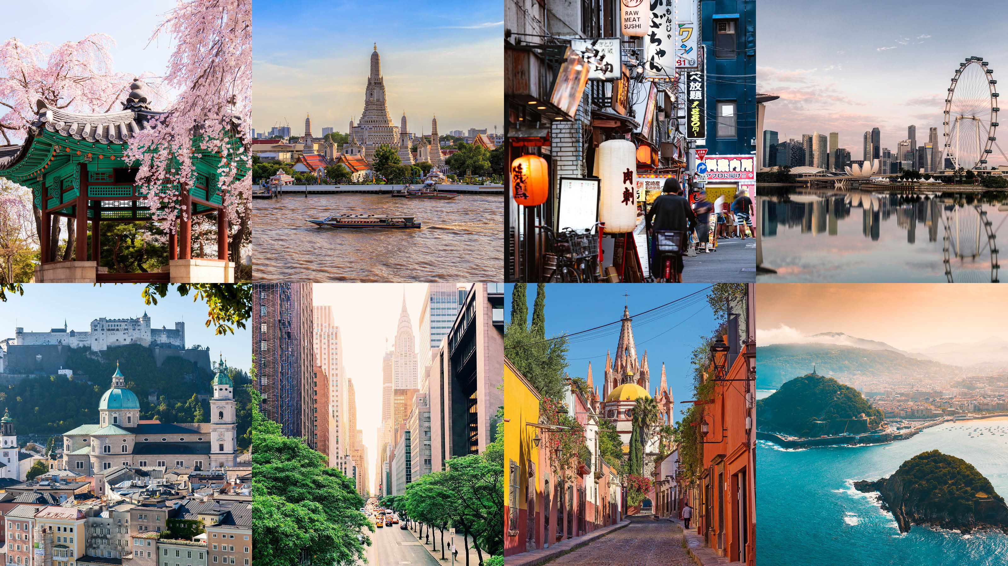
4
Choose a city you know. Discuss and answer the questions below.
Work in groups of 4 in 5 minutes.
What city is it?
What is it like? (the weather, hotel, food, people…)
What can you see and do there? <At least 2>
How do you feel about it?

Slide 46
5
Share the information you have collected in 4 with your class.
Speaking
What city is it?
What is it like? (the weather, hotel, food, people…)
What can you see and do there? <At least 2>
How do you feel about it?

Slide 47

See you later!

