Slide 1


UNIT 7
TELEVISION

Slide 2

LESSON 5
Skills 1

Slide 3


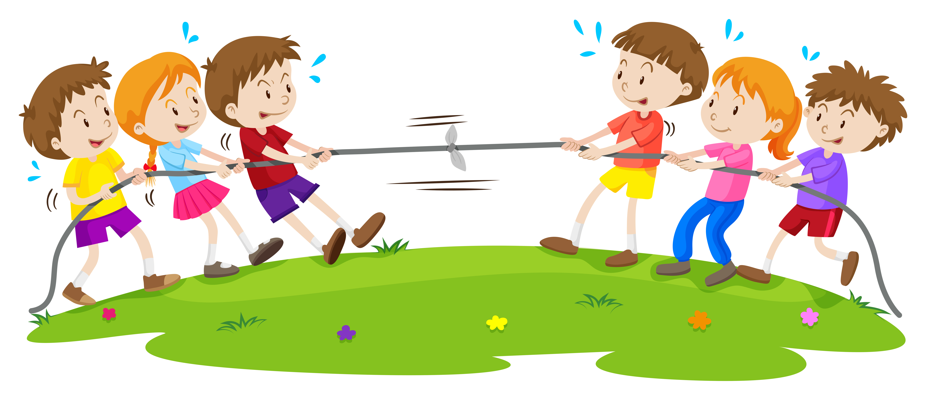

Vocabulary
plant
/ˈkærəktə(r)/
compete
/kəmˈpiːt/
race
/reɪs/

Slide 4
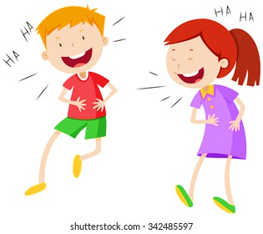

Vocabulary
laugh
/lɑːf/
dolphin /ˈdɒlfɪn/

Slide 5


Read the first two columns of the TV guide and answer the questions.
TIME | PROGRAMME | DESCRIPTION
8.00 | Wildlife: Cuc Phuong Forest | Watch the colourful world of plants, ﬂowers, and animals in their real life.
9.00 | Comedy: The Fox Teacher | Have a lot of fun with a fox teacher and his students on their first day at school.
10.30 | Sports: The Pig Race | Watch the cute pigs compete in the most exciting races. Who wins?
11.00 | Game show: Children are Always Right | Join this game show today and try to answer interesting questions about pets.
12.15 | Science: The Dolphins | Watch funny and interesting clips of intelligent dolphins in their natural life - the sea.
1.
What’s in the Wildlife programme?
It’s Cuc Phuong Forest.
2.
Is The Fox Teacher a comedy?
Yes, it is.
What time is the Sports programme?
3.
It’s on at 10.30.
4.
Can we watch a game show at 10.30?
No, we can’t.
5.
What is the topic of the Science programme?
It’s about dolphins.

Slide 6
Read and answer the questions.
TIME | PROGRAMME | DESCRIPTION
8.00 | Wildlife: Cuc Phuong Forest | Watch the colourful world of plants, ﬂowers, and animals in their real life.
9.00 | Comedy: The Fox Teacher | Have a lot of fun with a fox teacher and his students on their first day at school.
10.30 | Sports: The Pig Race | Watch the cute pigs compete in the most exciting races. Who wins?
11.00 | Game show: Children are Always Right | Join this game show today and try to answer interesting questions about pets.
12.15 | Science: The Dolphins | Watch funny and interesting clips of intelligent dolphins in their natural life - the sea.

Slide 7

Read the TV guide in 1 and write the programmes that these people may choose to watch.
People | Programmes
1. Phong wants to know more about dogs and cats.
2. Bob likes programmes that make him laugh.
3. Nga loves learning about plants and animals.
4. Minh likes watching races.
5. Linh is interested in sea animals.
Children are Always Right
The Fox Teacher
Cuc Phuong Forest
The Pig Race
The Dolphins
Notes:
Teacher clicks Back button to go back to the TV guide.

Slide 8


Work with teacher. Tell about your favourite TV programme. Your talk should include:
the name of the programme
the channel it is on
You can use these suggestions.
the content of the programme
My favourite programme is ...
It’s on ...
It’s about ...
the reason you like it

Slide 9

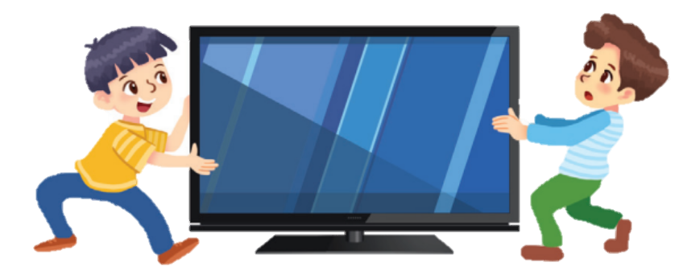
Complete the conversation with the words / phrases in the box. Then practise it with your friend.
Phong: Turn to (1) _______, Minh. Harry Potter is going to be on. Minh: But I’m watching Kids are Always Right. Phong: Is the topic of the (2) _______ about pets? Minh: No, it’s about the Amazon. It’s only half way through. Phong: I can’t miss Harry Potter. (3) _________ does your programme finish? Minh: (4) _______ 8.30. Phong: I’ll miss the first part of the film. Why don’t you go and watch it with Dad? Minh: Dad is watching his (5) _________ team, Manchester United. He never misses it. Phong: Well ... So I’ll wait till 8.30. It’s your day today, (6) _______?
VTV cab
game show isn’t it favourite
VTV cab What time At
show
What time
At
favourite
isn’t it

Slide 10

See you later!

