Slide 1

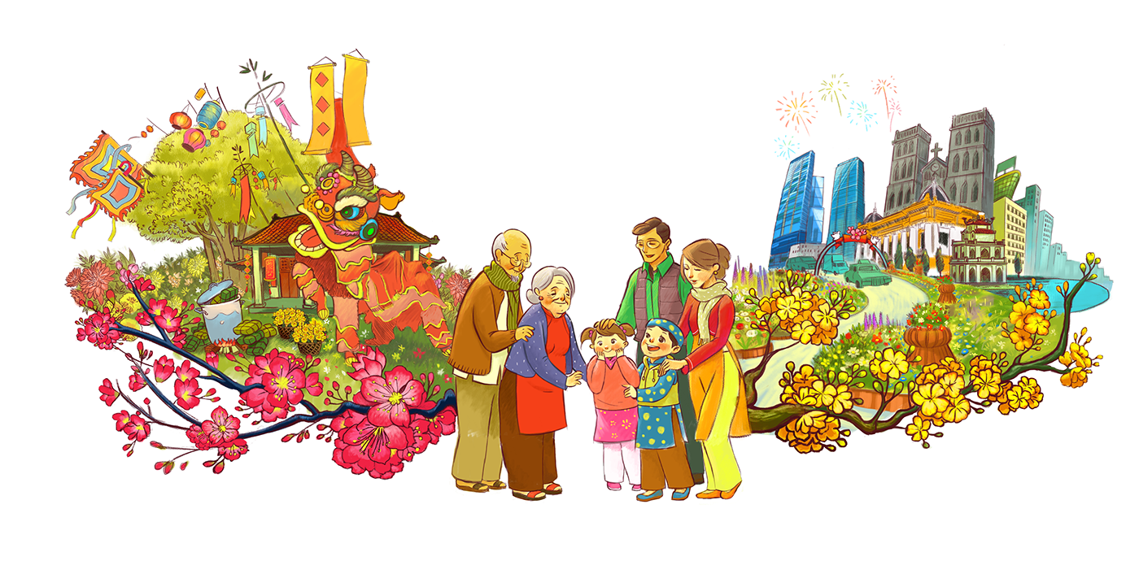
UNIT 6
Our Tet holiday

Slide 2

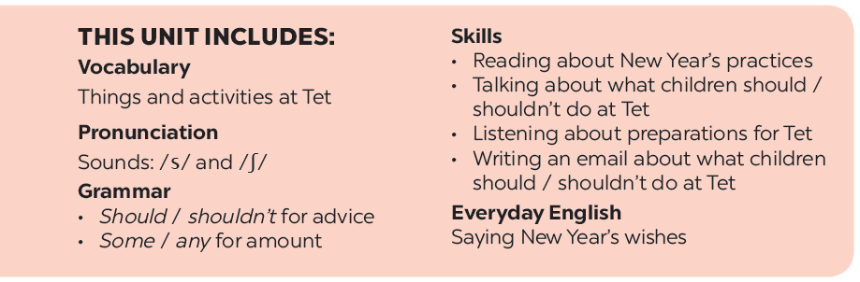
Contents of Unit 6

Slide 3
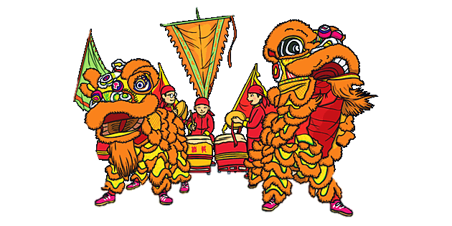
LESSON 1
Getting started

Slide 4
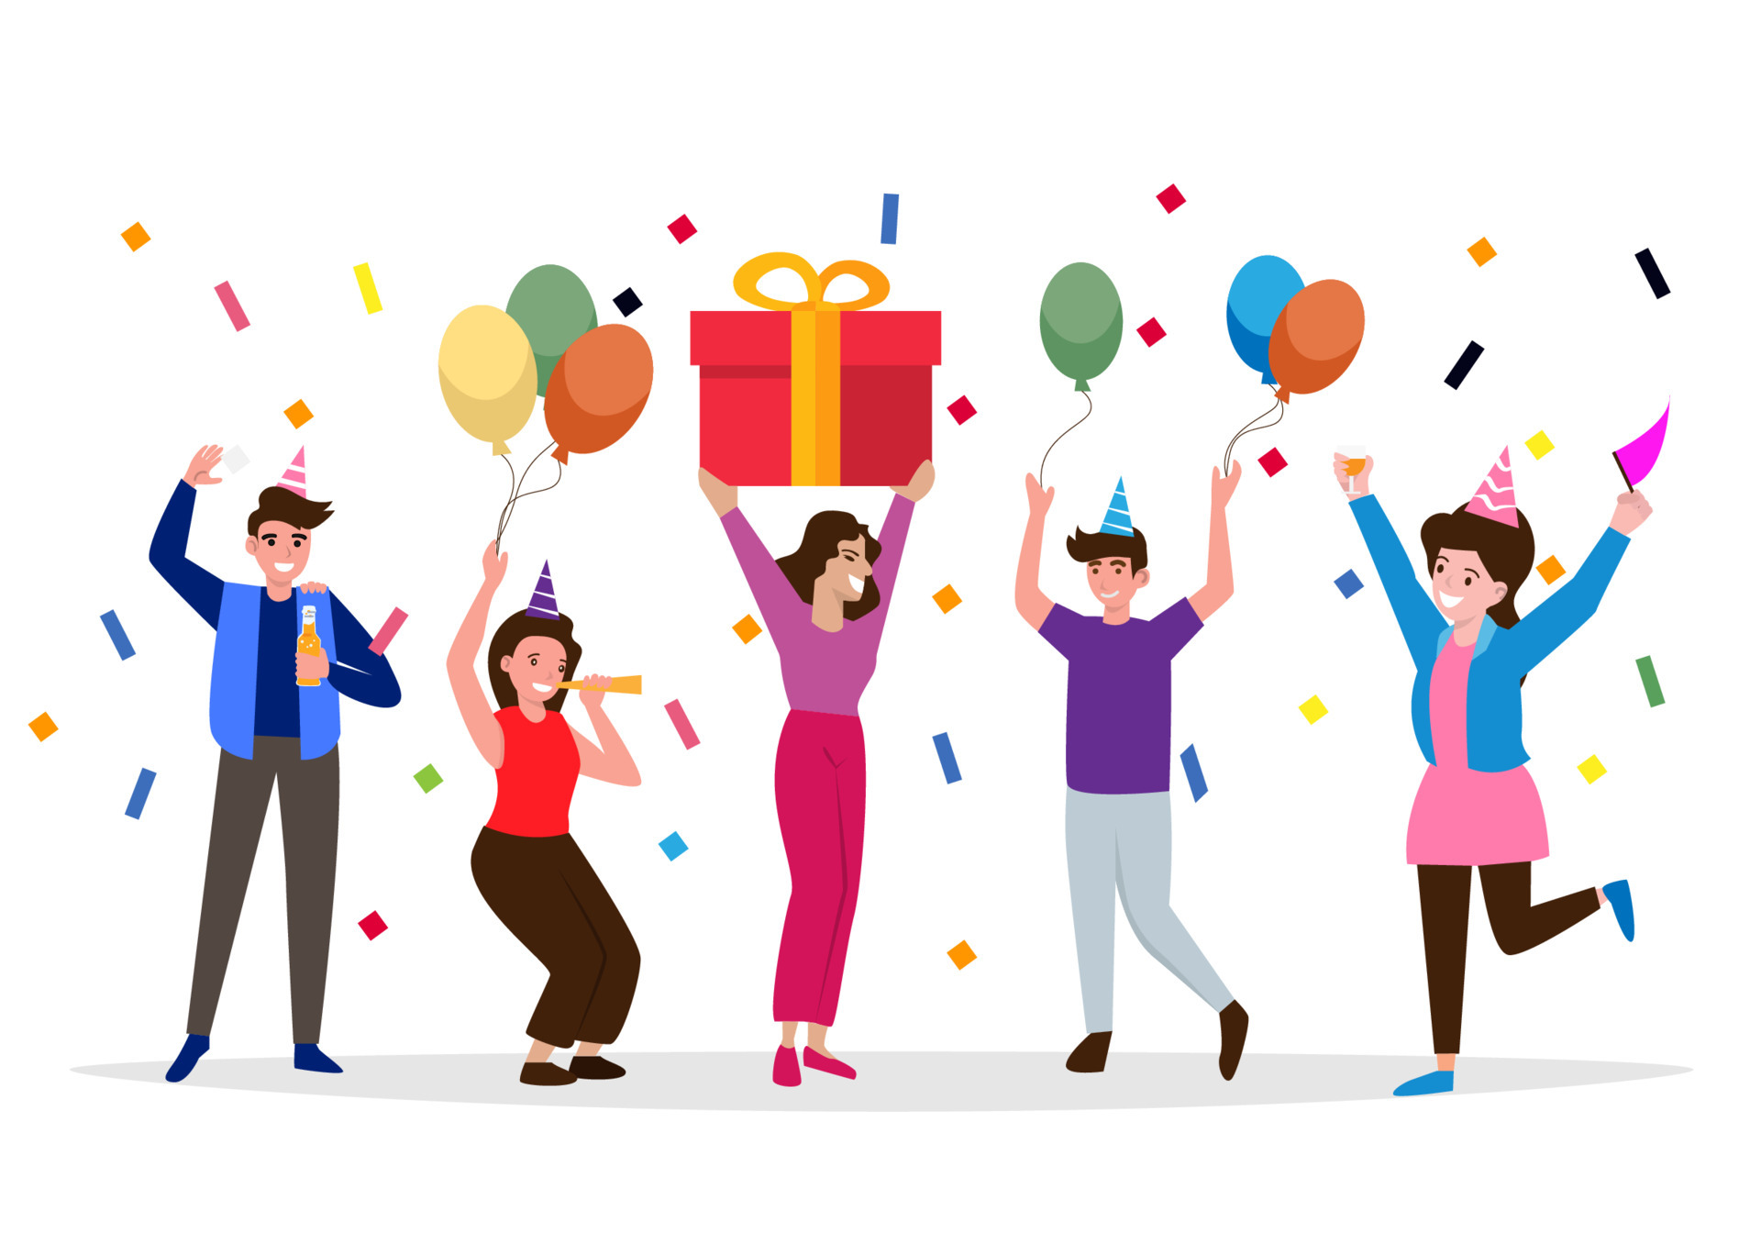


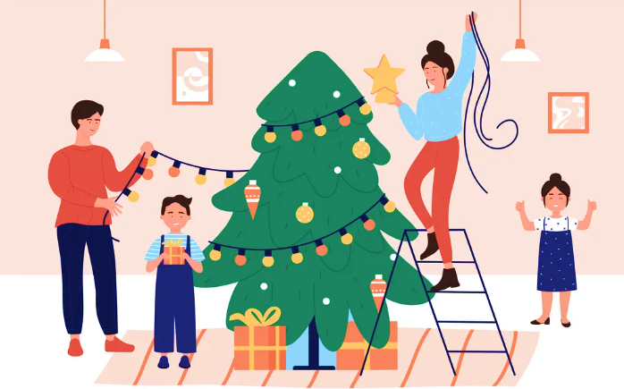

Vocabulary
celebrate
/ˈselɪbreɪt/
clean
/kliːn/
decorate /ˈdekəreɪt/
family gathering
/ˈfæməli ˈɡæðərɪŋ/

Slide 5
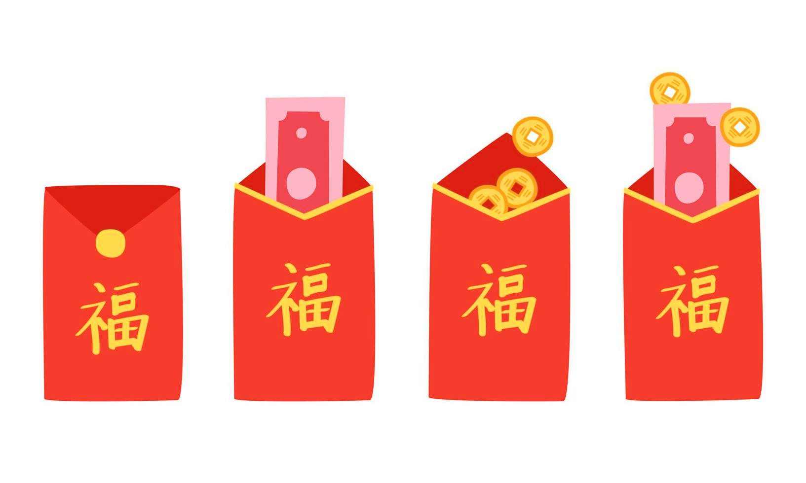

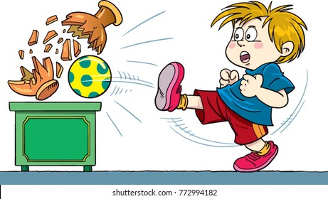
Vocabulary
lucky money
/ˈlʌki ˈmʌni/
special
/ˈspeʃl/
break
/breɪk/

Slide 6

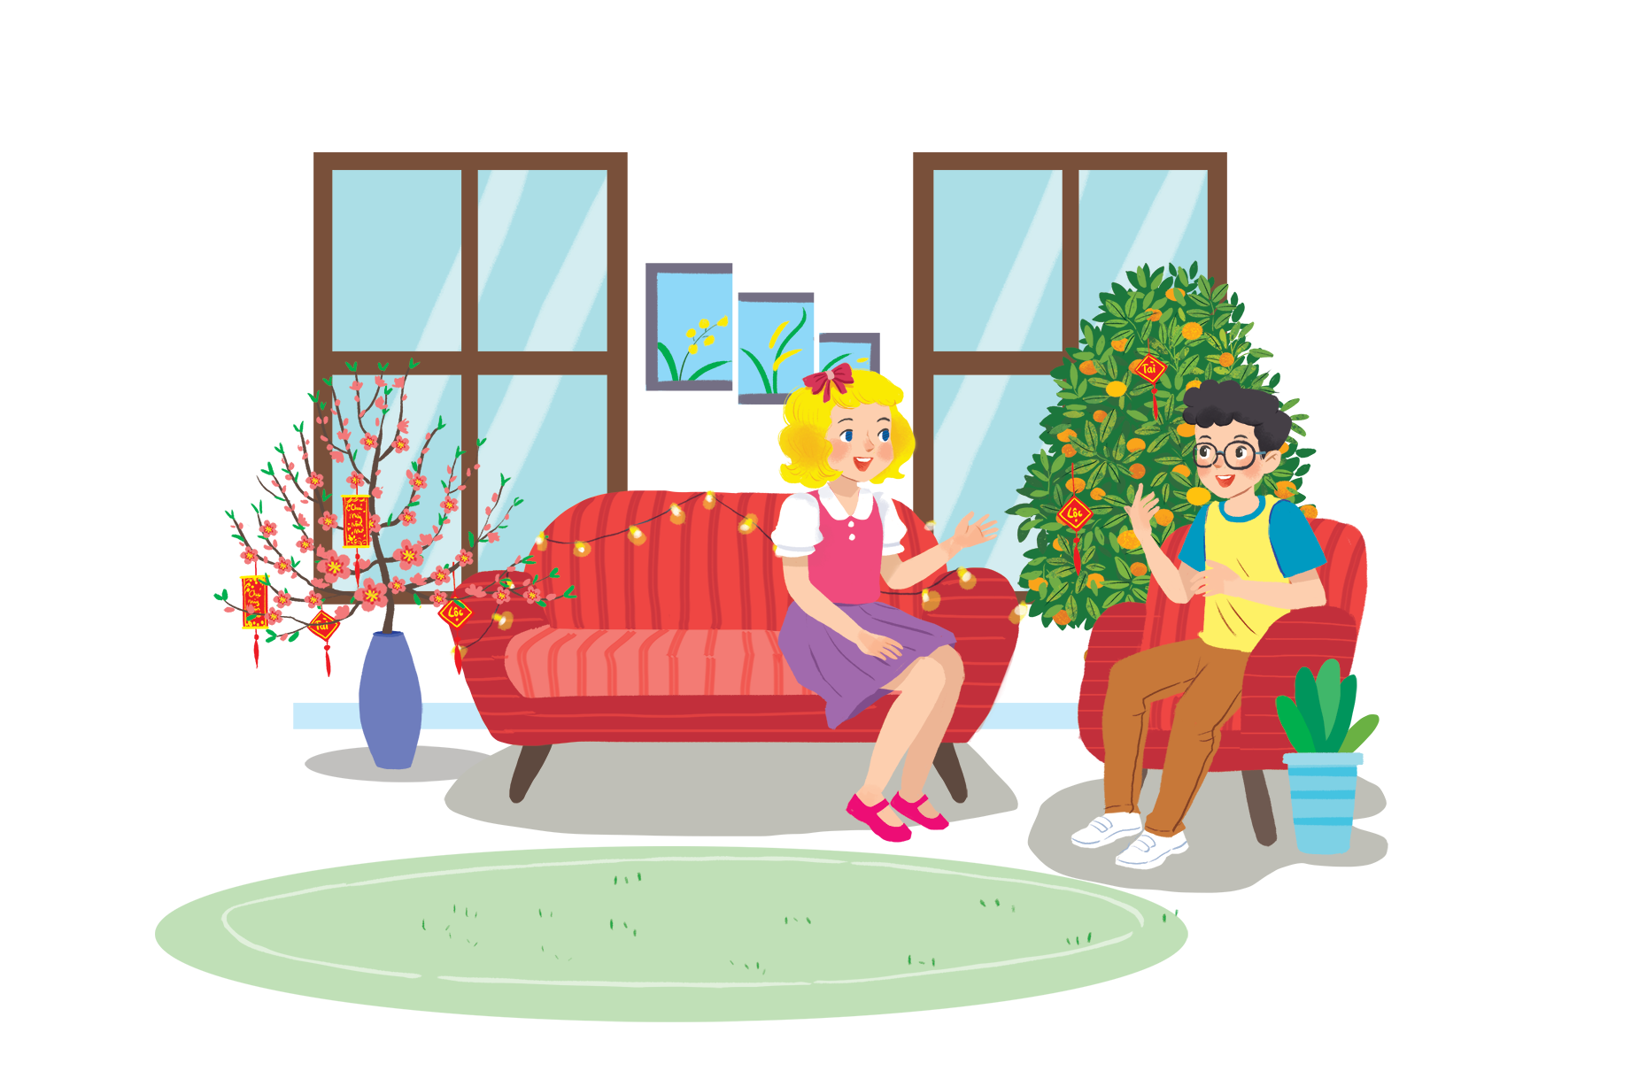
Listen and read.
Happy New Year!
Linda: Phong, does Viet Nam celebrate New Years?
Phong: Yes, we do. We have Tet.
Linda: When is Tet?
Phong: At different times. This year, it’s in January.
Linda: What do you do at Tet?
Phong: We clean our homes and decorate them with ﬂowers.
Linda: Is Tet a time for family gatherings?
Phong: Yes. It’s a happy time for everybody.
Linda: Great.
Phong: Yes, and another good thing about Tet is that children get lucky money.
Linda: That sounds interesting. Is there anything special people should do?
Phong: We should say “Happy New Year” when we meet people, and we shouldn’t break anything.

Slide 7

What are Linda and Phong talking about?
Happy New Year!
Linda: Phong, does Viet Nam celebrate New Years?
Phong: Yes, we do. We have Tet.
Linda: When is Tet?
Phong: At different times. This year, it’s in January.
Linda: What do you do at Tet?
Phong: We clean our homes and decorate them with ﬂowers.
Linda: Is Tet a time for family gatherings?
Phong: Yes. It’s a happy time for everybody.
Linda: Great.
Phong: Yes, and another good thing about Tet is that children get lucky money.
Linda: That sounds interesting. Is there anything special people should do?
Phong: We should say “Happy New Year” when we meet people, and we shouldn’t break anything.
A.
New Years in the world
B.
Tet in Viet Nam
C.
What to eat and wear during Tet

Slide 8






Complete the sentences about Tet with the information from the conversation in 1.
1.
This year Tet is in ___________.
January
2.
We decorate our ___________.
homes
3.
Tet is a time for family ___________.
gatherings
4.
Children get ___________.
lucky money
5.
People shouldn’t ___________ anything.
break

Slide 9

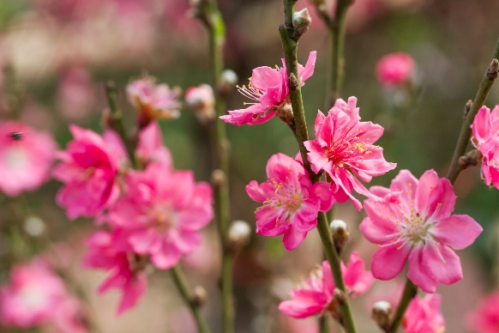
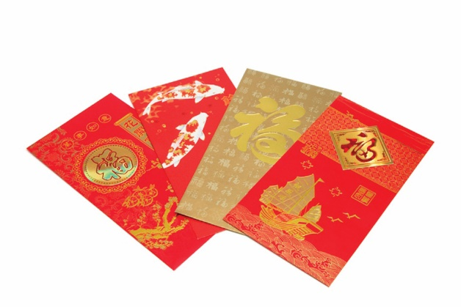
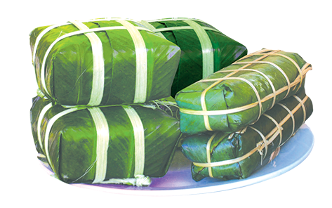
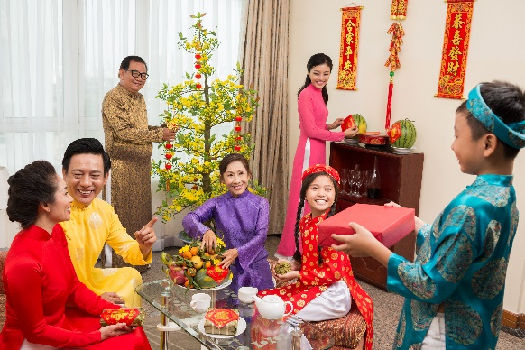
Match the words / phrases in the box with the pictures.
a. lucky money
a. lucky money
c. banh chung and banh tet
c. banh chung and banh tet
b. peach flowers
b. peach flowers
d. family gathering
d. family gathering
1
2
b. peach flowers
a. lucky money
3
4
c. banh chung and banh tet
d. family gathering

Slide 10


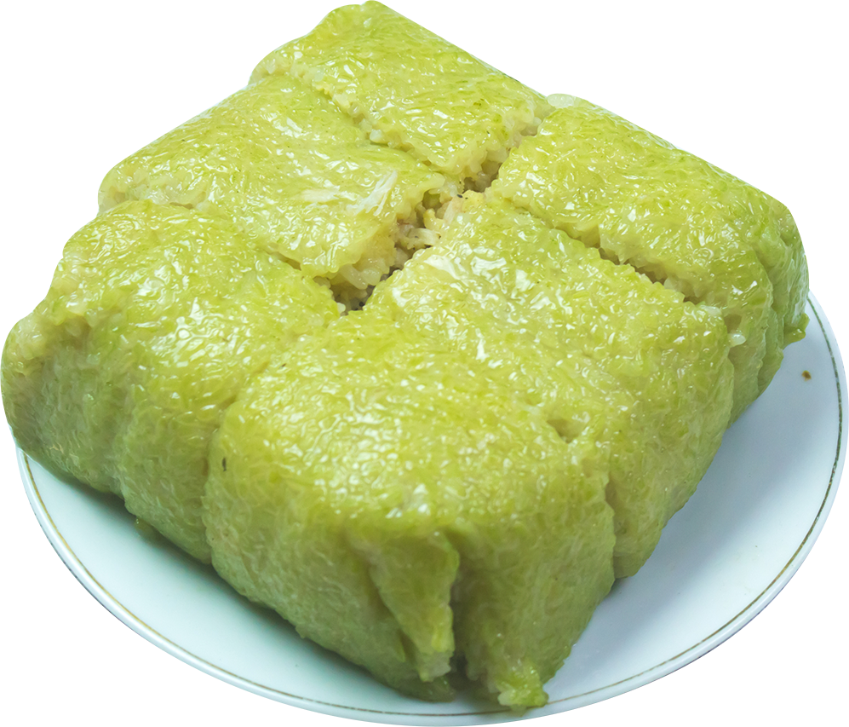
Is it about Tet?
Write two things or activities and share them with teacher. Teacher listens and decides whether they are about or not about Tet.
Example:
Student: banh chung
Teacher: It’s about Tet.
Student: flying a kite.
Teacher: It’s not about Tet.

Slide 11

THANK YOU!

