Slide 1

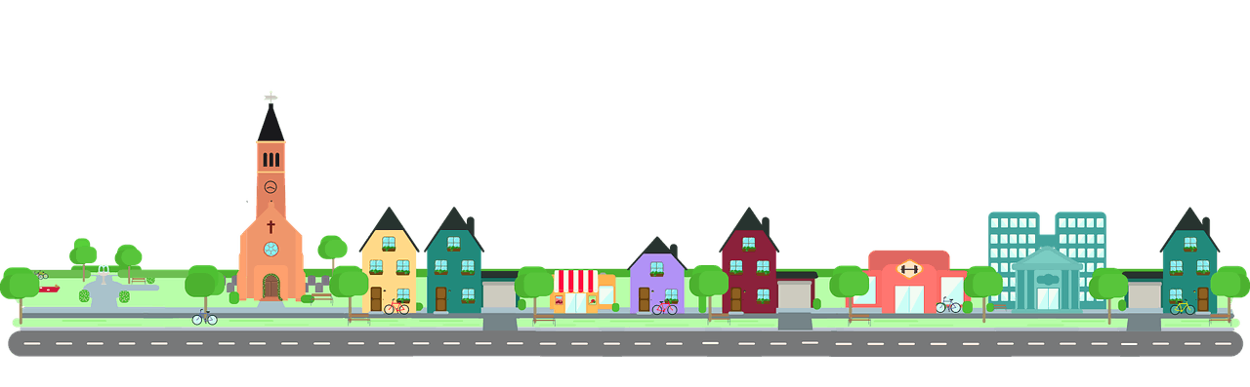
MY NEIGHBOURHOOD
UNIT 4

Slide 2


Lesson 6
Skills 2

Slide 3
LISTENING

Slide 4

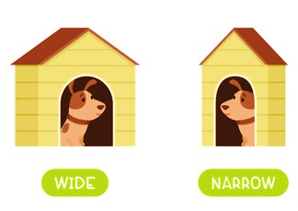



VOCABULARY
narrow
/ˈnærəʊ/
faraway
/ˈfɑːrəweɪ/
factory
/ˈfæktəri/
air
/eə(r)/

Slide 5

Listen to the conversation between Khang and Vy and tick () T (true) or F (False).
 |  | T | F
1. | Vy lives in the centre of Ho Chi Minh City.
2. | There is a big market near her house.
3. | The streets are narrow.
4. | The schools are faraway.
5. | There are some factories near her neighbourhood.





Audio script
Notes:
T clicks Audio script to see the script of the audio

Slide 6
AUDIO SCRIPT
Khang: Where do you live, Vy?
Vy: I live in the suburbs of Ho Chi Minh City.
Khang: What do you like about it?
Vy: There are many things I like about it. There’s a big market near my house. There are also many shops, restaurants and art galleries here. The streets are wide. The people here are helpful and friendly.
Khang: What do you dislike about it?
Vy: The schools are too faraway. There are also some factories near here, so the air isn’t very clean and the streets are noisy and crowded.

Slide 7

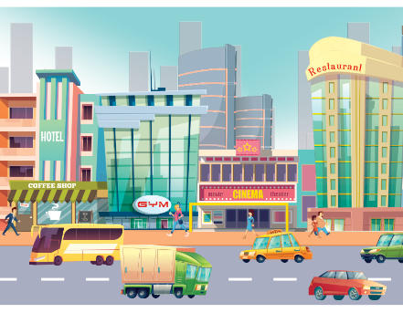
Listen to the conversation again and fill the blanks.
What Vy likes
What Vy dislikes
art galleries
faraway
- many shops, restaurants and (1) in her neighbourhood
- too (4) school
wide
- dirty air
- (2) streets
- noisy and (5) streets
friendly
crowded
- helpful and (3) people
Audio script
Notes:
T clicks Audio script to see the script of the audio

Slide 8
AUDIO SCRIPT
Khang: Where do you live, Vy?
Vy: I live in the suburbs of Ho Chi Minh City.
Khang: What do you like about it?
Vy: There are many things I like about it. There’s a big
market near my house. There are also many shops,
restaurants and art galleries here. The streets are
wide. The people here are helpful and friendly.
Khang: What do you dislike about it?
Vy: The schools are too faraway. There are also some
factories near here, so the air isn’t very clean and the
streets are noisy and crowded.

Slide 9
WRITING

Slide 10

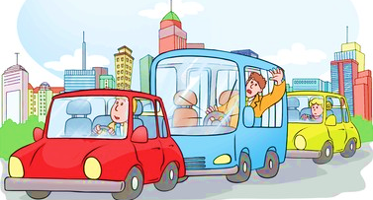

VOCABULARY
sandy beach
/ˈsændi biːtʃ/
heavy traffic
/ˈhevi ˈtræfɪk/
office
/ˈɒfɪs/

Slide 11

Tick () what you like or dislike about a neighbourhood.
 |  | Like | Dislike
1. | sandy beaches
2. | heavy traffic
3. | many modern buildings and offices
4. | peaceful streets
5. | good restaurants and cafés
6. | sunny weather
7. | helpful and friendly people
8. | many shops and markets

Slide 12


Write a paragraph of about 50 words about your neighbourhood saying what you like and dislike about it. Use Khang’s blog as a model.
I live in _______. There are many / some things I like about my neighbourhood.
However, there are some / many / one thing(s) I dislike about it.

Slide 13


Thank you!

