Slide 1
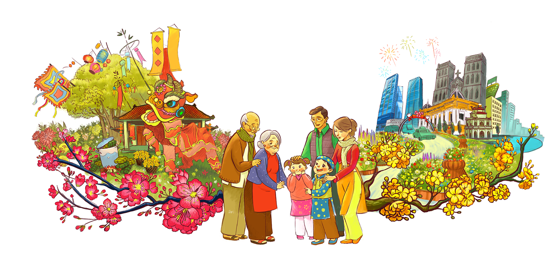
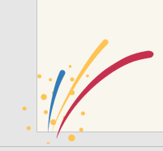
UNIT 6
Our Tet holiday

Slide 2

Warm-up
What do they do?

Slide 3
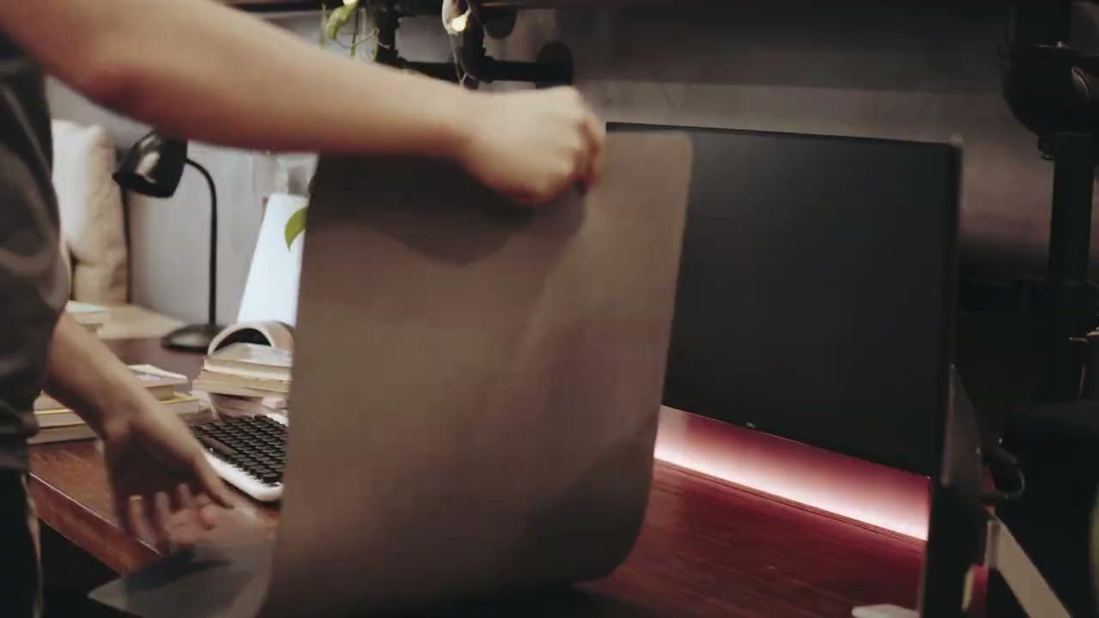
Warm-up

Slide 4
Warm-up
What do they do?
Clean the house, cook Banh chung, decorate the house with flowers,…

Slide 5
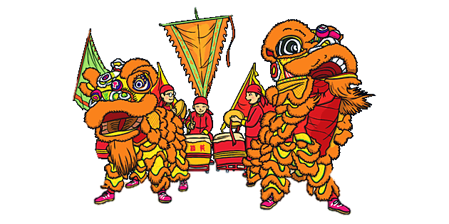
A Closer Look 1
Vocabulary

Slide 6
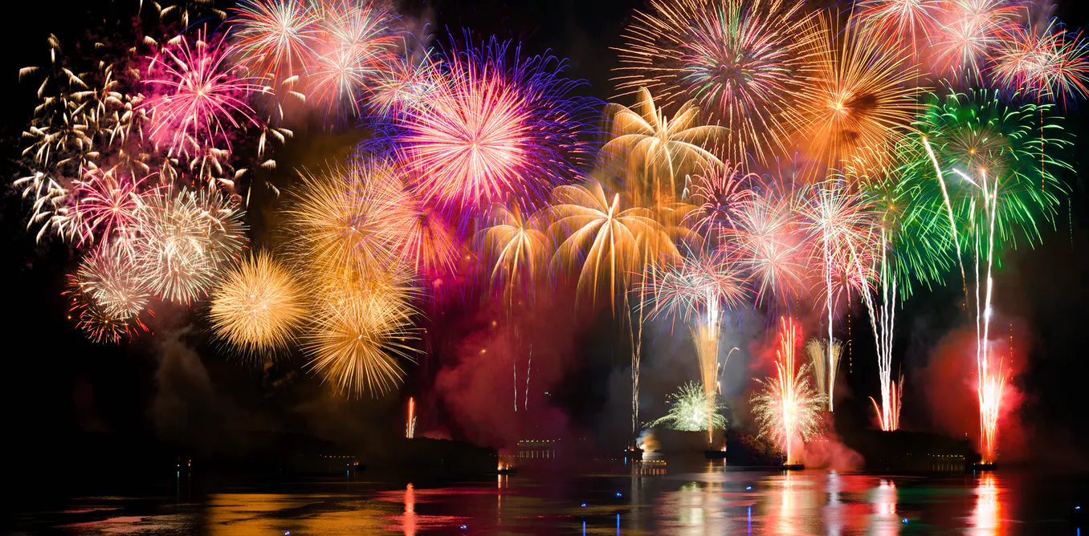

Vocabulary
fireworks
/ˈfaɪə.wɜːk/
watch fireworks

Slide 7
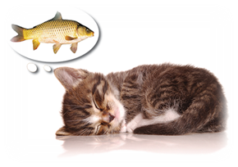
Vocabulary
wish
/wɪʃ/
make a wish

Slide 8
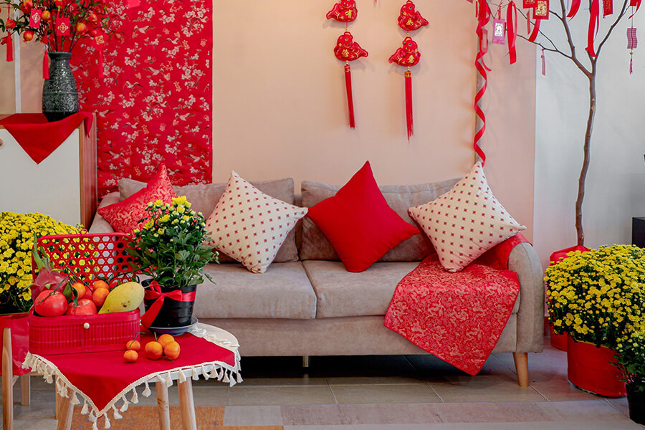
Vocabulary
furniture
/ˈfɜː.nɪ.tʃər/

Slide 9
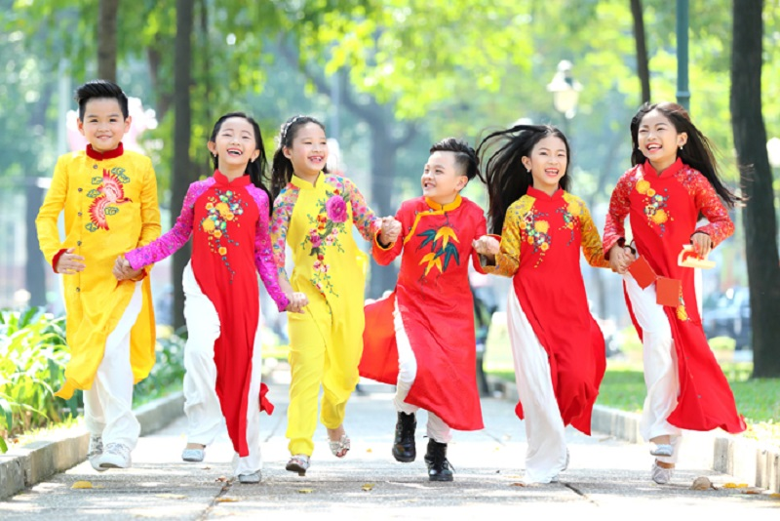
Vocabulary
fun
/fʌn/
have fun

Slide 10
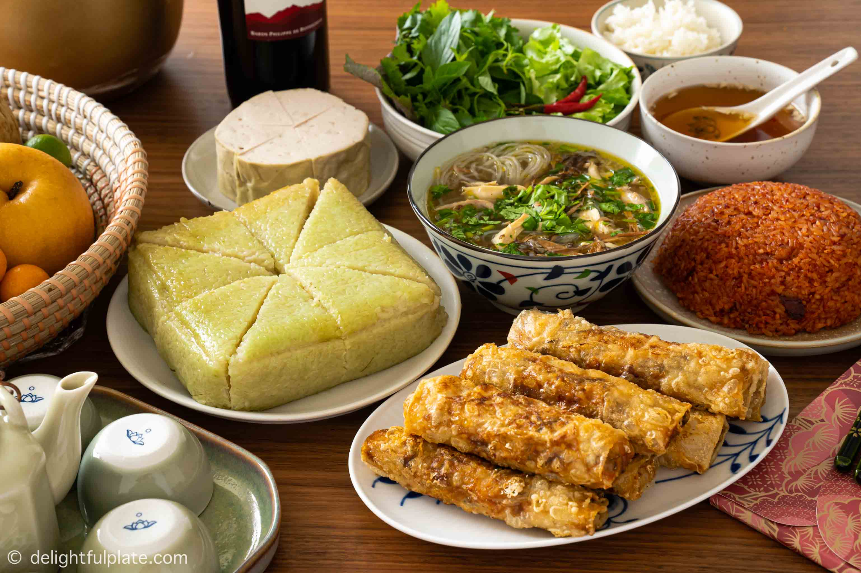
Vocabulary
special food
/ˈspeʃl fuːd/

Slide 11

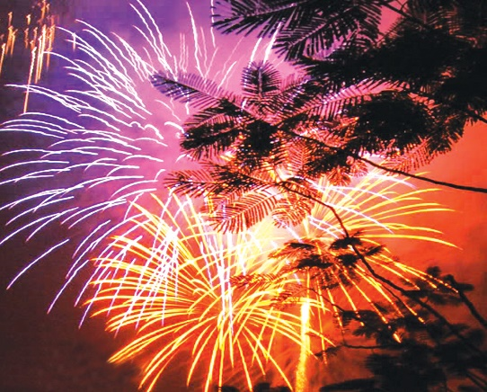
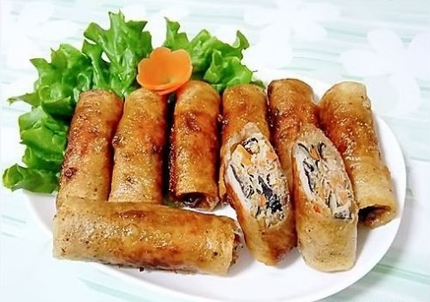
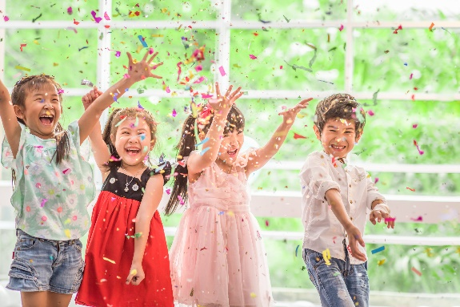
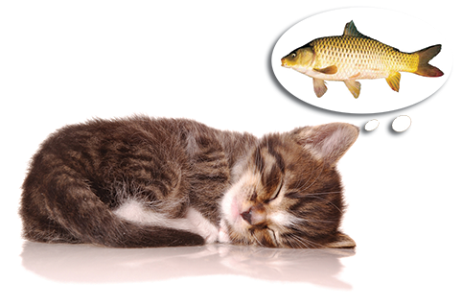
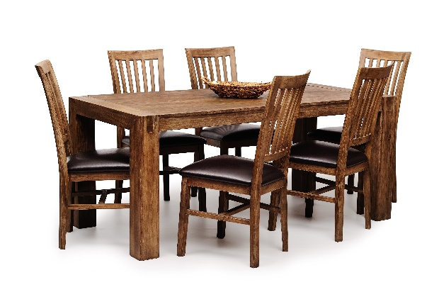
Write the words / phrases in the box under the pictures.
wish
fun
fireworks
special food
furniture
1. fireworks
2. special food
3. fun
1.
2.
3.
4.
4. wish
5. furniture
5.

Slide 12


Match the verbs with the nouns.
Verbs
Nouns
1 –
2 –
3 –
4 –
5 –
6 –
f
a. a wish
1. have
f. fun
e
e. relatives
2. visit
b. fireworks
d
d. lucky money
3. give
c. the furniture
a
4. make
d. lucky money
c
a. a wish
5. clean
e. relatives
b
c. the furniture
f. fun
6. watch
b. fireworks
Notes:
S writes the letters next to the numbers

Slide 13

Complete the sentences with the words in the box.
shopping
celebrate
clean
food
peach
1.
In Viet Nam, we _________ Tet in January or February.
celebrate
2.
At Tet, we decorate our houses with _________ flowers.
peach
3.
Children should help their parents to _________ their houses.
clean
4.
People do a lot of _________ before Tet.
shopping
5.
My mother usually cooks special _________ during Tet.
food

Slide 14
A Closer Look 1
Pronunciation

Slide 15


Slide 16


Pronunciation
/s/ and /ʃ/
Listen and repeat the words.
shopping
special
rice
spring
wish
celebrate

Slide 17


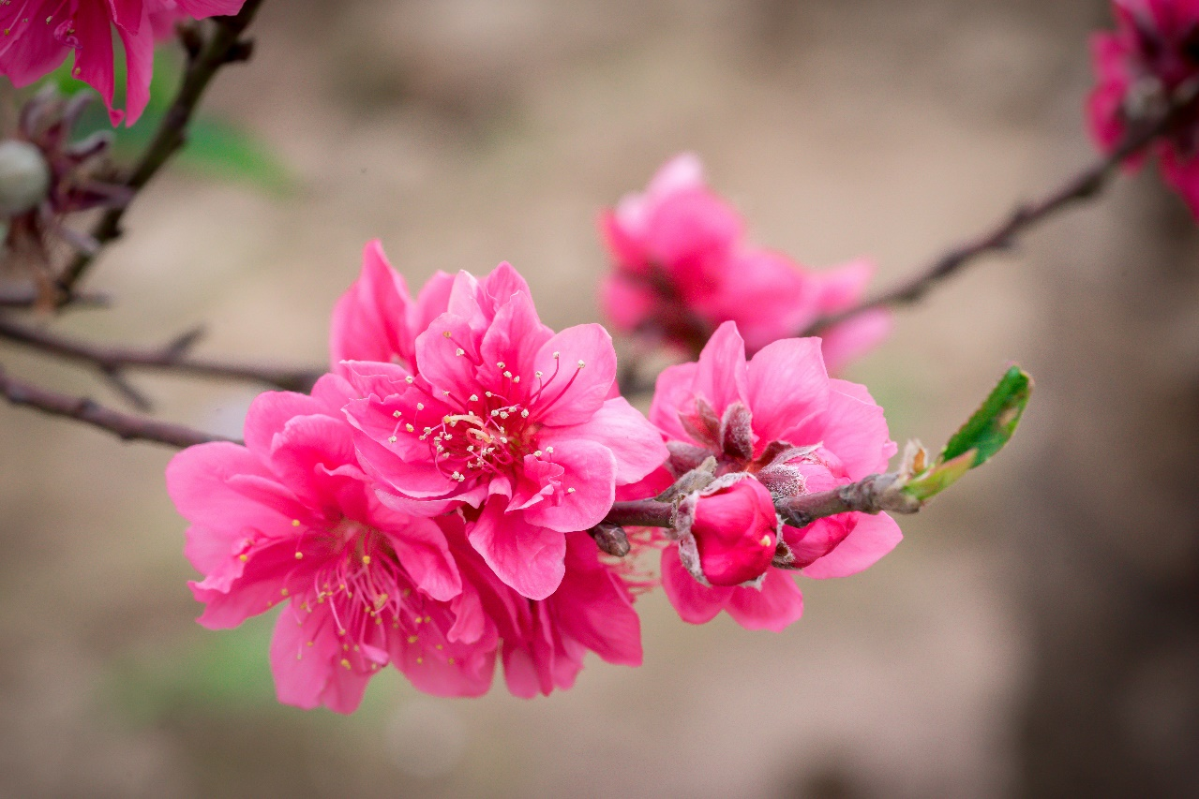
Listen and repeat the poem. Pay attention to the sounds /s/ and /ʃ/ in the underlined words.
Spring is coming!
Tet is coming!
She sells peach flowers.
Her cheeks shine.
Her eyes smile.
Her smile is shy.
She sells peach flowers.

Slide 18
See you later!

