Slide 2




Unit
4
REMEMBERING THE PAST
LESSON 2: A CLOSER LOOK 1

Slide 3

OBJECTIVES
By the end of the lesson, students will be able to:
Use the lexical items related to the topic Remembering the past;
Pronounce the sounds /m/ and /l/ in words and sentences correctly.

Slide 4
LESSON 2: A CLOSER LOOK 1
LESSON 2: A CLOSER LOOK 1
Option 1: Brainstorming
Option 2: Time machine
WARM-UP
Vocabulary
Task 1: Complete the following table. There is one example.
Task 2: Complete the following sentences, using the
correct forms of the words from 1.
Task 3: Complete the following sentences with the
words from the box.
VOCABULARY
PRONUNCIATION
Task 4: Listen and repeat the words. Pay attention to
the sounds /m/ and /l/.
Task 5: Listen and repeat the sentences. Pay attention the the underlined words.
CONSOLIDATION
Wrap-up
Homework

Slide 5
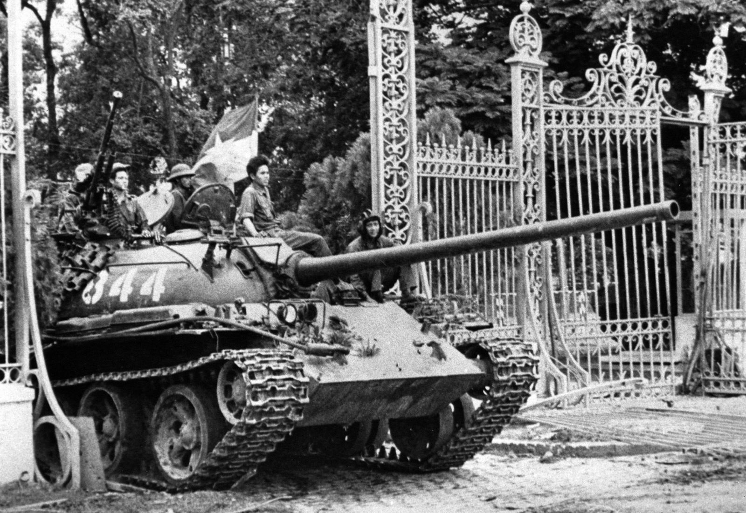
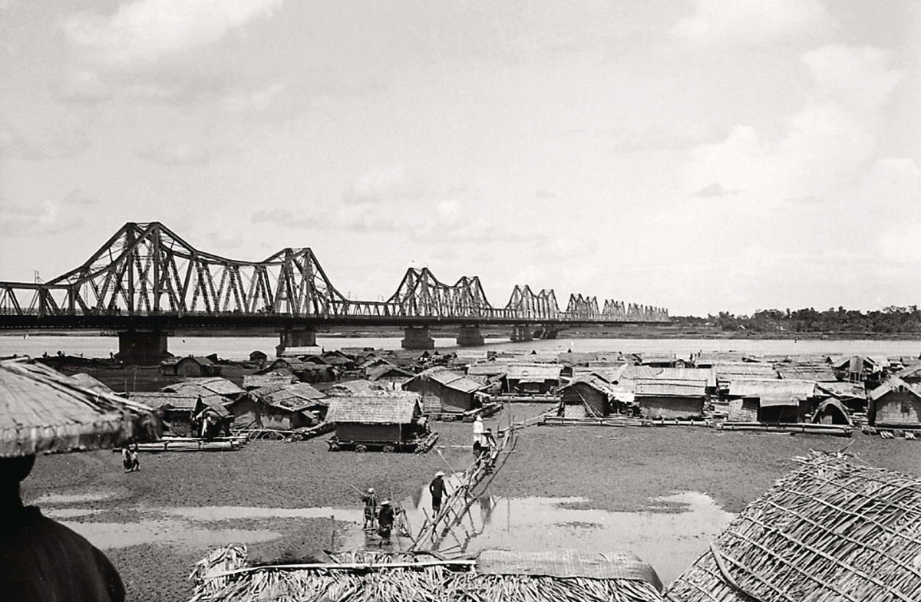
WARM-UP
OPTION 1
Look at the pictures
North Vietnamese tank entering through the gates of the Independence Palace of Saigon on April 30, 1975

Slide 6
WARM-UP
OPTION 1
Look at the pictures
Long Bien Bridge crossing over the Red River, built between 1898 and 1902

Slide 7

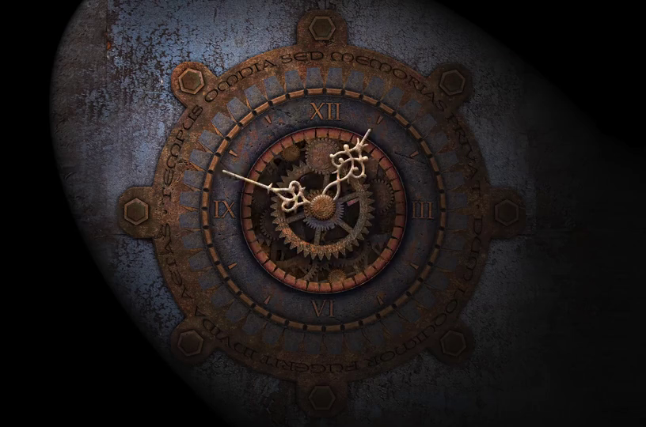
WARM-UP
OPTION 2

Slide 8
WARM-UP
OPTION 2
- Imagine that you have a time machine.
- Draw a picture about your time machine journey or write a short story by answering these questions:
1. Where would you go?
2. What time period would you visit? Why?
- Share your ideas.

Slide 9

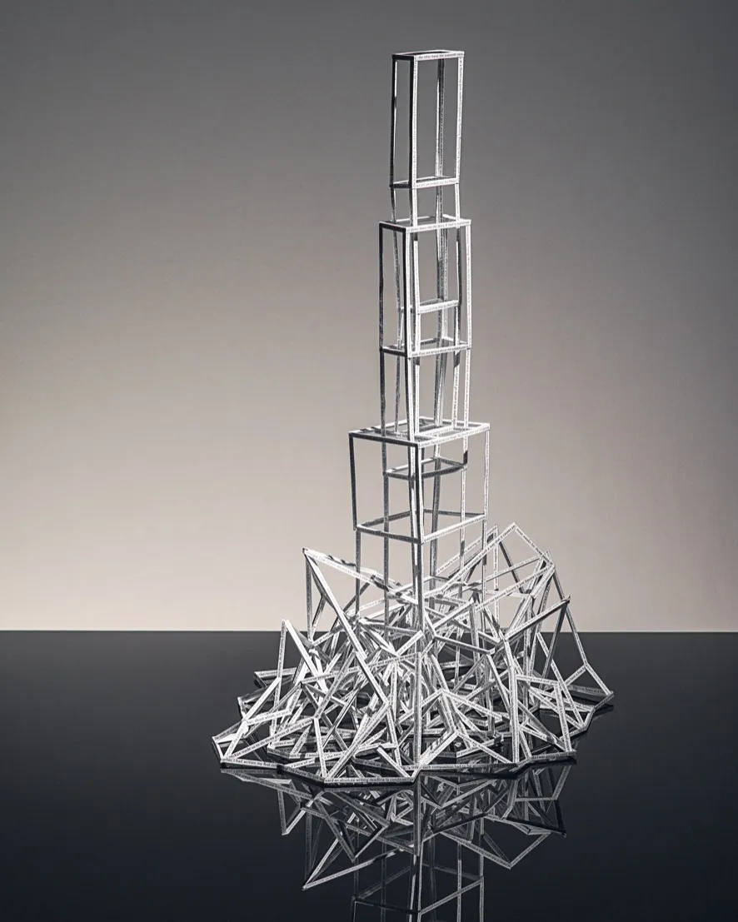

VOCABULARY
something that has been made or built from parts, especially a large building
structure (n)
/ˈstrʌktʃə/
cấu trúc

Slide 10
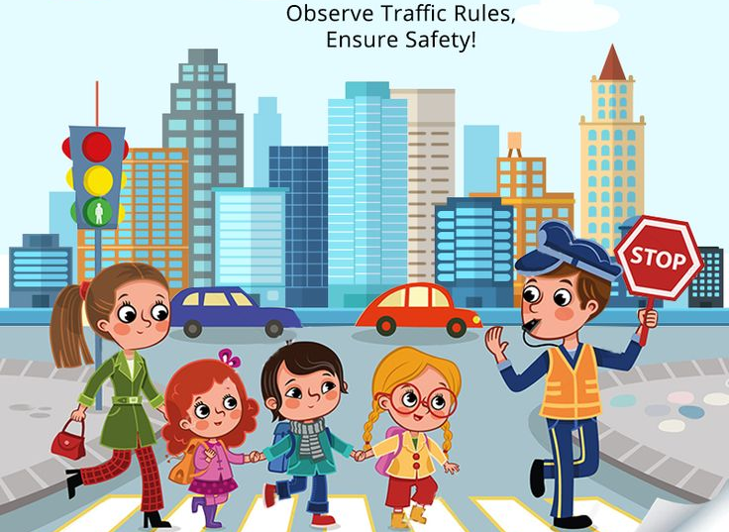
VOCABULARY
to encourage people to like, buy, use, do, or support something
promote (v)
/prəˈməʊt/
thúc đẩy

Slide 11
VOCABULARY
to obey
observe (v)
/əbˈzɜːv/
duy trì, tuân theo

Slide 12
VOCABULARY
benefit (v)
to be helped by something or to help someone
/ˈbenɪfɪt/
Ex: The new law will benefit many homeowners.
giúp ích

Slide 13
VOCABULARY
New words | Pronunciation | Meaning
1. structure (n) | /ˈstrʌktʃə/ | cấu trúc
2. promote (v) | /prəˈməʊt/ | thúc đẩy
3. observe (v) | /əbˈzɜːv/ | duy trì, tuân theo
4. benefit (v) | /ˈbenɪfɪt/ | giúp ích
VERB | NOUN
protect
1. promote
2. recognise
3. contribute
4. observe
5. preserve
6. occupy

Slide 14
VOCABULARY
1
Complete the following table. There is one example.
VERB | NOUN
protect
1. promote
2. recognise
3. contribute
4. observe
5. preserve
6. occupy
protection
promotion
recognition
contribution
observation
preservation
occupation

Slide 15
EXTRA ACTITIVTY
- Work in groups to find three verbs in Getting Started, and then give their equivalent nouns.
- Representatives from each group gives your groups’ answers.
Suggested answer:
build → building
need → need
thank → thanks
wish → wish
know → knowledge
decide → decision
damage → damage
Notes:
wish → wish
know → knowledge
decide → decision
damage → damage

Slide 16
VOCABULARY
2
Complete the sentences, using the correct forms of the words from 1.
observe
1. People in these mountainous areas still __________ their local customs and traditions.
2. The invention of the seat belt made a good ______________ to road safety.
contribution
preservation
3. We believe that _____________ of these old structures will benefit the community in many ways.

Slide 17
VOCABULARY
2
Complete the sentences, using the correct forms of the words from 1.
promotion
4. The aim of the culture festival is the ____________ of friendship and tourism.
5. In 2006, Duong Lam became the first village that was ___________ as a national historic and cultural relic.
recognised

Slide 18
VOCABULARY
3
Complete the following sentences with the words from the box.
magnificent takeaway heritage
generations structures
structures
1. Stonehenge, England, one of the oldest stone _____________ in the world, is about 5,000 years old.
takeaway
2. If you are busy, you can get a ____________ from one of these restaurants.
3. It’s our duty to keep our customs and traditions alive for future _______________.
generations

Slide 19
VOCABULARY
3
Complete the following sentences with the words from the box.
magnificent takeaway heritage
generations structures
4. Windsor Castle is about a thousand years old but it’s absolutely ______________.
magnificent
5. We need a lot of effort to safeguard and preserve our __________.
heritage

Slide 20
LESSON 2: A CLOSER LOOK 1
LESSON 2: A CLOSER LOOK 1
WARM-UP
Option 1: Brainstorming
Option 2: Time machine
Vocabulary
Task 1: Complete the following table. There is one
example.
Task 2: Complete the following sentences, using the
correct forms of the words from 1.
Task 3: Complete the following sentences with the
words from the box.
VOCABULARY
PRONUNCIATION
Task 4: Listen and repeat the words. Pay attention to
the sounds /m/ and /l/.
Task 5: Listen and repeat the sentences. Pay attention
the the underlined words.

Slide 21
PRONUNCIATION
Review the sounds /m/ and /l/.
Listen and repeat:
/m/
/l/
/m/ | /l/

Slide 22
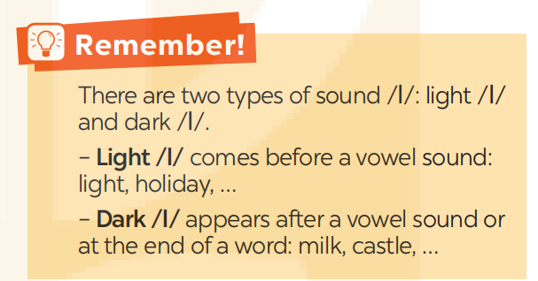
PRONUNCIATION
4
Listen and repeat the words. Pay attention to the sounds /m/ and /l/.
/m/ | /l/
monument
magnificent
programme
custom
grandma
landscape
celebrate
value
cultural
national

Slide 23
1. The collection includes objects of the Middle Ages.
2. You should be careful when shopping in this mall.
3. This monument is small but magnificent.
4. They maintain these windmills as working museums.
5. David fell off his bike and hurt his ankle.
PRONUNCIATION
- Give some examples that have sounds /m/ and /l/.

Slide 24
PRONUNCIATION
5
Listen and repeat the sentences. Pay attention the underlined words.
1. The collection includes objects of the Middle Ages.
2. You should be careful when shopping in this mall.
3. This monument is small but magnificent.
4. They maintain these windmills as working museums.
5. David fell off his bike and hurt his ankle.

Slide 25
EXTRA ACTIVITY
- Give at least one word having sound /l/ and one word having sound /m/.
- You should use words in this unit.
Suggested answers:
remember, life, let, look, temple, complex, largest, Cambodia, …

Slide 26
LESSON 2: A CLOSER LOOK 1
LESSON 2: A CLOSER LOOK 1
WARM-UP
Option 1: Brainstorm
Option 2: Time machine
Vocabulary
Task 1: Complete the following table. There is one example.
Task 2: Complete the following sentences, using the correct forms of the words from 1.
Task 3: Complete the following sentences with the
words from the box.
VOCABULARY
PRONUNCIATION
Task 4: Listen and repeat the words. Pay attention to
the sounds /m/ and /l/.
Task 5: Listen and repeat the sentences. Pay attention the
underlined words.
CONSOLIDATION
Wrap-up
Homework

Slide 27

CONSOLIDATION
1
Wrap-up
What have we learnt in this lesson?
Use the lexical items related to Remembering the past;
Pronounce the sounds /m/ and /l/ in words and sentences correctly.

Slide 28

CONSOLIDATION
2
Homework
- Do exercises in the workbook;
- Find 3 more words that have the sounds /m/ and /l/.

Slide 29
Website: hoclieu.vn
Fanpage: facebook.com/www.tienganhglobalsuccess.vn/

