Slide 2
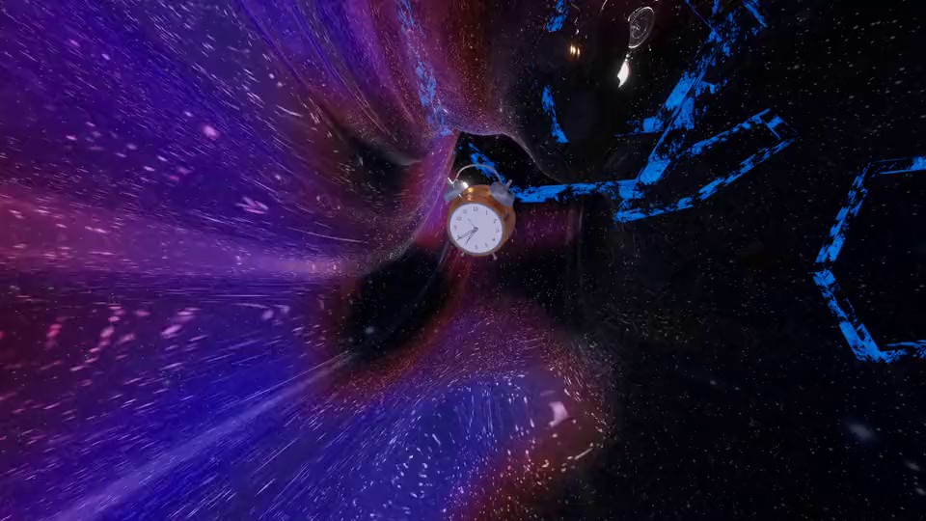


Unit
4
LESSON 1: GETTING STARTED
AT AN ENGLISH LESSON

Slide 3

OBJECTIVES
By the end of the lesson, students will be able to:
Use the words related to the topic remembering the past;
Gain vocabulary to talk about some historical places.

Slide 4
LESSON 1: GETTING STARTED
LESSON 1: GETTING STARTED
WARM-UP
Option 1: Think!
Option 2: Memory Lane
Vocabulary
PRESENTATION
Task 1: Listen and read.
Task 2: Read the conversation again and answer the questions.
Task 3: Complete each sentence with a
word or a phrase from the box.
Task 4: Look at the pictures and complete
the sentences.
PRACTICE
PRODUCTION
Task 5: Game: Remembering past events
CONSOLIDATION
Wrap-up
Homework

Slide 5
WARM-UP
OPTION 1
Answer the questions:
- Do you care about healthy living?
- What do you often do to keep fit?
- What did your parents / grandparents do to keep fit?
- What do you know about your grandparents’ lifestyle (their clothes / cooking / eating habits, …)?
THINK!

Slide 6
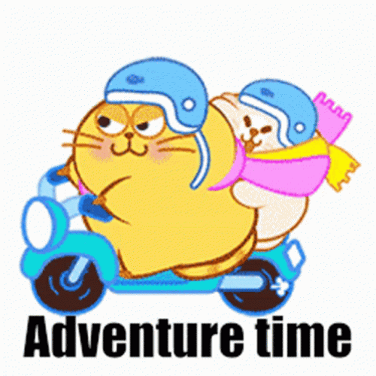
WARM-UP
OPTION 2
- Close your eyes and imagine you are walking down a memory lane.
- What memories do you see?
- Are they happy or sad?
- What do you smell?
- What do you hear?
MEMORY LANE
- Share your memories with the class.
Advantages team | Disadvantages team

Slide 7

PRESENTATION
complex (n)
involving a lot of different but related parts
/ˈkɒmpleks/
khu phức hợp, quần thể

Slide 8
PRESENTATION
relating to, or involved with religion, or living and worshiping according to the beliefs of a particular religion.
religious (adj)
/rɪˈlɪdʒəs/
Ex: He's deeply religious and goes to church twice a week.
(thuộc) tôn giáo

Slide 9
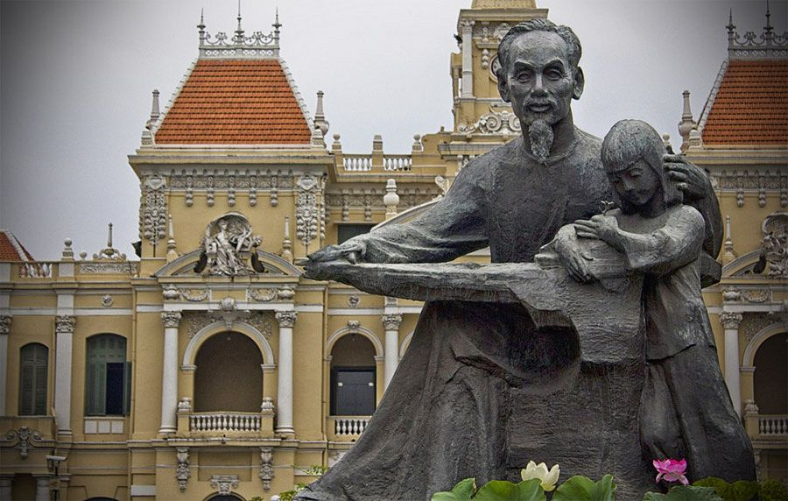
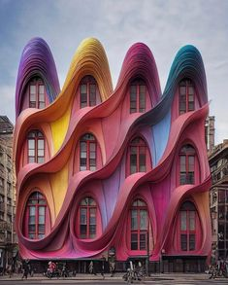
PRESENTATION
a structure or building that is built to honour a special person or event.
monument (n)
/ˈmɒnjumənt/
tượng đài

Slide 10
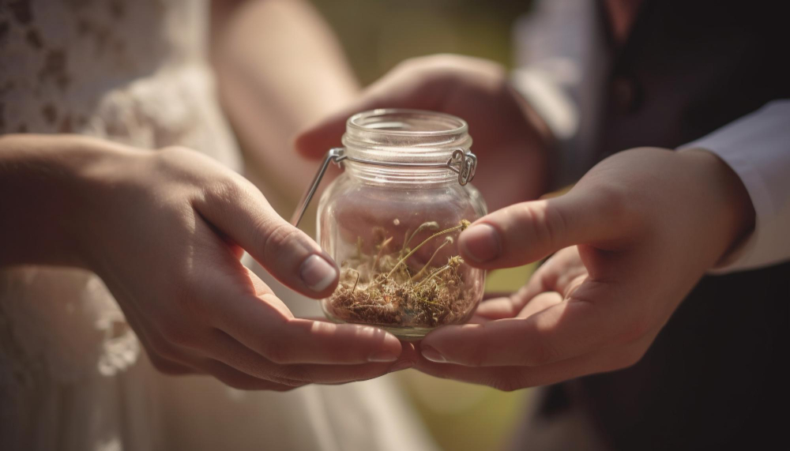
PRESENTATION
very good, beautiful, or deserving to be admired.
magnificent (adj)
/mæɡˈnɪfɪsənt/
tráng lệ

Slide 11
PRESENTATION
preserve (v)
to keep something as it is.
/prɪˈzɜːv/
bảo tồn

Slide 12
PRESENTATION
features belonging to the culture of a particular society, such as traditions, languages, or buildings, that were created in the past and still have historical importance.
heritage (n)
/ˈherɪtɪdʒ/
di sản
Ex: The historic building is as much part of our heritage as the paintings.

Slide 13
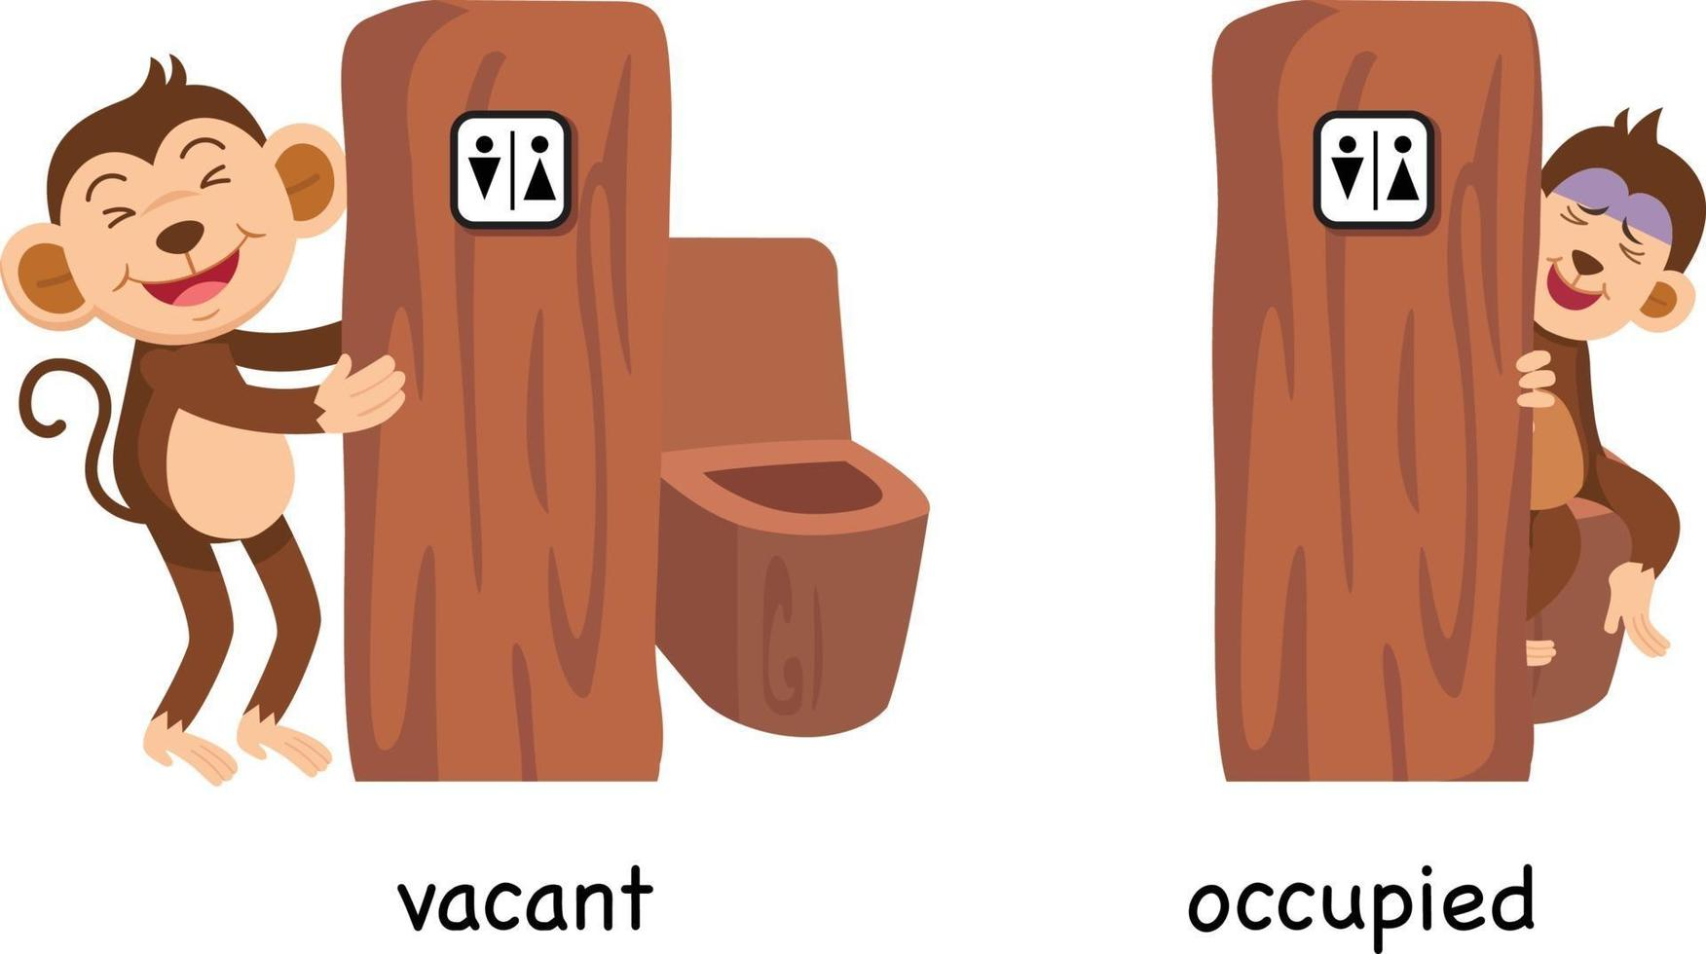
PRESENTATION
occupy (v)
take control
/ˈɒkjupaɪ/
chiếm giữ

Slide 14
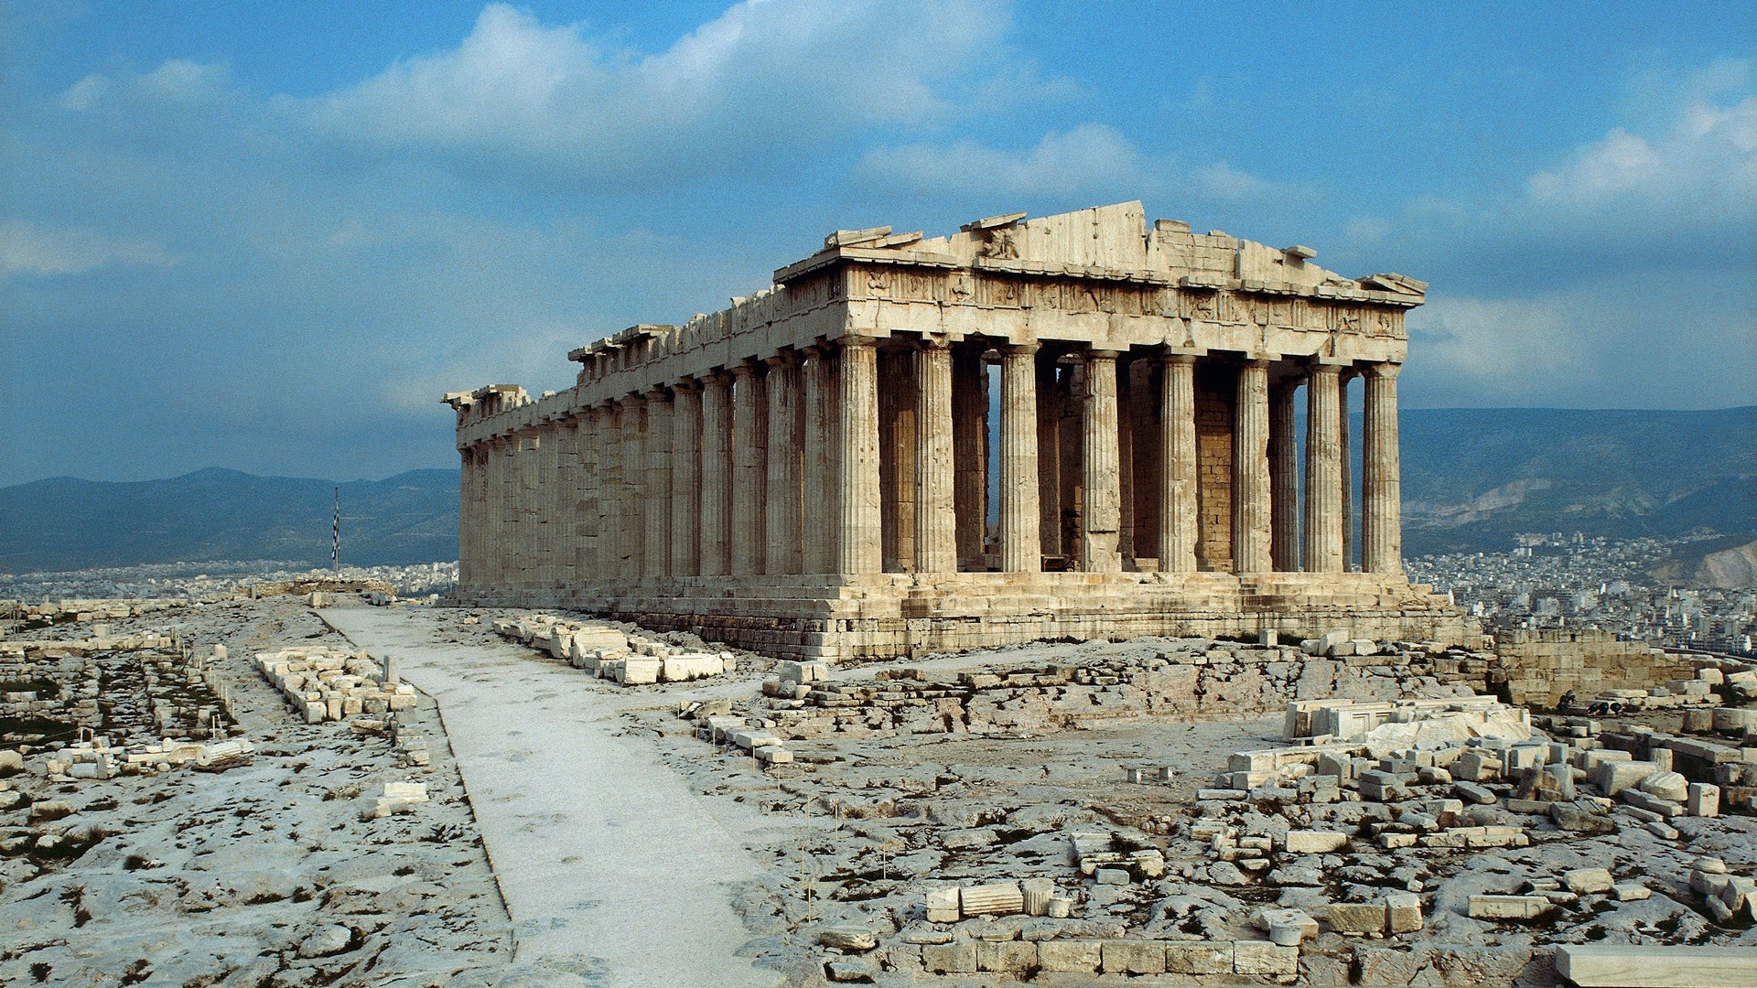
PRESENTATION
being used by someone or with someone in it.
occupied (adj)
/ˈɒkjupaɪd/
có người ở

Slide 15
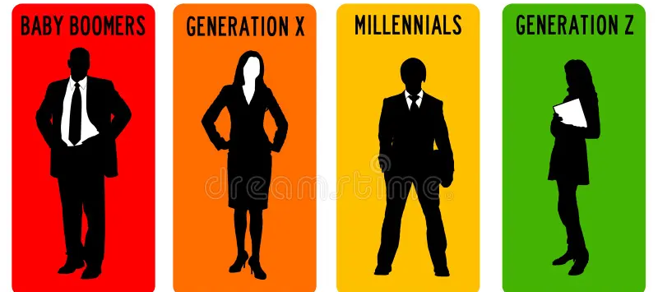
PRESENTATION
of or from a long time ago, having lasted for a very long time.
ancient (adj)
/ˈeɪnʃənt/
cổ đại, lâu đời

Slide 16
PRESENTATION
all the people of about the same age within a society
generation (n)
/ˌdʒenəˈreɪʃn/
thế hệ

Slide 17
PRESENTATION
found (v)
to bring something into existence.
Ex: Boston was founded in 1630 by Puritan colonists from England.
/faʊnd/
thành lập

Slide 18
PRESENTATION
New words | Pronunciation | Meaning
1. complex (n) | /ˈkɒmpleks/ | khu phức hợp, quần thể
2. religious (adj) | /rɪˈlɪdʒəs/ | (thuộc) tôn giáo
3. monument (n) | /ˈmɒnjumənt/ | tượng đài
4. magnificent (adj) | /mæɡˈnɪf.ɪ.sənt/ | tráng lệ
5. preserve (v) | /prɪˈzɜːv/ | bảo tồn
6. heritage (n) | /ˈher.ɪ.tɪdʒ/ | di sản

Slide 19
PRESENTATION
New words | Pronunciation | Meaning
7. occupy (v) | /ˈɒkjupaɪ/ | chiếm giữ
8. occupied (adj) | /ˈɒkjupaɪd/ | có người ở
9. ancient (adj) | /ˈeɪnʃənt/ | cổ đại, lâu đời.
10. generation (n) | /ˌdʒenəˈreɪʃn/ | thế hệ
11. found (v) | /faʊnd/ | thành lập

Slide 20
LESSON 1: GETTING STARTED
LESSON 1: GETTING STARTED
WARM-UP
Option 1: Think!
Option 2: Memory Lane
Vocabulary
PRESENTATION
Task 1: Listen and read.
Task 2: Read the conversation again and
answer the questions.
Task 3: Complete each sentence with a
word or a phrase from the box.
Task 4: Look at the pictures and complete
the sentences.
PRACTICE

Slide 21
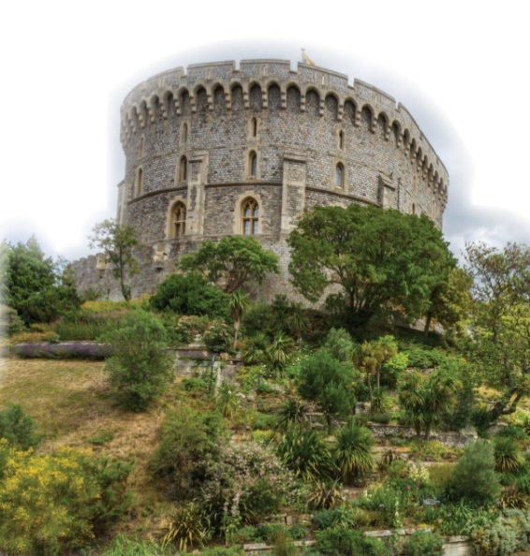

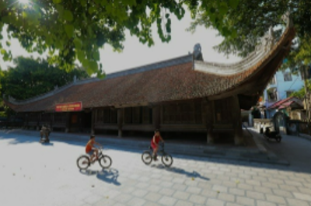
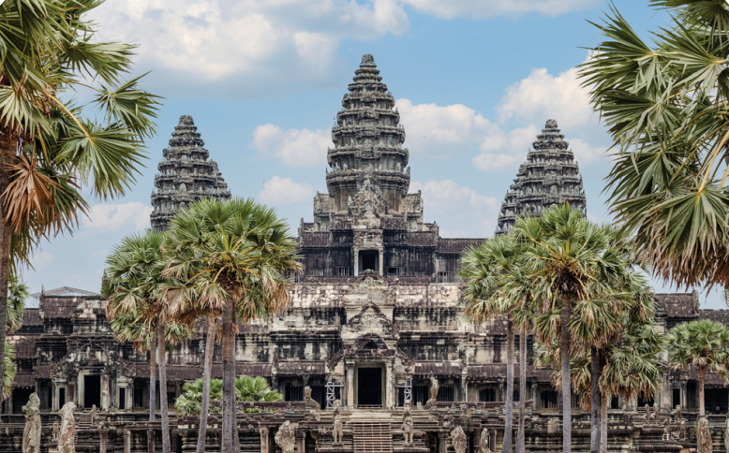
PRACTICE
- Look at the title of the conversation. Then look at the pictures.
What do you think they are discussing?
What do you see in the picture(s)?
What do you know about it / them?

Slide 22
PRACTICE
1
Listen and read.
Teacher: Now let’s look at what you’ve done on your projects. Group one first, please.
Mi: OK. This is Angkor Wat in Cambodia. It’s a temple complex, the largest religious monument in the world.
Teacher: Fantastic! When did people build it?
Mi: They built it in the 12th century. It’s a World Heritage Site. Millions of visitors go there every year.
Teacher: Thank you. I wish I could go there one day too. And now group two, please.

Slide 23
PRACTICE
1
Listen and read.
Nam: Our project is about Dinh Bang Communal House in Bac Ninh Province - a national historic site. People were building it for 36 years, and it’s about 300 years old!
Teacher: Great! It’s quite magnificent! Now group three, please.
Lan: Well, this is Windsor Castle in England. It was built about a thousand years ago. It’s been the home for about 40 English kings and queens.
Teacher: Yeah. It’s the oldest and largest occupied castle in the world.
Mi & Nam: Amazing! So we need to preserve our heritage for future
generations.
Teacher: Right. Thanks to preservation efforts, we know a lot about our history and life in the past.

Slide 24
PRACTICE
Questions:
- What are they talking about?
They are talking about historic buildings / our history / the past / life in the past …
- Tell me some words in the text that they think are related to the unit’s topic.
Cambodia, complex, monuments, build, communal, …

Slide 25
PRACTICE
2
Read the conversation again and answer the questions.
1. How old is Angkor Wat?
About 900 years old / Nearly a thousand years old.
2. What is Dinh Bang Communal House like?
It’s quite magnificent.
3. Where is Windsor Castle?
In England.
4. What helps us know about our history and life in the past?
Preservation efforts.
1. The best way to preserve our cultural ___________ is to share it with others.
2. Vietnamese people take great pride in their culture which has been ________________for thousands of years.
3. The foreign tourists gave a _____________performance of the Vietnamese folk songs and dances

Slide 26
PRACTICE
3
Complete each sentence with a word or a phrase from the box
occupied magnificent thanks to
heritage well preserved
heritage
1. The best way to preserve our cultural ___________ is to share it with others.
2. Vietnamese people take great pride in their culture which has been ________________ for thousands of years.
well preserved
magnificent
3. The foreign tourists gave a _____________ performance of the Vietnamese folk songs and dances
5. Many beautiful old castles are no longer ____________.
4. ___________ your kind contribution, we were able to save the ancient monument.

Slide 27
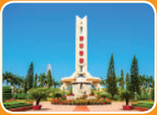

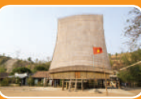
PRACTICE
3
Complete each sentence with a word or a phrase from the box
occupied magnificent thanks to
heritage well preserved
Thanks to
4. _________ your kind contribution, we were able to save the ancient monument.
5. Many beautiful old castles are no longer _________.
occupied

Slide 28
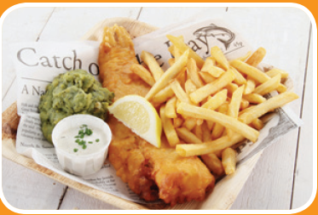
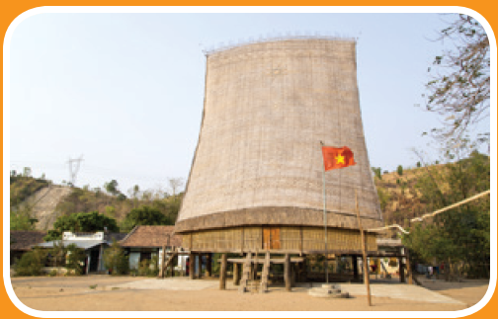
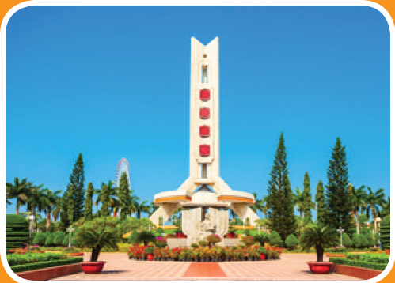

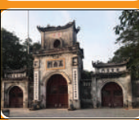
PRACTICE
4
Look at the pictures and complete the sentences.
1. This is a standard serving of ____________ with a slice of lemon.
communal
3. In the square, there is a _________ dedicated to the people killed in the war.
2. The __________ house has a significant meaning in the Bahnar community.
fish and chips
monument

Slide 29
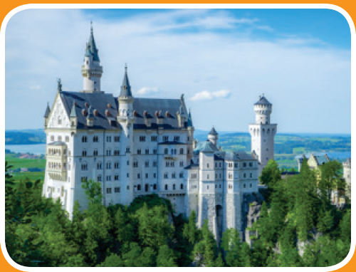
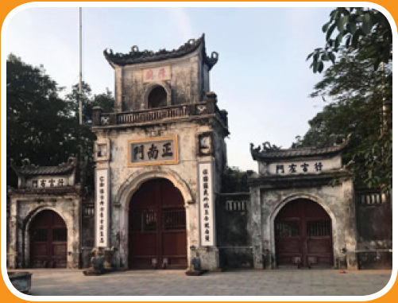
PRACTICE
4
Look at the pictures and complete the sentences.
5. In Nam Dinh City, there is a complex of three ________where people worship the Tran Dynasty’s Kings and royal family members.
4. They have decided to rebuild the _______ which was damaged in the disaster
temples
castle

Slide 30
LESSON 1: GETTING STARTED
LESSON 1: GETTING STARTED
Option 1: Think!
Option 2: Memory Lane
WARM-UP
Vocabulary
PRESENTATION
Task 1: Listen and read.
Task 2: Read the conversation again and
answer the questions.
Task 3: Complete each sentence with a
word or a phrase from the box.
Task 4: Look at the pictures and complete
the sentences.
PRACTICE
PRODUCTION
Task 5: Game: Remembering past events

Slide 31
PRODUCTION
5
GAME: Remembering past events
Work in two groups. Give short answers to the following questions. The group with more correct answers wins.

Slide 32
PRODUCTION
5
1. Who decided to move our capital from Hoa Lu to Dai La (Thang Long) in 1010?
King Ly Thai To (Ly Cong Uan).
2. When did Columbus discover the Americas?
In 1492.
3. When was the United States founded?
In 1776.

Slide 33
PRODUCTION
5
4. When did Nguyen Ai Quoc first go abroad?
In 1911.
5. What happened in world history in 1914?
World War I started / broke out.
6. Who was the last king of Viet Nam?
King Bao Dai (1913 – 1997).

Slide 34
LESSON 1: GETTING STARTED
Option 1: Think!
Option 2: Memory Lane
WARM-UP
Vocabulary
PRESENTATION
Task 1: Listen and read.
Task 2: Read the conversation again and
answer the questions.
Task 3: Complete each sentence with a
word or a phrase from the box.
Task 4: Look at the pictures and complete
the sentences.
PRACTICE
PRODUCTION
Task 5: Game: Remembering past events
CONSOLIDATION
Wrap-up
Homework

Slide 35

CONSOLIDATION
1
Wrap-up
What have we learnt in this lesson?
Use the words related to the topic Remembering the past;
Gain vocabulary to talk about some historical places.

Slide 36

CONSOLIDATION
2
Homework
- Do exercises in the workbook.

Slide 37
CONSOLIDATION
2
Homework
- Prepare for the Project of the unit;
- Open book p.49, look at the picture and say what the topic of the project is;
- Work in groups to design a poster;
- You will show and present in Lesson 7 – Looking back and Project.

Slide 38
CONSOLIDATION
2
Homework
Step 1: Collecting information (asking your grandparents and / or old people, searching the Internet, reading books / magazines, brainstorming ideas, etc.)
Step 3: Practising explaining their posters and answering questions about the content
Step 2: Organising ideas and visuals, and designing the posters

Slide 39
CONSOLIDATION
2
Homework
Step 1: Collecting information (asking your grandparents and / or old people, searching the Internet, reading books / magazines, brainstorming ideas, etc.)
Step 3: Practising explaining their posters and answering questions about the content
Step 2: Organising ideas and visuals, and designing the posters.

Slide 40
CONSOLIDATION
2
Homework
Step 1: Collecting information (asking your grandparents and / or old people, searching the Internet, reading books / magazines, brainstorming ideas, etc.)
Step 3: Practising explaining their posters and answering questions about the content.
Step 2: Organising ideas and visuals, and designing the posters

Slide 41
Website: hoclieu.vn
Fanpage: facebook.com/www.tienganhglobalsuccess.vn/

