Slide 1

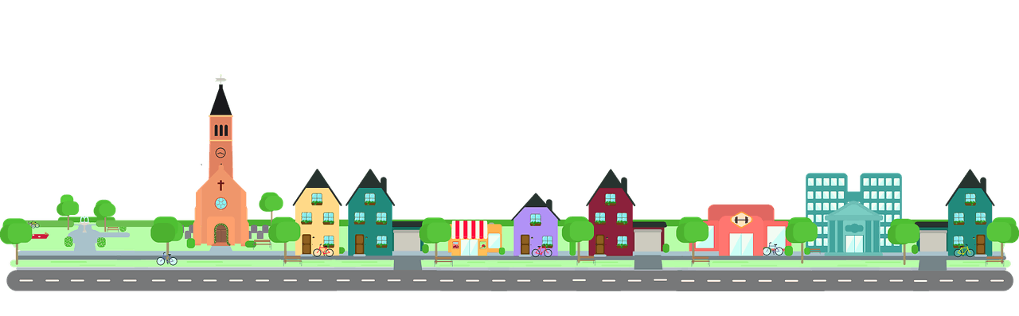
MY NEIGHBOURHOOD
UNIT 4

Slide 2


Lesson 5
Skills 1

Slide 3

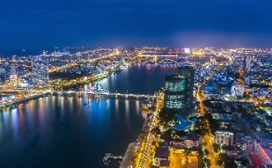
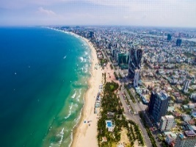

Read Khang’s blog. Look at the words in the box, then find them in the text and underline them. What do they mean?
Friday, December 23rd ...
MY NEIGHBOURHOOD
I live in the suburbs of Da Nang City. There are many things I like about my neighbourhood.
It’s great for outdoor activities because it has beautiful parks, sandy beaches and fine weather. There’s almost everything I need here: shops, restaurants, and markets. The people here are friendlier, and the food is better than in other places.
However, there are two things I dislike about it: there are many modern buildings and offices; and the streets are busy and crowded.
suburbs
an area on the edge of a large town/city
dislike
to not like someone or something
outdoor
Existing or happening outside a building
Posted by Khang at 4:55 PM

Slide 4

Read Khang’s blog again and fill the table with the information.
LIKES | DISLIKES
Friday, December 23rd ...
MY NEIGHBOURHOOD
I live in the suburbs of Da Nang City. There are many things I like about my neighbourhood.
It’s great for outdoor activities because it has beautiful parks, sandy beaches and fine weather. There’s almost everything I need here: shops, restaurants, and markets. The people here are friendlier, and the food is better than in other places.
However, there are two things I dislike about it: there are many modern buildings and offices; and the streets are busy and crowded.
beautiful parks
modern buildings and offices
sandy beaches
fine weather
busy and crowed streets
shops, restaurant, markets
friendly people
good food
Posted by Khang at 4:55 PM

Slide 5

Read Khang’s blog again. Then answer the questions.
1.
Where is Khang’s neighbourhood?
MY NEIGHBOURHOOD
It is in the suburbs of Da Nang City.
I live in the suburbs of Da Nang City. There are many things I like about my neighbourhood.
It’s great for outdoor activities because it has beautiful parks, sandy beaches and fine weather. There’s almost everything I need here: shops, restaurants, and markets. The people here are friendlier, and the food is better than in other places.
However, there are two things I dislike about it: there are many modern buildings and offices; and the streets are busy and crowded.
2.
Why is his neighbourhood great for outdoor activities?
Because it has beautiful parks, sandy beaches and fine weather.
3.
What are the people in his neighbourhood like?
They are very friendly.
4.
How are the streets in his neighbourhood?
They are busy and crowed.

Slide 6

Make notes about your neighbourhood.
Think about what you like / dislike about it.
LIKES | DISLIKES
Friendly people | Crowded streets

Slide 7

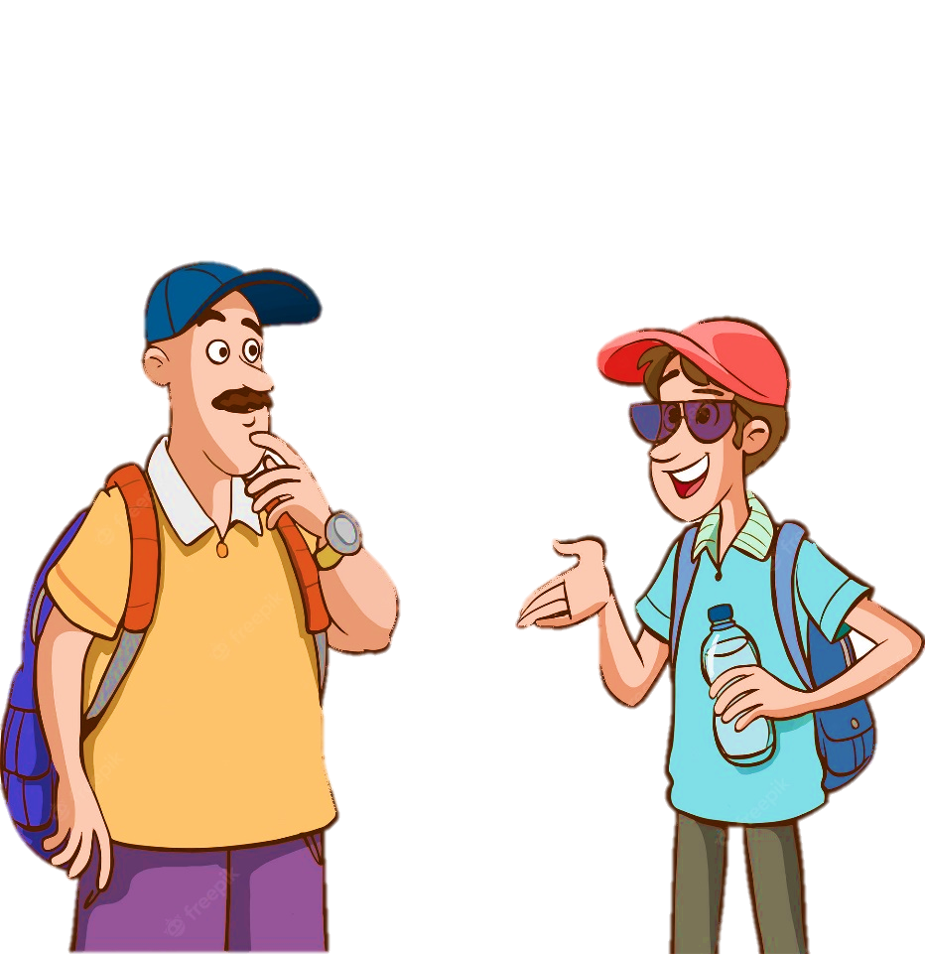
Work with teacher. Ask and answer about what you like and dislike about your neighbourhood.
Example:
A: Where do you live?
B: I live in the suburbs of Da Nang City.
A: What do you like about it?
B: The weather is fine. The people are friendly
and the food is good.
A: What do you dislike about it?
B: The streets are busy and crowded.

Slide 8

THANK YOU!

