Slide 1

WELCOME TO
PANTADO

Slide 2


UNIT 3
MY FRIENDS
Let’s start our lesson!

Slide 3
UNIT 3
01
02
03
LESSON 1
LESSON 2
LESSON 3
Getting started
A Closer Look 1
A Closer Look 2
Skills 1
04
05
LESSON 4
LESSON 5
Skills 2
Communication
Looking Back

Slide 4
LISTENING
SKILL 2

Slide 5
WARM-UP
Unjumble the given words
Teacher sticks some jumbled words onto the board.
Students raise hands to answer.
Jumble words

Slide 6
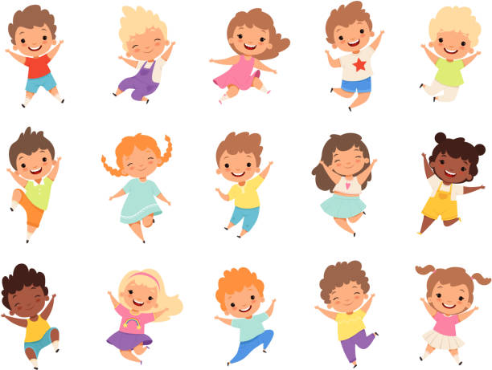
PRESENTATION
TACIEV
ACTIVE

Slide 7
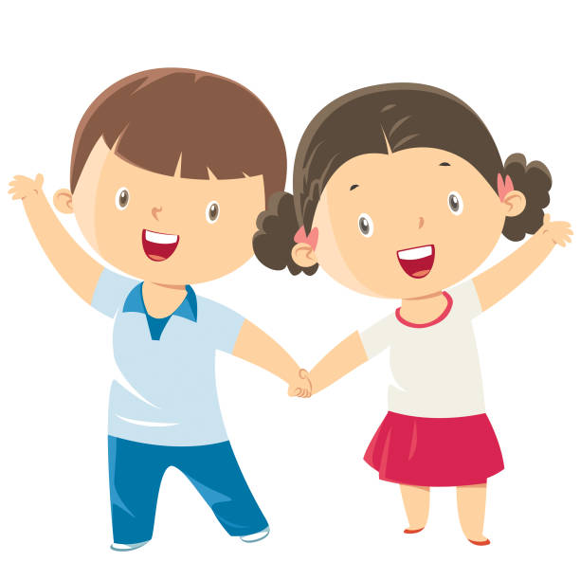
PRESENTATION
LFIEDRNY
FRIENDLY

Slide 8
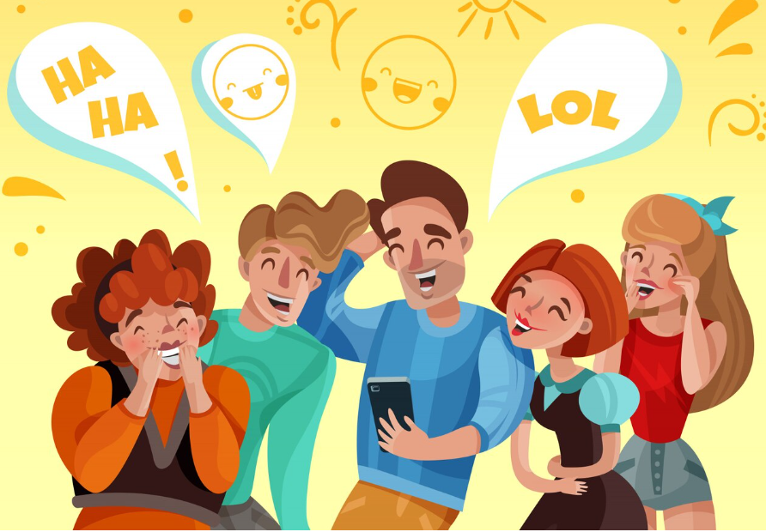
PRESENTATION
YNUNF
FUNNY

Slide 9
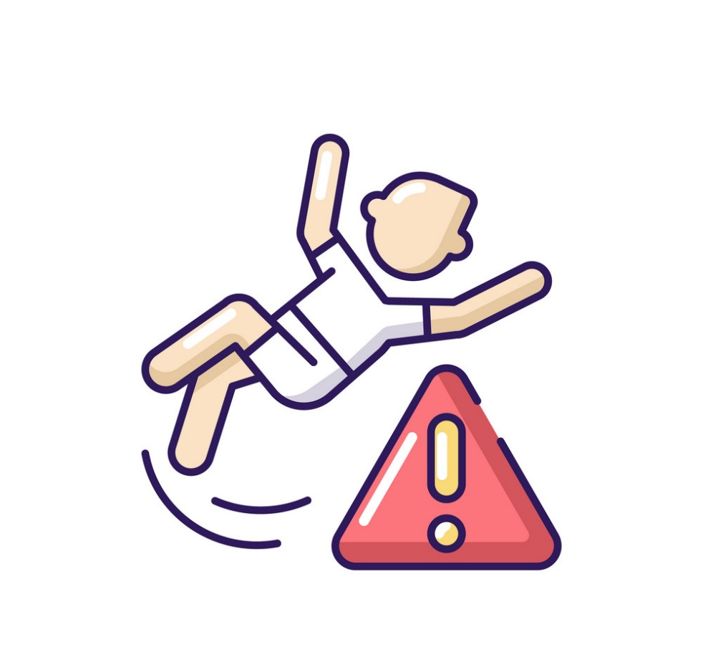
PRESENTATION
RCUFEAL
CAREFUL

Slide 10
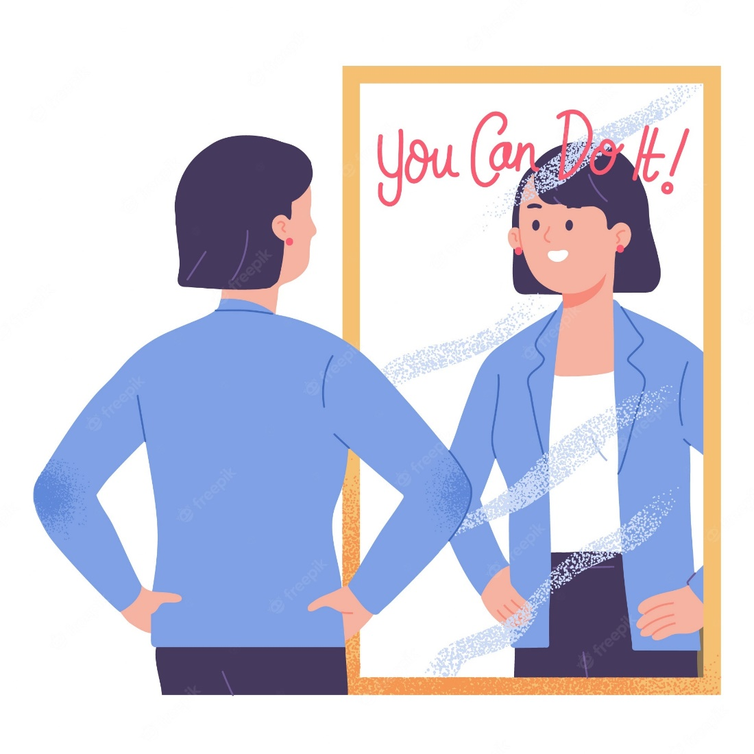
PRESENTATION
TOFCNDITEN
CONFIDENT

Slide 11

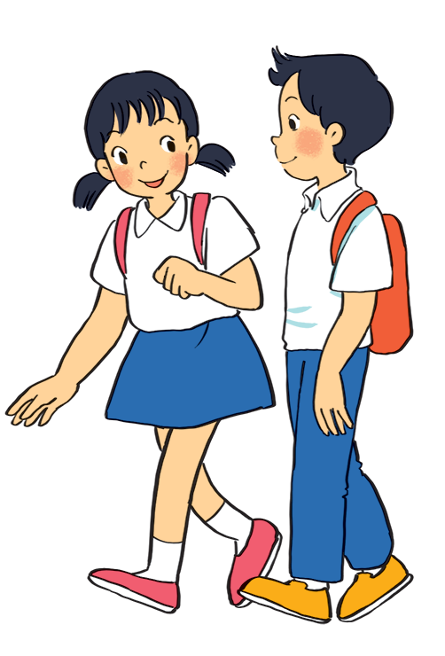
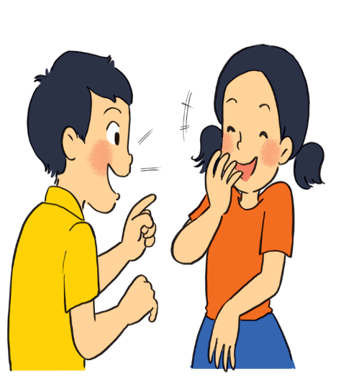
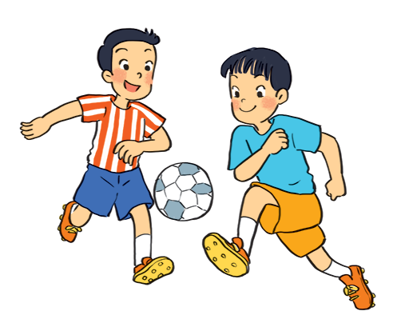
What are the students doing in each picture?
a
b
c
They are talking.
They are playing football.
They are walking.

Slide 12

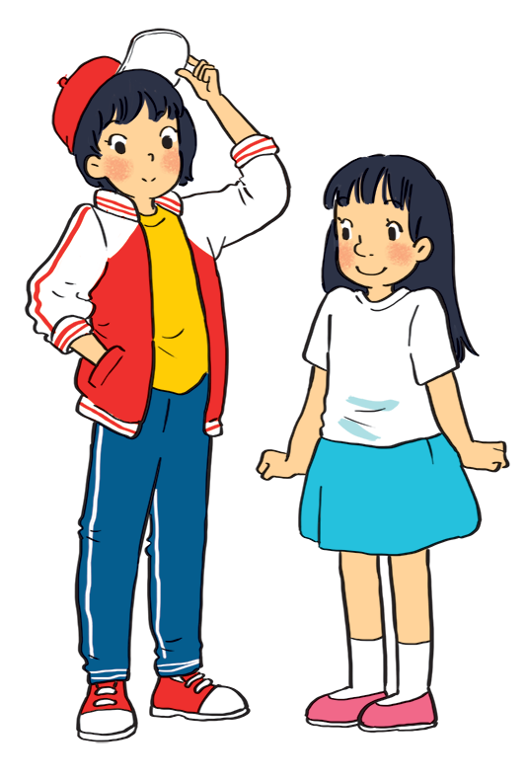
Listen to Mi and Minh talking about their best friends. Look at the picture below and say which one is Lan and which one is Chi.
Lan
Chi
Lan is the girl wearing a red and white jacket and a red cap.
Chi is the girl wearing a white T-shirt and a blue skirt.
Audio script
Notes:
Click “Audio script” if you need to see the script of the audio.

Slide 13

AUDIO SCRIPT
Mi: My best friend is Lan. She studies with me in class 6A. She’s tall and slim. She has short black hair and a small mouth. She’s very active and friendly. She likes playing sports and has many friends. Look, she’s playing football over there!
Minh: Chi is my best friend. We’re in class 6B. She’s short with long black hair and a big nose. I like her because she’s kind to me. She helps me with my English. She’s also hard-working. She always does her homework before class. Look, she’s going to the library.

Slide 14

Listen to the talk again. Fill each blank with a word / number you hear.
6A
1.
Mi and Lan are studying in class _______.
mouth
Lan has short _______ hair and a small ________.
2.
black
friendly
3.
Lan is active and ________.
big
4.
Chi’s hair is long and black, and her nose is ________.
5.
kind
Chi is ________ to Minh.
Audio script
Notes:
Click “Audio script” if you need to see the script of the audio.

Slide 15
AUDIO SCRIPT
Mi: My best friend is Lan. She studies with me in class 6A. She’s tall and slim. She has short black hair and a small mouth. She’s very active and friendly. She likes playing sports and has many friends. Look, she’s playing football over there!
Minh: Chi is my best friend. We’re in class 6B. She’s short with long black hair and a big nose. I like her because she’s kind to me. She helps me with my English. She’s also hard-working. She always does her homework before class. Look, she’s going to the library.

Slide 16
WRITING
SKILL 2

Slide 17

Ask and answer about your best friend. Use these notes to help you.
1.
What’s his / her name?
His / her name is …
2.
What does he / she look like?
He / she is … (tall / short / beautiful …)
3.
What’s he / she like?
He / she is … (nice / friendly …)
4.
Why do you like him / her?
Because he / she …

Slide 18


Write a diary entry of about 50 words about your best friend. Use the answers to the questions in 4.
Dear Diary,
My best friend is
I like
because

Slide 19

See you later!

