Slide 1


UNIT 3
MY FRIENDS
Let’s start our lesson!

Slide 2
LESSON 1 Getting started

Slide 3

Notes:
Link: https://www.youtube.com/watch?v=YGi3f_fHIzg

Slide 4

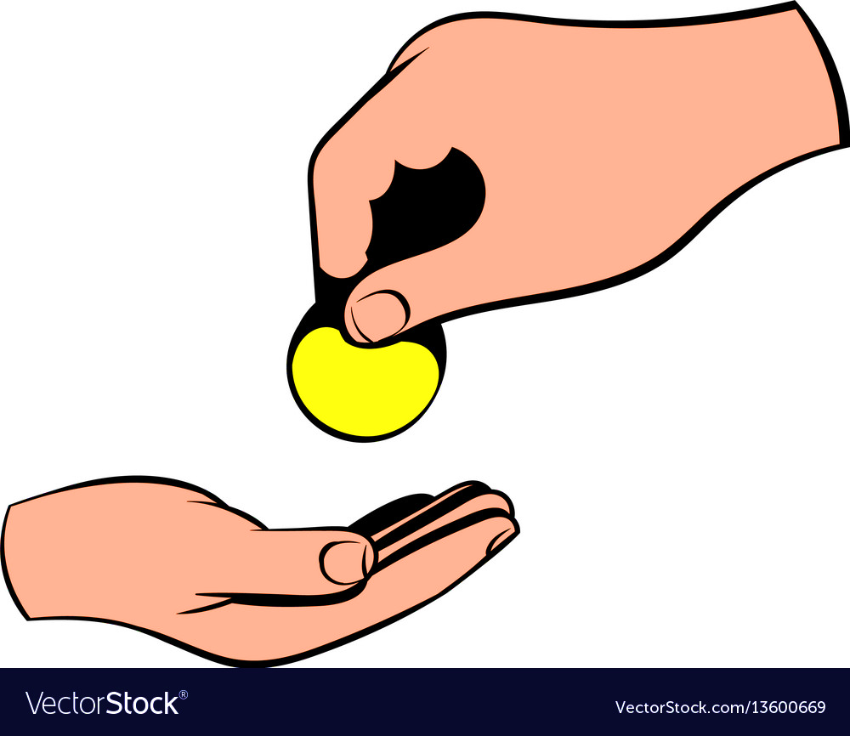



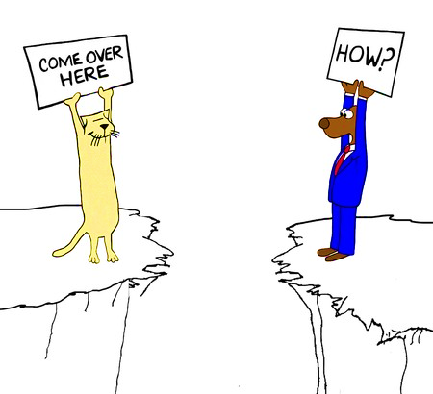
Vocabulary
biscuit
/ˈbɪskɪt/
pass
/pɑːs/
bookshop /ˈbʊkʃɒp/
magazine /ˌmæɡəˈziːn/
come over
/kʌm ˈəʊvər/

Slide 5
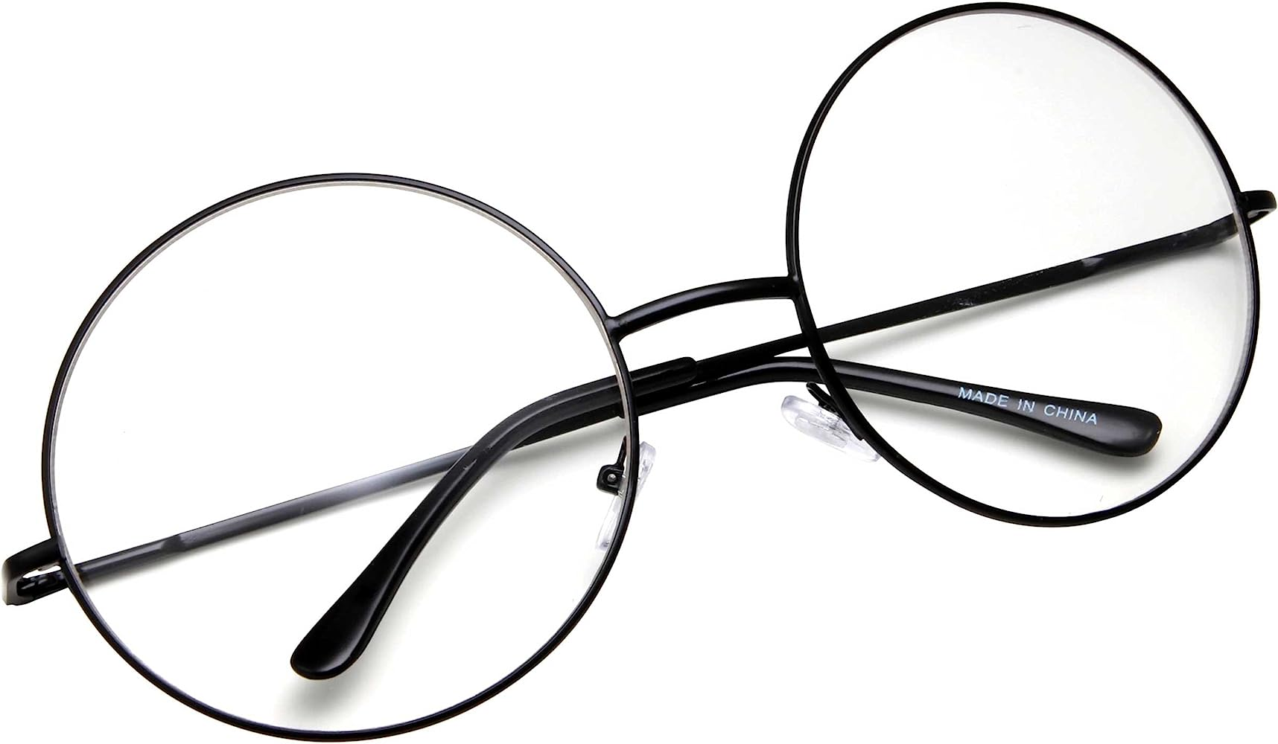
PRESENTATION
glasses (n)
/ˈɡlɑːsɪz/
mắt kính

Slide 6
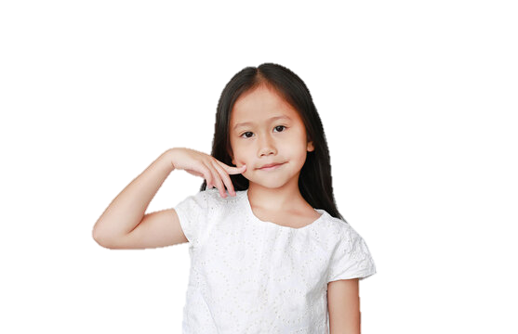
PRESENTATION
cheek (n)
/tʃiːk/
má

Slide 7
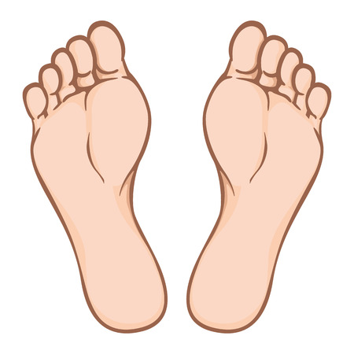
PRESENTATION
foot (n-s)
feet (n-p)
/fʊt/
/fiːt/
bàn chân

Slide 8
PRESENTATION
New words | Pronunciation | Meaning
1. glasses (n) | /ʌnˈjuːʒuəl/ | kính
2. cheek (n) | /tʃiːk/ | má
3. foot (n-s) / feet (n-p) | /fʊt/ /fiːt/ | bàn chân

Slide 9
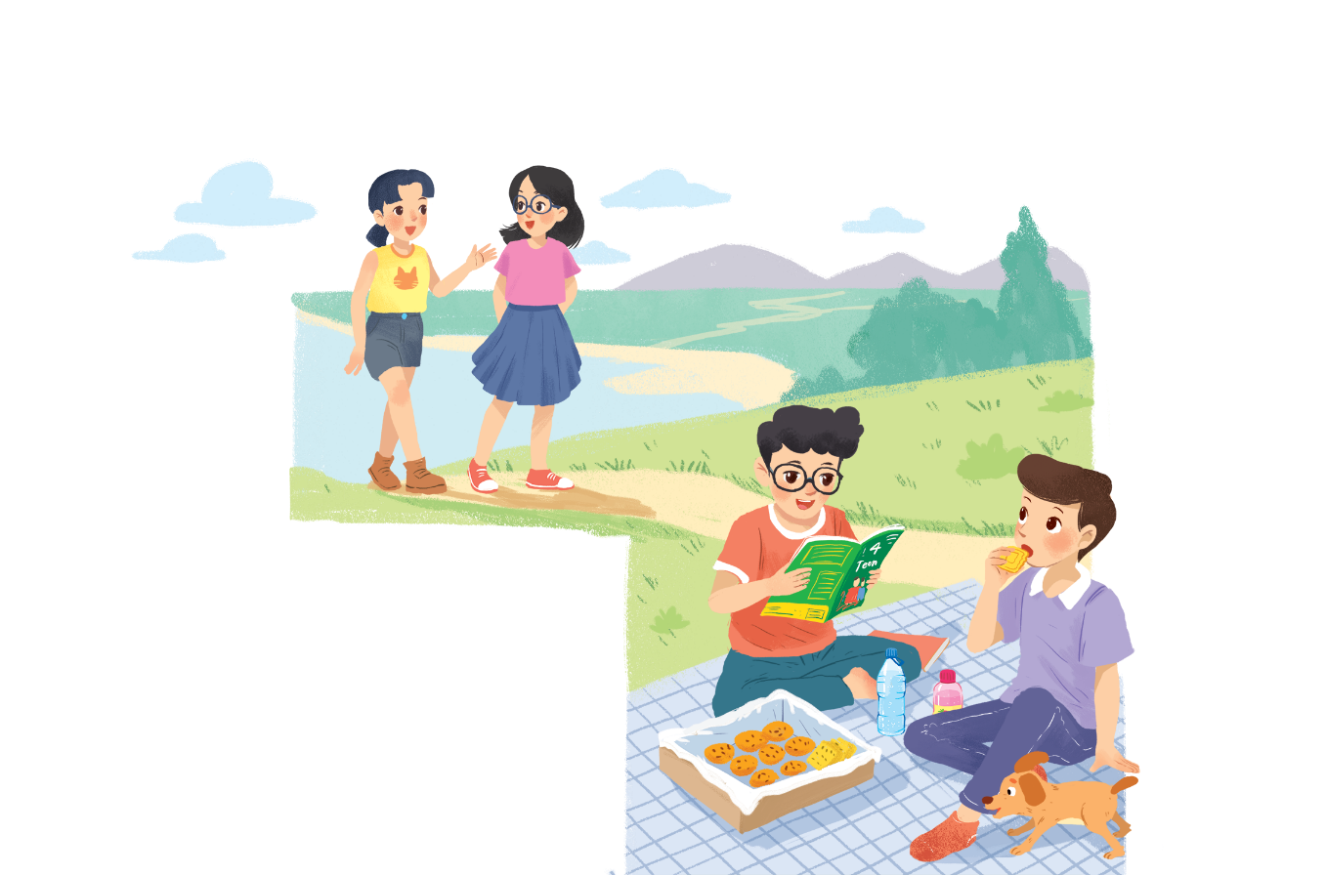

Listen and read.
A surprise guest
Phong: That was a great idea, Nam. I love picnics!
Nam: Please pass me the biscuits.
Phong: Sure. Here you are.
Nam: Thanks. What are you reading, Phong?
Phong: 4Teen. It’s my favourite magazine!
Nam: Look! It’s Mai. And she is with someone.
Phong: Oh, who’s that? She has glasses and long black hair.
Nam: I don’t know. They’re coming over.
Mai: Hi there. This is my friend Chau.
Phong & Nam: Hi, Chau. Nice to meet you.
Chau: Nice to meet you, too.
Nam: Would you like to sit down? We have lots of food.
Mai: Oh, sorry, we can’t. We’re going to the bookshop.
Chau: Bye for now.
Phong & Nam : Bye bye.

Slide 10

Phong: That was a great idea, Nam.
I love picnics!
Nam: Please pass me the biscuits.
Phong: Sure. Here you are.
Nam: Thanks. What are you reading, Phong?
Phong: 4Teen. It’s my favourite magazine!
Nam: Look! It’s Mai. And she is with someone.
Phong: Oh, who’s that? She has glasses and long black hair.
Nam: I don’t know. They’re coming over.
Mai: Hi there. This is my friend Chau.
Phong & Nam: Hi, Chau. Nice to meet you.
Chau: Nice to meet you, too.
Nam: Would you like to sit down? We have lots of food.
Mai: Oh, sorry, we can’t. We’re going to the bookshop.
Chau: Bye for now.
Phong & Nam : Bye bye.
Fill the blanks with the words from the conversation.
Phong and Nam are having a ______.
1.
picnic
4Teen is Phong’s ________________
2.
favourite magazine .
3.
Mai
Phong and Nam see _____ and ______.
Chau
4.
long black hair
Chau has _______ and ____________.
glasses
5.
Mai and Chau ____________ the bookshop.
are going to

Slide 11

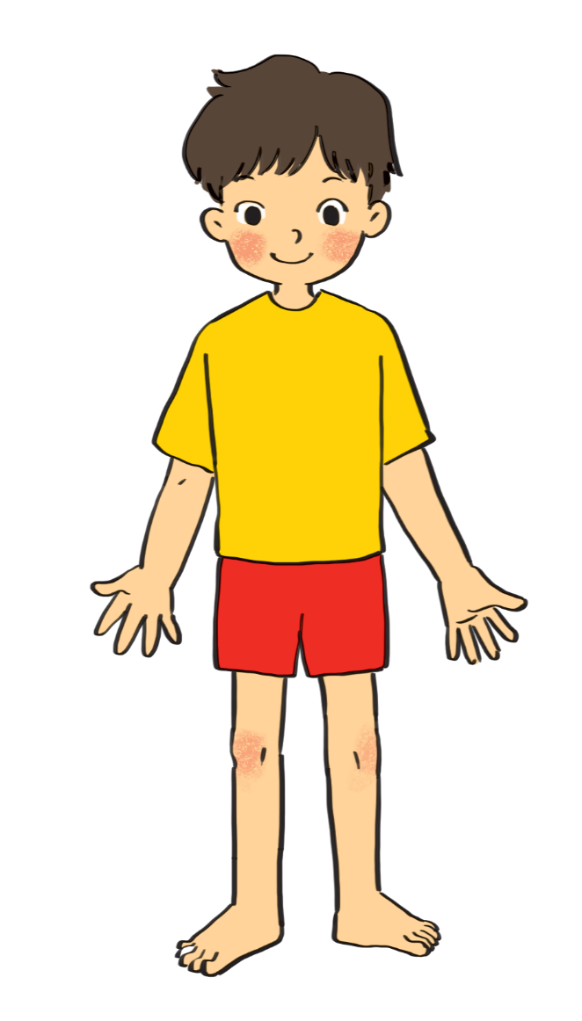
Label the body parts with the words in the box.
10.
hair
1.
eye
cheek
hand
cheek
hand
cheek
9.
nose
leg
arm
2.
leg
arm
8.
mouth
shoulder
eye
eye
shoulder
3.
shoulder
7.
arm
nose
foot
hand
nose
foot
4.
hair
mouth
leg
hair
mouth
5.
6.
foot
Do you know any other words for body parts?

Slide 12

Complete the word webs.
Example:
arms
hair
long / short

Slide 13
Complete the word webs.
nose
eyes
head
big / small
feet
hand
ears

Slide 14
Complete the word webs.
blonde
curly
long/short
black
hair
wavy
straight
fair

Slide 15


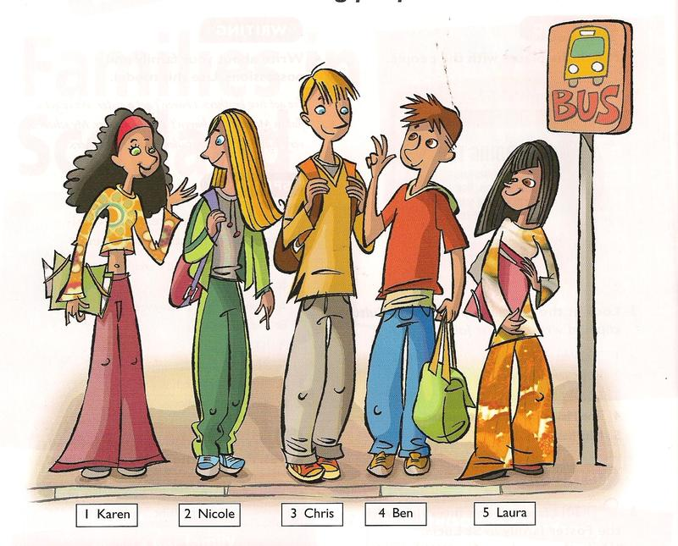
Guessing
Describe a person. Teacher will guess who he / she is.
Example:
She has long hair and big eyes.

Slide 16

See you later!

