Slide 1


WELCOME

Slide 2

UNIT 1 MY NEW SCHOOL
Let’s start our lesson!

Slide 3

SKILLS 1
LESSON 3
SKILLS 1

Slide 4



VOCABULARY
art
/ɑːt/
boarding school
international
/ˈbɔːdɪŋ skuːl/
/ˌɪntəˈnæʃnəl/

Slide 5



VOCABULARY
sport
/spɔːt/
field
club
/fiːld/
/klʌb/

Slide 6
- SKILLS 1 -
READING

Slide 7


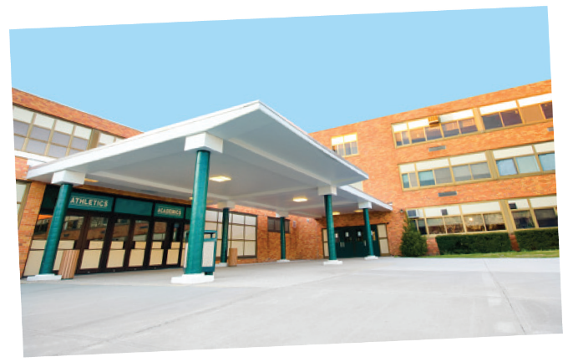
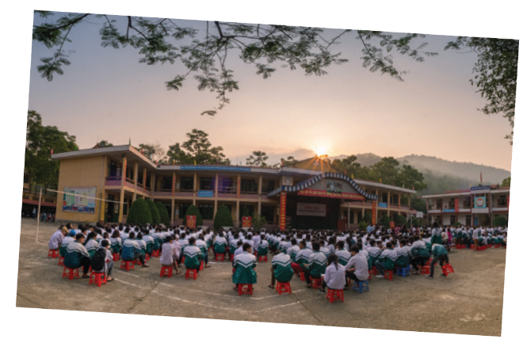

Look at the pictures and quickly read the passages. Match 1-3 with A-C.
Sunrise is a boarding school in Sydney. Students study and live there. About 1,200 boys and girls go to Sunrise. It has students from all over Australia. They study subjects like Maths, Science and English.
A. a school in Bac Giang
B. an international school
An Son is a lower secondary school in Bac Giang. It has only 8 classes. There are mountains and green fields around the school. There is a computer room and a library. There is also a school garden and a playground.
C. a boarding school in Sydney
1. Sunrise
C
Dream is an international school. Here students learn English with English-speaking teachers. In the afternoon, they join many interesting clubs. They play sports and games. Some students do paintings in the art club.
2. An Son
A
3. Dream
B

Slide 8

Read the passages again and complete these sentences.
Sunrise is a boarding school in Sydney. Students study and live there. About 1,200 boys and girls go to Sunrise. It has students from all over Australia. They study subjects like Maths, Science and English.
boarding
1. Students live and study in a __________ school. They only go home at weekends.
2. Sunrise is a school in __________.
3. There are _______________________ around An Son School.
4. ______________ has an art club.
5. At Dream School, students learn English with ________________________.
Sydney
An Son is a lower secondary school in Bac Giang. It has only 8 classes. There are mountains and green fields around the school. There is a computer room and a library. There is also a school garden and a playground.
mountains and green fields
Dream school
Dream is an international school. Here students learn English with English-speaking teachers. In the afternoon, they join many interesting clubs. They play sports and games. Some students do paintings in the art club.
English-speaking teachers

Slide 9

Answer the questions.
Sunrise is a boarding school in Sydney. Students study and live there. About 1,200 boys and girls go to Sunrise. It has students from all over Australia. They study subjects like Maths, Science and English.
1. | Which school is a boarding school?
2. | Where is An Son School?
3. | Is there a school garden in An Son School?
4. | What do Dream School students do in the afternoon?
Sunrise is a boarding school.
It is in Bac Giang.
An Son is a lower secondary school in Bac Giang. It has only 8 classes. There are mountains and green fields around the school. There is a computer room and a library. There is also a school garden and a playground.
Yes, there is.
Dream is an international school. Here students learn English with English-speaking teachers. In the afternoon, they join many interesting clubs. They play sports and games. Some students do paintings in the art club.
They join many interesting clubs.

Slide 10
- SKILL 1 -
SPEAKING

Slide 11

Which school would you like to go to? Why or Why not? Complete the table.
Sunrise is a boarding school in Sydney. Students study and live there. About 1,200 boys and girls go to Sunrise. It has students from all over Australia. They study subjects like Maths, Science and English.
Name of school | Reasons you like it | Reason you don’t like it
An Son is a lower secondary school in Bac Giang. It has only 8 classes. There are mountains and green fields around the school. There is a computer room and a library. There is also a school garden and a playground.
Then discuss your choice with your teacher.
Example:
A: Which school would you like to go to?
B: I’d like to go to Dream School.
A: Why?
B: Because I’d like to paint in the art club.
Dream is an international school. Here students learn English with English-speaking teachers. In the afternoon, they join many interesting clubs. They play sports and games. Some students do paintings in the art club.

Slide 12

See you later!

