Slide 1

Unit 3: WEATHER
Lesson 3.3
Page 42

Slide 2
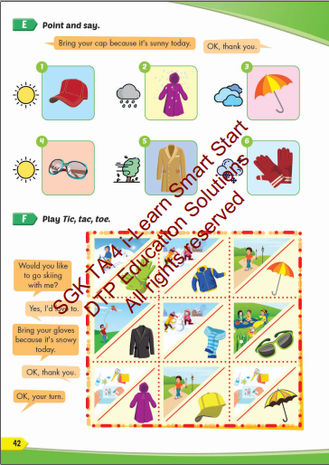
Lesson Outline
Warm-up
Practice
Speaking
Consolidation
Wrap-up

Slide 3
Objectives
By the end of this lesson, students will be able to the weather like today.
Vocabularies:
sunglasses, coat, cap, raincoat, umbrella, gloves.
Structure:
Bring your cap because it's sunny today.
OK, thank you.

Slide 4

WARM UP

Slide 5
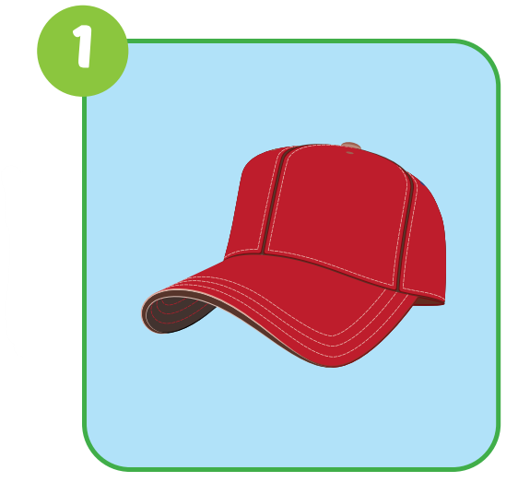
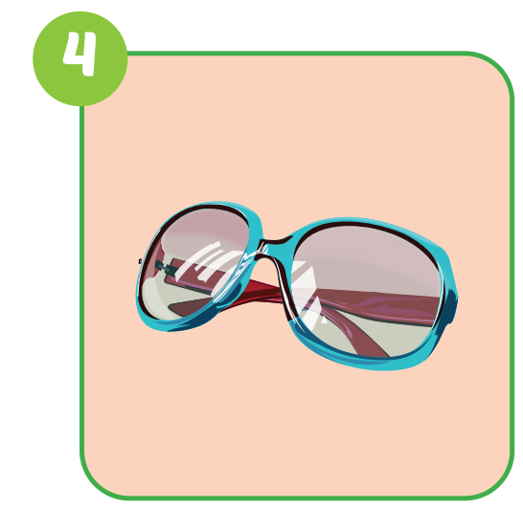
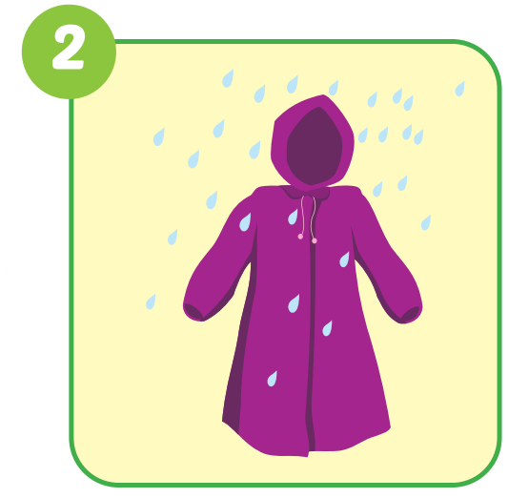
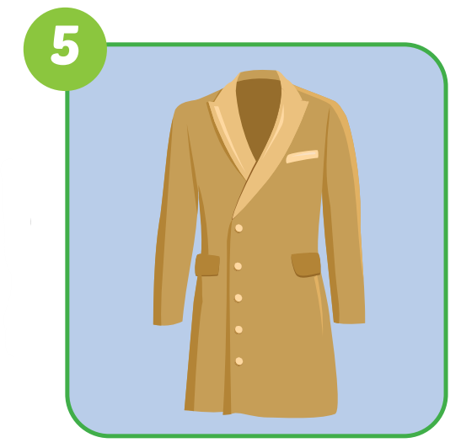
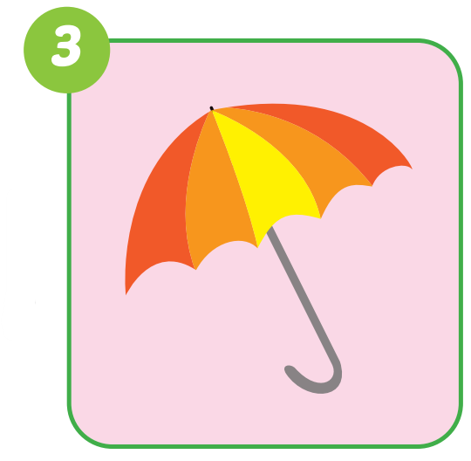
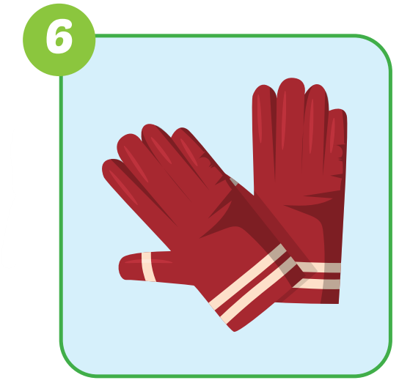
sunglasses
umbrella
cap
raincoat
gloves
coat

Slide 6

Practice

Slide 7

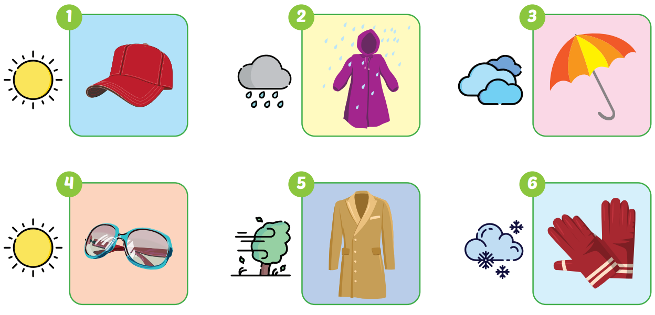
Bring your cap because it's sunny today.
OK, thank you.

Slide 8
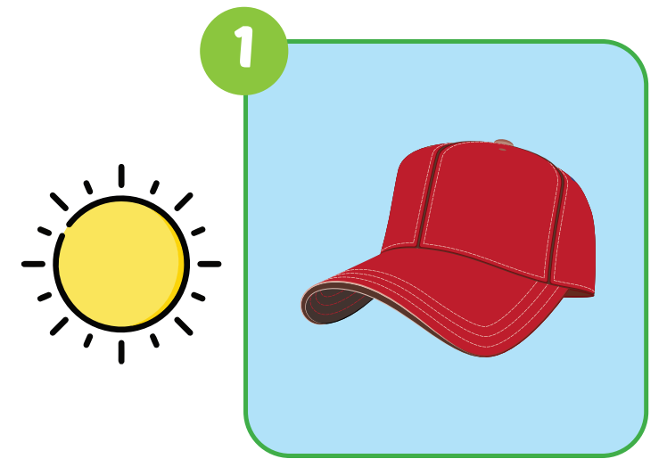
Bring your cap because it's sunny today.
OK, thank you.

Slide 9
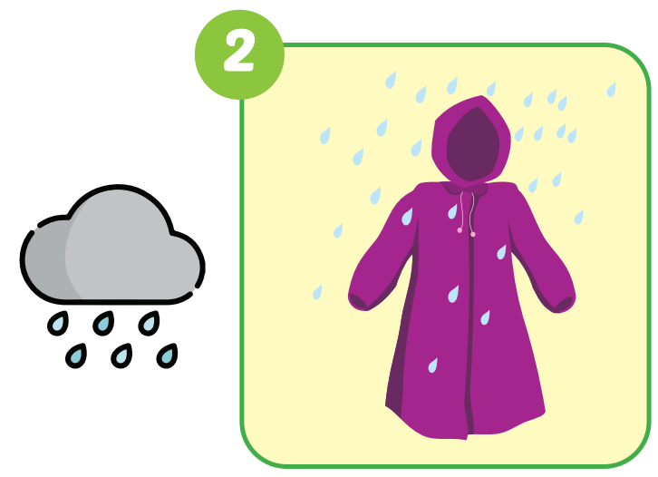
Bring your raincoat because it's rainy today.
OK, thank you.

Slide 10
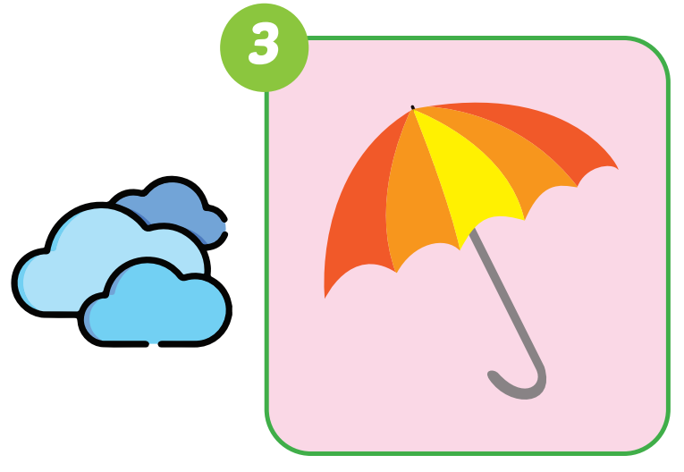
Bring your umbrella because it's cloudy today.
OK, thank you.

Slide 11
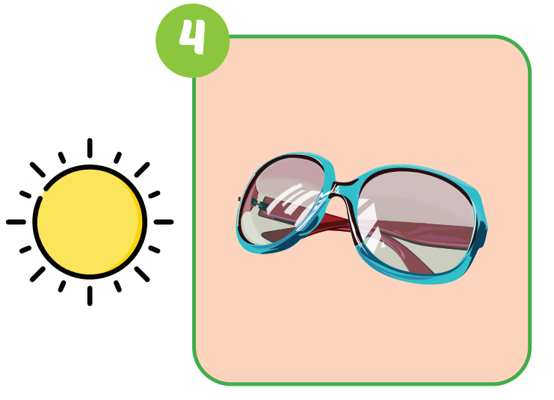
Bring your sunglasses because it's sunny today.
OK, thank you.

Slide 12
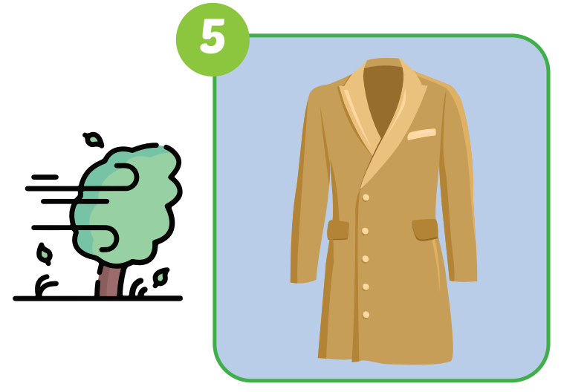
Bring your coat because it's windy today.
OK, thank you.

Slide 13
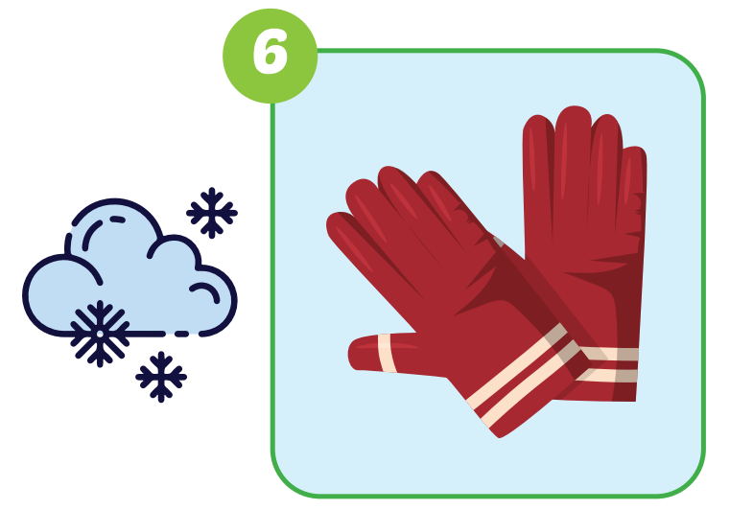
Bring your gloves because it's snowy today.
OK, thank you.

Slide 14

Speaking

Slide 15

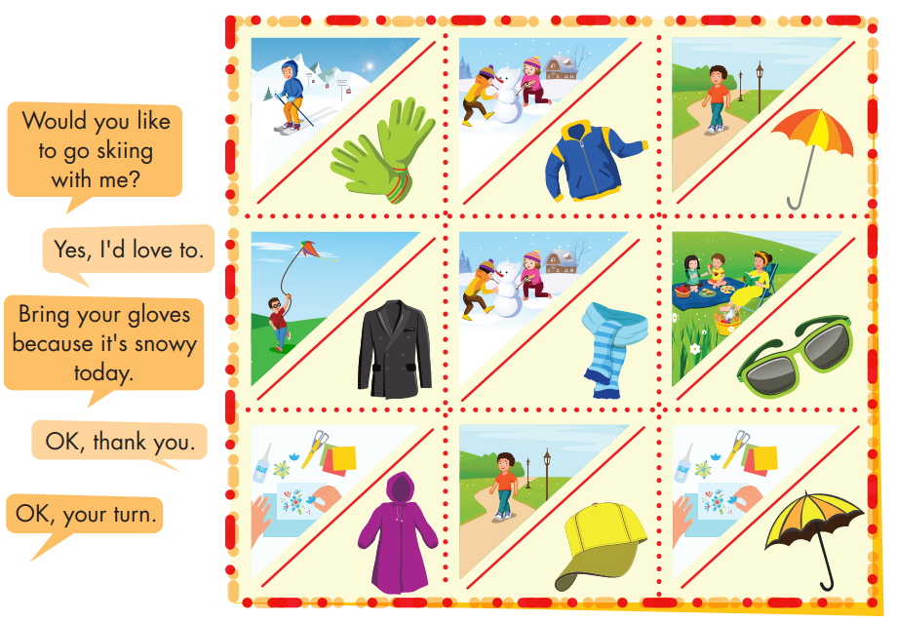

Slide 16
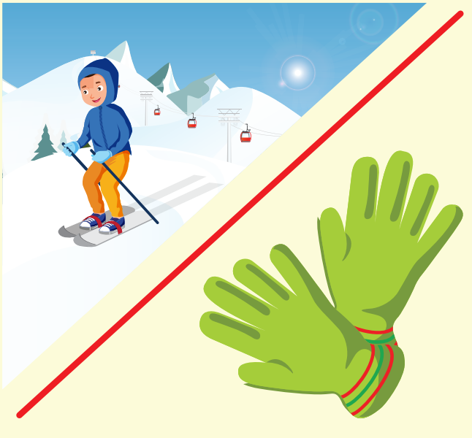
Would you like to go skiing with me?
Yes, I'd love to.
Bring your gloves because it's snowy today.
OK, thank you.

Slide 17
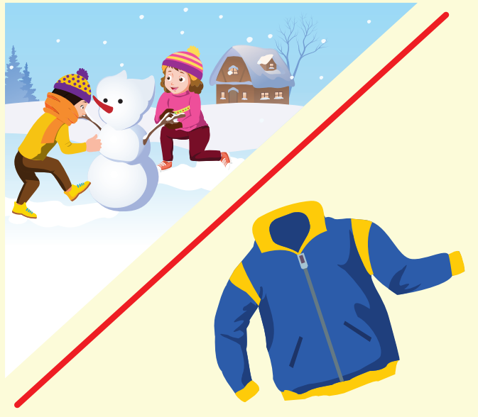
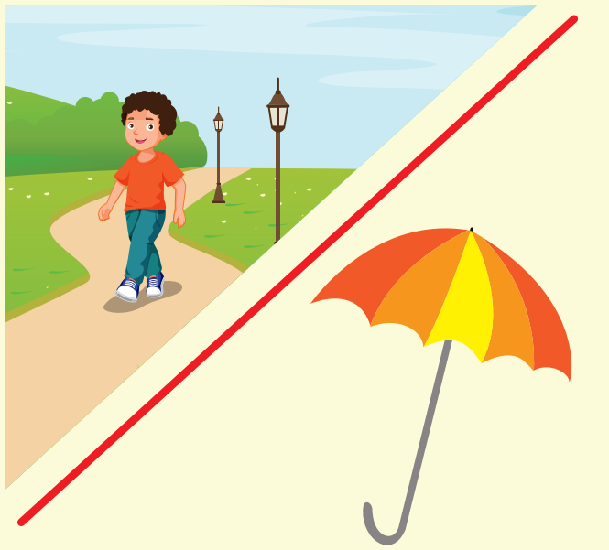

Slide 18
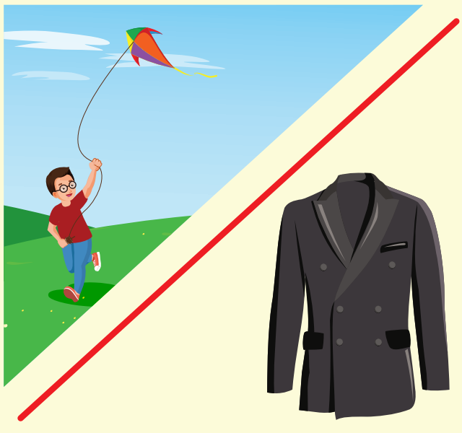
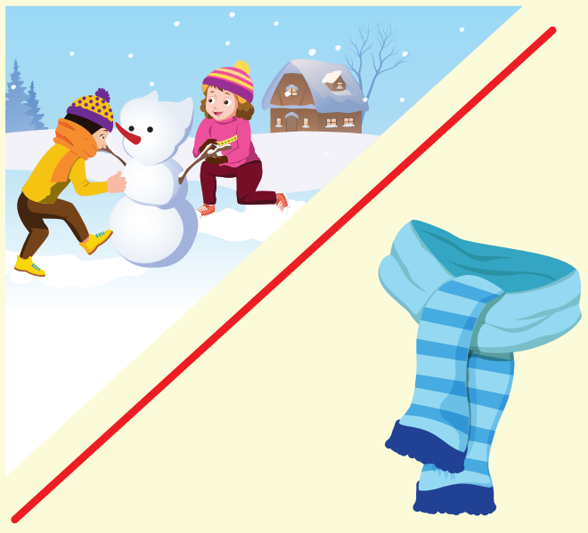

Slide 19



Slide 20
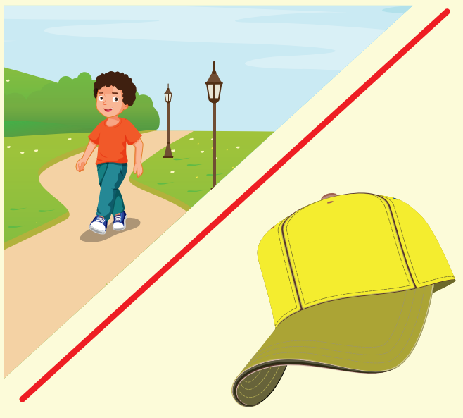


Slide 21

CONSOLIDATION

Slide 22
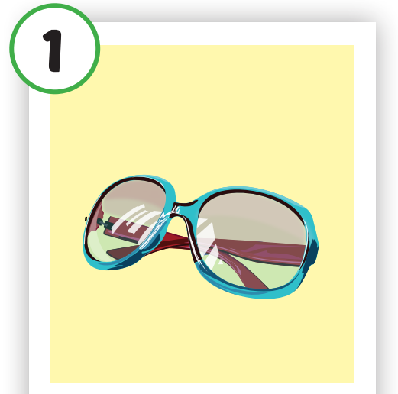
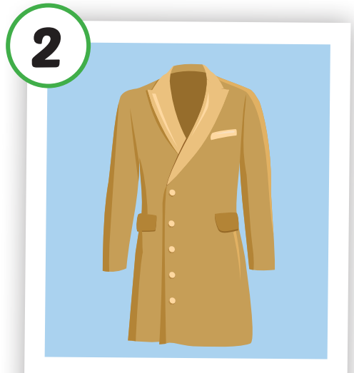
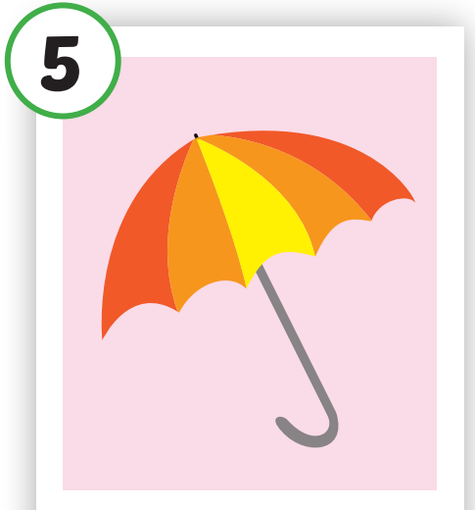
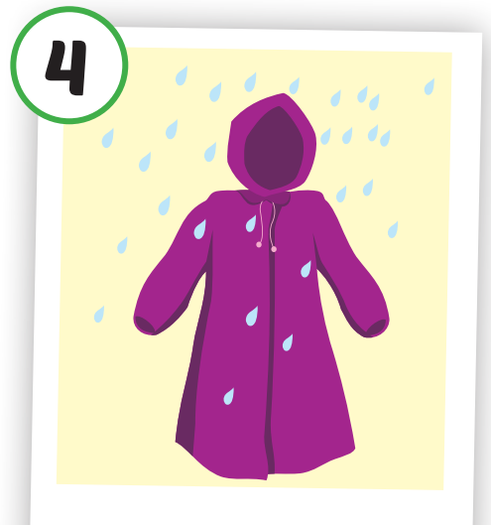

Crossword puzzles
3
4
m
r
2
c
1
n
l
Notes:
Students play the crossword puzzles. They practice spelling.

Slide 23
Crossword puzzles
3
4
m
r
2
c
s
u
n
g
l
a
s
s
e
s
1
Notes:
Students play the crossword puzzles. They practice spelling.

Slide 24
Crossword puzzles
3
4
m
r
2
c
o
s
u
n
g
l
a
s
s
e
s
1
t
Notes:
Students play the crossword puzzles. They practice spelling.

Slide 25
Crossword puzzles
3
u
4
m
r
b
2
r
c
e
o
s
u
n
g
l
a
s
s
e
s
1
l
t
a
Notes:
Students play the crossword puzzles. They practice spelling.

Slide 26
Crossword puzzles
3
u
4
m
r
b
2
a
r
c
i
e
o
s
u
n
g
l
a
s
s
e
s
1
c
l
t
o
a
a
t
Notes:
Students play the crossword puzzles. They practice spelling.

Slide 27

WRAP-UP

Slide 28
Today’s lesson
Vocabularies
sunglasses, coat, cap, raincoat, umbrella, gloves.
Structures/ Sentence patterns
Bring your cap because it's sunny today.
OK, thank you.

Slide 29
Homework
Practice the vocabularies and structure; and make sentences using them.
Do the exercises in Tiếng Anh 4 i-Learn Smart Start WB (page 27).
Do the exercises in Tiếng Anh 4 i-Learn Smart Start Notebook (page 18).
Prepare the next lesson (page 43 SB).
Play the consolidation games in Tiếng Anh 4 i-Learn Smart Start DHA App on www.eduhome.com.vn

Slide 30

Have a nice day!

