Slide 1

Unit 3: WEATHER
Lesson 3.2
Page 41

Slide 2
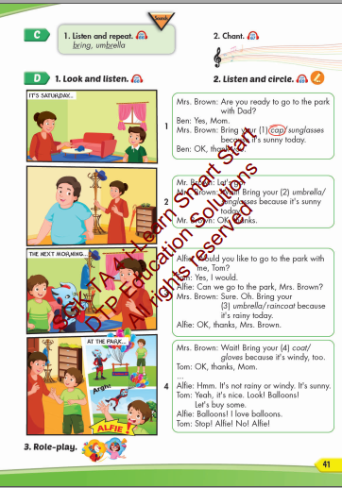
Lesson Outline
Warm-up
Listening
Consolidation
Wrap-up

Slide 3
Objectives
By the end of this lesson, students will be able to the weather like today.
Vocabulary: bring, umbrella.
Structure: Bring your sunglasses because it's sunny today.
OK, thank you.

Slide 4

WARM UP

Slide 5



sunglasses
1

Slide 6


2
raincoat

Slide 7


3
umbrella

Slide 8


4
cap

Slide 9


5
coat

Slide 10


6
gloves

Slide 11

It’s time to learn …

Slide 12

Listening

Slide 13




Click each English word to hear the sound.
bring
umbrella
/ˈbrɪŋ/
mang theo
/ʌmˈbrelə/
Cái ô

Slide 14


Click the earphone to hear the sound.
Bring your umbrella, your brown umbrella because it's rainy today.
Bring some bread, some brown bread because I'm hungry today.

Slide 15

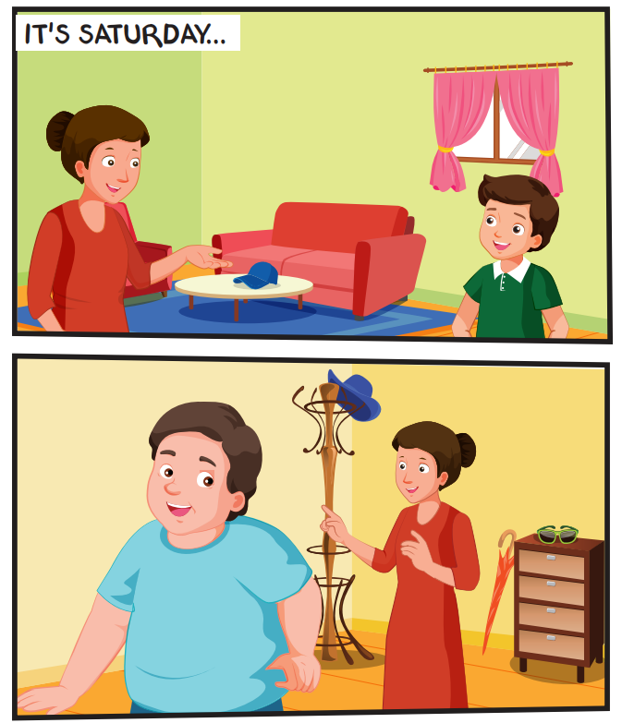
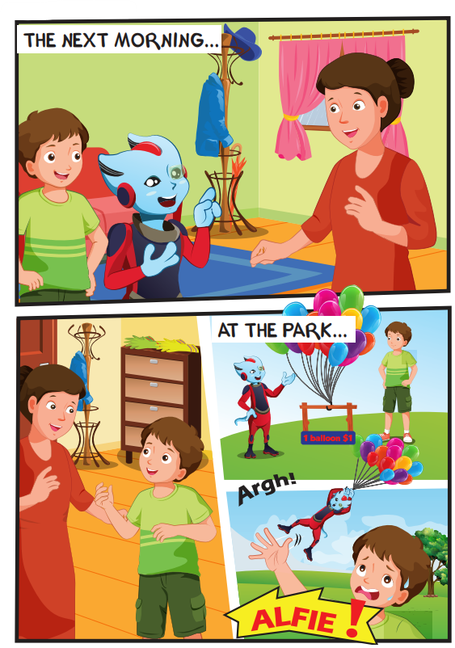

Slide 16

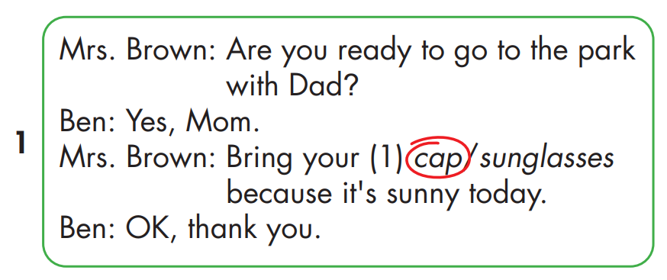

Slide 17
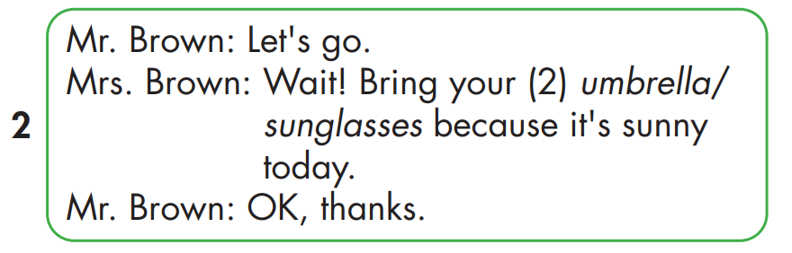
Click each English word to hear the sound.

Slide 18
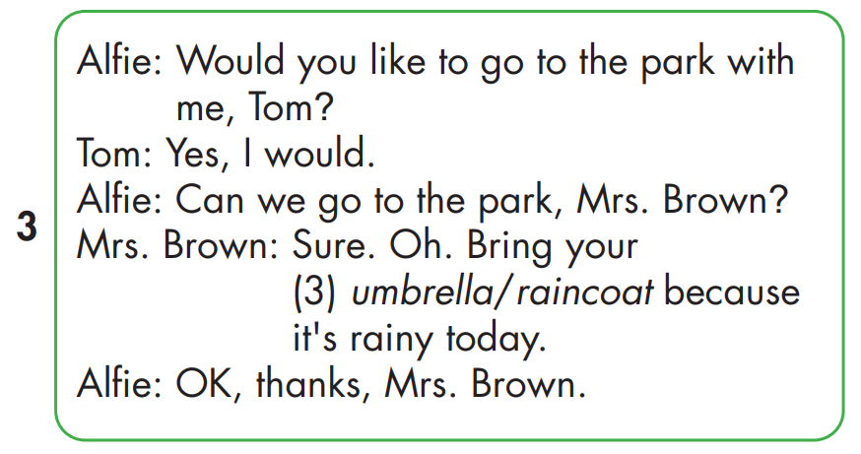
Click each English word to hear the sound.

Slide 19
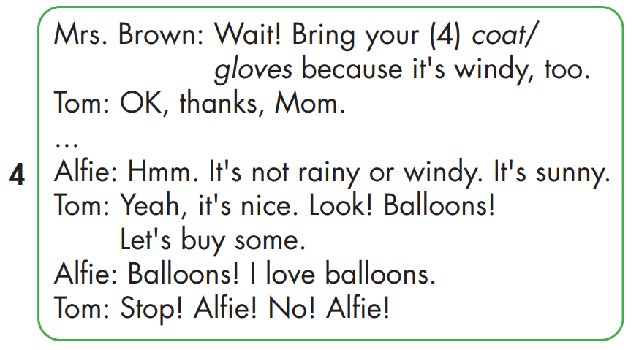
Click each English word to hear the sound.

Slide 20

Practice

Slide 21



Bring your coat because it's windy today.
OK, thank you.

Slide 22
Bring your gloves because it's snowy today.
OK, thank you.

Slide 23
Bring your raincoat because it's rainy today.
OK, thank you.

Slide 24
Bring your cap because it's sunny today.
OK, thank you.

Slide 25
Bring your umbrella because it's rainy today.
OK, thank you.

Slide 26

CONSOLIDATION

Slide 27

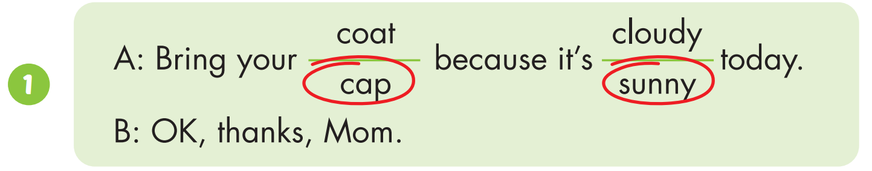

Slide 28
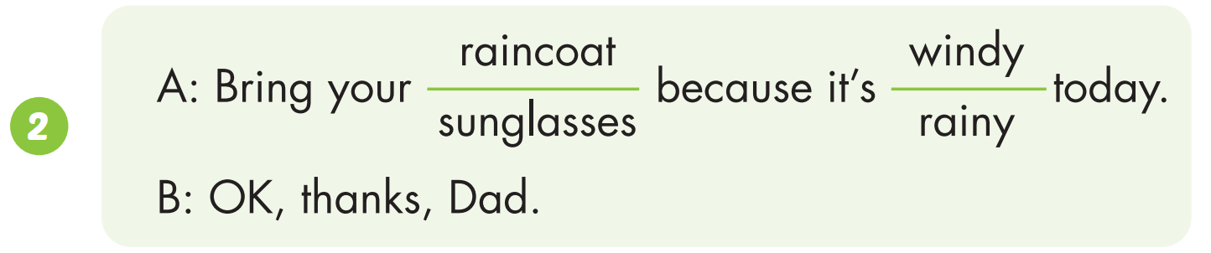

Slide 29
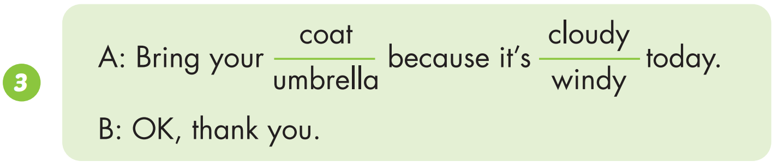

Slide 30
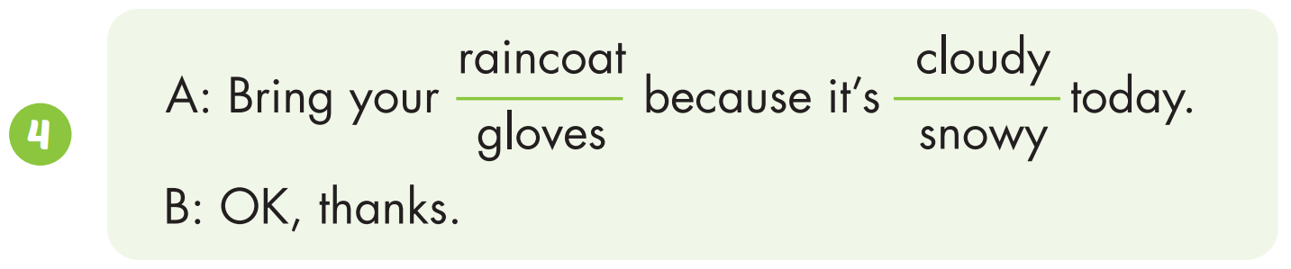

Slide 31

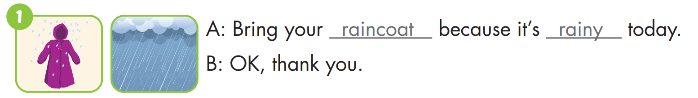
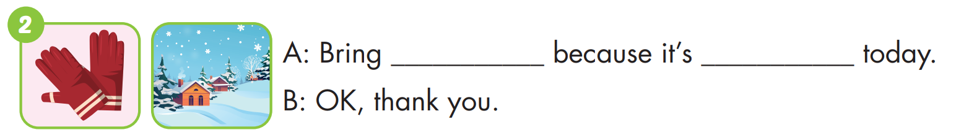
gloves
snowy

Slide 32
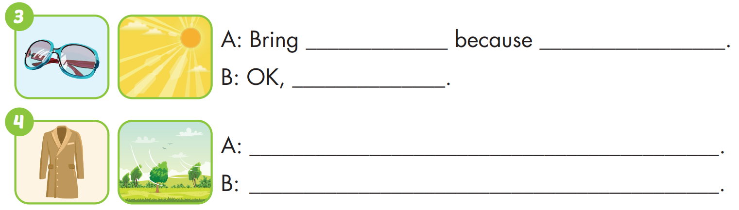
your sunglasses
it's sunny today
thank you
Bring your coat because it's windy today
OK, thank you

Slide 33

WRAP-UP

Slide 34
Today’s lesson
Vocabularies
bring, umbrella.
Structures/ Sentence patterns
Bring your sunglasses because it's sunny today.
OK, thank you.

Slide 35
Homework
Practice the vocabularies and structure; and make sentences using them.
Do the exercises in Tiếng Anh 4 i-Learn Smart Start WB (page 27).
Do the exercises in Tiếng Anh 4 i-Learn Smart Start Notebook (page 18).
Prepare the next lesson (page 42 SB).
Play the consolidation games in Tiếng Anh 4 i-Learn Smart Start DHA App on www.eduhome.com.vn

Slide 36

Have a nice day!

