Slide 1

Unit 3: WEATHER
Lesson 3.1
Page 40

Slide 2
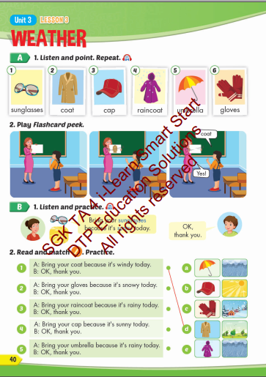
Lesson Outline
Warm-up
Vocabulary
Structure
Consolidation
Wrap-up

Slide 3
Objectives
By the end of this lesson, students will be able to the weather like today.
Vocabulary: sunglasses, coat, cap, raincoat, umbrella, gloves.
Structure: Bring your sunglasses because it's sunny today.
OK, thank you.

Slide 4

WARM UP

Slide 5


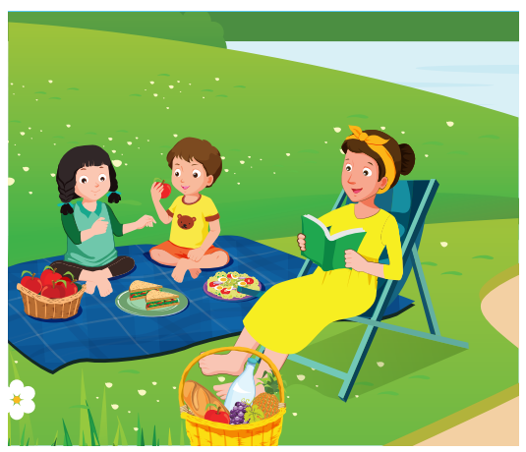
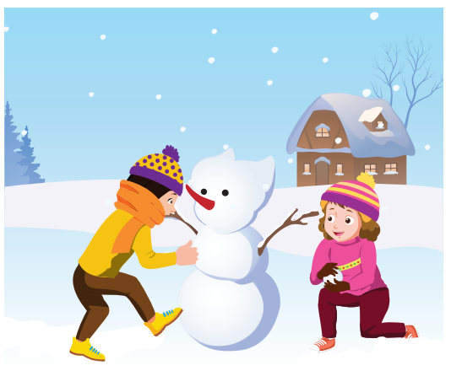
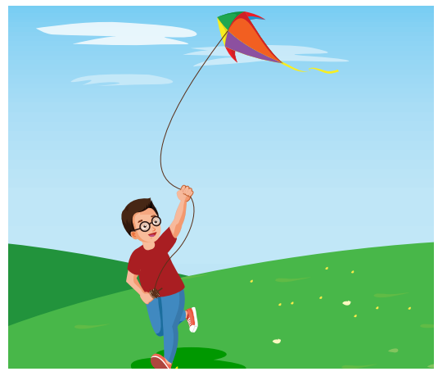

Look at the word and say the right number.
4
3
2
1
fly a kite

Slide 6
Look at the word and say the right number.
4
3
2
1
have a picnic

Slide 7
Look at the word and say the right number.
4
3
2
1
do arts and crafts

Slide 8
Look at the word and say the right number.
4
3
2
1
make a snowman

Slide 9

It’s time to learn …

Slide 10

New words
sunglasses,
coat,
cap,
raincoat,
umbrella,
gloves

Slide 11

Vocabulary

Slide 12

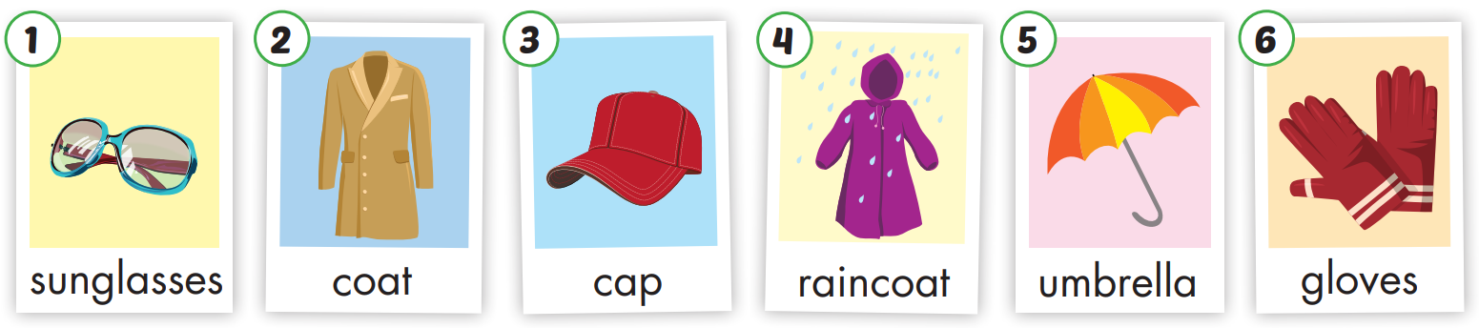

Slide 13
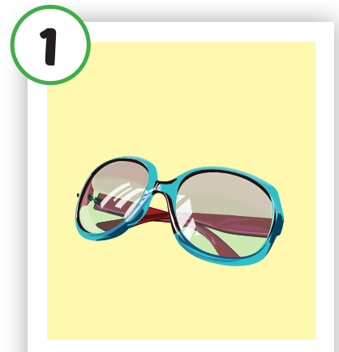
Click each English word to hear the sound.
sunglasses
/ˈsʌnɡlæsɪz/
Kính râm

Slide 14
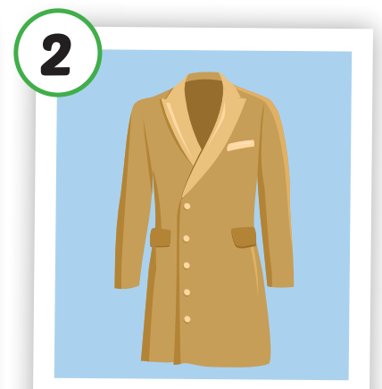
Click each English word to hear the sound.
coat
/koʊt/
Áo choàng

Slide 15
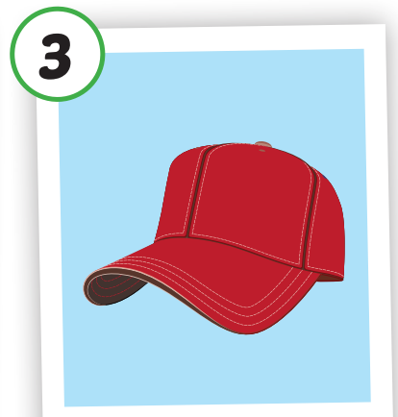
Click each English word to hear the sound.
cap
/kæp/
Mũ lưỡi trai

Slide 16
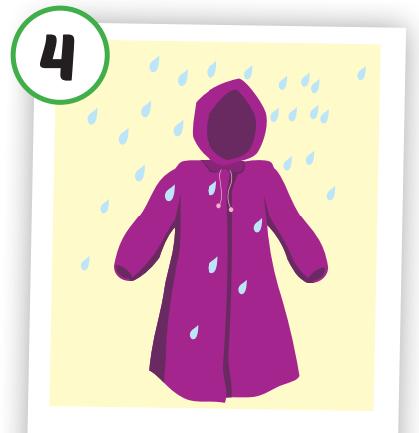
Click each English word to hear the sound.
raincoat
/ˈreɪnkoʊt/
Áo mưa

Slide 17
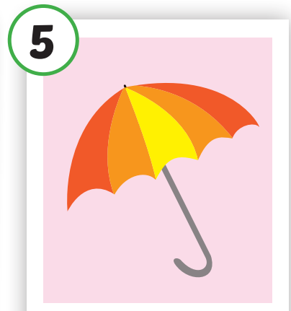
Click each English word to hear the sound.
umbrella
/ʌmˈbrelə/
Cái ô

Slide 18
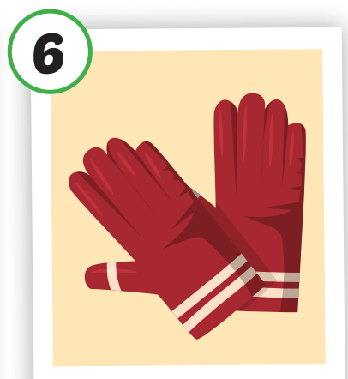
Click each English word to hear the sound.
gloves
/ɡlʌvz/
Găng tay

Slide 19
Practice

Slide 20

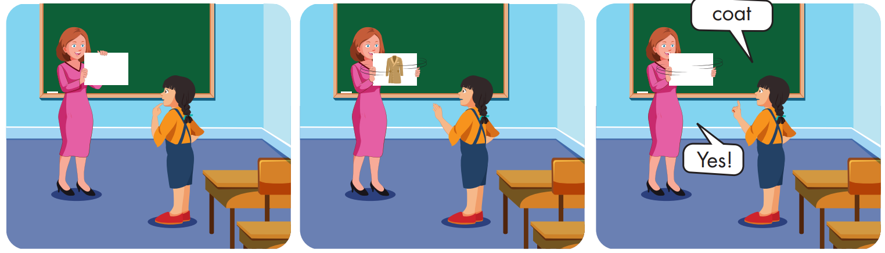

Slide 21
Structures:
Bring your sunglasses because it's sunny today.
OK, thank you.

Slide 22

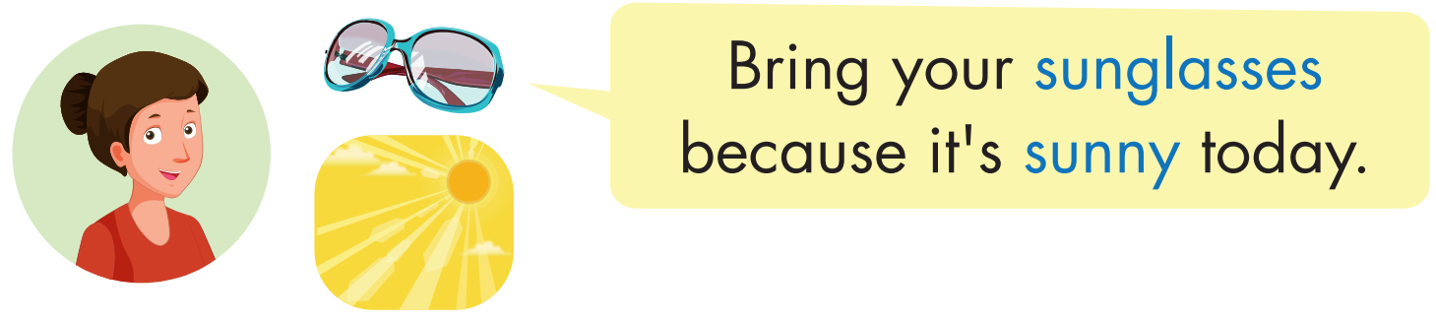

Click each English word to hear the sound.

Slide 23
Practice

Slide 24
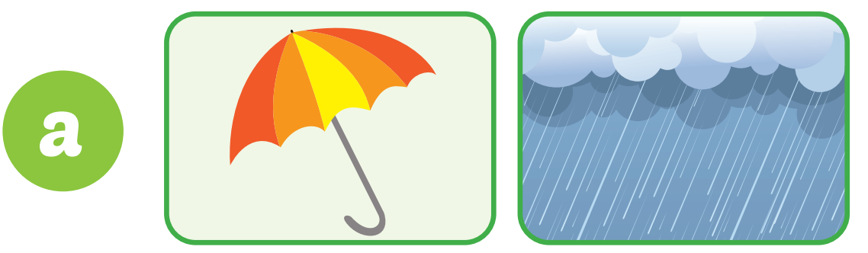


Bring your umbrella because it's rainy today.
OK,
thank you.

Slide 25
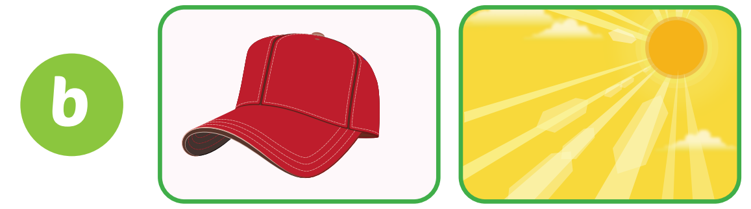
Bring your cap because it's sunny today.
OK,
thank you.

Slide 26
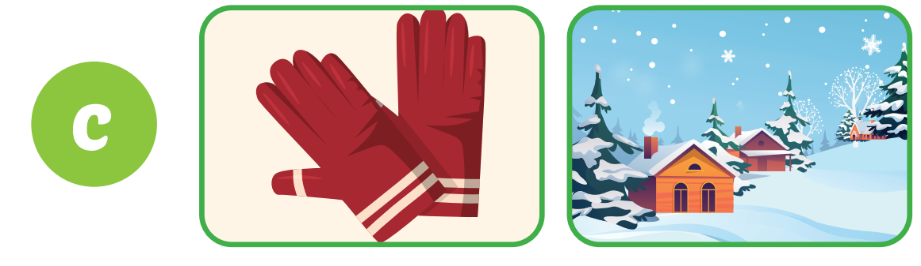
Bring your gloves because it's snowy today.
OK,
thank you.

Slide 27
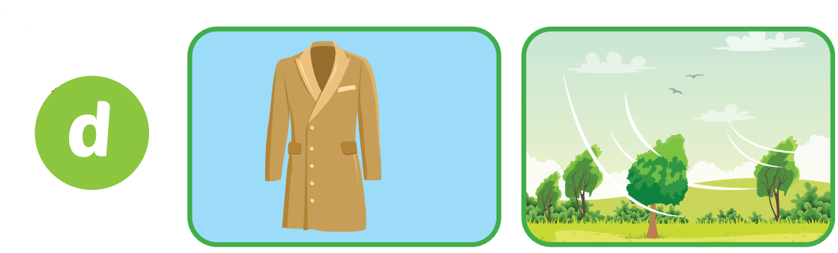
Bring your coat because it's windy today.
OK,
thank you.

Slide 28

Bring your raincoat because it's rainy today.
OK,
thank you.

Slide 29

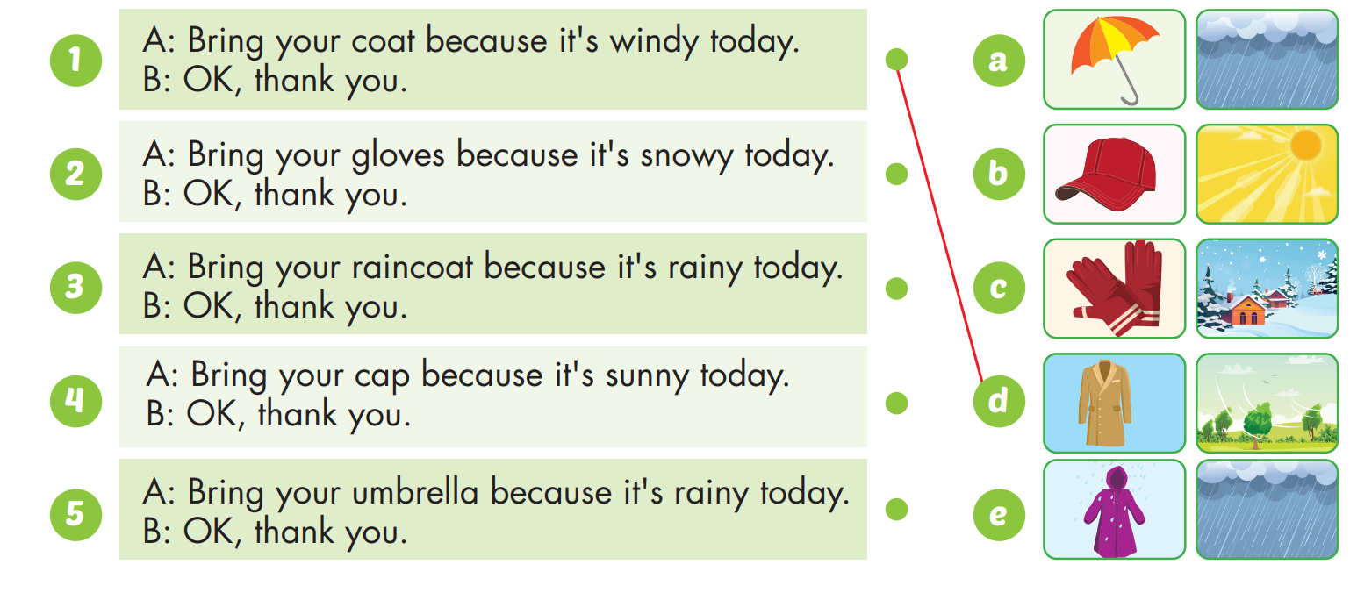

Slide 30

Practice

Slide 31

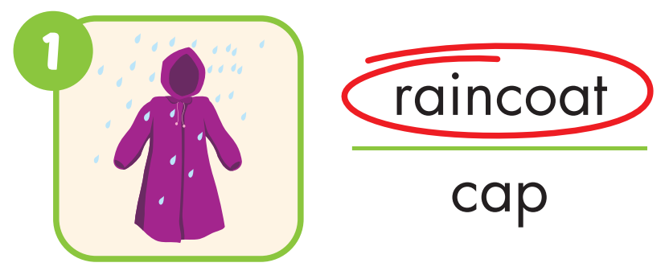
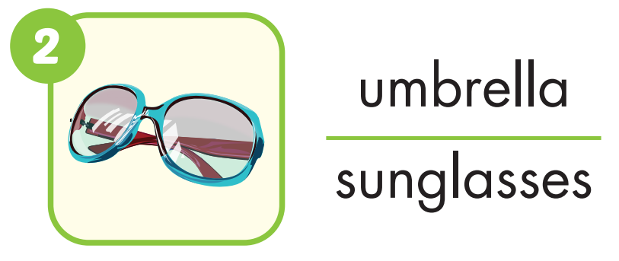

Slide 32
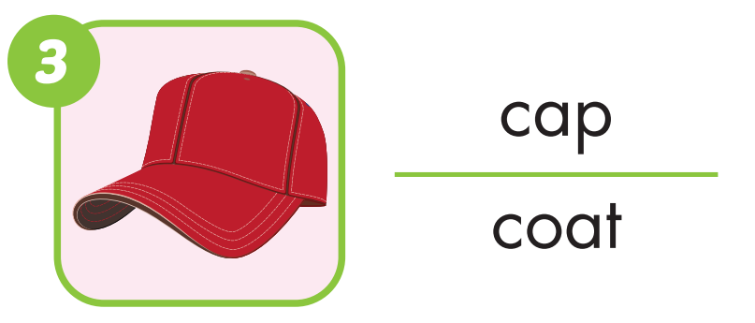


Slide 33
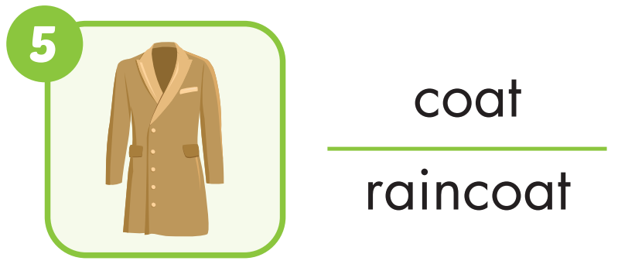


Slide 34

CONSOLIDATION

Slide 35
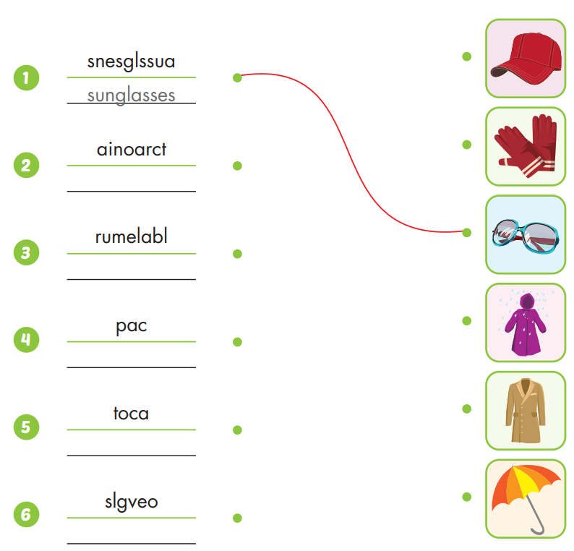

raincoat
umbrella
cap
coat
gloves

Slide 36

WRAP-UP

Slide 37
Today’s lesson
Vocabularies
sunglasses, coat, cap, raincoat, umbrella, gloves.
Structures/ Sentence patterns
Bring your sunglasses because it's sunny today.
OK, thank you.

Slide 38
Homework
Practice the vocabularies and structure; and make sentences using them.
Do the exercises in Tiếng Anh 4 i-Learn Smart Start WB (page 26).
Do the exercises in Tiếng Anh 4 i-Learn Smart Start Notebook (page 18).
Prepare the next lesson (page 41 SB).
Play the consolidation games in Tiếng Anh 4 i-Learn Smart Start DHA App on www.eduhome.com.vn

Slide 39
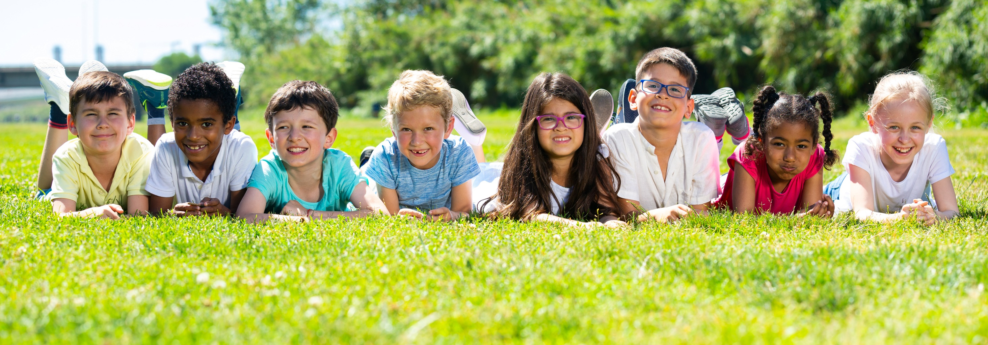
Have a nice day!

Slide 40
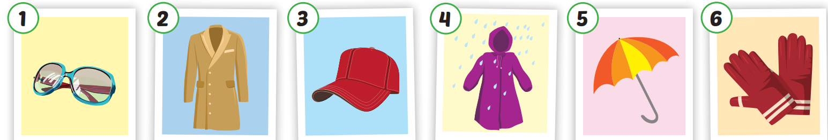
Click each English word to hear the sound.
sunglasses
coat
cap
raincoat
umbrella
gloves
/ˈsʌnɡlæsɪz/
Kính râm
/koʊt/
Áo choàng
/kæp/
Mũ lưỡi trai
/ ˈreɪnkoʊt/
Áo mưa
/ʌmˈbrelə/
Cái ô
/ɡlʌvz/
Găng tay

