Slide 1

Unit 2
WHAT I CAN DO
LESSON 3.2 - PAGE 27

Slide 2
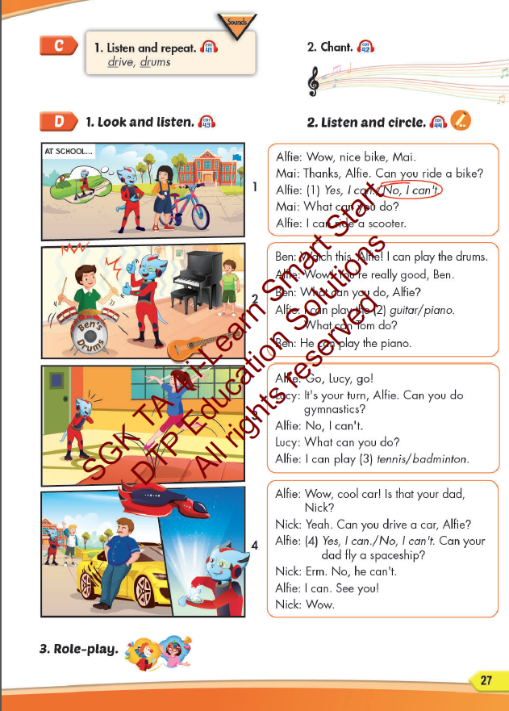
Lesson Outline
Warm-up
Listening
Consolidation
Wrap-up

Slide 3
Objectives
By the end of this lesson, students will be able to identify the /dr/ sound and practice the conversations.
Vocabulary: drive, drums
Structure: What can you do? - I can play the drums.
What can your mom do? - She can drive a car.
Phonics: /dr/

Slide 4

WARM UP

Slide 5



LISTEN AND CHOOSE

Slide 6
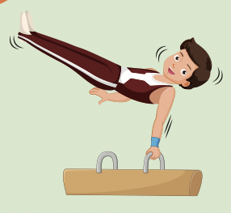
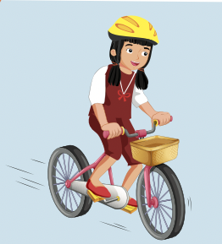
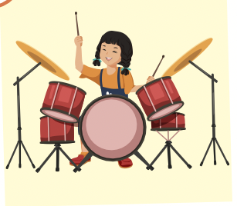


Slide 8
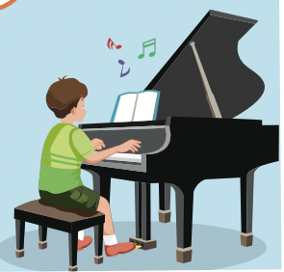
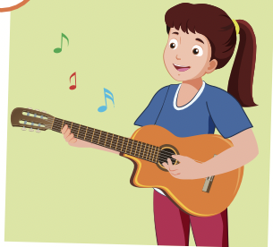
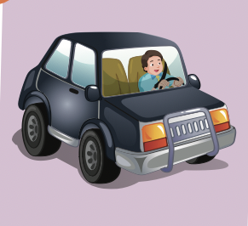

Slide 10

It’s time to learn …

Slide 11

Phonics /dr/

Slide 12

Presentation

Slide 13
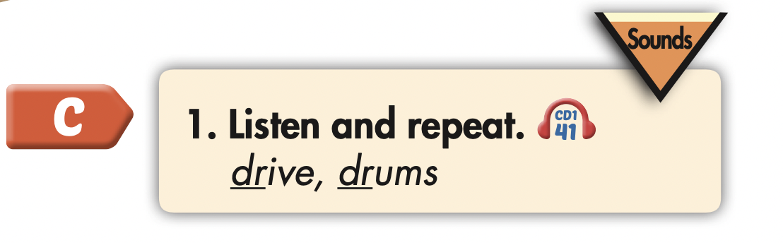
Click the icon to hear the sound.
drive
drum
/draɪv/
/drʌm/

Slide 14

Practice

Slide 15



Slide 16
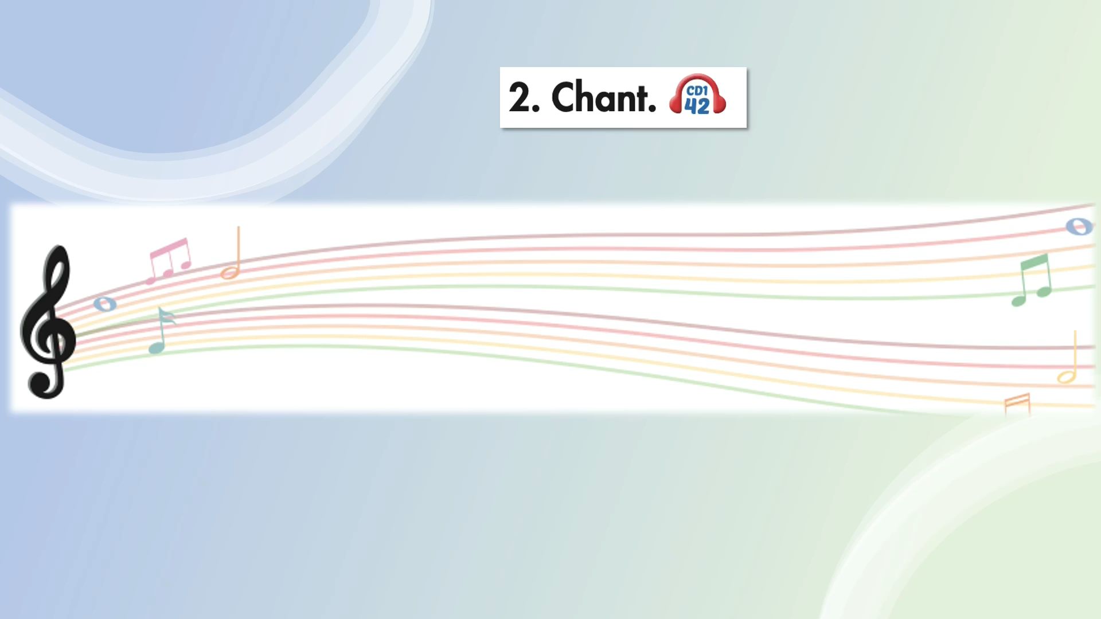

Slide 17
Structures
What can you do?
- I can play the drums.
What can your mom do?
- She can drive a car.

Slide 18

Listening

Slide 19
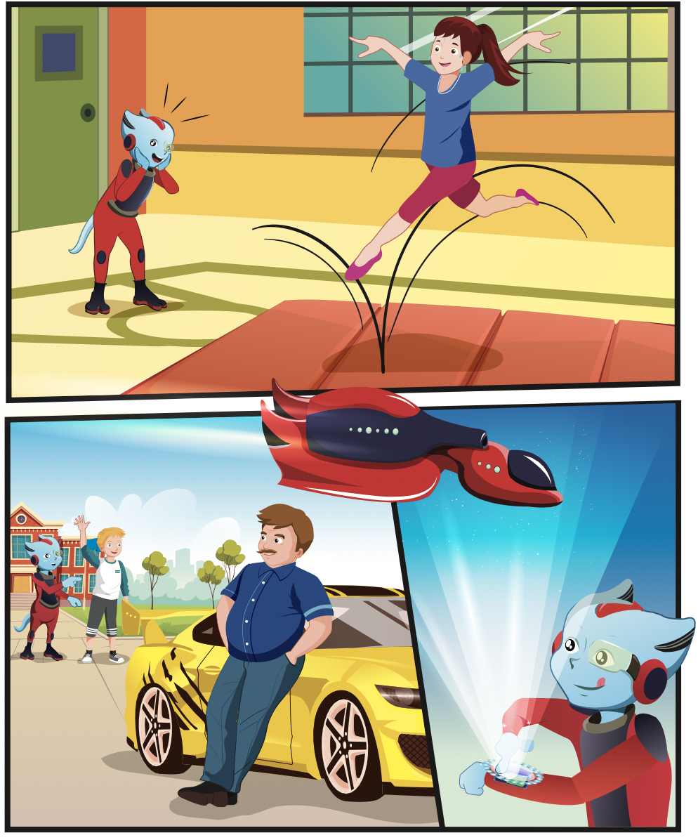
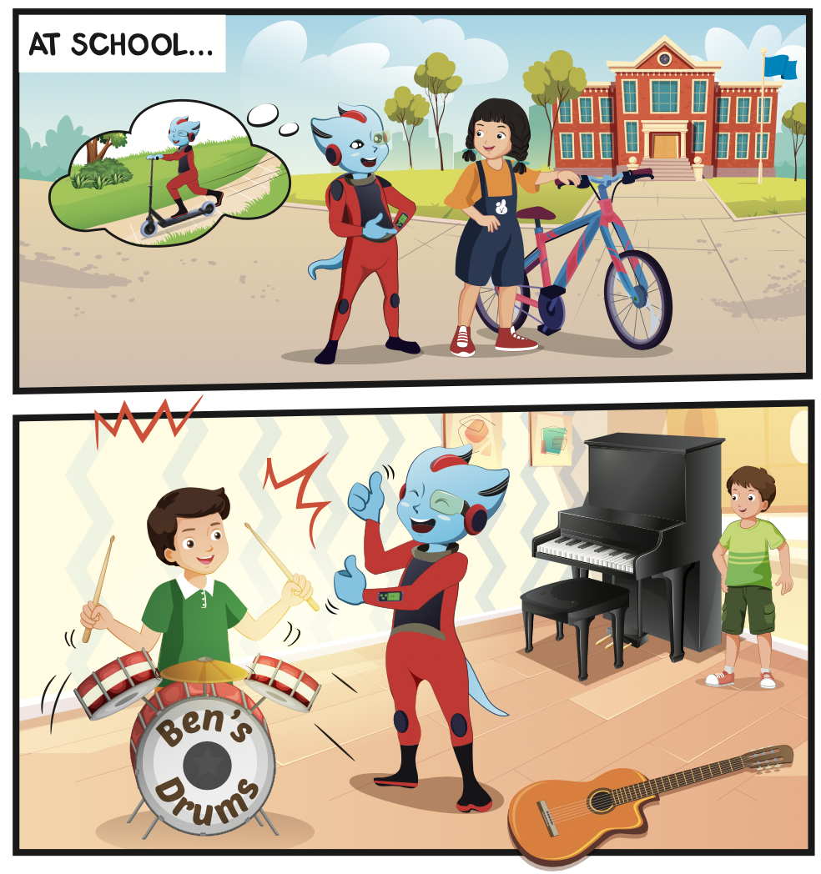
Which classes do they have?
Who can you see?
What can you see in the music class?

Slide 20


Slide 21

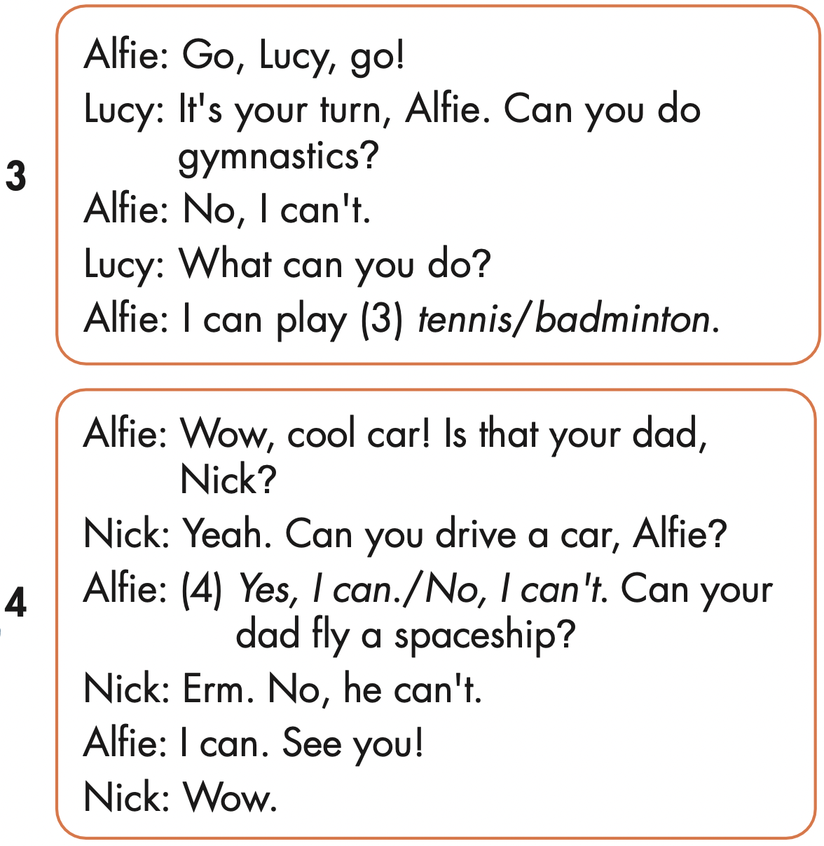
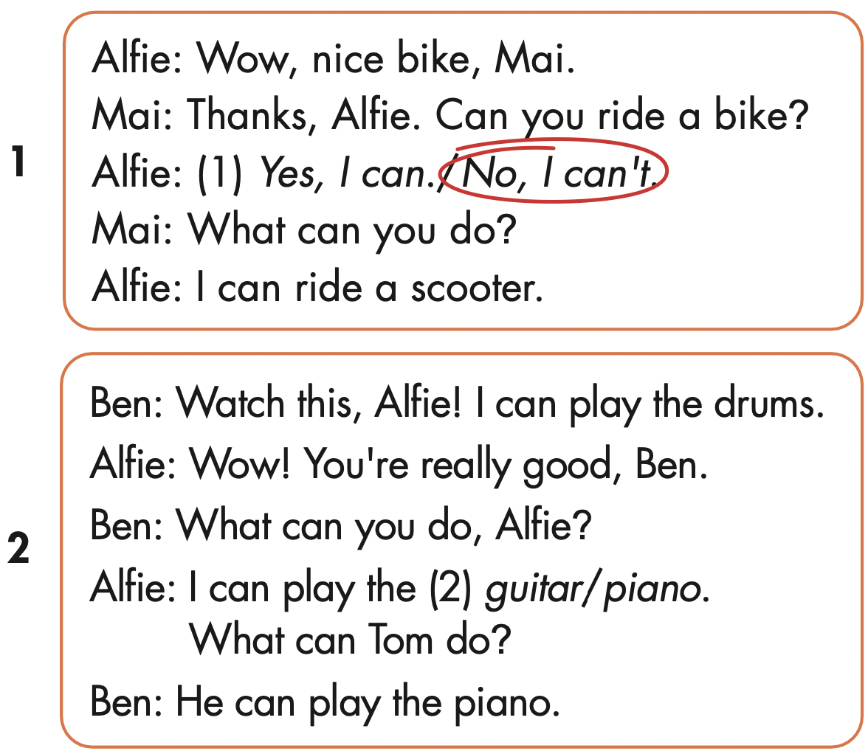

Slide 22

Production

Slide 23



Slide 24

Writing

Slide 25
Make your own stories.

Slide 26

CONSOLIDATION

Slide 27

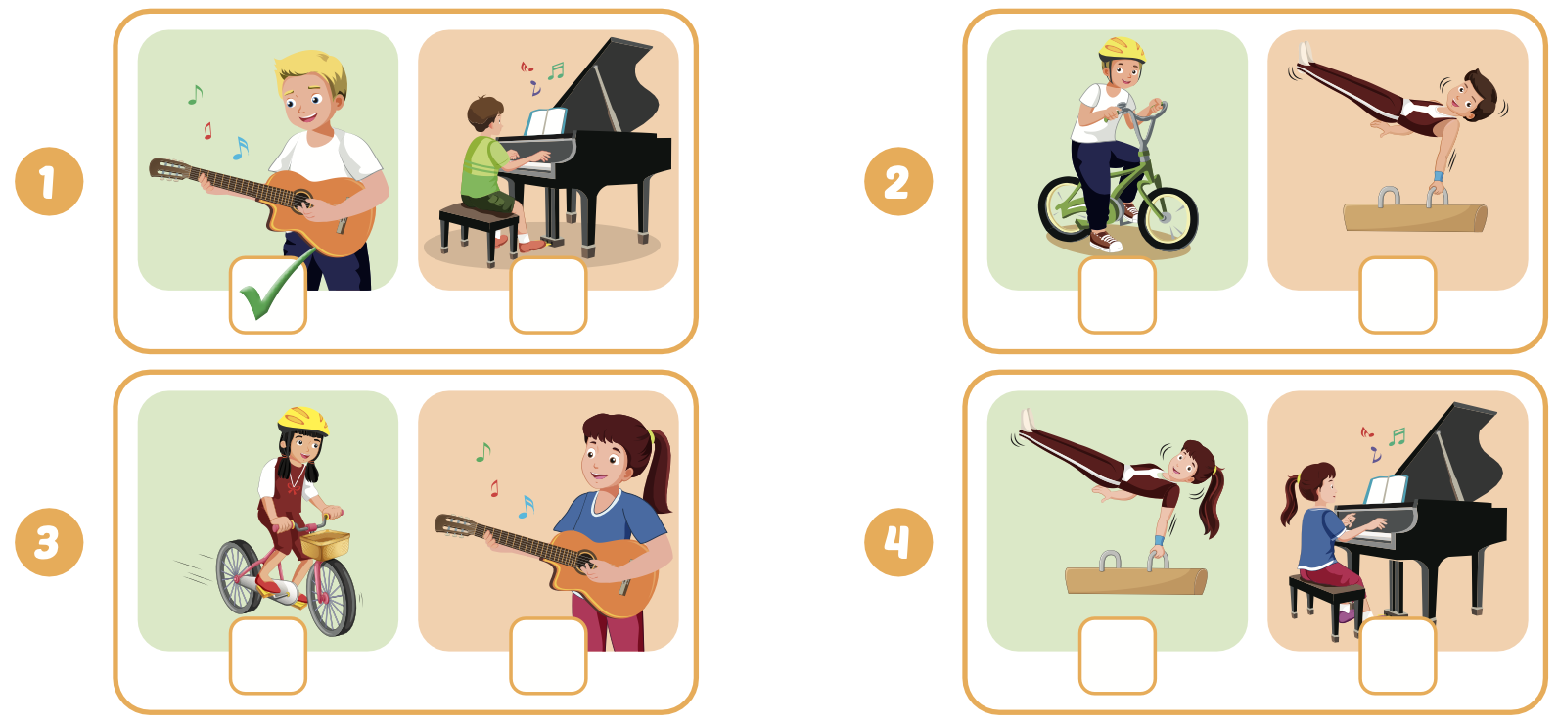

Extra Practice
WB, page 17

Slide 28

WRAP-UP

Slide 29
Today’s lesson
Phonics
/dr/
Structures/ Sentence patterns
What can you do?
- I can play the drums.
What can your mom do?
- She can drive a car.

Slide 30
Homework
Practice the vocabularies and structure; and make sentences using them.
Do the exercises in Tiếng Anh 4 i-Learn Smart Start WB (page 17)
Do the exercises in Tiếng Anh 4 i-Learn Smart Start Notebook (page 12)
Prepare the next lesson (page 28 SB)
Play the consolidation games in Tiếng Anh 4 i-Learn Smart Start DHA App on www.eduhome.com.vn

Slide 31

Enjoy your day!

