Slide 1

Unit 1: SCHOOL
Lesson 1.2
Page 7

Slide 2
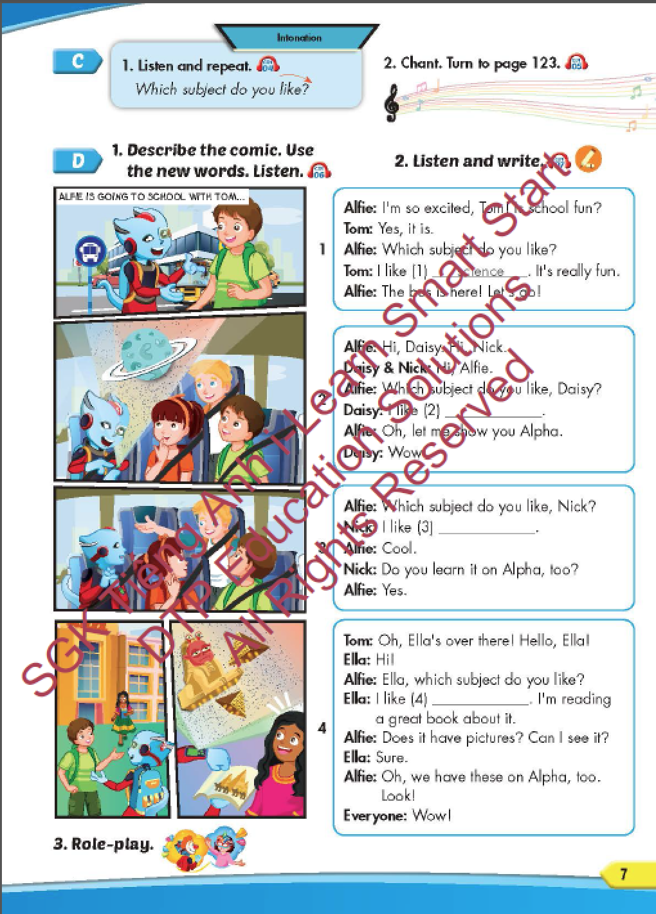
Lesson Outline
Warm-up
Pronunciation
Listening
Speaking
Consolidation
Wrap-up

Slide 3
Objectives
By the end of this lesson, students will be able to practice the intonation, the target language and the conversations.
Pronunciation: intonation for WH questions
Structure: Which subject do you like? - I like science.
Which subject does he like? - He likes English.

Slide 4

WARM-UP

Slide 5
Listen and choose. Then say.

Slide 6


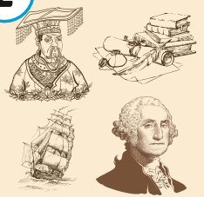
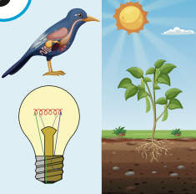


Listen and choose
A
B
C

Slide 7

Listen and choose
B
C
A

Slide 8
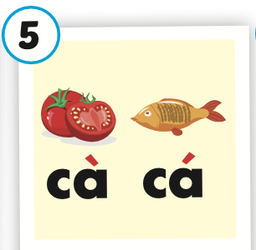

Listen and choose
B
C
A

Slide 9
Listen and choose
A
B
C

Slide 10

It’s time to learn …

Slide 11

Pronunciation
Intonation for WH-questions

Slide 12

Presentation

Slide 13
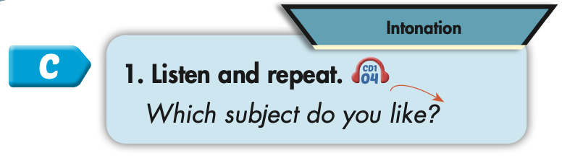
Click on the picture to hear the sound.
Which subject do you like?

Slide 14
Practice

Slide 15



Slide 16
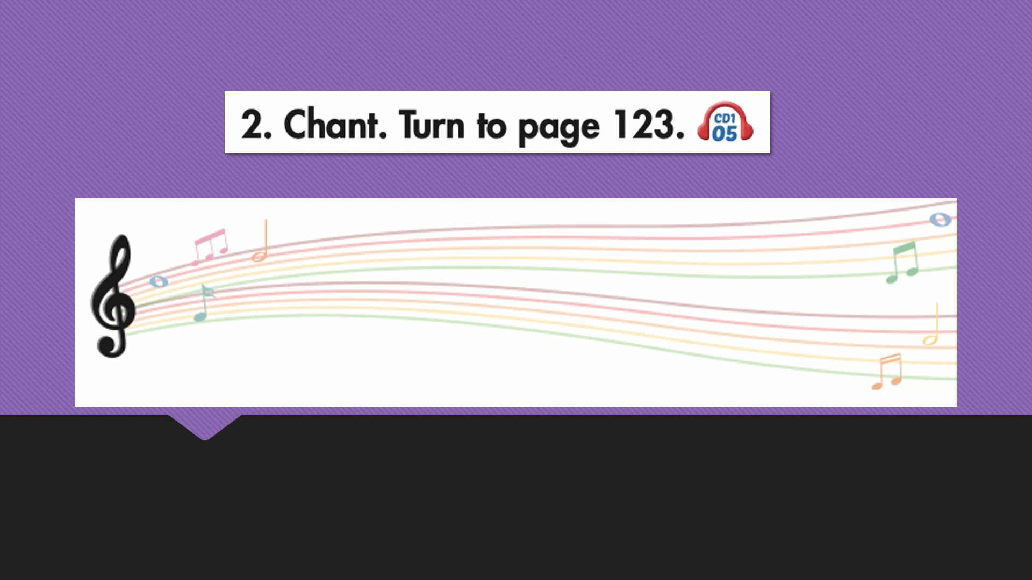

Slide 17

Structure
Which subject do you like?
- I like science.
Which subject does he like?
- He likes English.

Slide 18
Presentation

Slide 19

Speaking

Slide 20
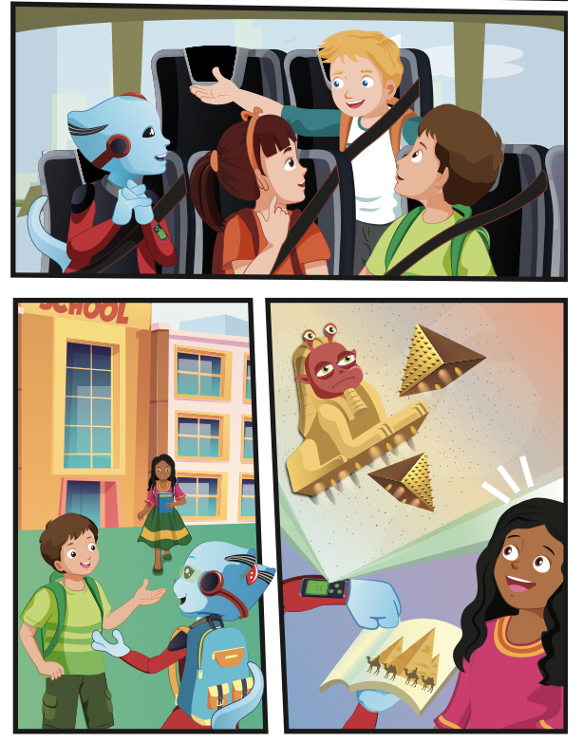
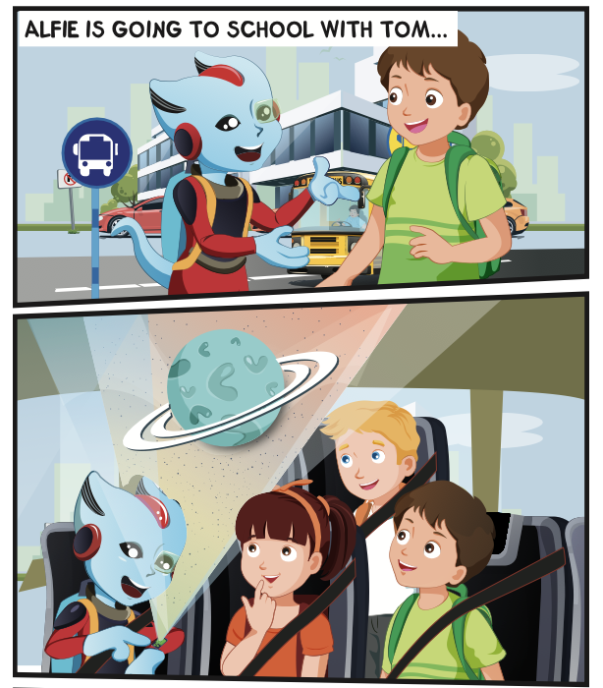
Who is talking?
Where are they?

Slide 21

Listening

Slide 22

Click on D to hear the sound.

Slide 23

Practice

Slide 24
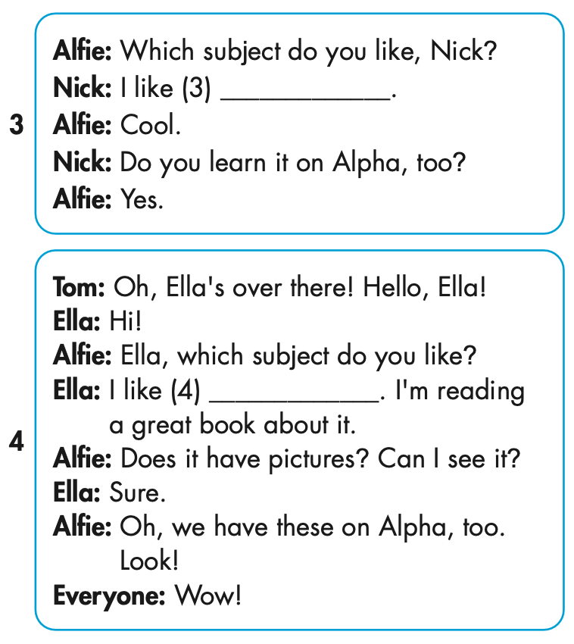

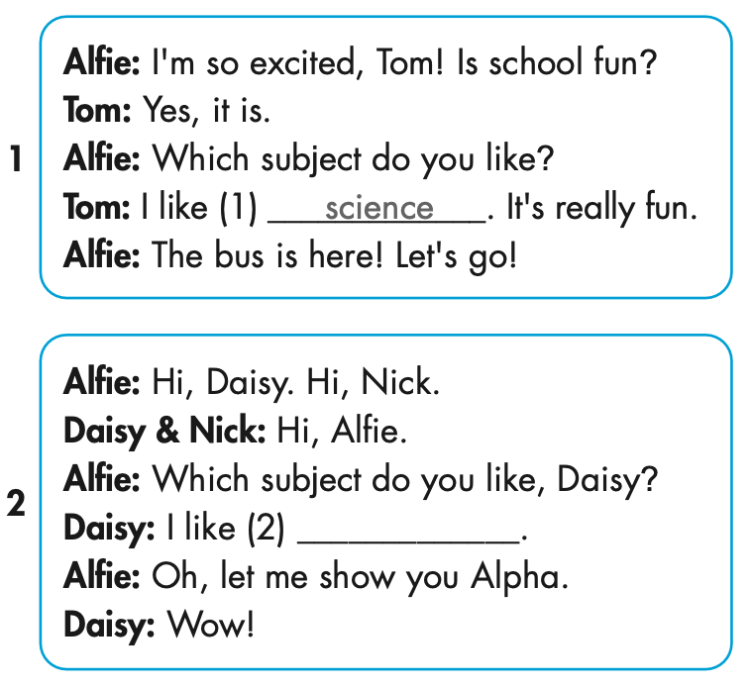

Slide 25
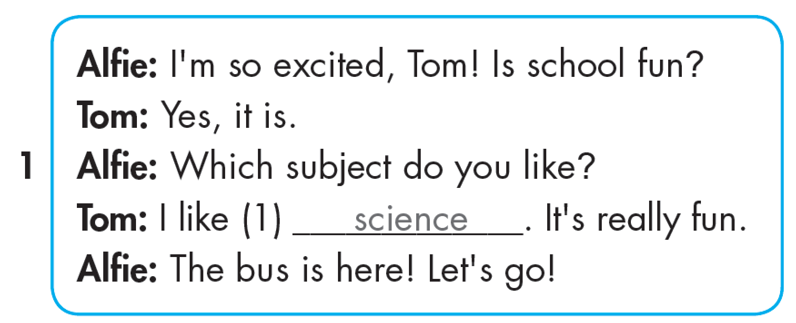

Slide 26
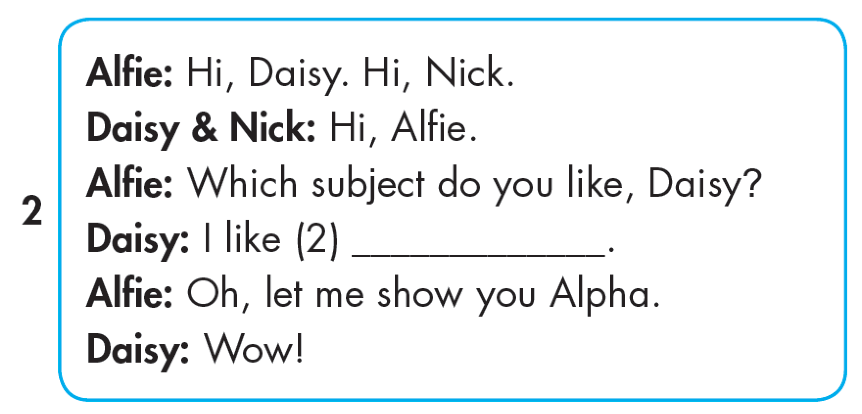
geography

Slide 27
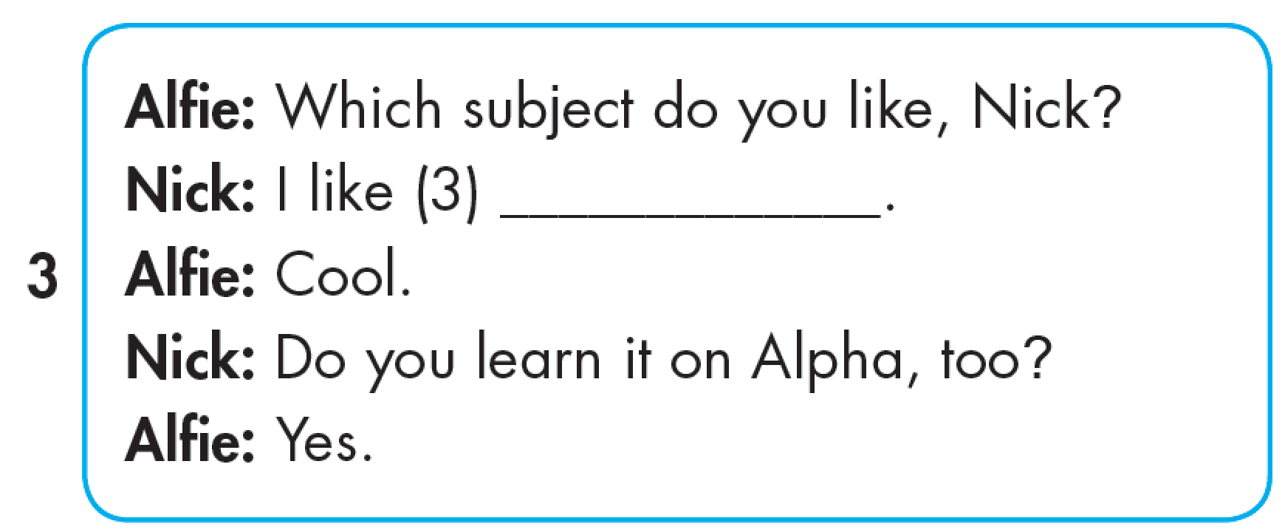
I.T.

Slide 28
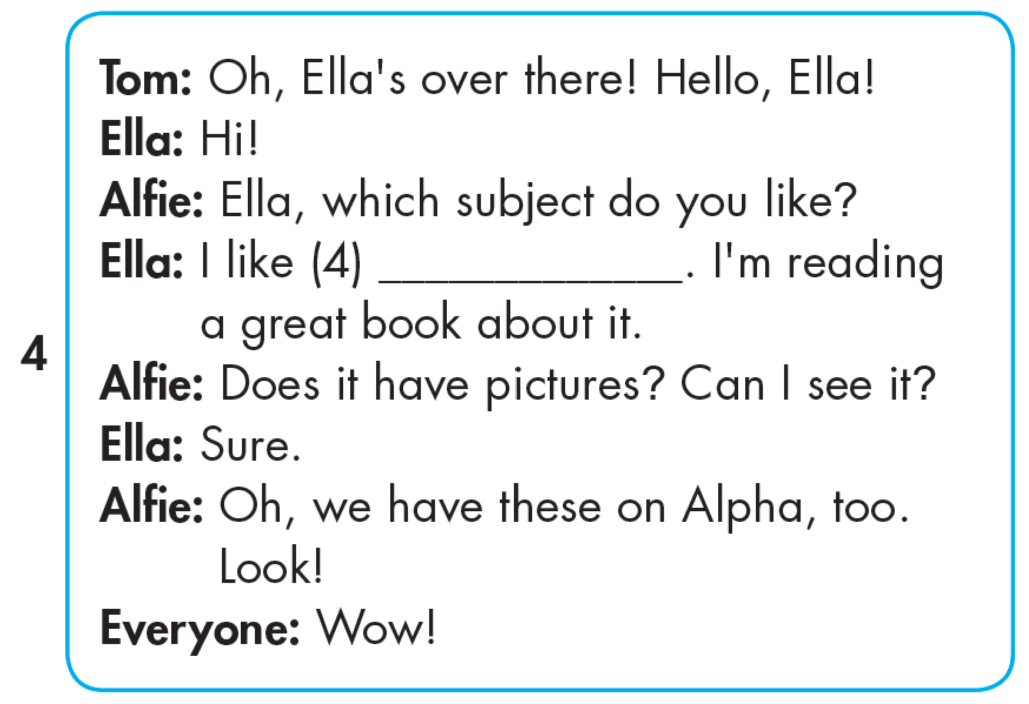
history

Slide 29

Reading

Slide 30


Slide 31

Production

Slide 32

Writing

Slide 33
MAKE YOUR OWN STORY

Slide 34


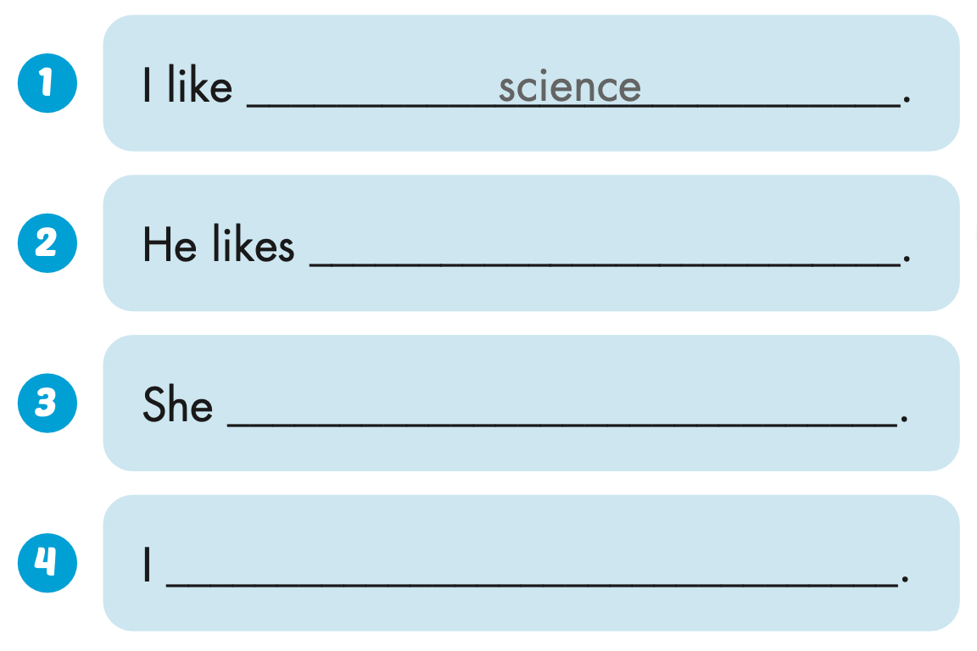
Extra Practice
WB, page 3
Click on C to hear the sound.
geography
likes I.T.
like history

Slide 35

CONSOLIDATION

Slide 36

SCHOOL
SUBJECTS
GAME
Notes:
36

Slide 37

MATHS
GEOGRAPHY
ENGLISH
GEOGRAPHY
Notes:
37

Slide 38

SCIENCE
MATHS
CHEMISTRY
SCIENCE
Notes:
38

Slide 39



MATHS
I.T.
PE
I.T.
Notes:
39

Slide 40

VIETNAMESE
Con cá
ENGLISH
HISTORY
VIETNAMESE
Notes:
40

Slide 41

WRAP-UP

Slide 42
Today’s lesson
Pronunciation
Intonation for WH-questions
Structures/ Sentence patterns
Which subject do you like?
- I like science.
Which subject does he like?
- He likes English.

Slide 43
Homework
Practice the vocabularies and structure, and make sentences using them.
Do the exercises in Tiếng Anh 5 i-Learn Smart Start WB (page 3).
Do the exercises in Tiếng Anh 5 i-Learn Smart Start Notebook.
Prepare the next lesson (page 8 SB).
Play the consolidation games in Tiếng Anh 5 i-Learn Smart Start DHA App on www.eduhome.com.vn

Slide 44

Enjoy your day!

Slide 45

Lesson 3
Stay positive and have a nice day!

