Slide 1

Unit 2: Holidays
Lesson 1.2
Page 21

Slide 2
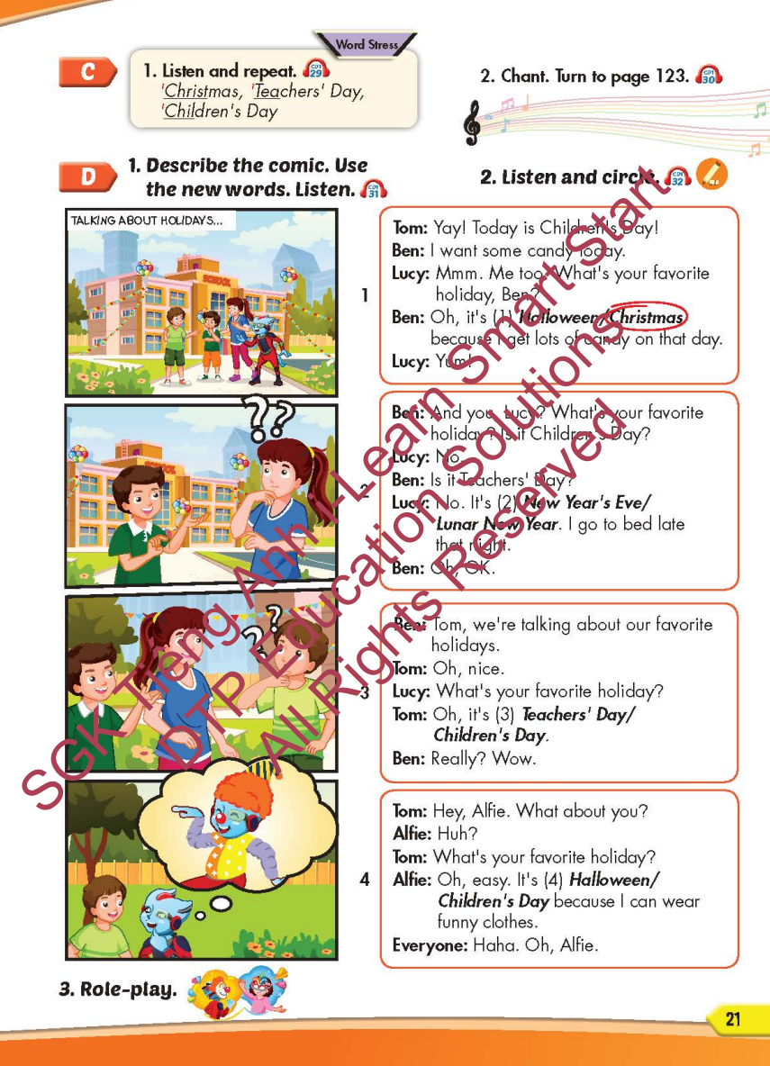
Lesson Outline
Warm-up
Listening
Consolidation
Wrap-up

Slide 3
Objectives
By the end of this lesson, students will be able to…
Stress: For most holidays, we usually stress the first syllable.
Structure: What's your favorite holiday? - It's Halloween.
What's her favorite holiday? - It's Christmas

Slide 4

WARM-UP

Slide 5
HIDDEN PICTURE

Slide 6



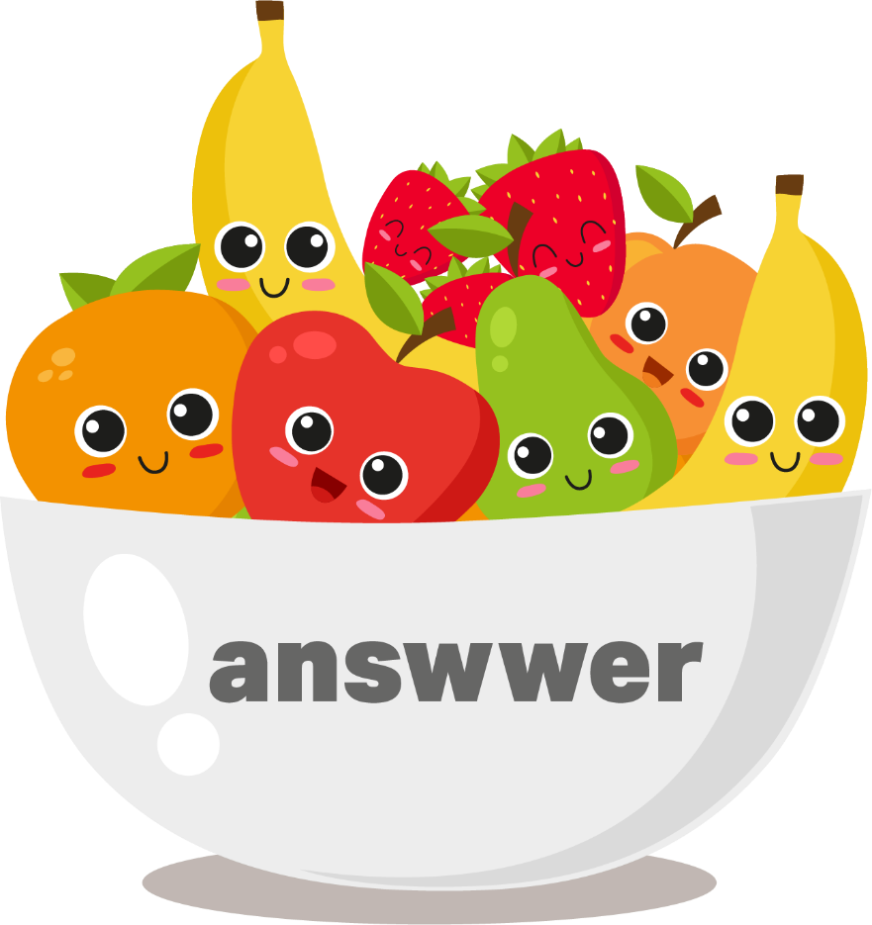

Halloween

Slide 7

New Year's Eve

Slide 8
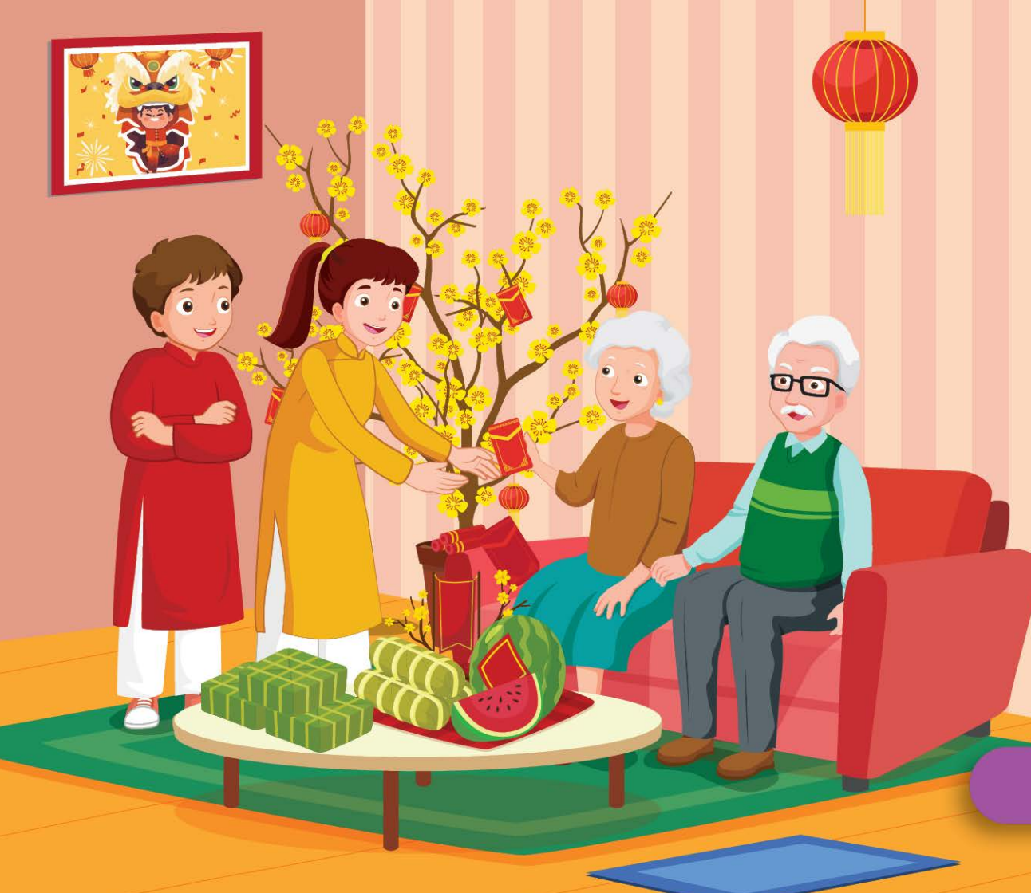
Lunar New Year (Tết)

Slide 9

Christmas

Slide 10

Teachers' Day

Slide 11

Children's Day

Slide 12

It’s time to learn …

Slide 13

Stress
'Christmas, 'Teachers' Day,
'Children's Day

Slide 14

Listening

Slide 15
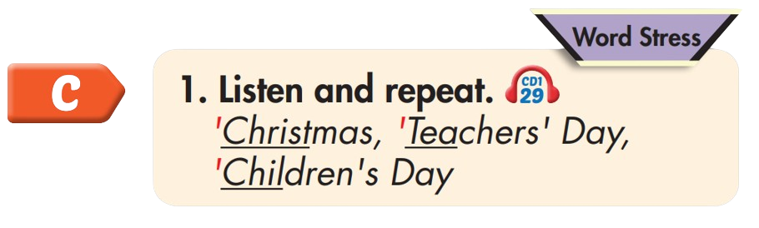

'Christmas
'Teachers' Day
'Children's Day

Slide 16
Practice

Slide 17



Slide 18
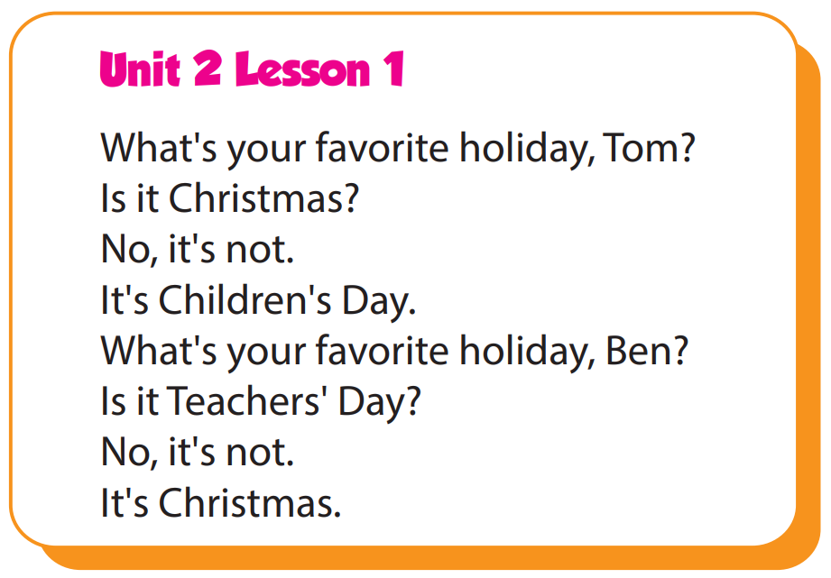

Slide 19
Structure
What's your favorite holiday?
- It's Halloween.
What's her favorite holiday?
- It's Christmas.

Slide 20

Speaking

Slide 21
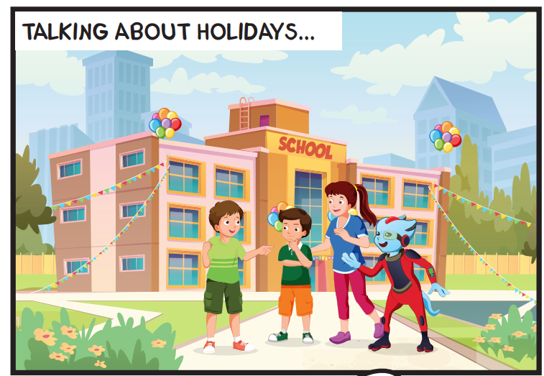
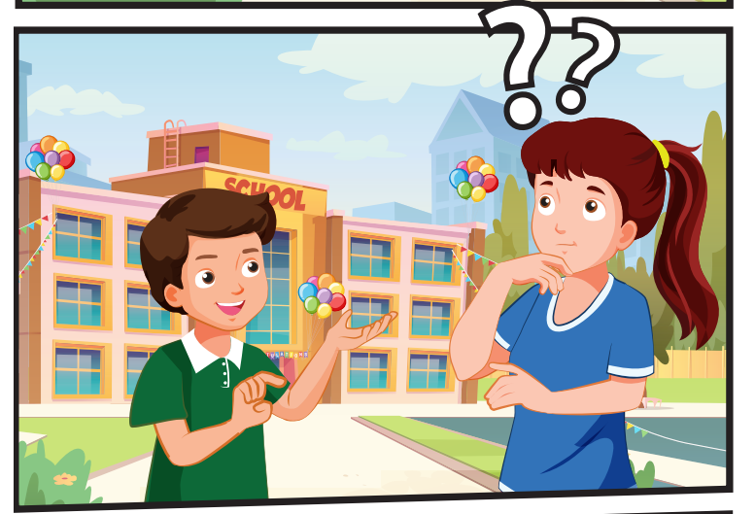
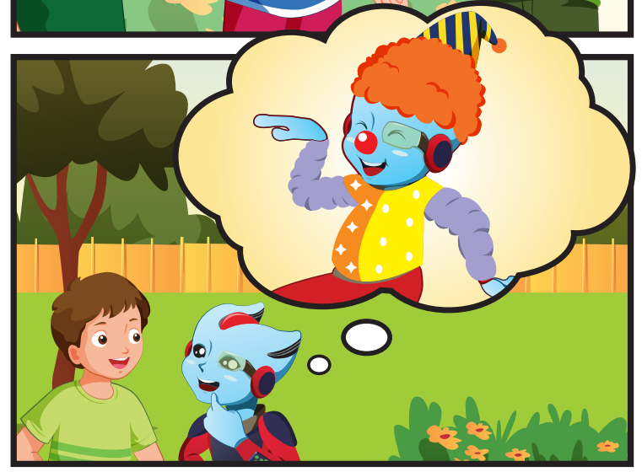
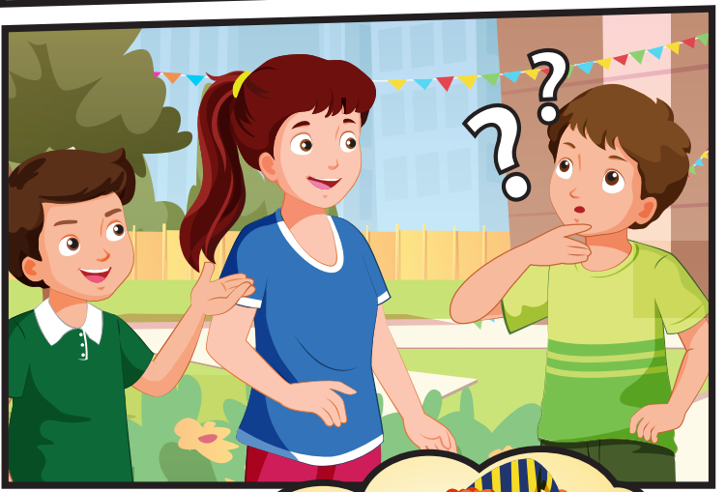
Who can you see?
(Tom, Ben, Lucy, Alfie

Slide 22
Where are they?
They're at school.

Slide 23

Listening

Slide 24


Slide 25

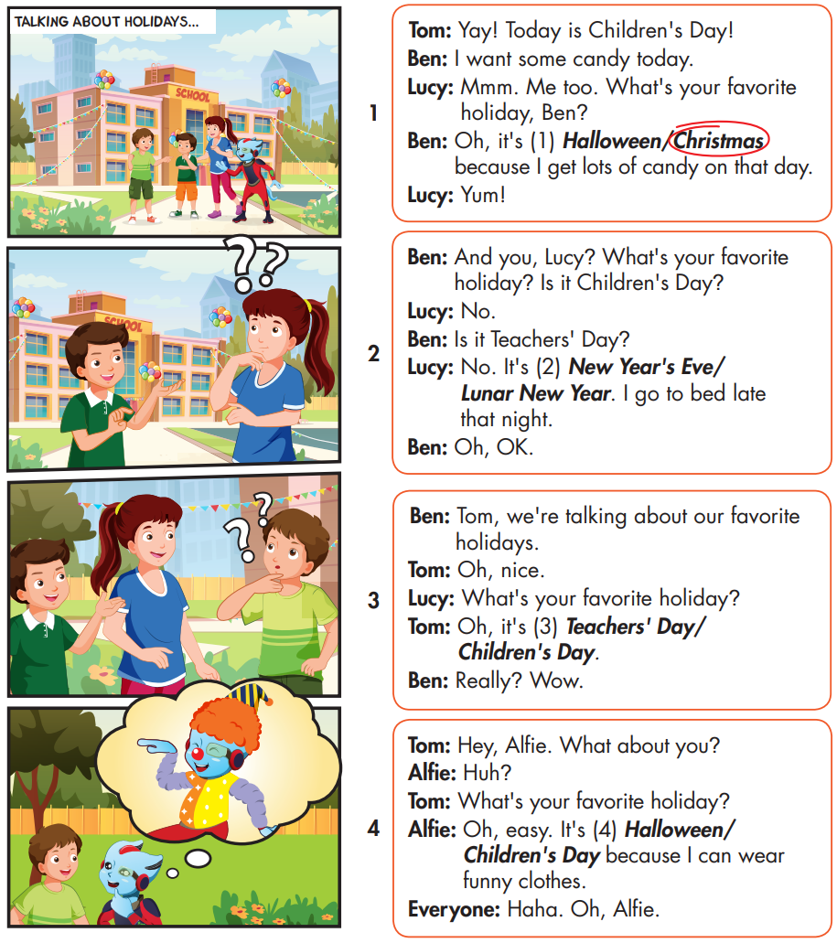

Slide 26
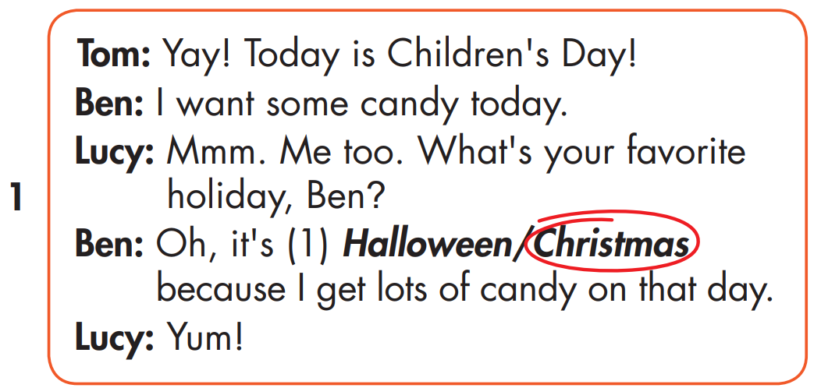

Slide 27
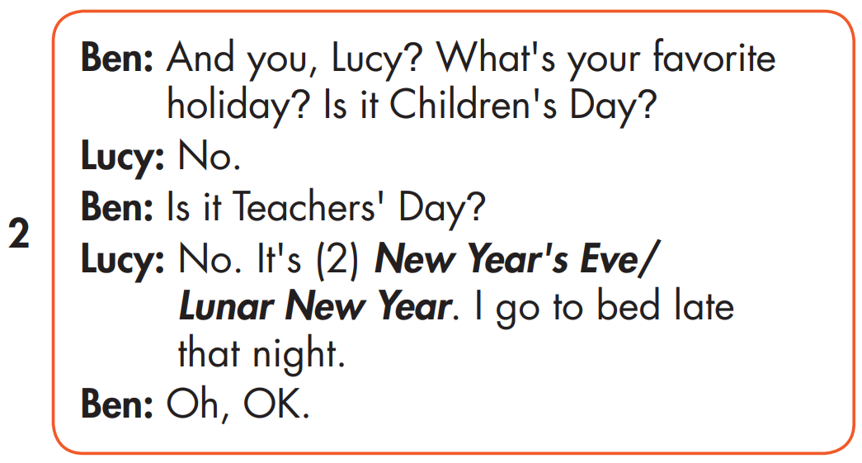


Slide 28
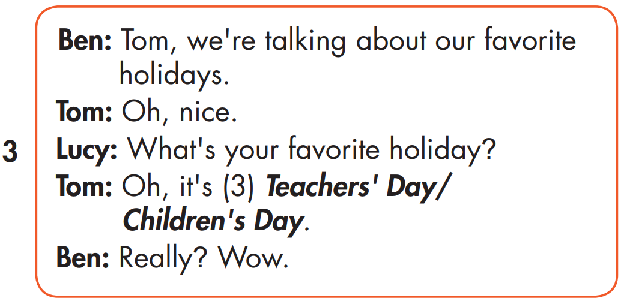

Slide 29
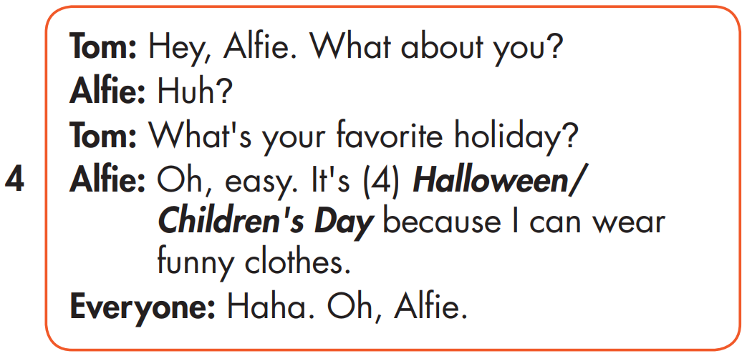

Slide 30

Speaking

Slide 31



Slide 32

Writing

Slide 33
MAKE YOUR OWN STORY

Slide 34

Production

Slide 35

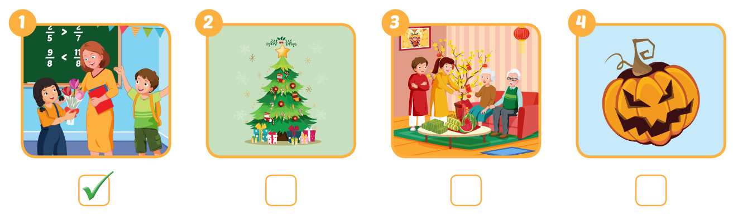


Extra Practice
WB, page 13

Slide 36

CONSOLIDATION

Slide 37

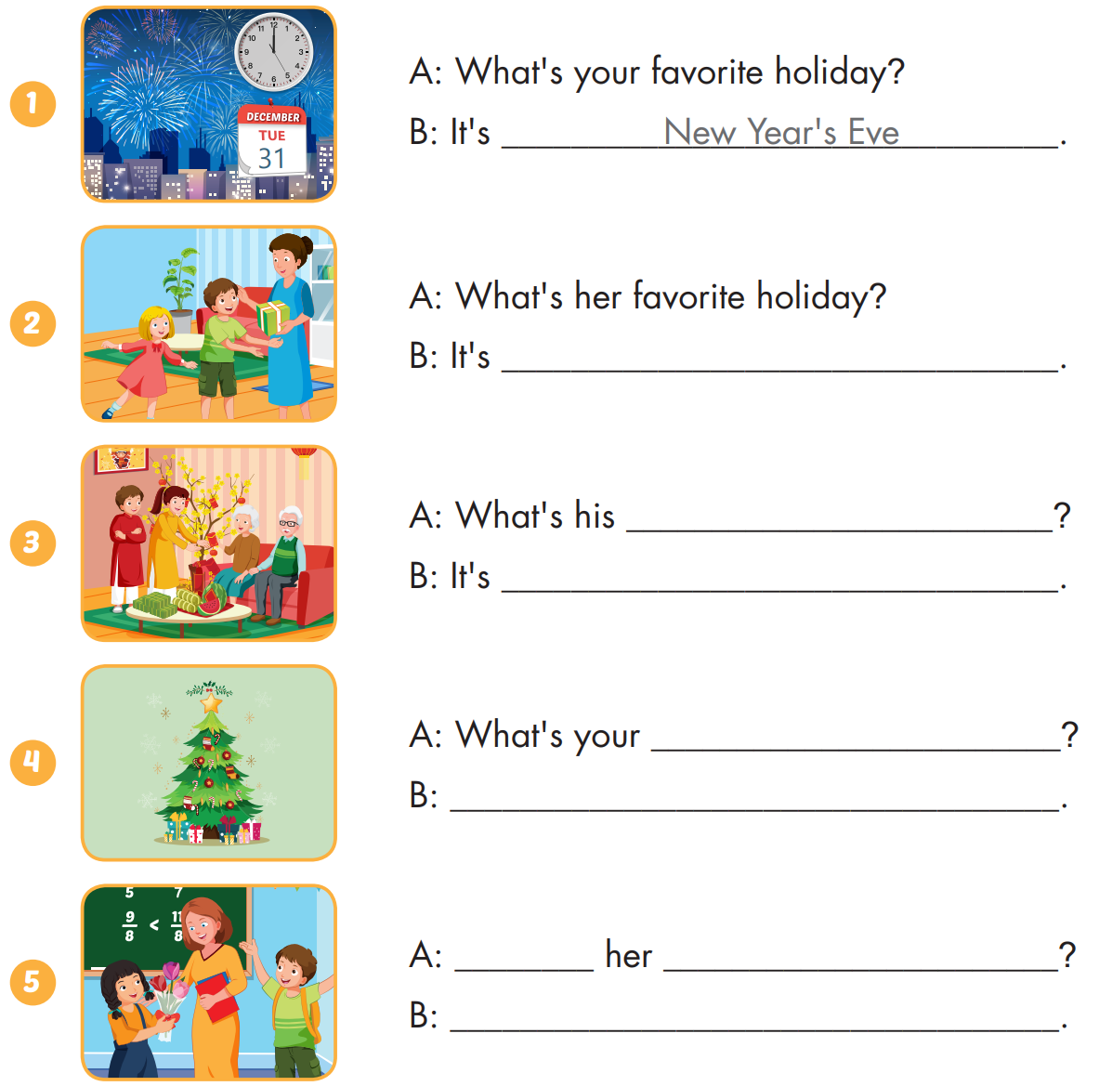
Extra Practice
WB, page 13

Slide 38
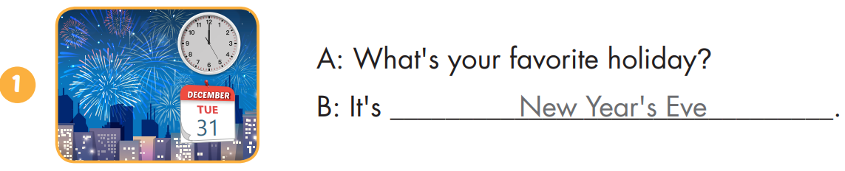
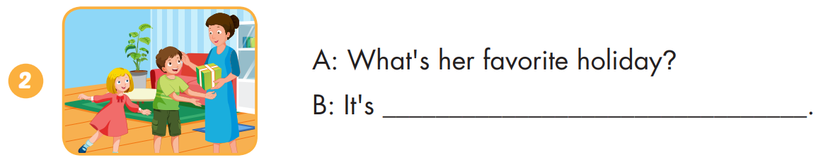
Extra Practice
WB, page 13
Children's Day

Slide 39
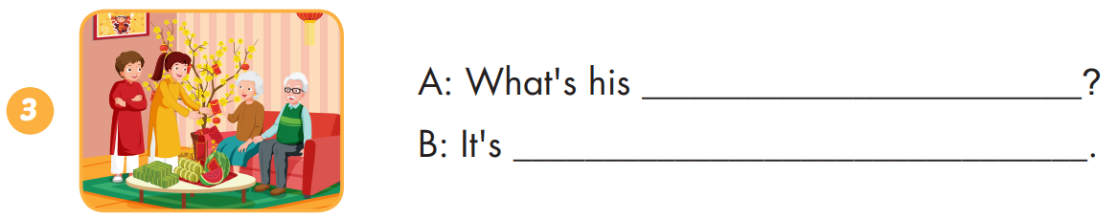
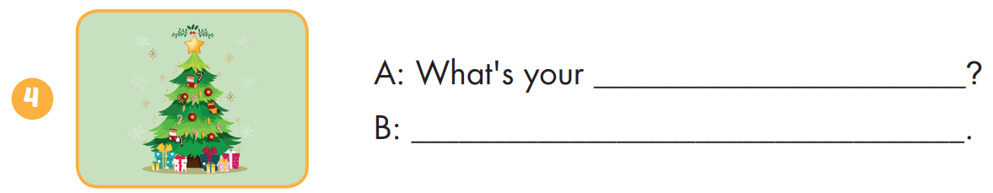
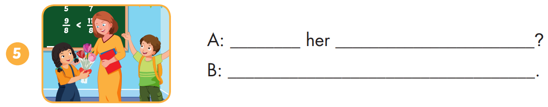
Extra Practice
WB, page 13
favorite holiday
Lunar New Year
favorite holiday
It's Christmas Day.
What's favorite holiday
It's Teachers' Day

Slide 40

WRAP-UP

Slide 41
Today’s lesson
Stress
For most holidays, we usually stress the first syllable.
Structures/ Sentence patterns
What's your favorite holiday?
- It's Halloween.
What's her favorite holiday?
- It's Christmas.

Slide 42
Homework
Practice the vocabularies and structure, and make sentences using them.
Do the exercises in Tiếng Anh 5 i-Learn Smart Start WB (page 13)
Do the exercises in Tiếng Anh 5 i-Learn Smart Start Notebook (page 10)
Prepare the next lesson (page 22 SB)
Play the consolidation games in Tiếng Anh 5 i-Learn Smart Start DHA App on www.eduhome.com.vn

Slide 43

Enjoy your day!

Slide 44
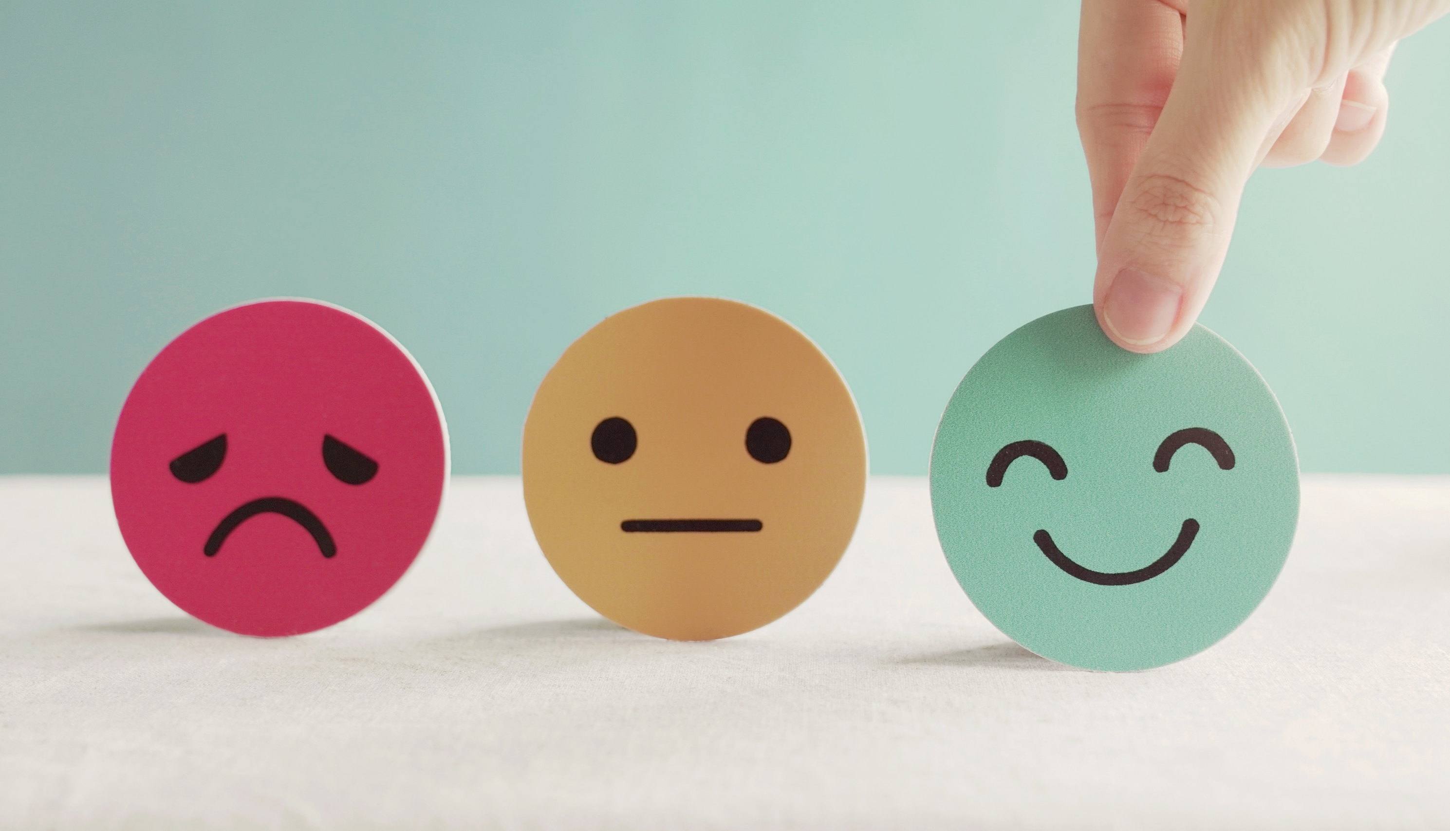
Lesson 3
Stay positive and have a nice day!

