Slide 1

Unit 2
WHAT I CAN DO
LESSON 2. 1 - PAGE 23

Slide 2
Objectives
By the end of this lesson, students will be able to ask about what others can or can't do.
Vocabulary: hop, fly, jump (rope), swim, run, climb (a tree)
Structure: Can Lucy hop?
- Yes, she can. / No, she can't.
Can Tom and Ben swim?
- Yes, they can. / No, they can't.
Can you jump rope?
- Yes, we can. / No, we can't.

Slide 3

WARM UP

Slide 4
LET’S PLAY!
WHAT’S MISSING?

Slide 5
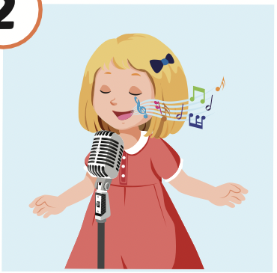
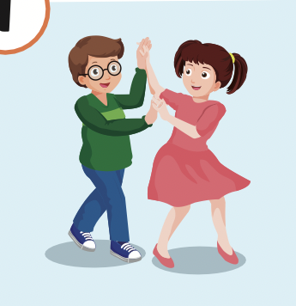
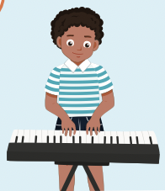
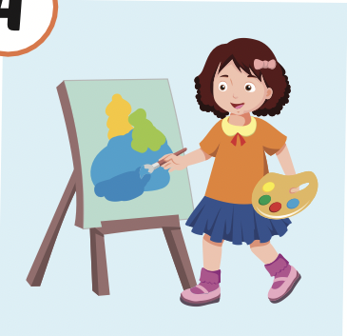
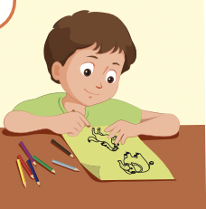
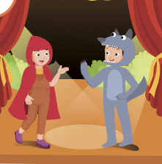

Slide 11

It’s time to learn …

Slide 12

New words
hop,
fly,
jump (rope),
swim,
run,
climb (a tree)

Slide 13

Presentation

Slide 14


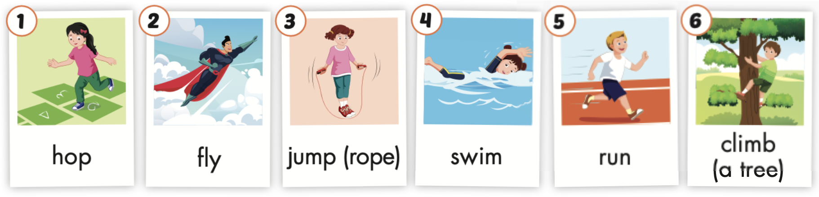
Click the icon to hear the sound.

Slide 15
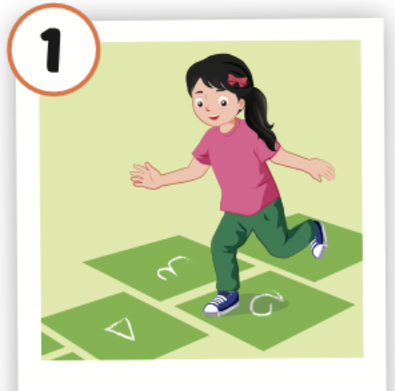
Click the picture to hear the sound.
hop
/hɑːp/
nhảy lò cò

Slide 16
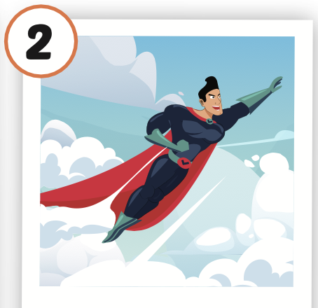
Click the picture to hear the sound.
fly
/flaɪ/
bay

Slide 17
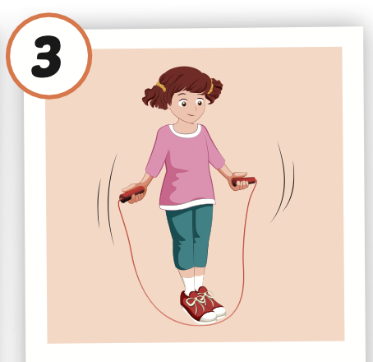
Click the picture to hear the sound.
jump (rope)
/dʒʌmp roʊp/
nhảy (dây)

Slide 18
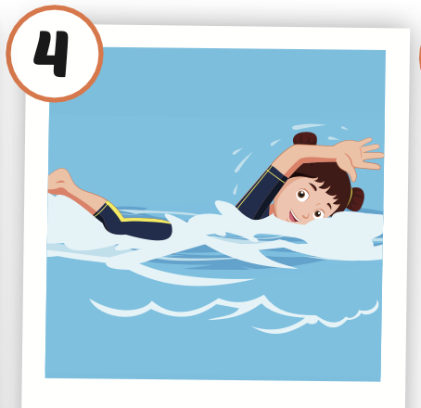
Click the picture to hear the sound.
swim
/swɪm/
bơi

Slide 19
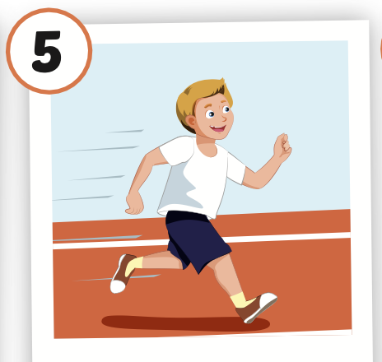
Click the picture to hear the sound.
run
/rʌn/
chạy

Slide 20

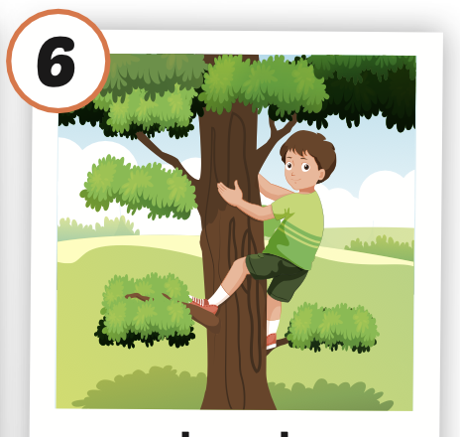
Click the picture to hear the sound.
climb (a tree)
/klaɪm ə triː/
leo, trèo (cây)

Slide 21

Practice

Slide 22



LISTEN AND CHOOSE
LET’S PLAY!

Slide 27
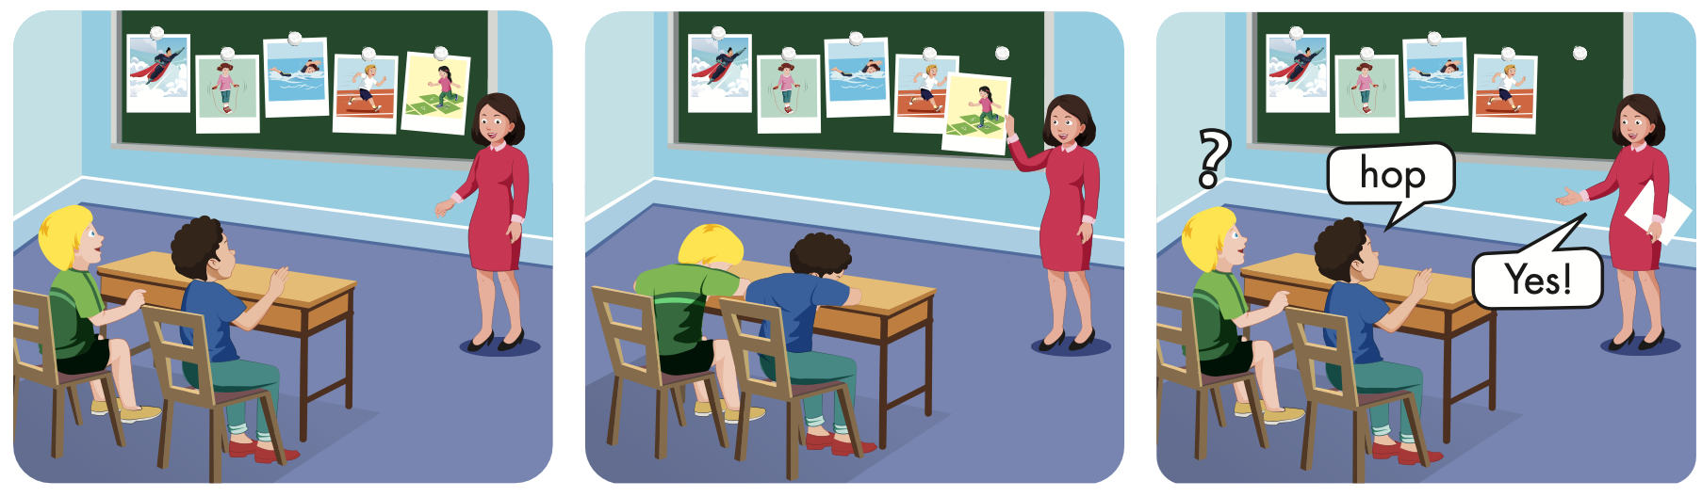

Slide 28
Structures
Can Lucy hop?
- Yes, she can. / No, she can’t.
Can Tom and Ben swim?
- Yes, they can. / No, they can't.
Can you jump rope?
- Yes, we can. / No, we can't.

Slide 29
Presentation

Slide 30

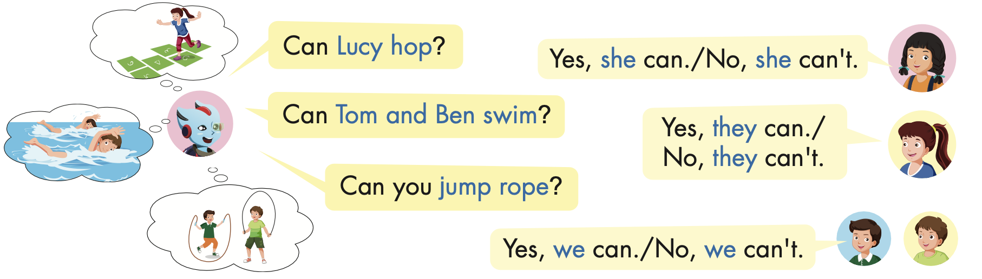

Slide 31
Practice

Slide 32
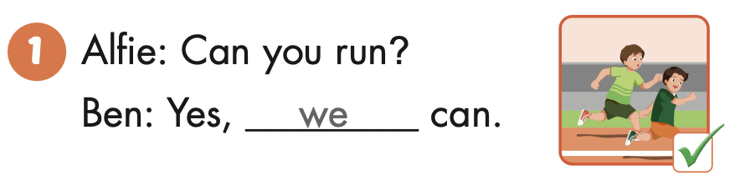
Can you run?
Yes, we can.

Slide 33
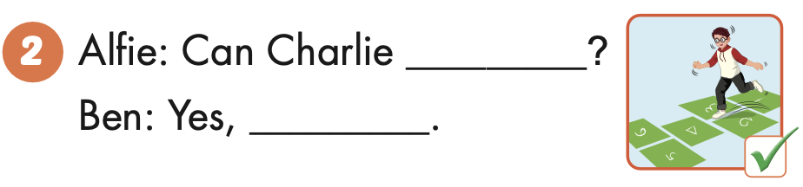
Can Charlie hop?
Yes, he can.
Charlie

Slide 34
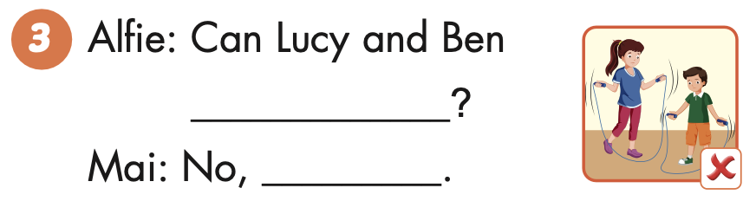
Can Lucy and Ben jump rope?
No, they can’t.
Lucy and Ben

Slide 35

Writing

Slide 36


Slide 37
hop
he can

Slide 38
jump ropes
the can’t

Slide 39
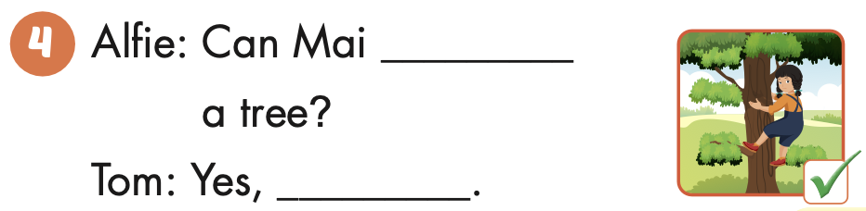
climb
she can

Slide 40

Production

Slide 41



Slide 42












> Someone has deleted some words.
> Guess the deleted word within the time limit (12 seconds).

Slide 43

Can he run?
CHECK
Notes:
43

Slide 44
Can she hop?
CHECK
Notes:
44

Slide 45

Y
Can he climb a tree?
Yes, he can.
CHECK
Notes:
45

Slide 46
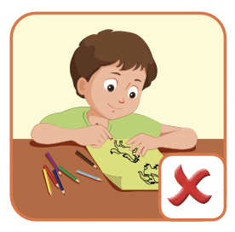
Can Tom draw?
No, he can’t.
CHECK
Notes:
46

Slide 47

CONSOLIDATION

Slide 48

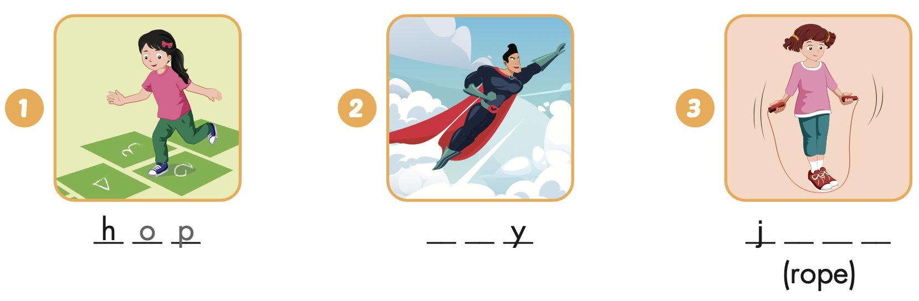
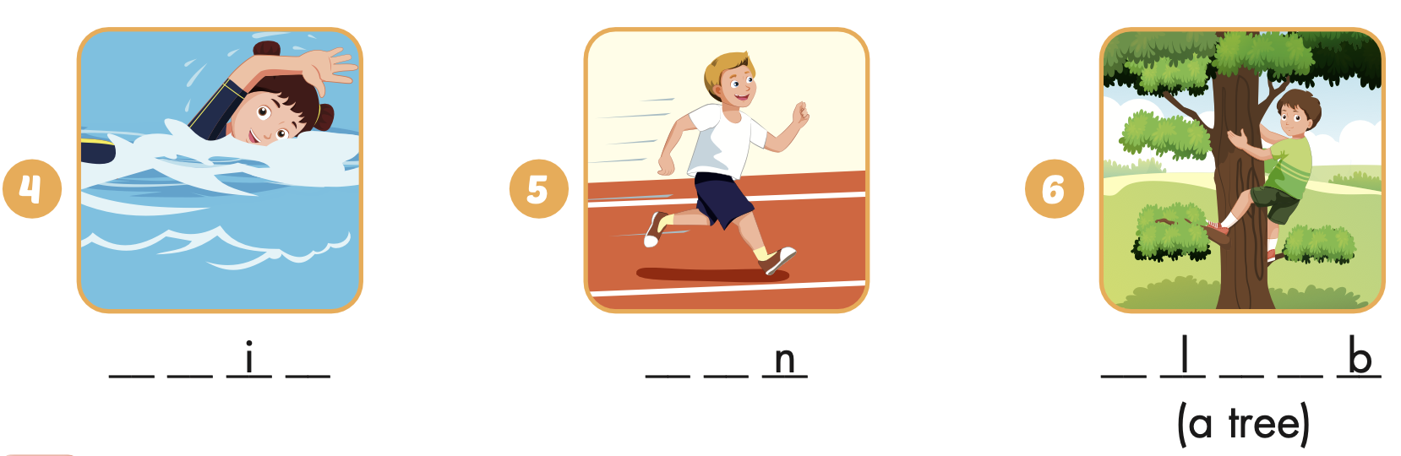
Extra Practice
WB, page 14
f l
u m p
s w m
r u
c i m

Slide 49
Today’s lesson
Structures/ Sentence patterns
Can Lucy hop?
- Yes, she can. / No, she can’t.
Can Tom and Ben swim?
- Yes, they can. / No, they can't.
Can you jump rope?
- Yes, we can. / No, we can't.
Vocabularies
hop, fly, jump (rope), swim, run, climb (a tree)

