Slide 1
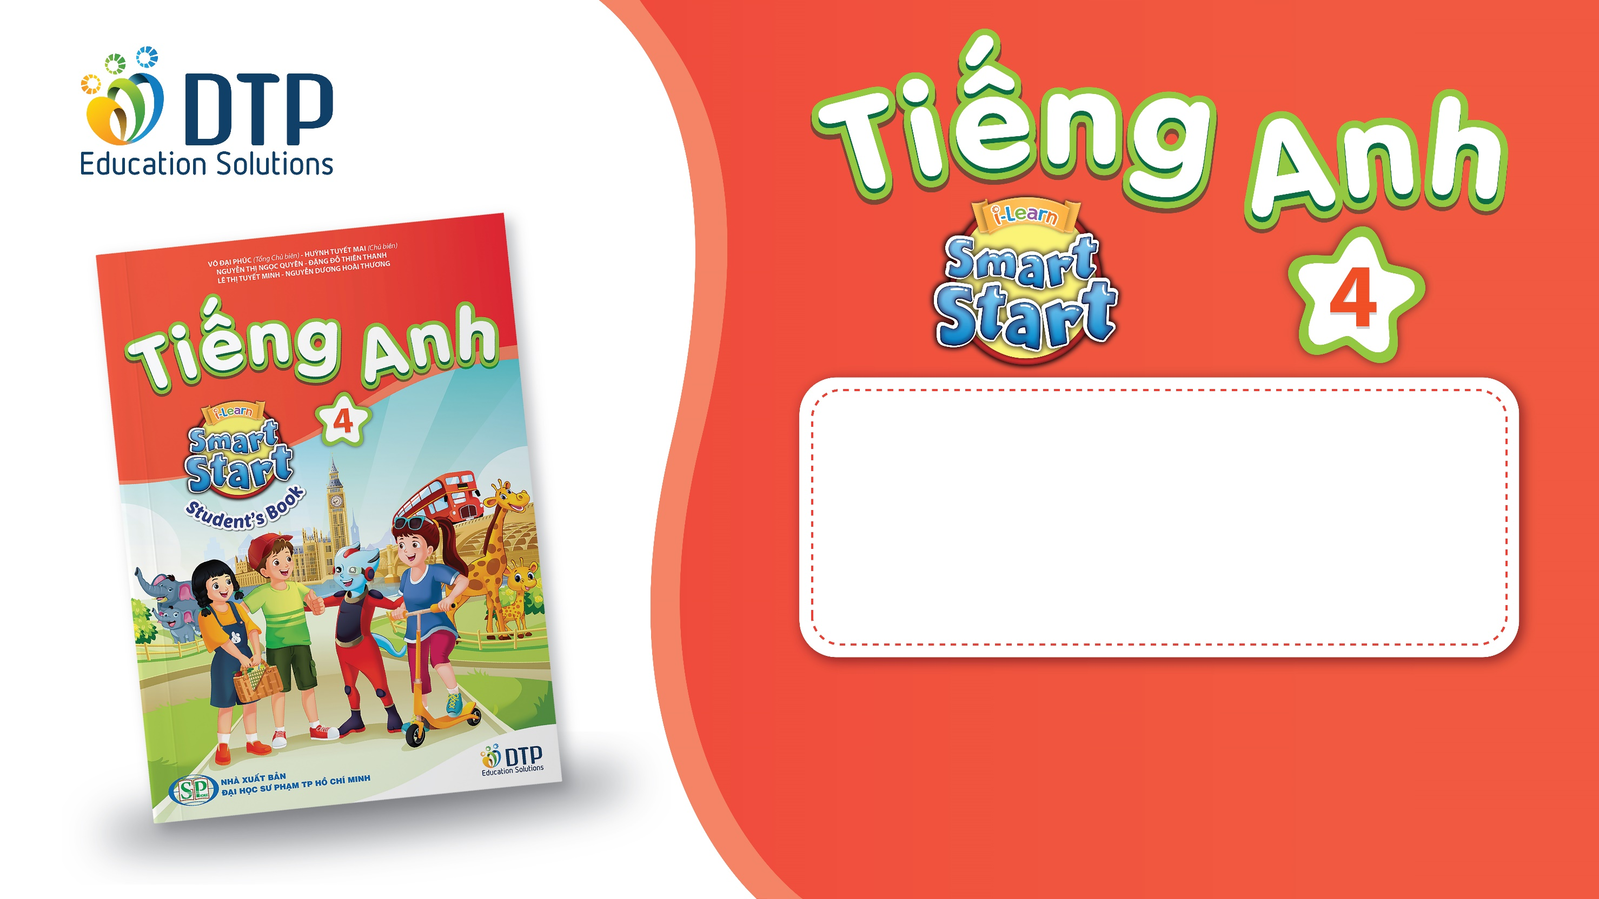
Unit 1: Animals
Lesson 1.1
Page 6

Slide 2
Objectives
By the end of this lesson, students will be able to…
Vocabulary: Pronounce and use the words related to the topic properly: snake, monkey, horse, camel, hippo, rhino.
Structure: This is a monkey. - These are monkeys.
That's a snake. - Those are snakes

Slide 3

WARM UP

Slide 4

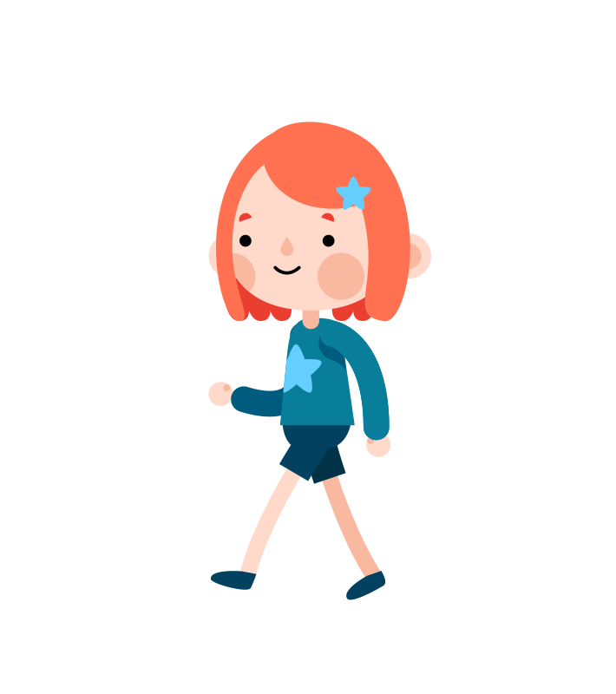

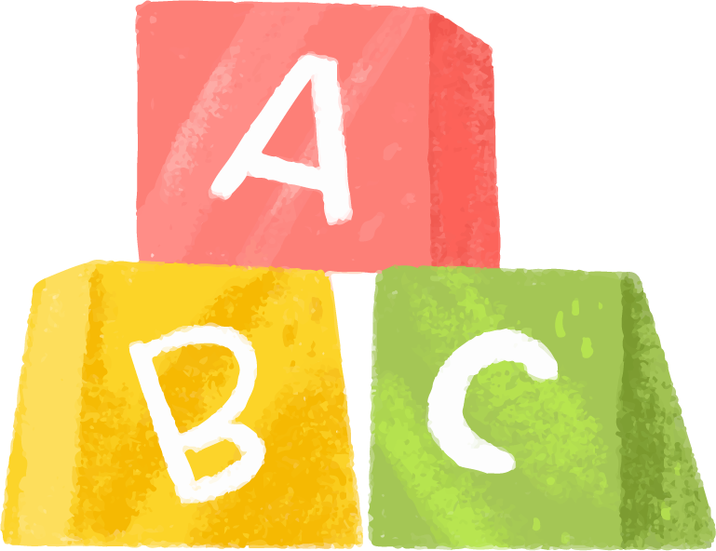

Game: Finding the way home.

Slide 5




1
3
4
2
5
7
6
8

Slide 6

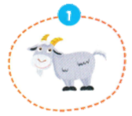
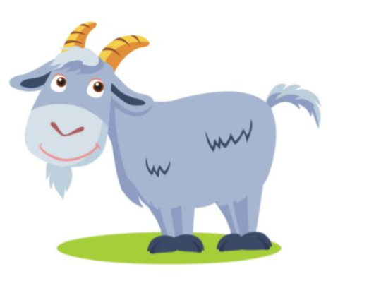

It’s a …..
It’s a goat.

Slide 7

It’s a …..
It’s a bird.

Slide 8
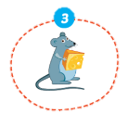
It’s a ….
It’s a mouse.

Slide 9
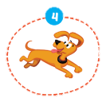
It’s a ….
It’s a dog.

Slide 10
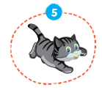
It’s a ….
It’s a cat.

Slide 11
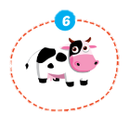
It’s a …..
It’s a cow.

Slide 12
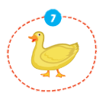
It’s a …..
It’s a duck.

Slide 13
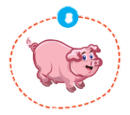
It’s a …..
It’s a pig.

Slide 14

It’s time to learn …

Slide 15

New words
snake, monkey, horse,
camel, hippo, rhino

Slide 16

Presentation

Slide 17

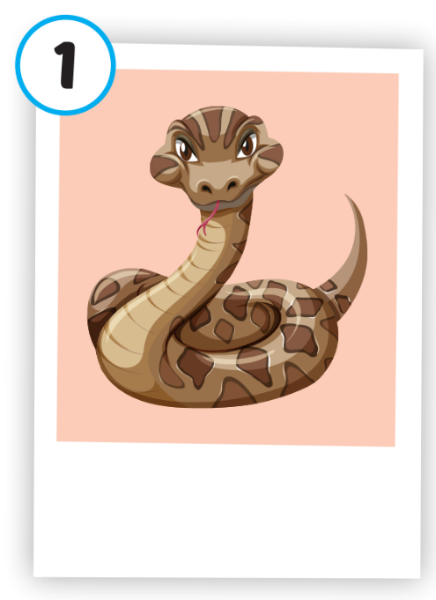
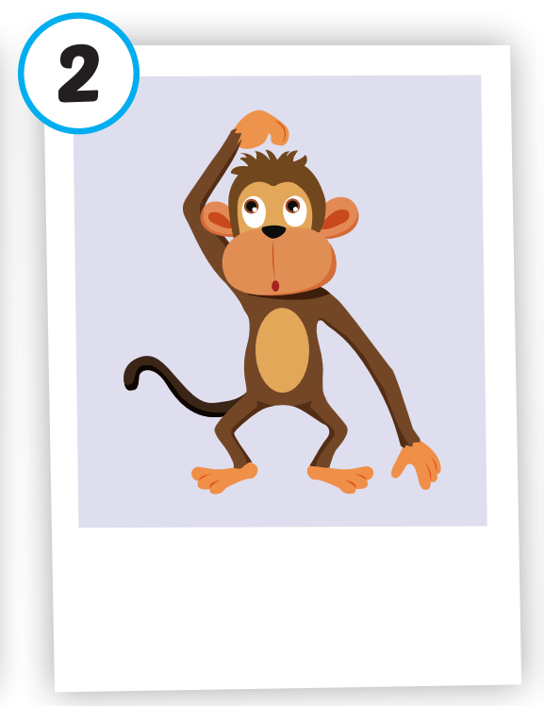
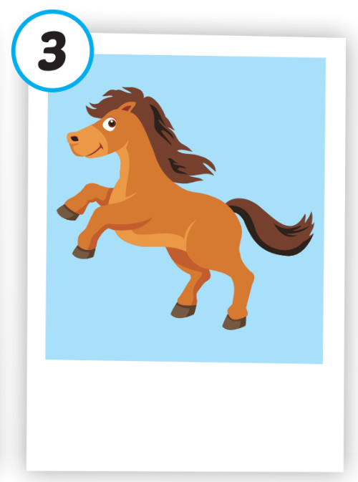
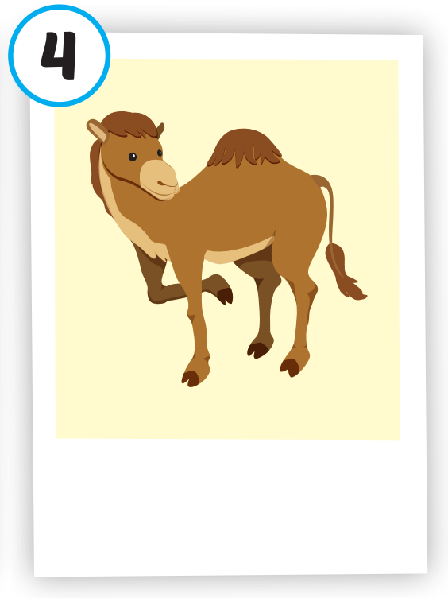
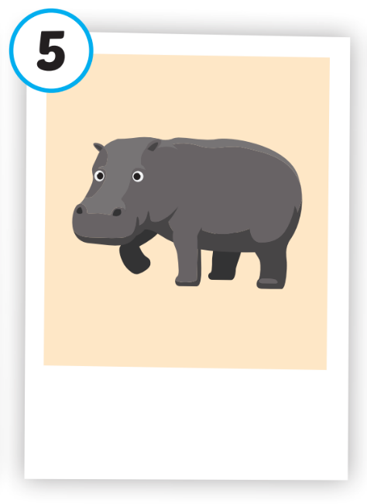
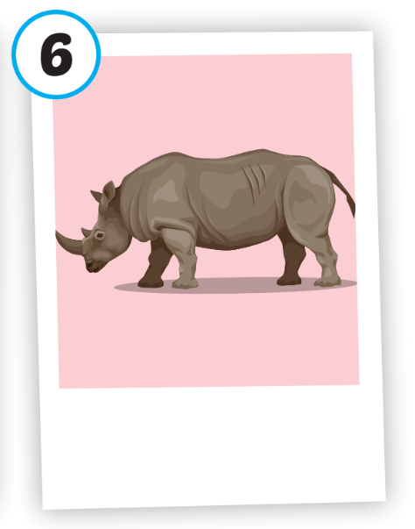
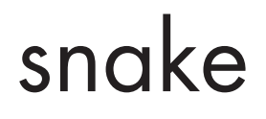





Click on each picture to hear the sound.
/hɔːrs/
con ngựa
/ˈkæməl/
con lạc đà
/ˈhɪpoʊ/
con hà mã
/ˈraɪnoʊ/
con tê giác
/sneɪk/
con rắn
/ˈmʌŋki/
con khỉ

Slide 18
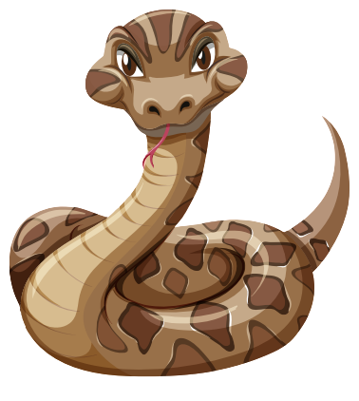
Click on each picture to hear the sound.
/sneɪk/
con rắn

Slide 19

Click on each picture to hear the sound.
/ˈmʌŋki/
con khỉ
Notes:
Click vào hình A. 1. Listen and point. Repeat để cho cả audio full chạy

Slide 20
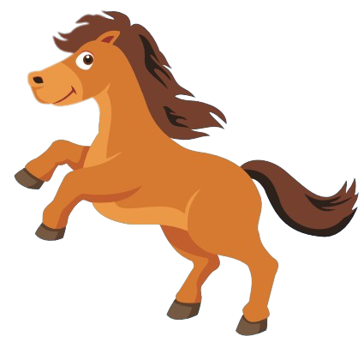
Click on each picture to hear the sound.
/hɔːrs/
con ngựa
Notes:
Click vào hình A. 1. Listen and point. Repeat để cho cả audio full chạy

Slide 21
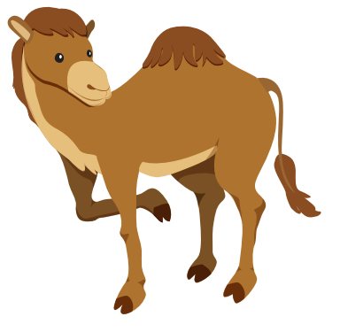
Click on each picture to hear the sound.
/ˈkæməl/
con lạc đà

Slide 22

Click on each picture to hear the sound.
/ˈhɪpoʊ/
con hà mã
Notes:
Click vào hình A. 1. Listen and point. Repeat để cho cả audio full chạy

Slide 23
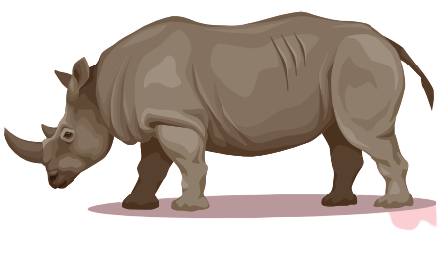
Click on each picture to hear the sound.
/ˈraɪnoʊ/
con tê giác

Slide 24
Practice

Slide 25
Check your memory

Slide 26


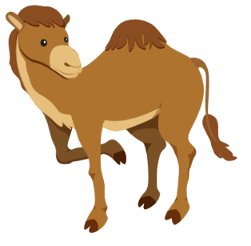

Listen and choose
A
B
C

Slide 27

Listen and choose
A
B
C

Slide 28



Listen and choose
A
B
C

Slide 29
Listen and choose
A
B
C

Slide 30

Listen and choose
A
B
C

Slide 31


Listen and choose
A
B
C

Slide 32

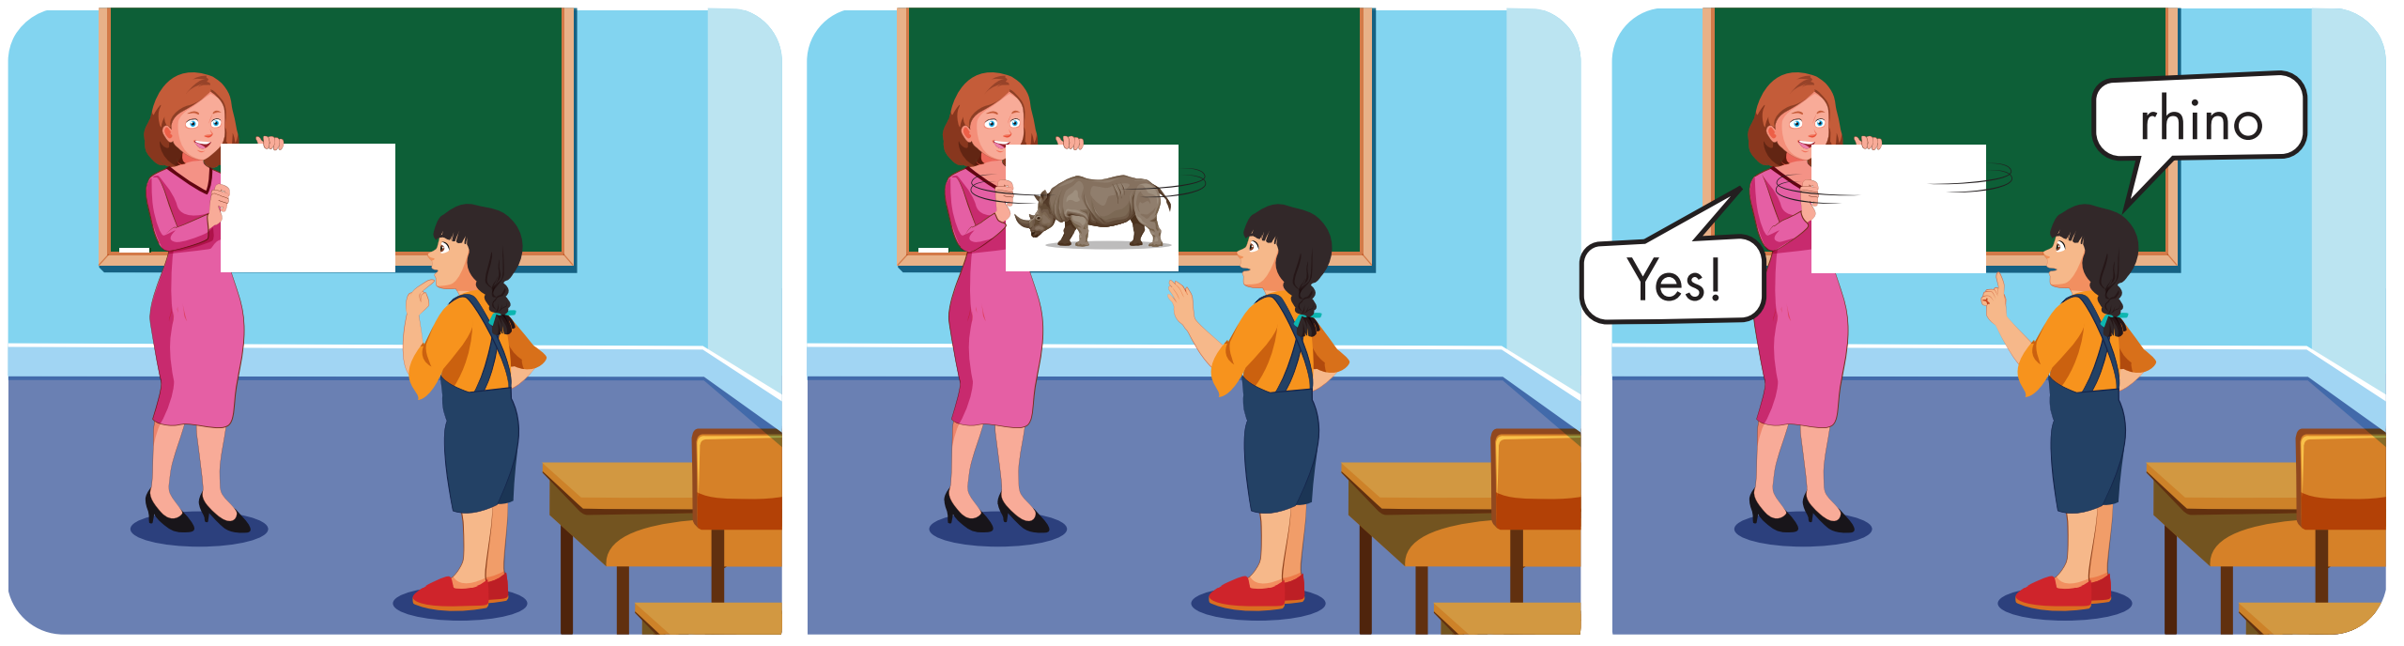

Slide 33
Structure
This is a monkey.
These are monkeys.
That's a snake.
Those are snakes

Slide 34
Presentation

Slide 35
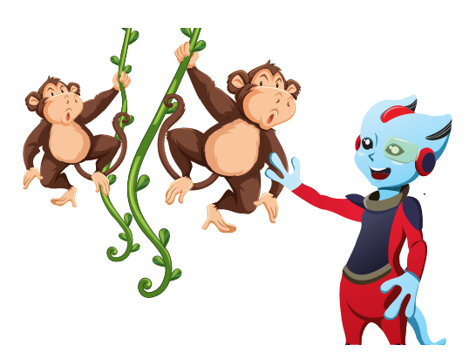
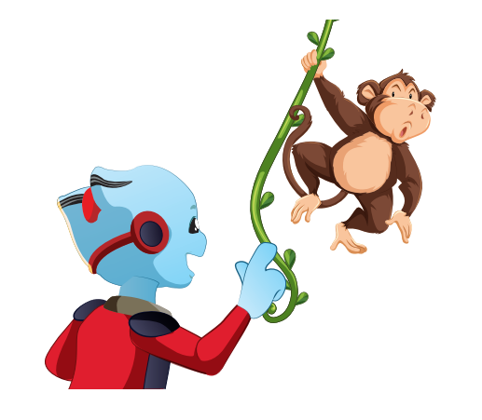

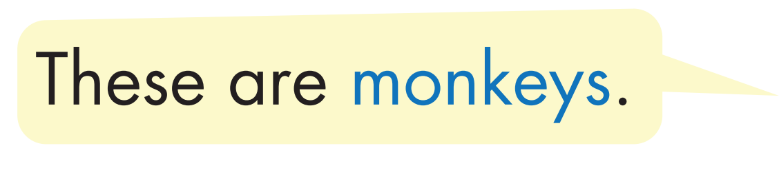

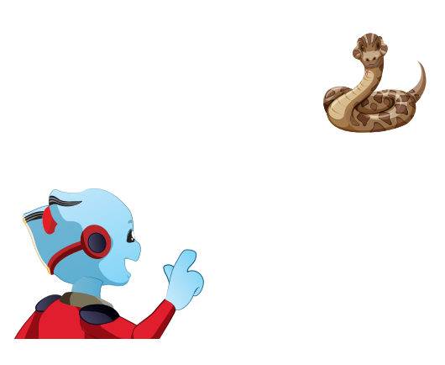
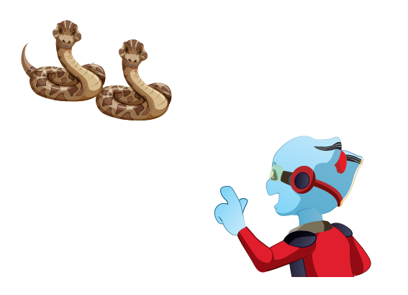


Structure

Slide 36

Practice

Slide 37


Slide 38
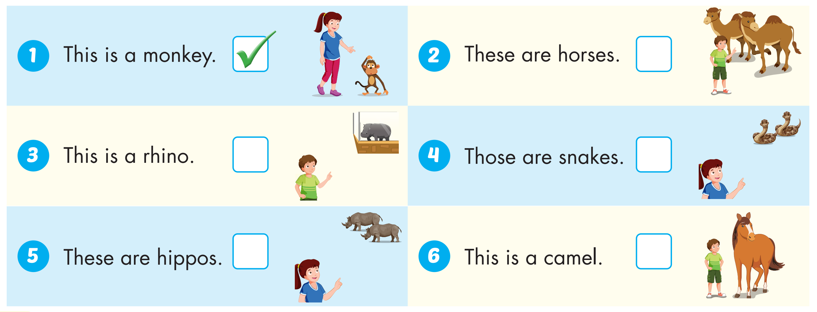



Slide 39

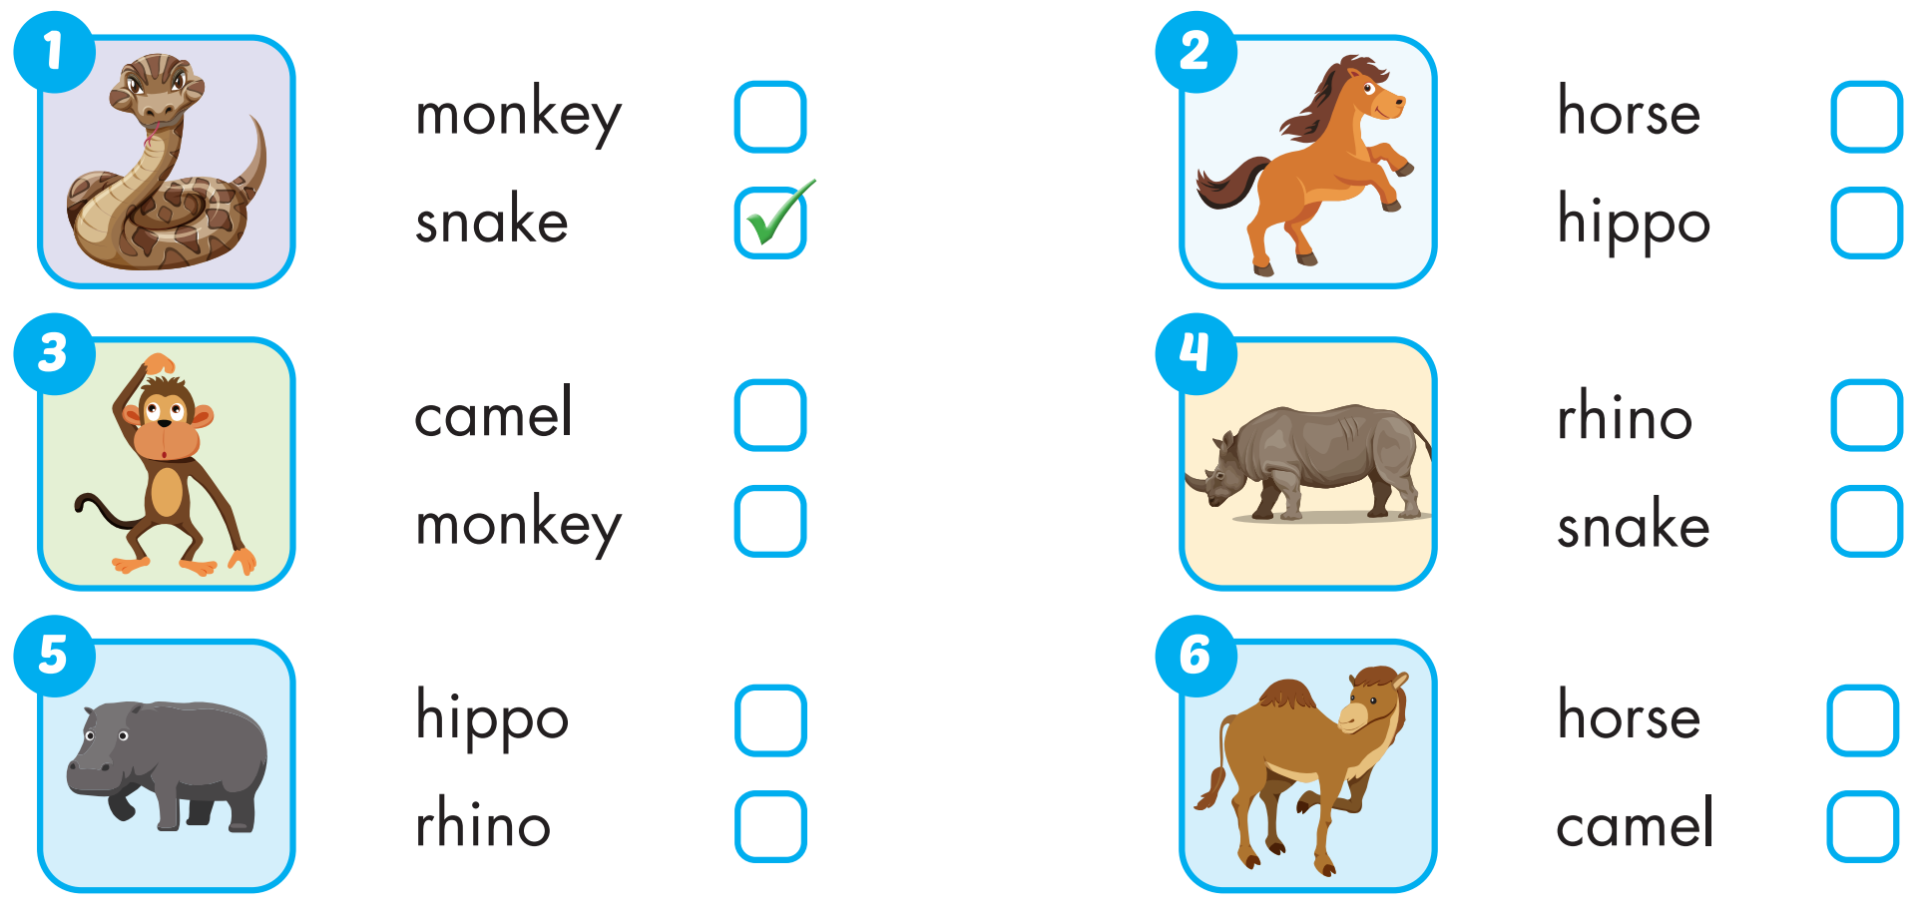
Extra Practice
WB, page 2

Slide 40

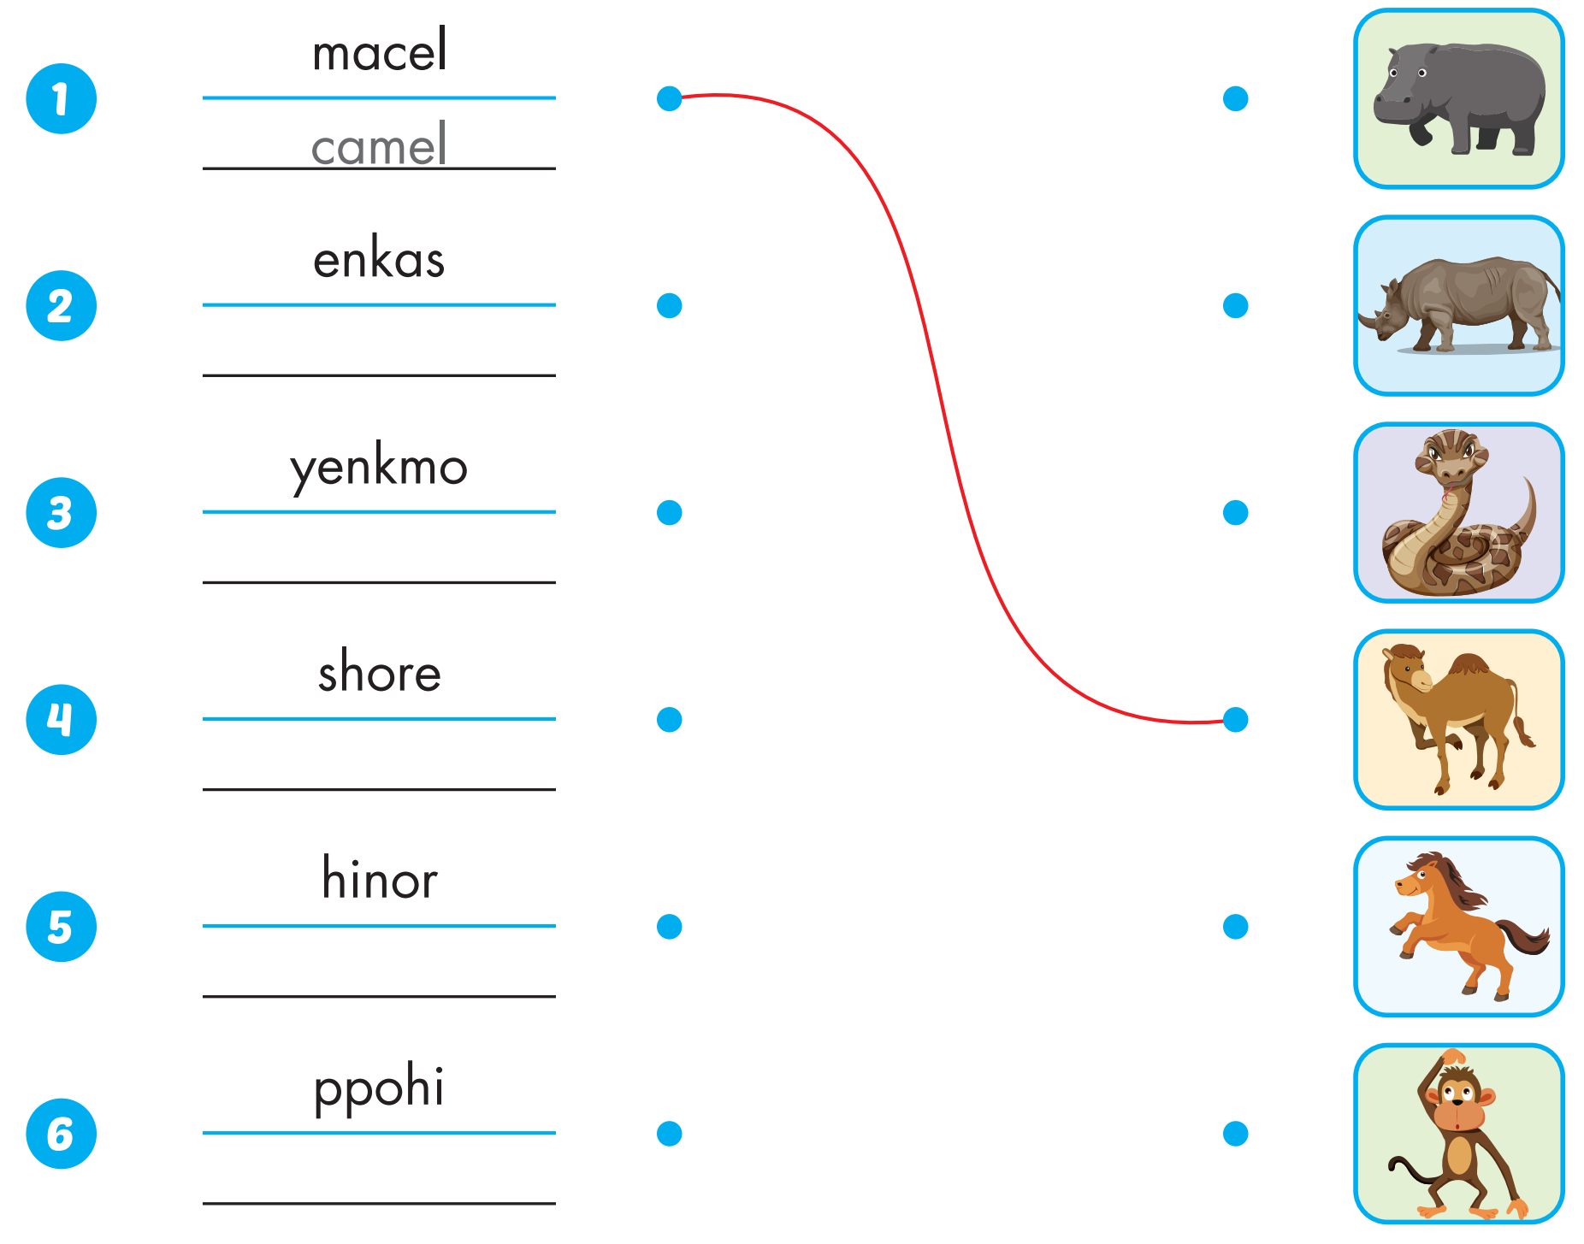
Extra Practice
WB, page 2
snake
monkey
horse
rhino
hippo

Slide 41

Production

Slide 42

CONSOLIDATION

Slide 43

WRAP-UP

Slide 44
Today’s lesson
Vocabularies
snake, monkey, horse, camel, hippo, rhino.
Structures/ Sentence patterns
This is a monkey.
These are monkeys.
That's a snake.
Those are snakes

