Slide 1

Unit 17
What would you like to eat
Lesson 1

Slide 2
VOCABULARY

Slide 3

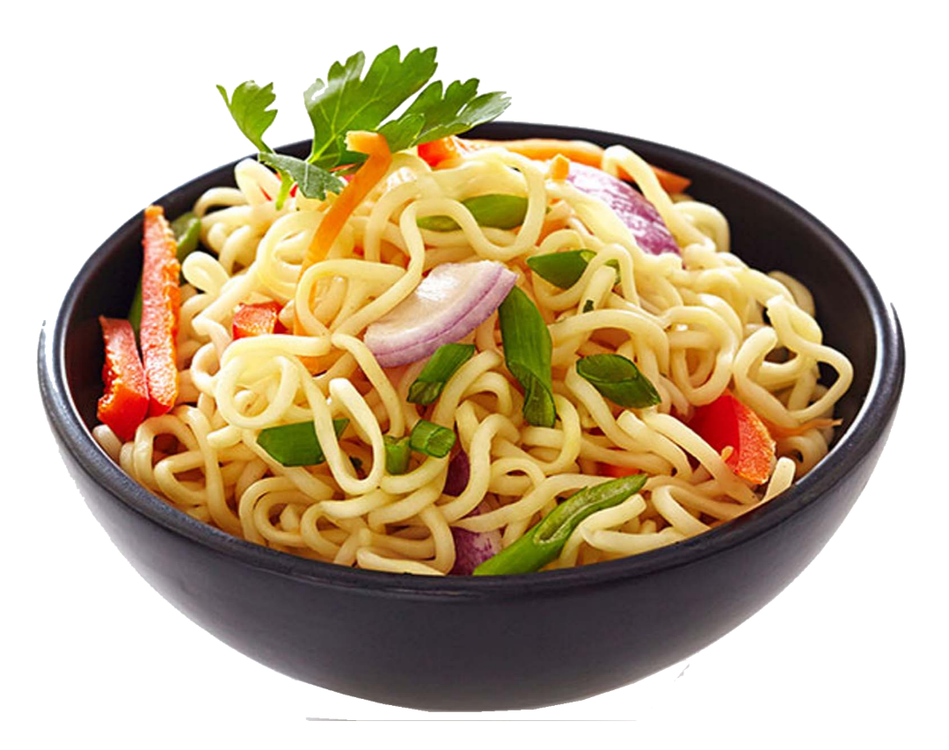
Vocabulary
noodle
s
/ˈnuːdlz/

Slide 4
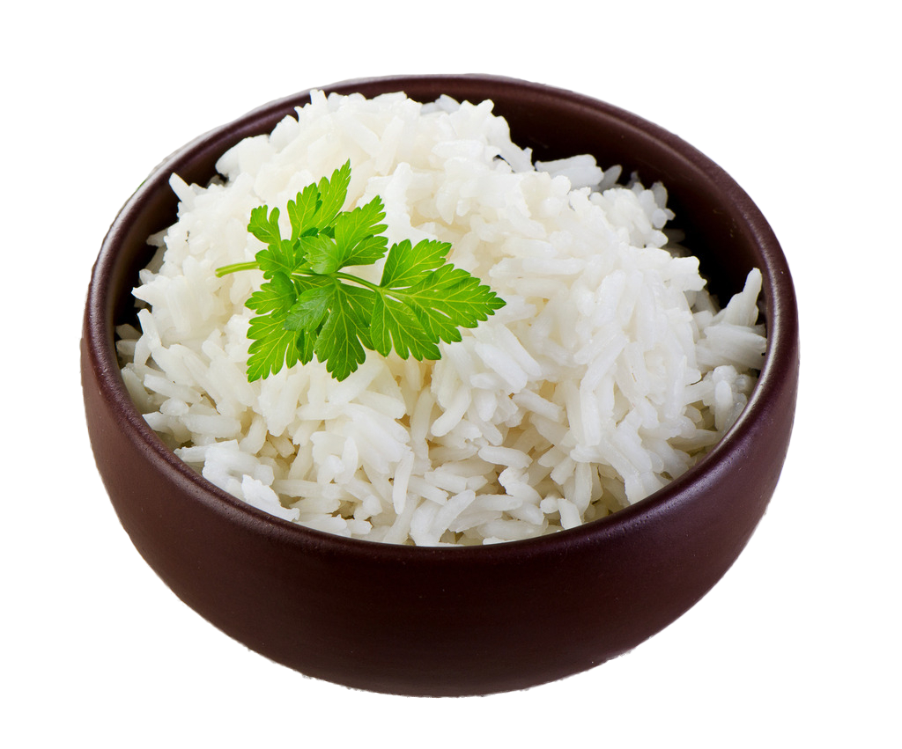
Vocabulary
rice
/raɪs/

Slide 5
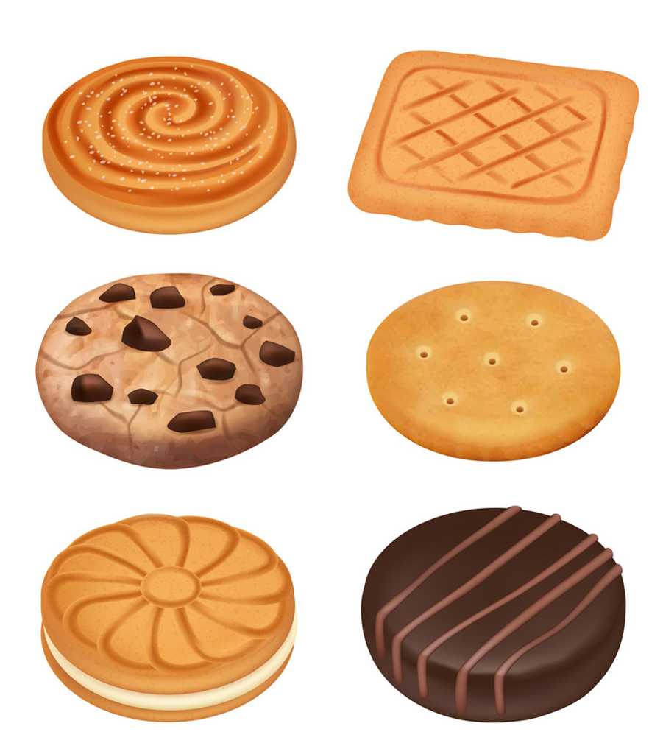
Vocabulary
biscuit
s
/ˈbɪskɪts/

Slide 6

Vocabulary
lemonade
/ˌleməˈneɪd/

Slide 7
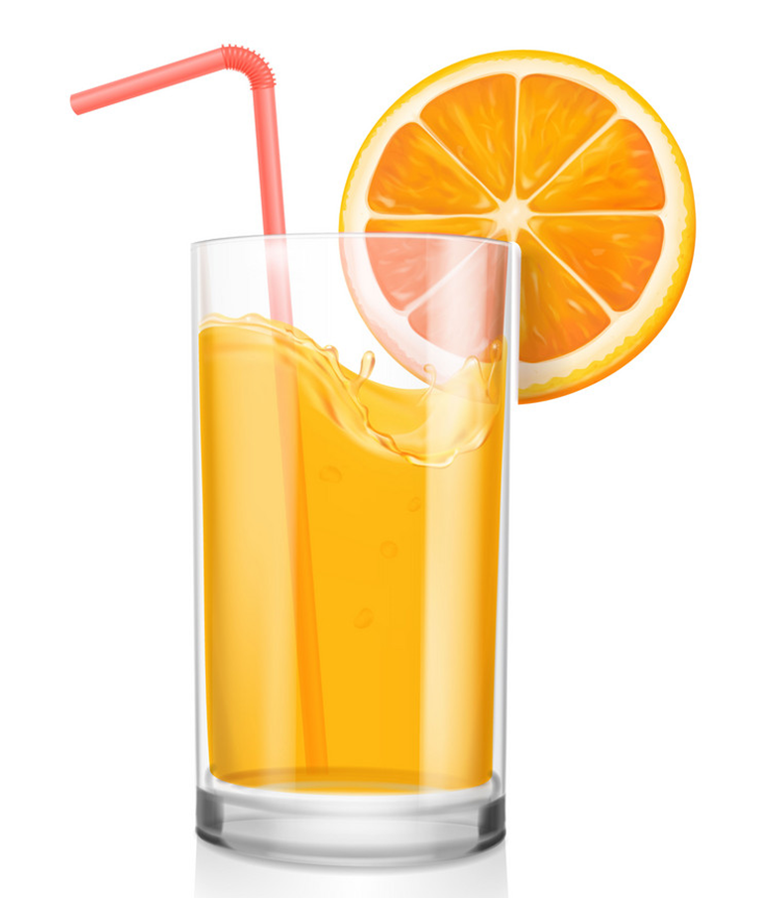
Vocabulary
orange juice
/ˈɔːrɪndʒ dʒuːs/

Slide 8
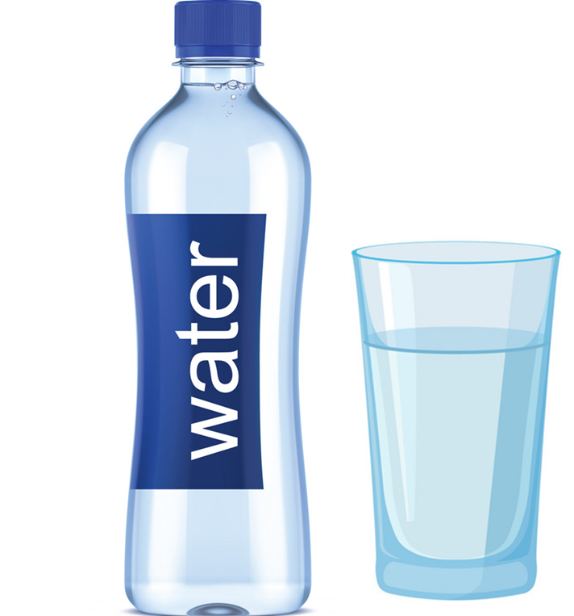
Vocabulary
water
/ˈwɔːtər/

Slide 9
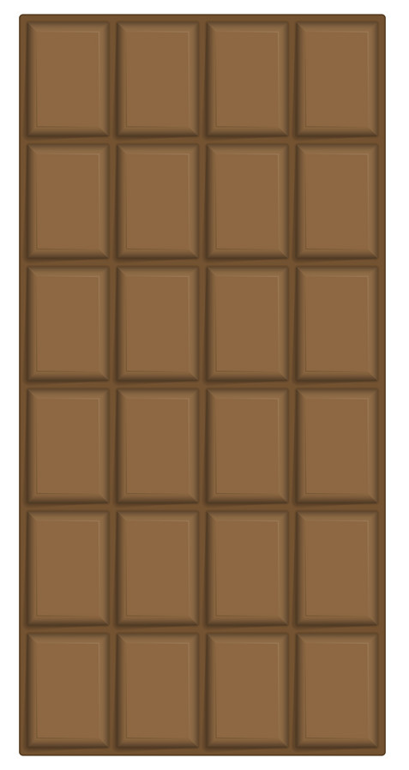
Vocabulary
bar
/bɑːr/

Slide 10
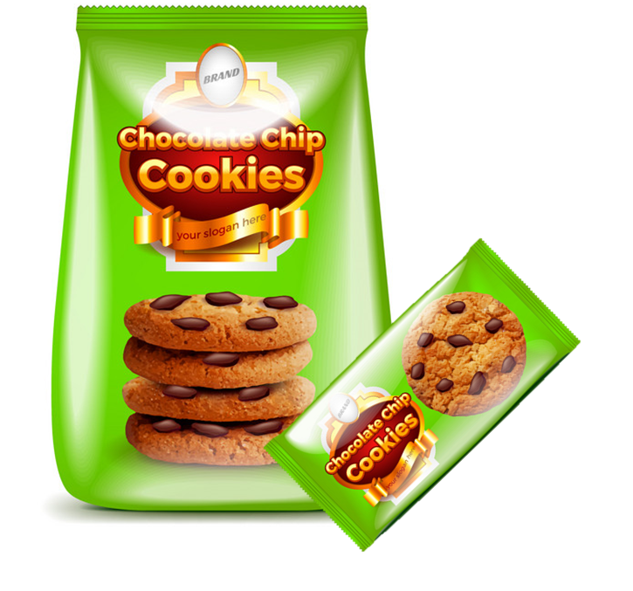
Vocabulary
packet
/ˈpækɪt/

Slide 11
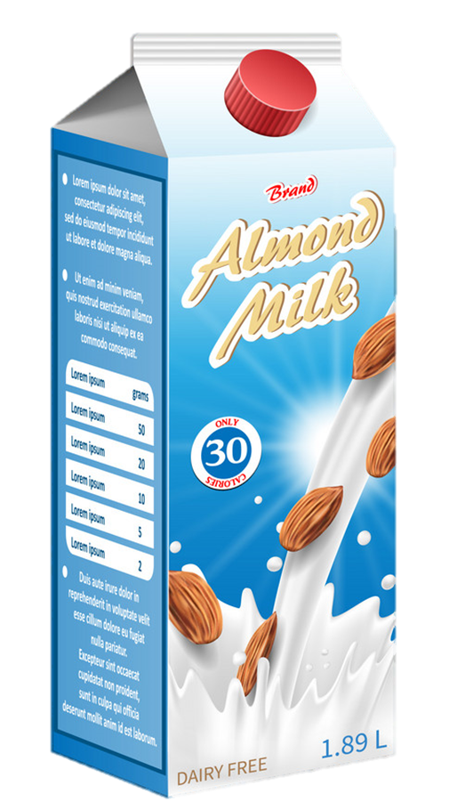

Vocabulary
carton
/ˈkɑːrtn/

Slide 12
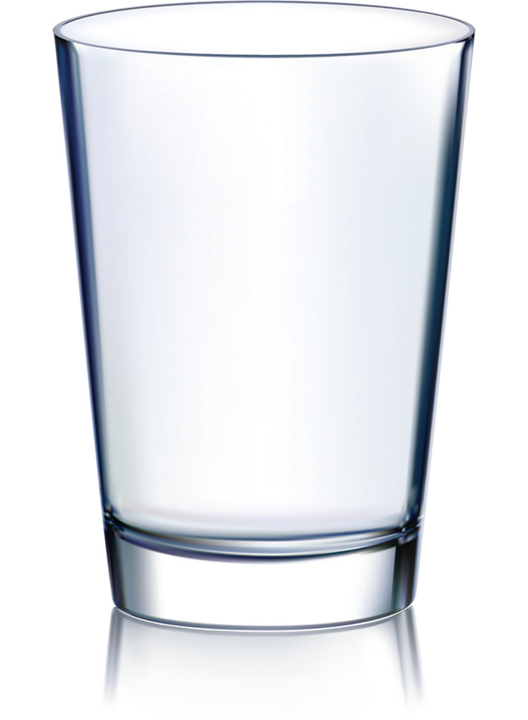
Vocabulary
glass
/ɡlæs/
glasses
/ɡlæsɪz/

Slide 13

Vocabulary
bowl
/bəʊl/

Slide 14
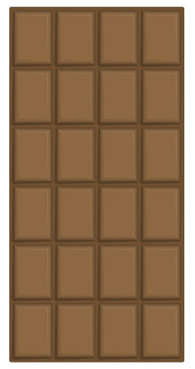
Vocabulary
a bar
a bowl
a carton
a packet
a glass

Slide 15
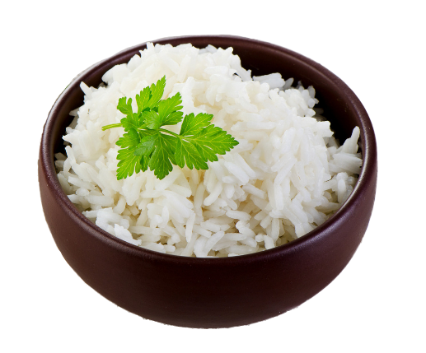
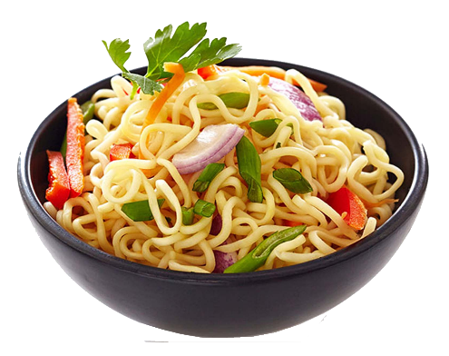
Vocabulary
water
lemonade
orange juice
rice
a biscuit
noodles

Slide 16

LET’S PLAY
PLAY

Slide 17
A. water
B. juice
C. glass
D. milk
Next

Slide 18
A. choclate
B. bread
C. rice
D. biscuit
Next

Slide 19
A. Orange juice
B. Lemonade
C. Lemon juice
D. Water
Next

Slide 20
A. noodles
B. bread
C. rice
D. biscuits
Next

Slide 21
A. Orange juice
B. Lemonade
C. Water
D. Milk
Next

Slide 22
A. rice
B. chocolate
C. biscuits
D. noodle
Next

Slide 23
A. packet
B. bar
C. bowl
D. bottle
Next

Slide 24
A. bar
B. glass
C. packet
D. bowl
Next

Slide 25
A. bowl
B. carton
C. glass
D. cup
Next

Slide 26
A. bottle
B. cup
C. glass
D. carton
Next

Slide 27
A. carton
B. glass
C. bowl
D. packet
Next

Slide 28
WELL DONE!

Slide 29
GRAMMAR

Slide 30
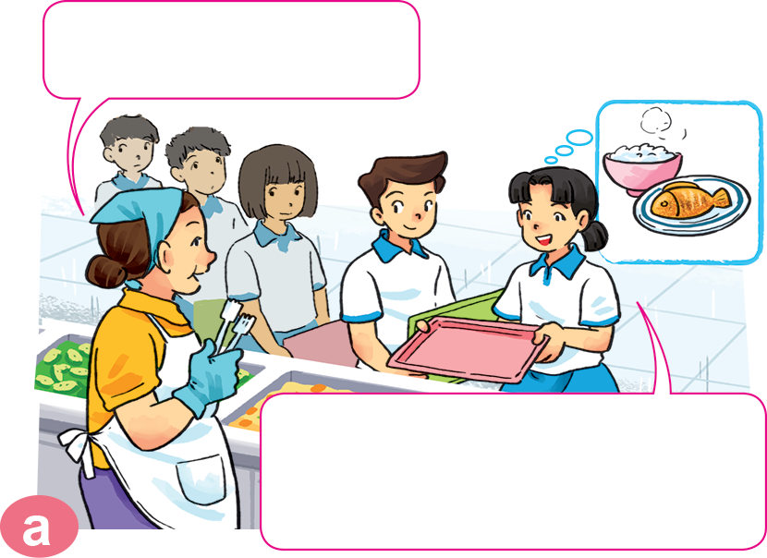
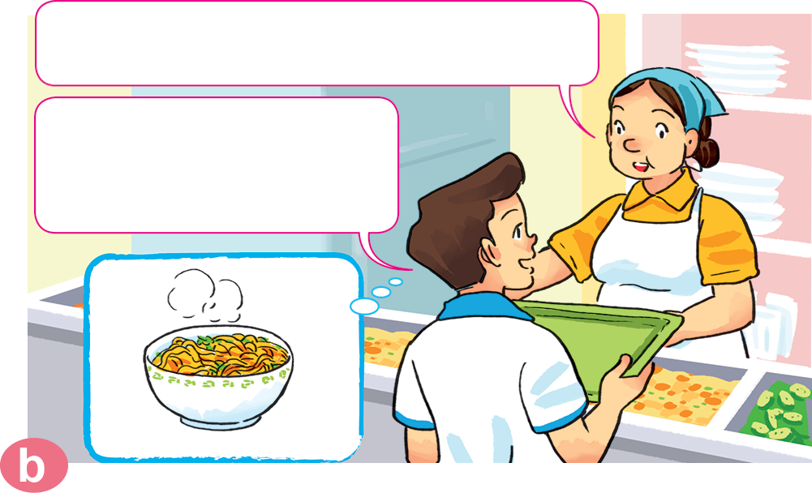

1. Look, listen and repeat.
Can I help you?
What would you like to eat?
I'd like a bowl of noodles, please.
Yes. I'd like some rice with fish, please.

Slide 31
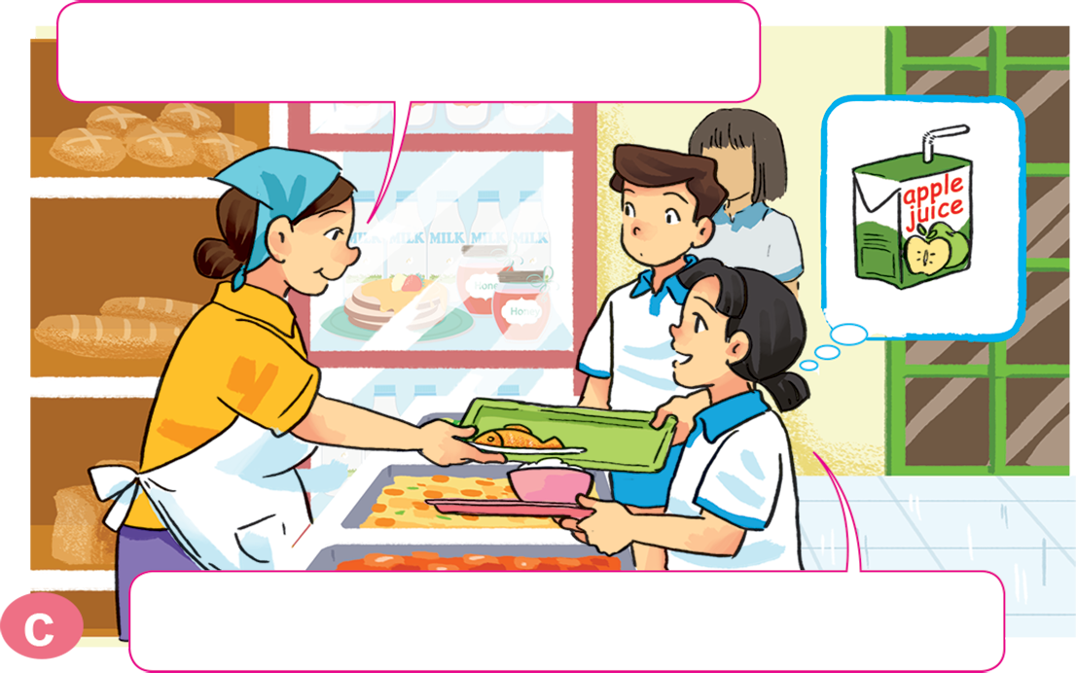
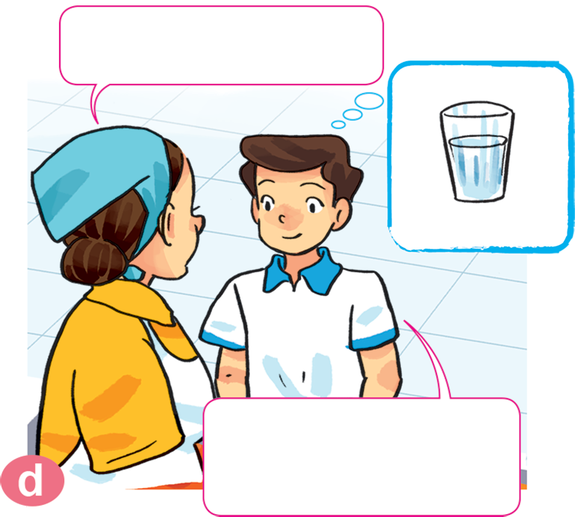
1. Look, listen and repeat.
What would you like to drink?
How about you?
I'd like a glass of water, please.
I'd like a carton of apple juice, please.

Slide 32
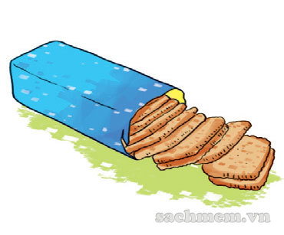
2. Point and say.
What would you like to eat?
I'd like ______________________, please.
a packet of biscuits

Slide 33
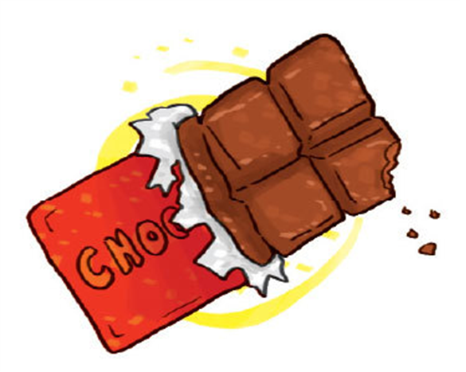
2. Point and say.
What would you like to eat?
I'd like ______________________, please.
a bar of chocolate

Slide 34

2. Point and say.
What would you like to drink?
I'd like ______________________, please.
a carton of lemonate

Slide 35


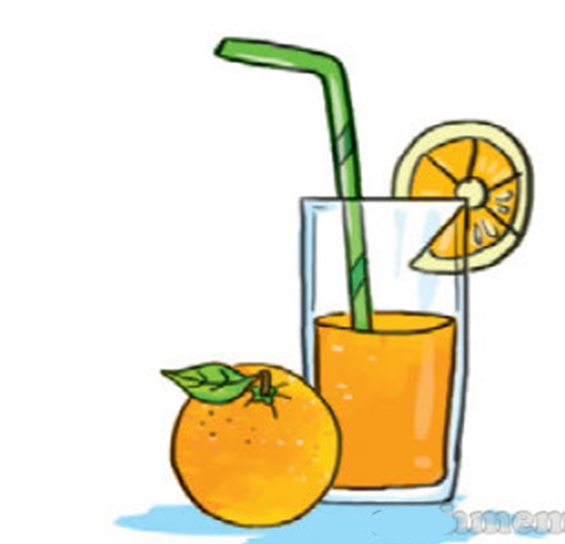
2. Point and say.
What would you like to drink?
I'd like ______________________, please.
a glass of orange juice

Slide 36
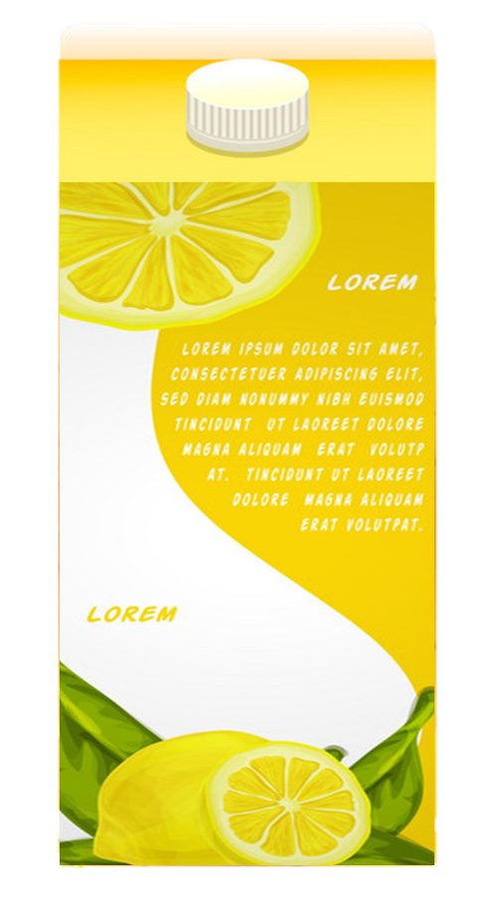

What would you like to eat/drink?
I'd like__________, please.
a packet of biscuits
a carton of lemonade
a bar of
chocolate
a glass of
orange juice
Ms.Phạm English

Slide 37

3. Let’s talk.
What would you like to eat/drink?
I'd like __________, please.

Slide 38
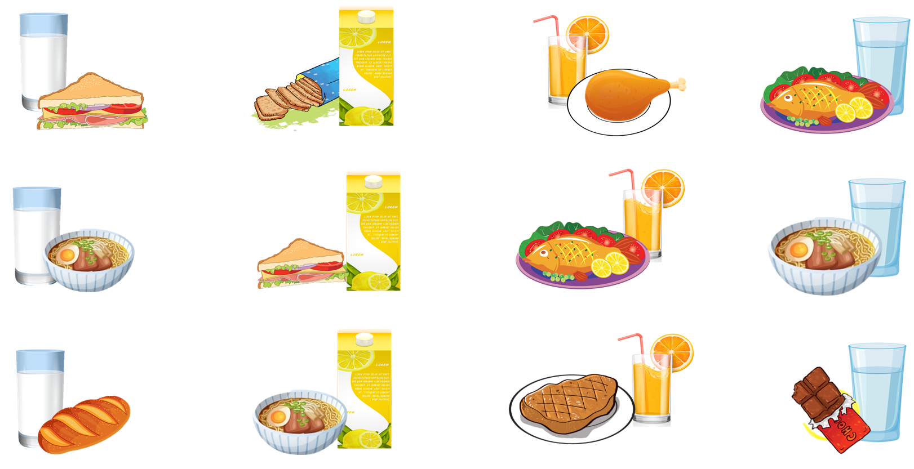


4. Listen and tick.
1.
2.
3.
4.
a
a
a
a
b
b
b
b
c
c
c
c

Slide 39
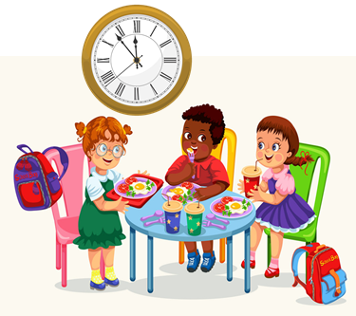
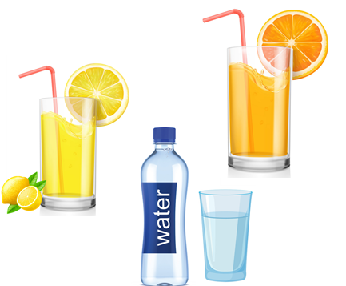
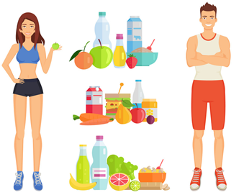
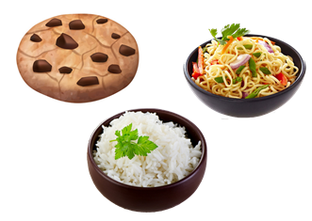
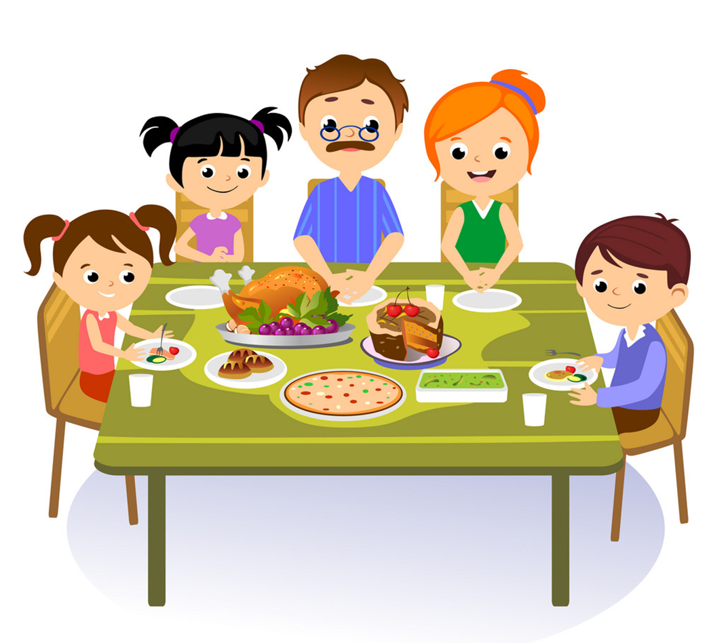
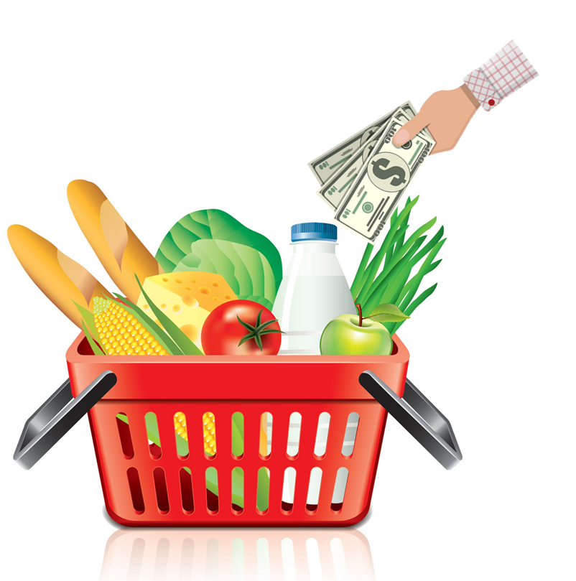
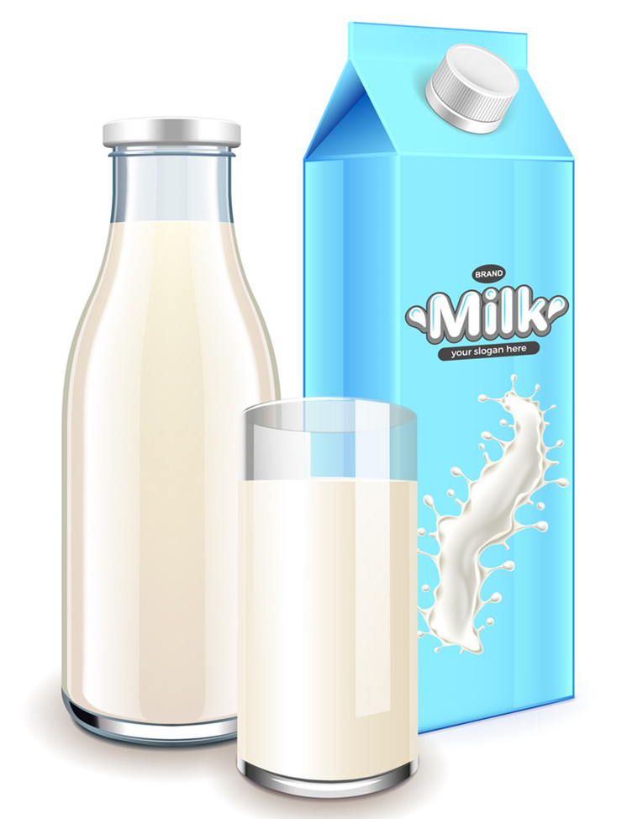
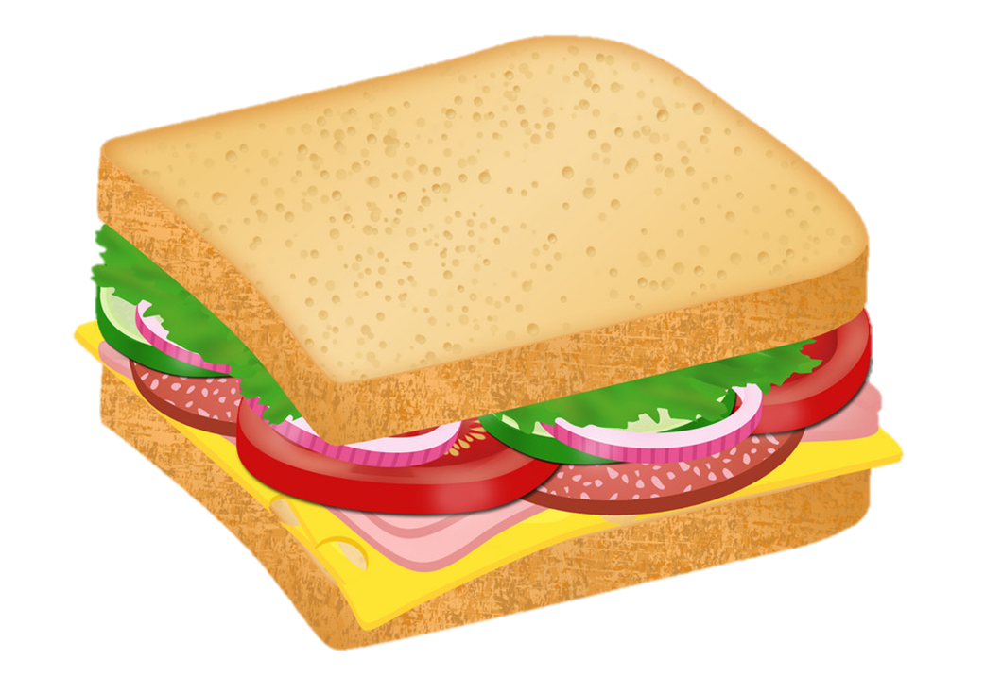
Vocabulary
lunch
food
drink
Healthy
/lʌntʃ/
/fuːd/
/drɪŋk/
/ˈhelθi/
milk
sandwich
meal
buy
/mɪlk/
/ˈsænwɪtʃ/
/miːl/
/baɪ/

Slide 40
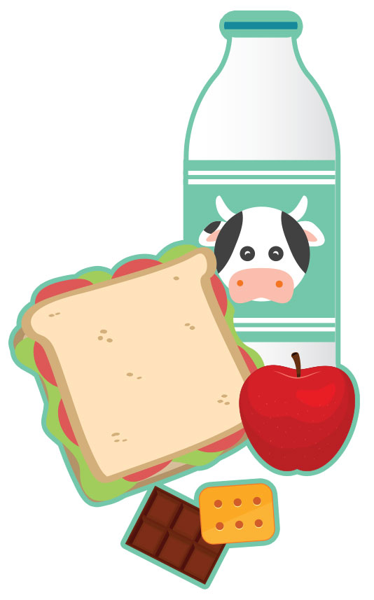
5. Read and complete.
What do English children usually eat nowadays? At (1) ________, Jim goes to a shop and buys a (2) ________, some chocolate and some milk. Some of his friends buy (3) ________ at the shop, too. Some of the sandwiches are (4) ________, but some aren't. School meals are healthier, but Jim and his friends never (5) ______ at the school canteen.
healthy
lunch
eat
sandwich
lunch
food
sandwich
healthy
food
eat

Slide 41
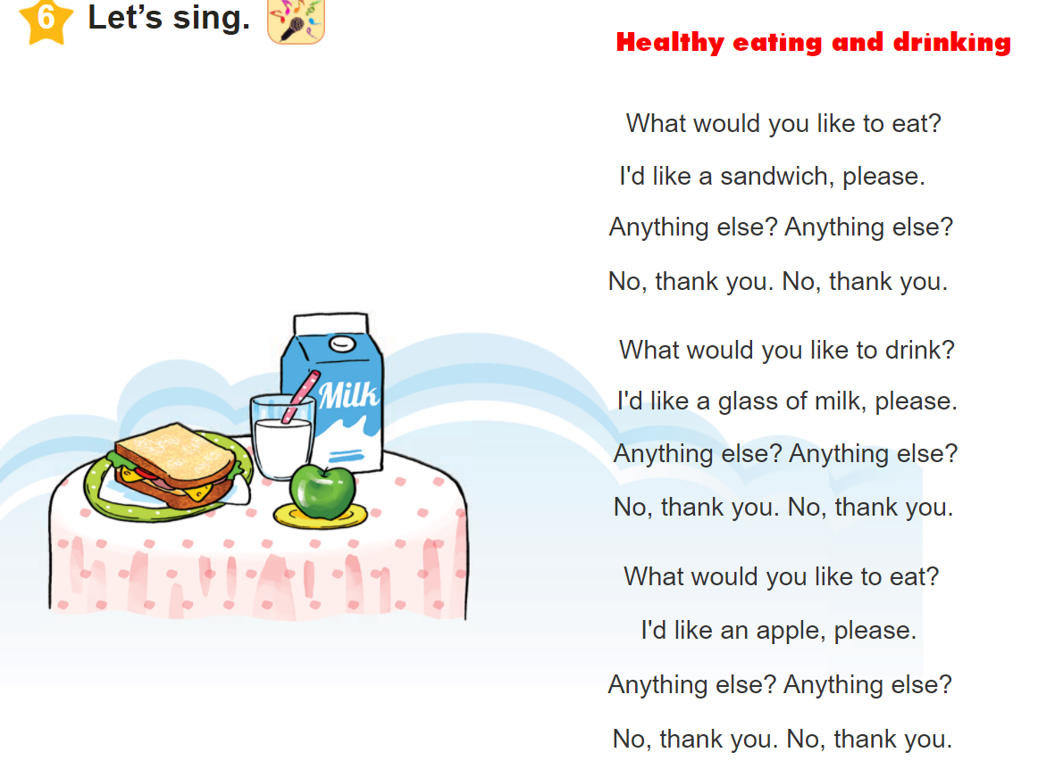


6. Let’s sing

