Slide 1

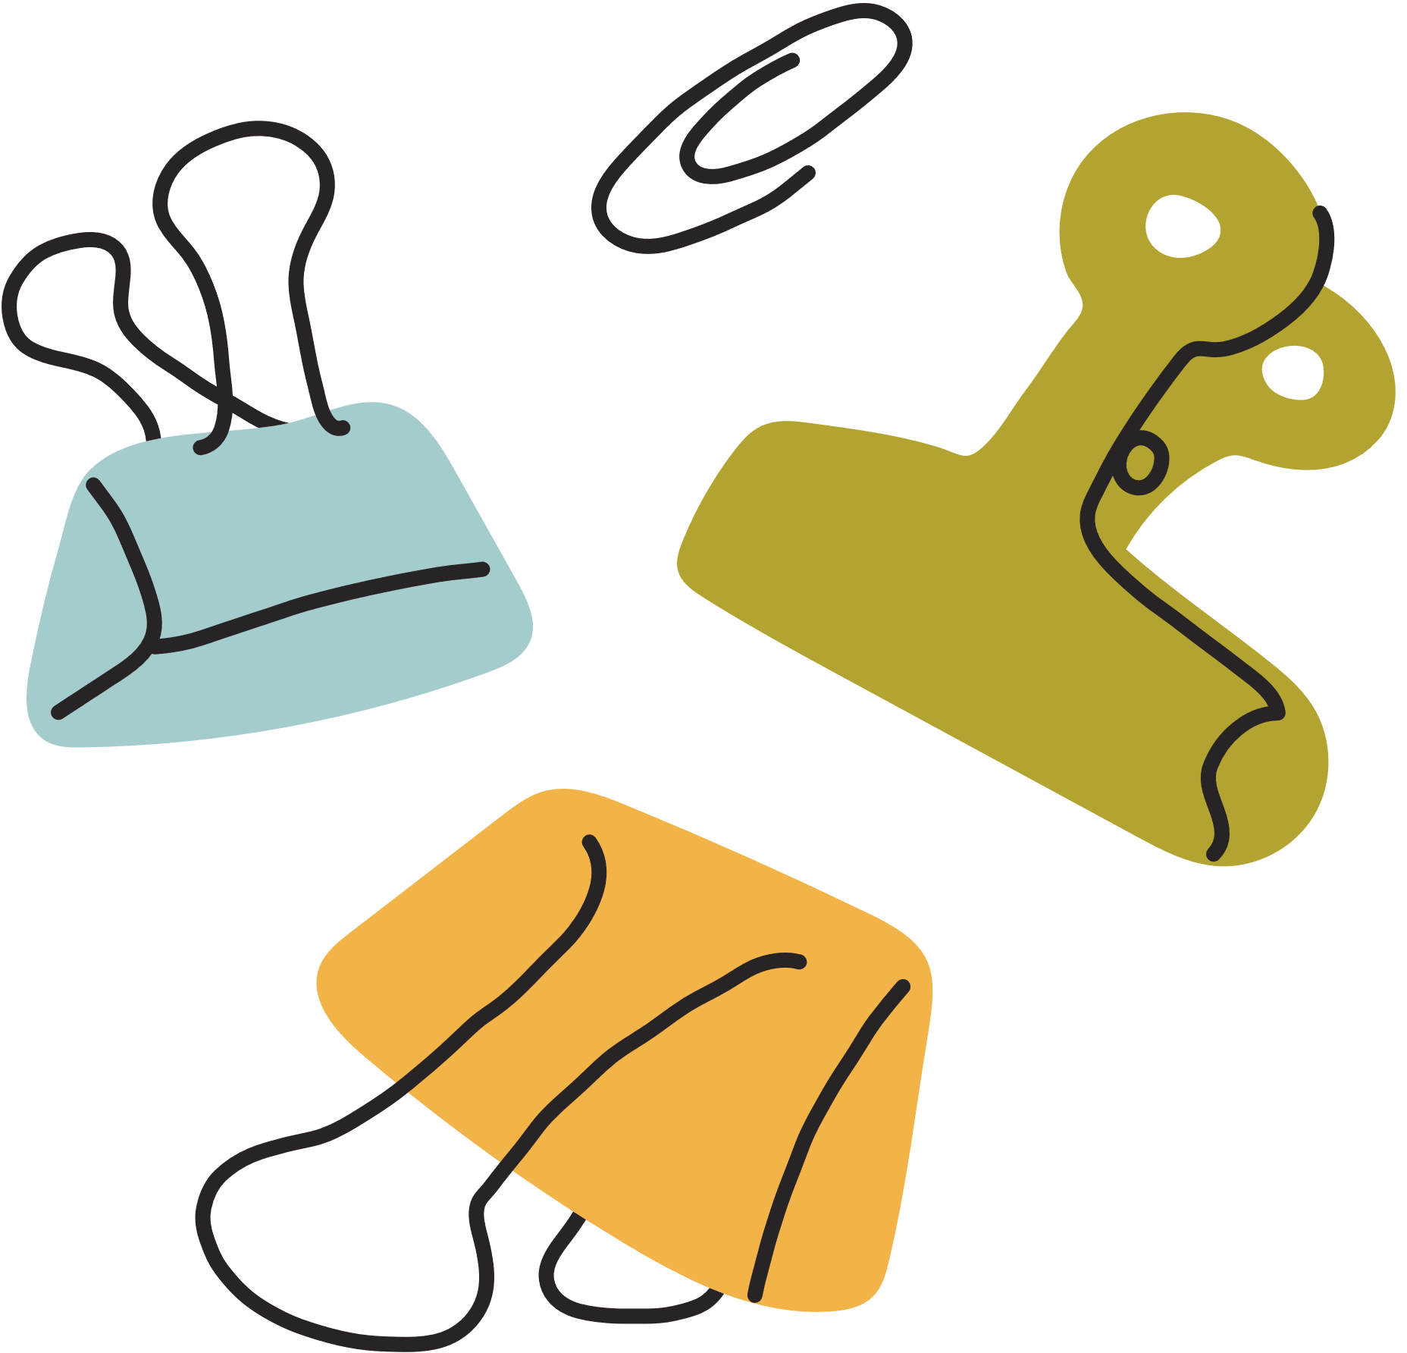

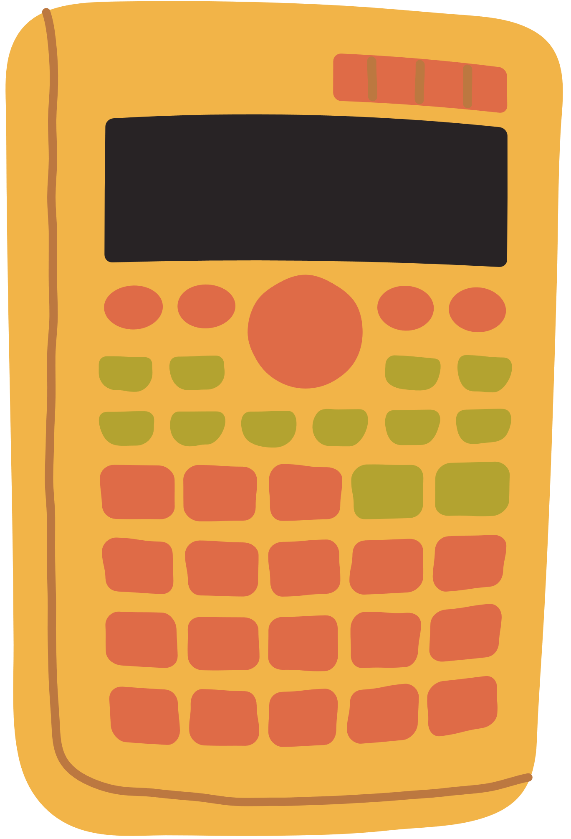




Warm Up
Who’s faster?
Listen and write down the number,
addition or subtraction

Slide 2
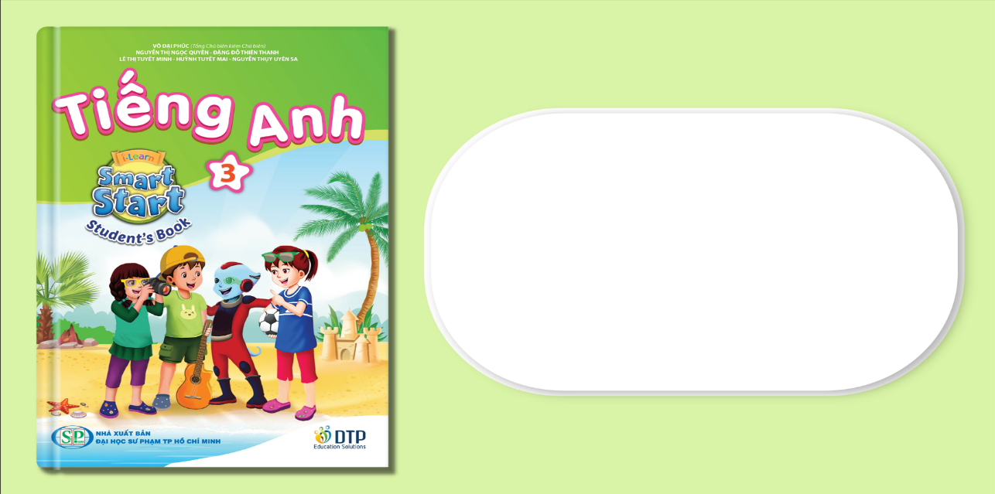
Unit 7: Toys
Lesson 4.2
Page 106

Slide 3


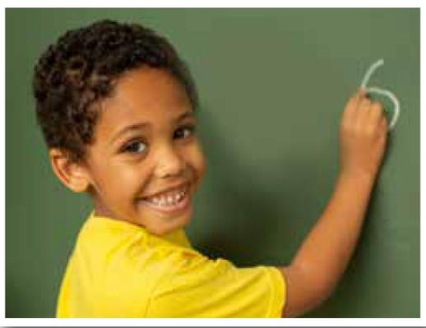

What can you see?
Reading

Slide 4






At school, we learn addition (+) and subtraction (-) with blocks.
I have ten blocks on my desk. I put four blocks in a bag.
How many blocks do I have? I have six blocks.
I like Math!
10 – 4 = 6

Slide 5

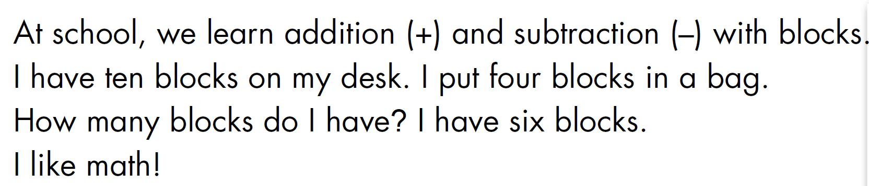

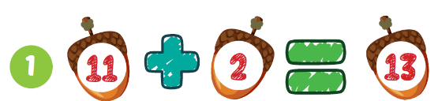
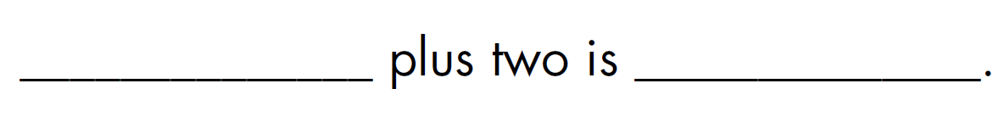
Eleven
thirteen

Slide 6
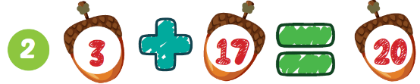
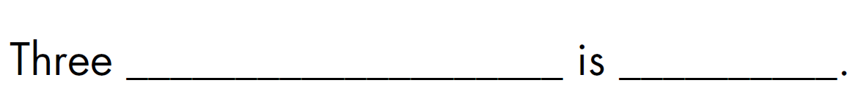
plus seventeen
twenty

Slide 7
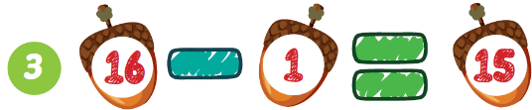
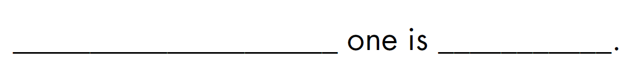
Sixteen minus
fifteen

Slide 8
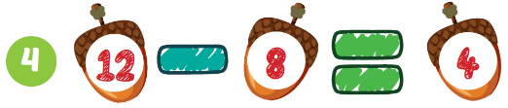
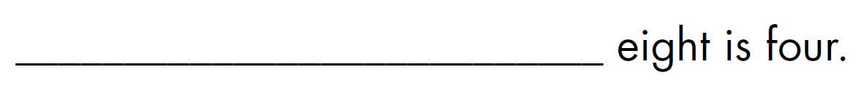
Twelve minus

Slide 9
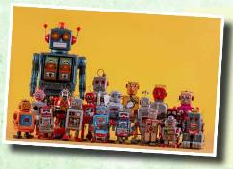
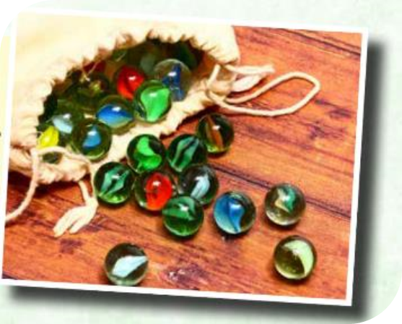
Listening

Slide 10

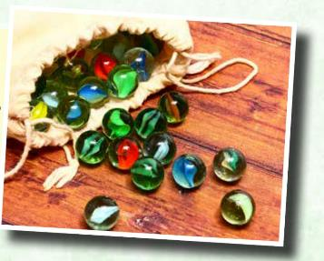
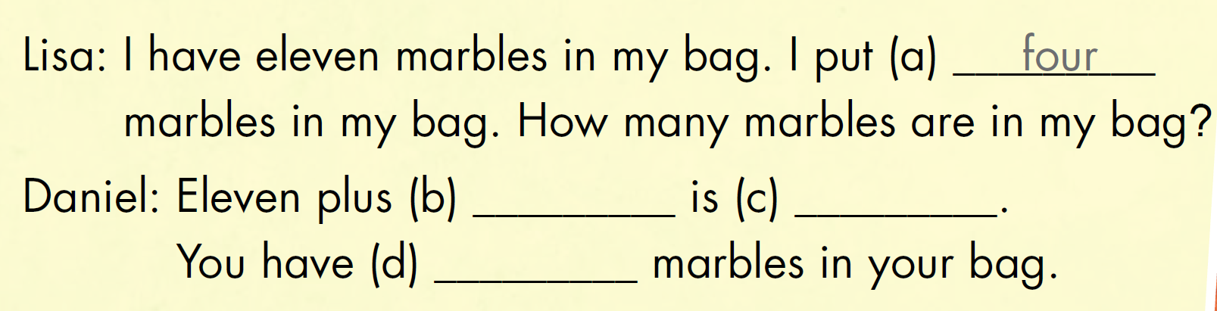
four
fifteen
fifteen
Notes:
Click vào:Look and listen để nghe âm thanh

Slide 11
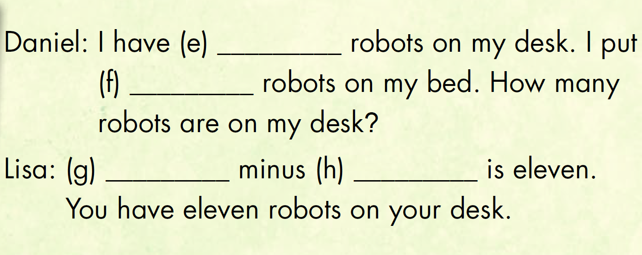
fourteen
three
Fourteen
three
Notes:
Click vào:Look and listen để nghe âm thanh

Slide 12
Tuesday, April 2nd , 2024
Unit 3. Toys
Lesson 11
I have three dice in my bag. I put two dice in my bag. How many dice are in my bag?
+ three plus two is five.

Slide 13








Today’s lesson:
Vocabularies
Reading
Review numbers 11-20, addition, subtraction
Read to know about identifying and doing simple math with real objects
Listening
Structures
Listen to friends talking about the quantity of items that they have
How many marbles are in my bag? Eleven plus four is fifteen

Slide 14
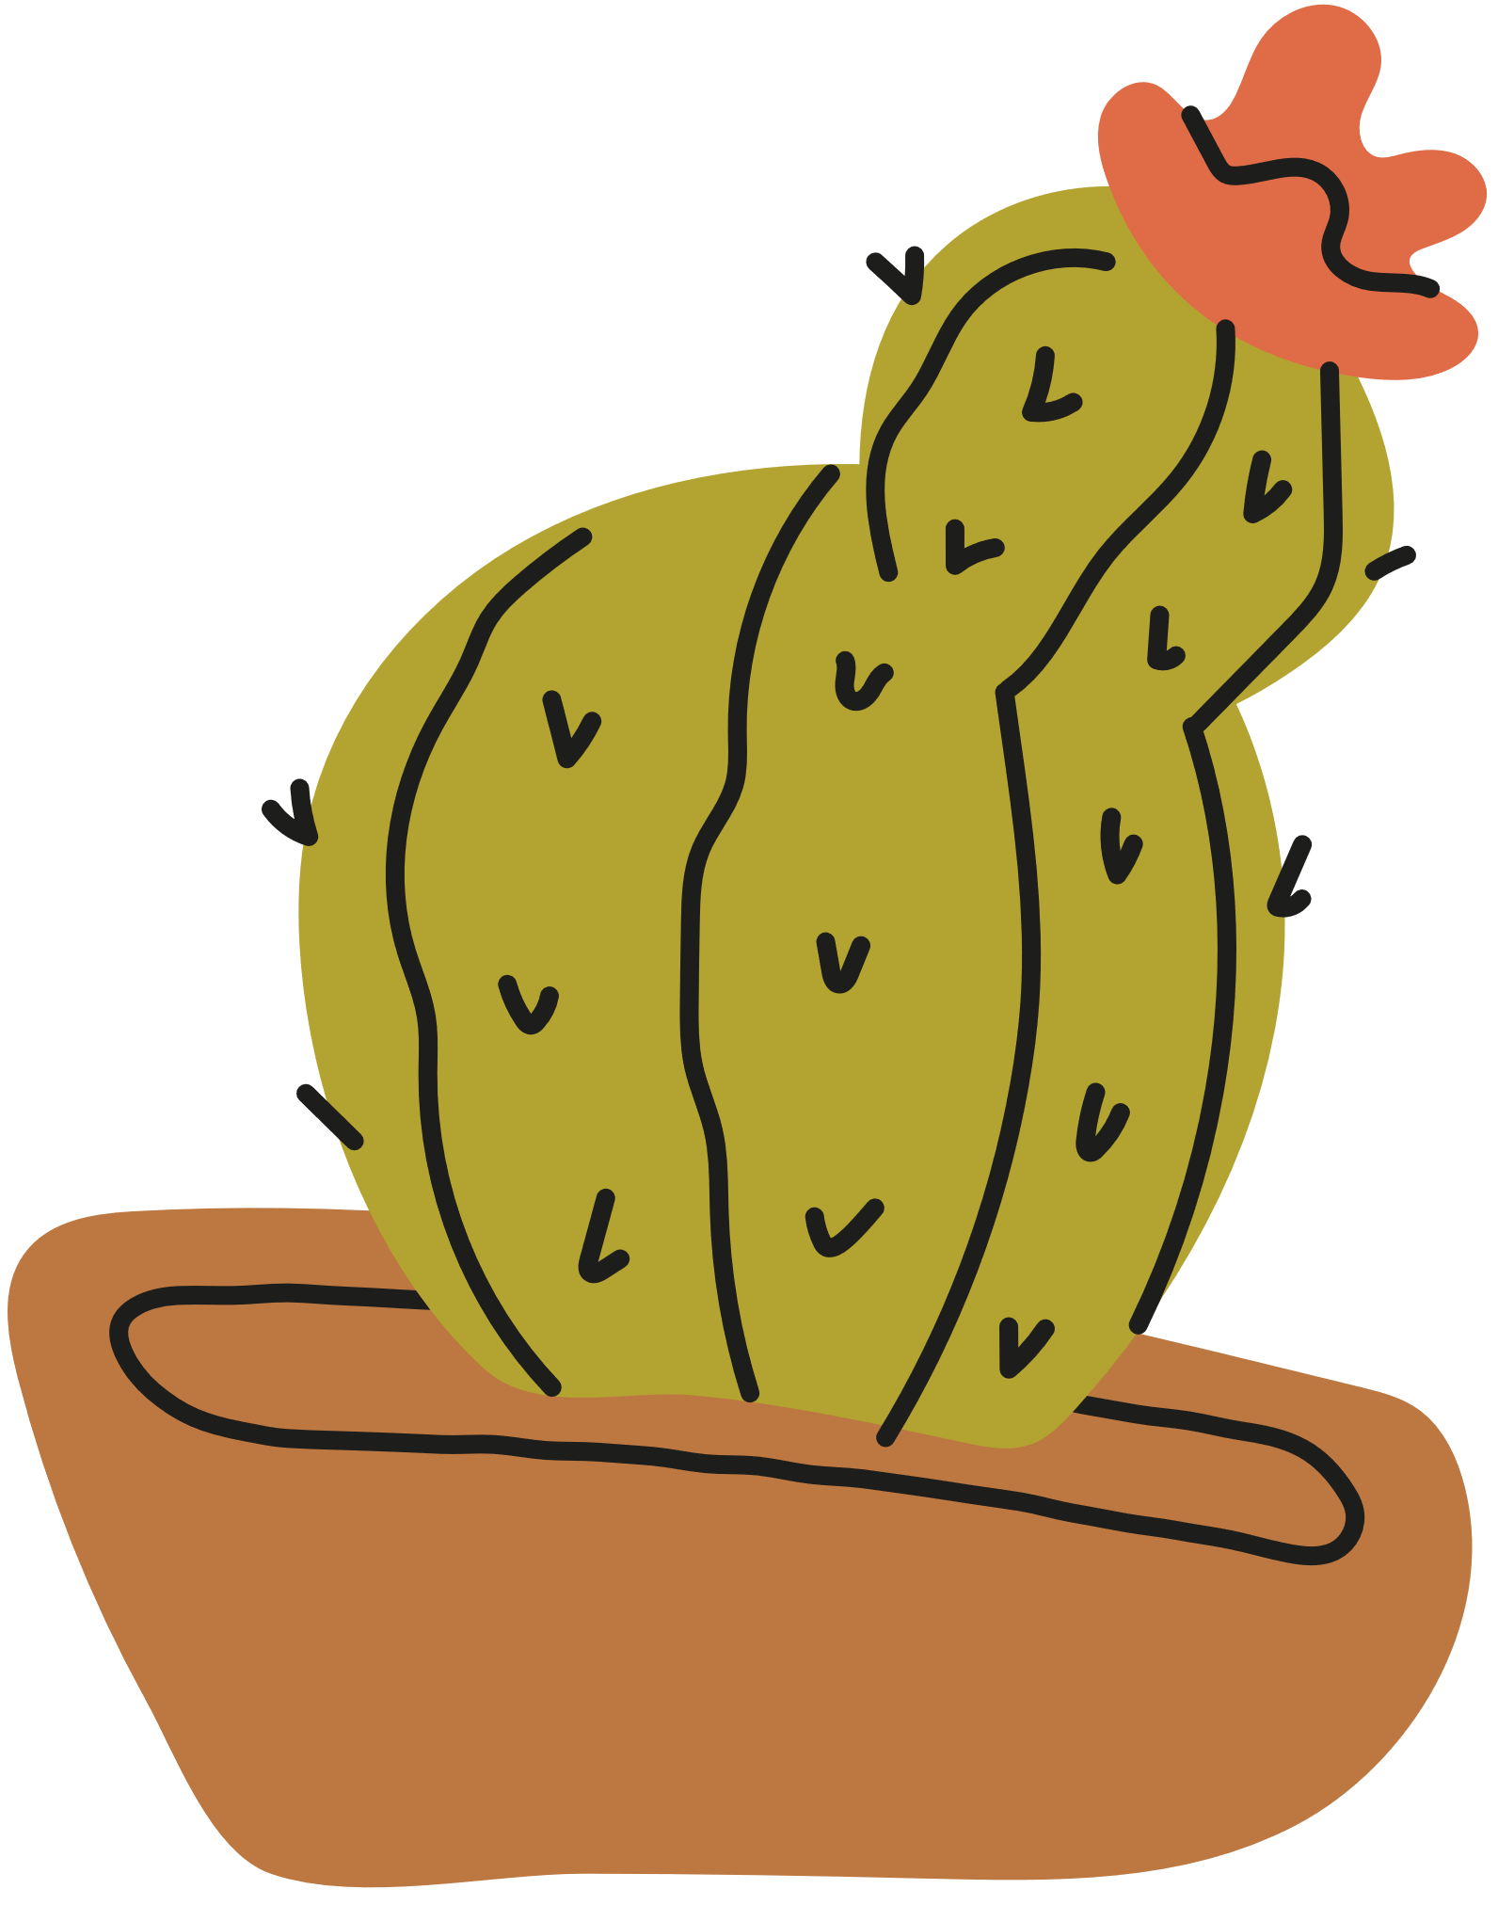
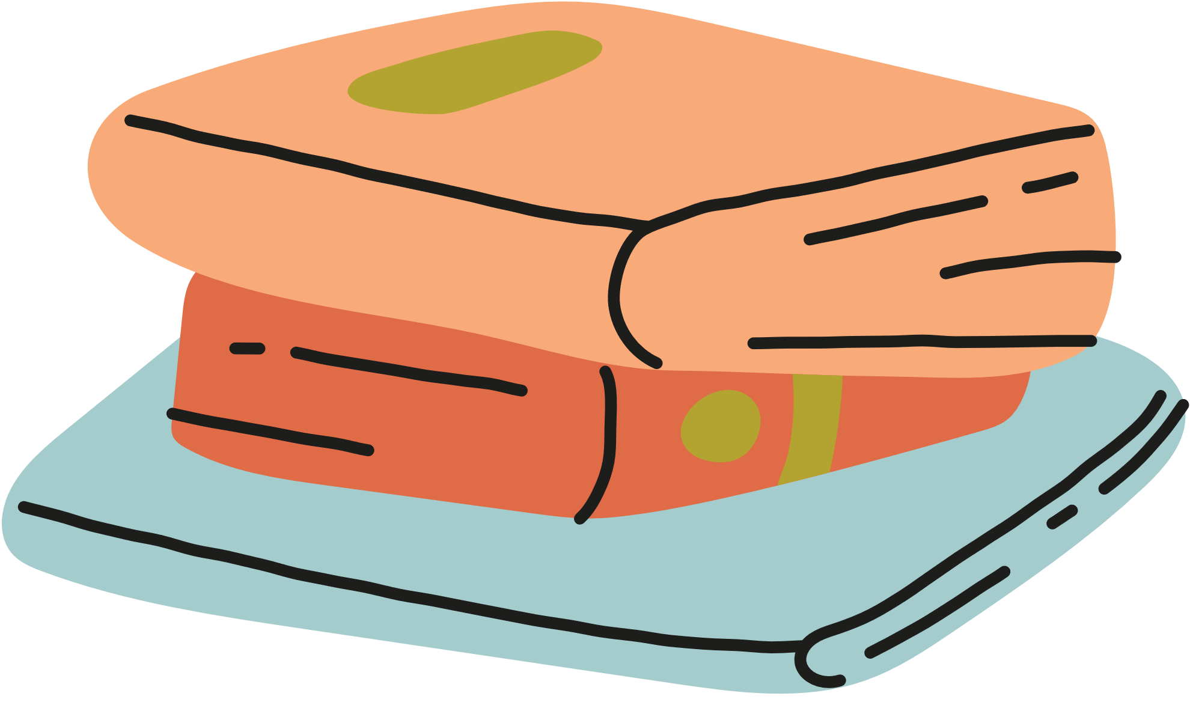
Thank you

