Slide 1
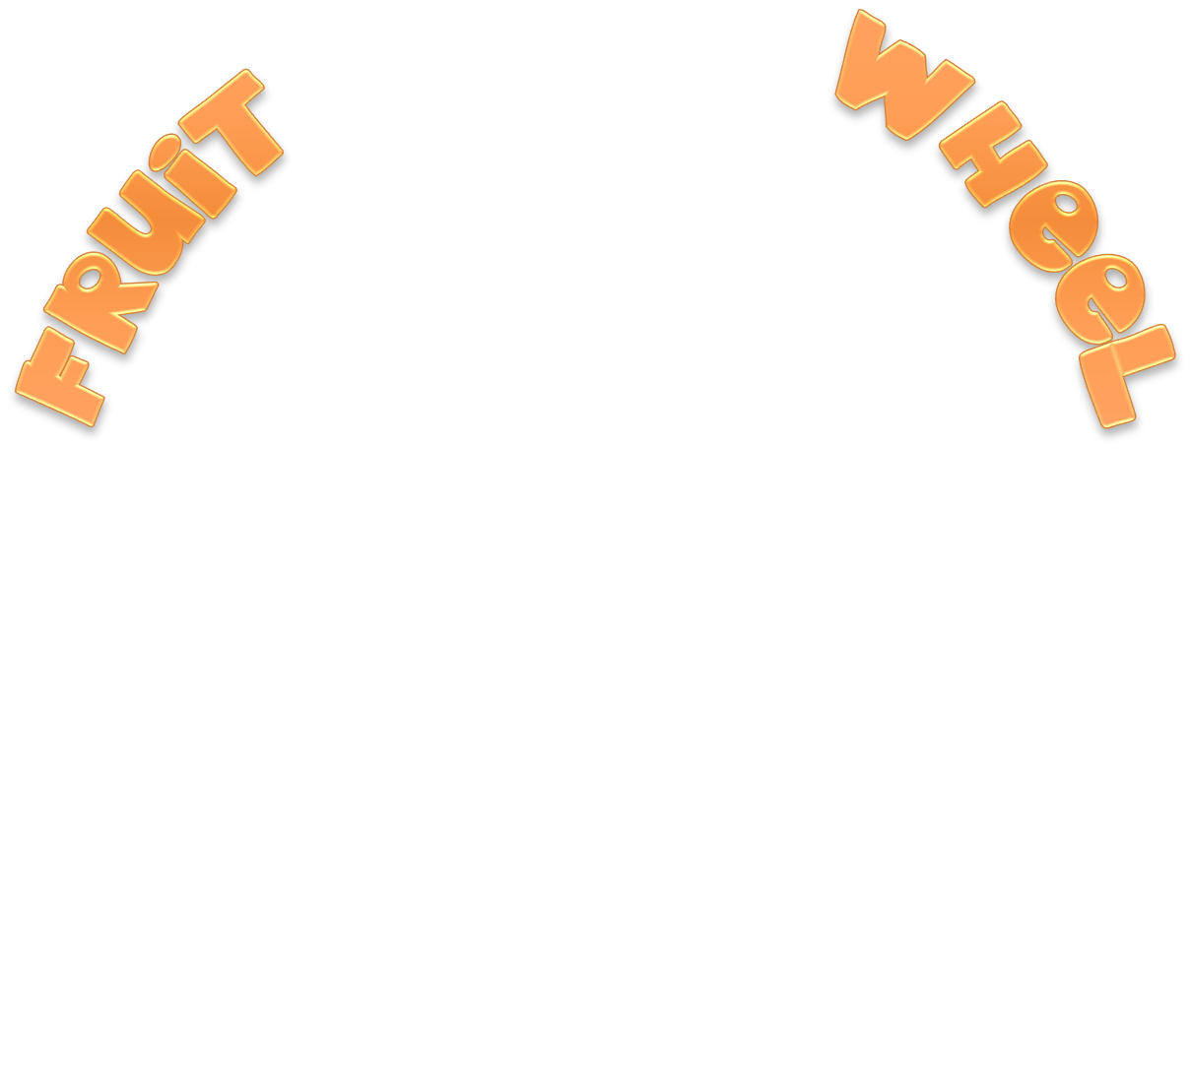




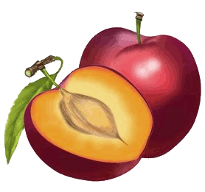

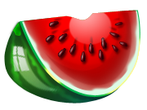
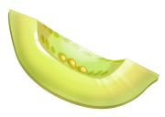


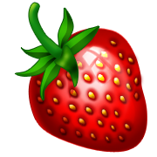

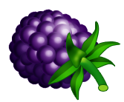


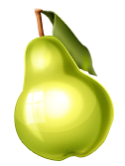



Slide 2



Spin the wheel and click the right word

Slide 3
Spin the wheel and click the right word
apple
strawberry
melon
pear
peach
lemon
pineapple
banana
orange
blackberry
plum
watermelon

Slide 4
Spin the wheel and click the right word
apple
strawberry
melon
pear
peach
lemon
pineapple
banana
orange
blackberry
plum
watermelon

Slide 5
Spin the wheel and click the right word
apple
strawberry
melon
pear
peach
lemon
pineapple
banana
orange
blackberry
plum
watermelon

Slide 6
Spin the wheel and click the right word
apple
strawberry
melon
pear
peach
lemon
pineapple
banana
orange
blackberry
plum
watermelon

Slide 7
Spin the wheel and click the right word
apple
strawberry
melon
pear
peach
lemon
pineapple
banana
orange
blackberry
plum
watermelon

Slide 8
Spin the wheel and click the right word
apple
strawberry
melon
pear
peach
lemon
pineapple
banana
orange
blackberry
plum
watermelon

Slide 9
Spin the wheel and click the right word
apple
strawberry
melon
pear
peach
lemon
pineapple
banana
orange
blackberry
plum
watermelon

Slide 10
Spin the wheel and click the right word
apple
strawberry
melon
pear
peach
lemon
pineapple
banana
orange
blackberry
plum
watermelon

Slide 11
Spin the wheel and click the right word
apple
strawberry
melon
pear
peach
lemon
pineapple
banana
orange
blackberry
plum
watermelon

Slide 12
Spin the wheel and click the right word
apple
strawberry
melon
pear
peach
lemon
pineapple
banana
orange
blackberry
plum
watermelon

Slide 13
Spin the wheel and click the right word
apple
strawberry
melon
pear
peach
lemon
pineapple
banana
orange
blackberry
plum
watermelon

Slide 14
Spin the wheel and click the right word
apple
strawberry
melon
pear
peach
lemon
pineapple
banana
orange
blackberry
plum
watermelon
EXIT

