Slide 1

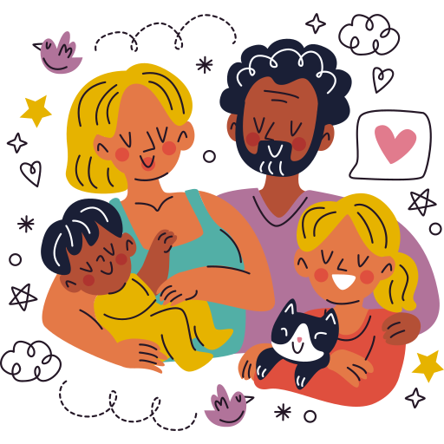
Unit 1:
FAMILY AND FRIENDS
Lesson 1 – Part 4, 5, 6

Slide 2

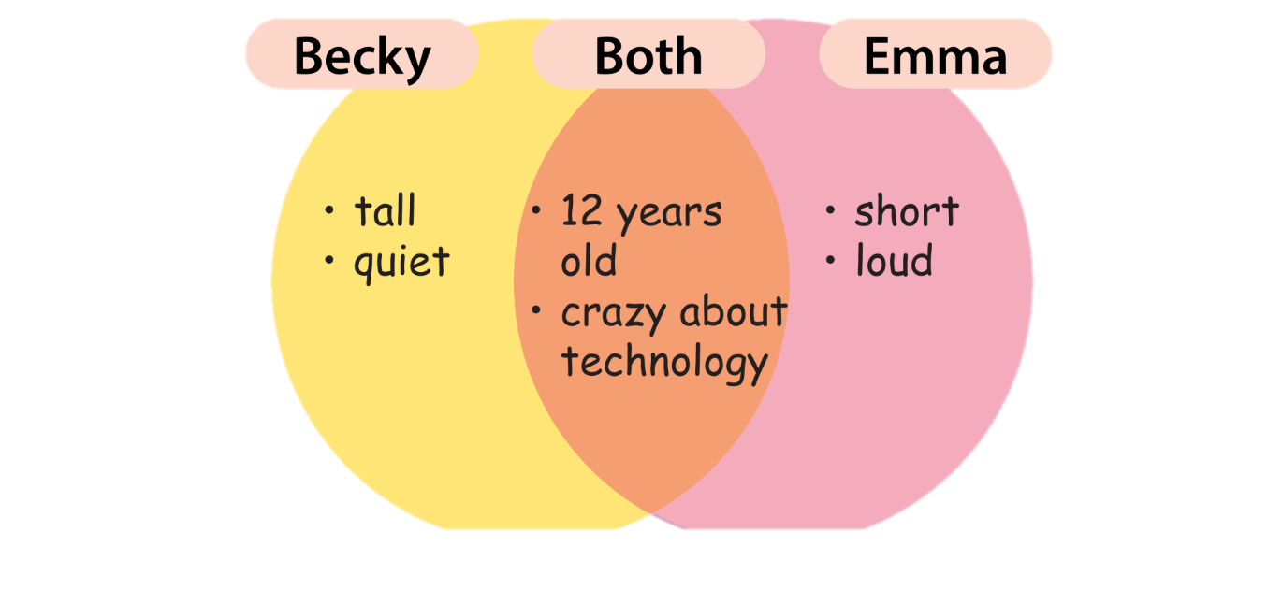




Slide 3

Both ….. and

Slide 4

Both Becky and Emma are crazy about technology.

Slide 5
Make a sentence, using “both”!
Both Becky and Emma are 12 years old.

Slide 6
but

Slide 7
Becky is quiet, but Emma is loud.

Slide 8
Make a sentence, using “but”!
Becky is tall, but Emma is short.

Slide 9




Look and write
big ears
small ears
live on land
but
The giraffe has small ears, _____ the elephant has big ears.
Both
_____ the giraffe and the elephant live on land.

Slide 10

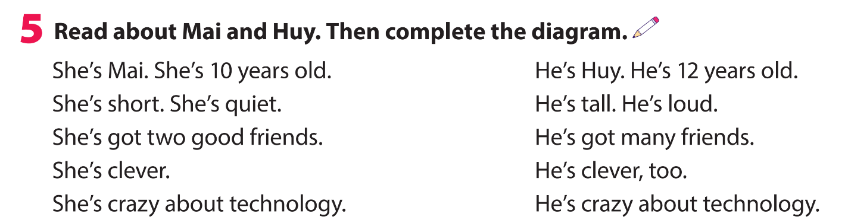
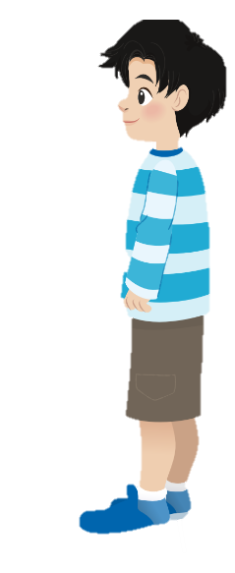
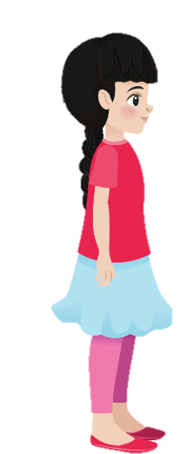
She’s Mai. She’s 10 years old.
He’s Huy. He’s 12 years old.
She’s short. She’s quiet.
He’s tall. He’s loud.
She’s got two good friends.
He’s got many friends.
She’s clever.
He’s clever, too.
She’s crazy about technology.
He’s crazy about technology.

Slide 11
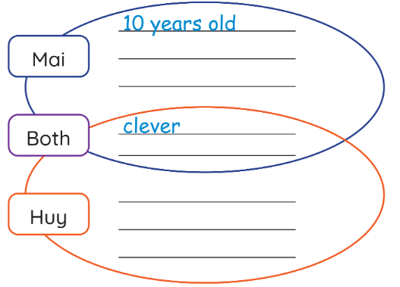
short
quiet
crazy about technology.
12 years old
tall
loud

Slide 12
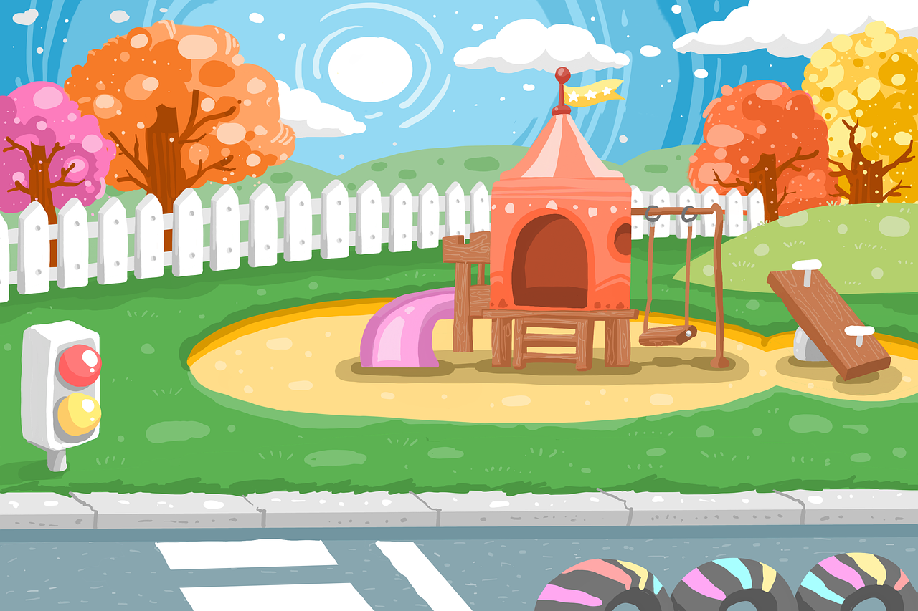



Read and write
“Both” - ”But”
crazy about technology
crazy about technology
Both Mai and Huy are crazy about technology.

Slide 13
Read and write
“Both” - ”But”
tall
short
Mai’s short, but Huy’s tall.

Slide 14
Read and write
“Both” - ”But”
clever
clever
Both Mai and Huy are clever.

Slide 15
Read and write
“Both” - ”But”
12 years old
10 years old
Mai’s 10 years old, but Huy’s 12 years old.

Slide 16

sister
Both my mum and my sister are tall.
quiet
tall
loud
mum
My mum is quiet, but my sister is loud.

Slide 17


05
Wrap-up &
Assessment

Slide 18
Wrap up
Unit 1: Family and friends Lesson 1 – Part 4,5,6
What have we learnt today?
Structures:
Both Becky and Emma are 12 years old.
Becky is quiet, but Emma is loud.

Slide 19


Thank you
& goodbye!

