Slide 1
















Thanh Am Primary School
Welcome to English class
Teacher: Ngoc Khue
Notes:
Để nguyên trang bìa như này, chỉ thay đổi tên bài trong quá trình làm. Logo của sách Wonderful World

Slide 2






Unit 0
Greeting 1
Notes:
Để nguyên trang bìa như này, chỉ thay đổi tên bài trong quá trình làm. Logo của sách Wonderful World

Slide 3






Warm up!

Slide 4
Memorization
game

Slide 5

E L O L H
HELLO
Notes:
- Show flashcard of letters E L O L H to sts in 5 seconds.
- Ask sts to read the letters they have seen
- Ask if sts know what word in English built from 5 letter.
- Write on the board Hello and introduce the greeting lesson.

Slide 6

Presentation
Task 1: Listen and repeat

Slide 7



Slide 8

Practice
Task 2: Say

Slide 9
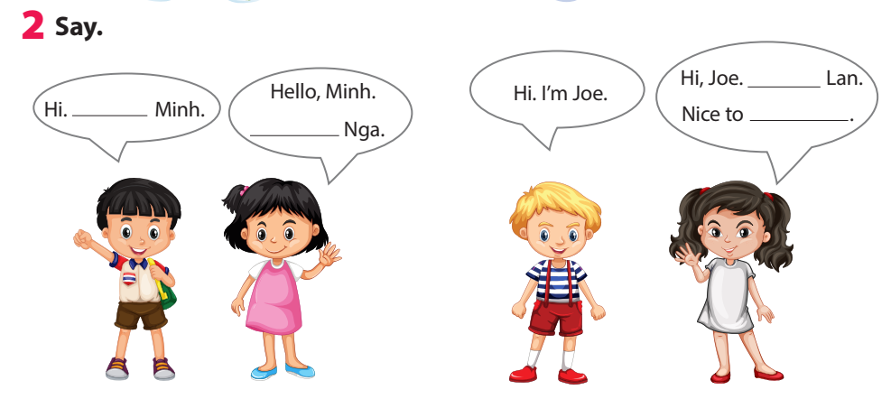
I’m
meet you
I’m
I’m
Notes:
Task 2: Say
- Ask sts how many friends can they see and their names.
- Have sts look at the bubbles and ask them to complete (spoken).
- Have sts practice the dialogues in chorus, group, pairs.

Slide 10

Hello/Hi. I’m…
Nice to meet you.
I’m Linh
Cinderella
Hello/Hi.
I’m Long - super man.
Notes:
- Ask Sts to choose a name that they like then make a name tag and decorate it, stick on chest.
- Have Sts to stand in 2 lines facing together.
- Ask sts of 2 lines shake hand and introduce their name, using
Hello/Hi. I’m…
Hello/Hi. I’m… Nice to meet you.
- When hearing hand clapping, sts in line 1 make a step to the left. They meet a new friend and practice the conversation again.

Slide 11

Assessment
Choose the correct answer!
Notes:
Thiết kế hoạt động tương tác ở phần Assessment (nội dung câu hỏi ở slide 17, 18.)

Slide 12

Choose the correct answer!
  1. ……, I’m Nhung.
Hello B. I’m Tuan
2. Hi, ……….
A. Hello B. I’m Ana
3. I’m Thanh. …….
A. Hello, Thanh B. Nice to meet you
Notes:
Choose the correct answer
……, I’m Nhung.
A. Hello B. I’m Tuan
2. Hi, ……….
A. Hello B. I’m Ana
3. I’m Thanh. …….
A. Hello, Thanh B. Nice to meet you
- Check in pair then whole class.
- Say goodbye

Slide 13
Let’s check!
  1. ……, I’m Nhung.
Hello B. I’m Tuan
2. Hi, ……….
A. Hello B. I’m Ana
3. I’m Thanh. …….
A. Hello, Thanh B. Nice to meet you
Notes:
Choose the correct answer
……, I’m Nhung.
A. Hello B. I’m Tuan
2. Hi, ……….
A. Hello B. I’m Ana
3. I’m Thanh. …….
A. Hello, Thanh B. Nice to meet you
- Check in pair then whole class.
- Say goodbye

Slide 14



Good bye.
See you again!

