Slide 1












Unit 1: My family
and friends
Lesson 1. Task 1 2 3

Slide 2
Presentation
2

Slide 3
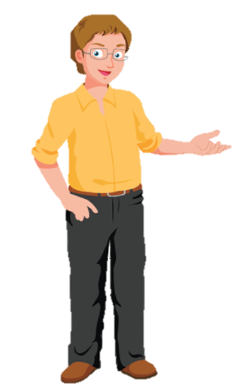
father
Notes:
Remember to tell students that “ Dad” and “father” is the same meaning.

Slide 4

mother
Notes:
Remember to tell students that “ Mum” and “ mother” is the same meaning.

Slide 5
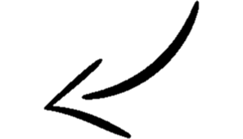
son
daughter

Slide 6
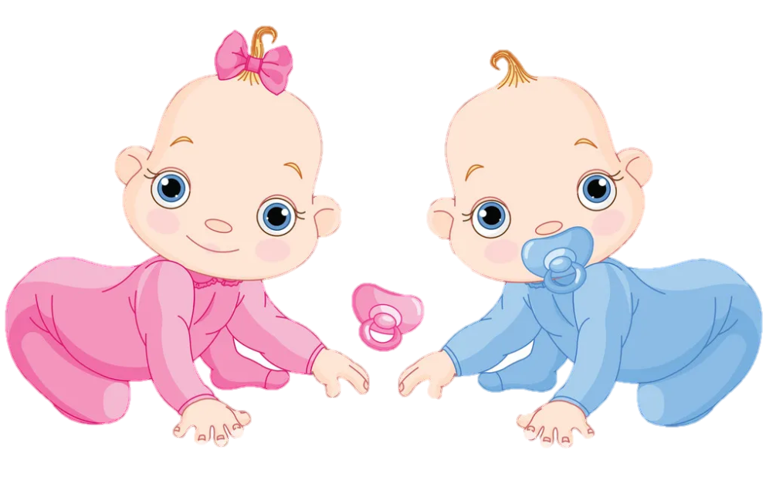
twins

Slide 7



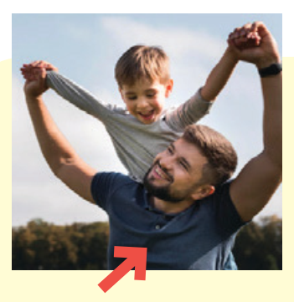
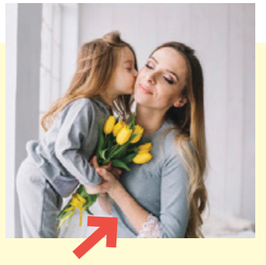
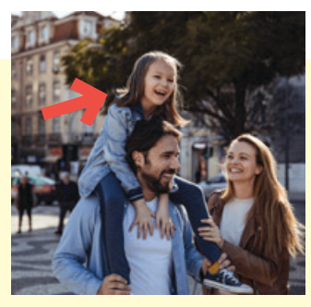
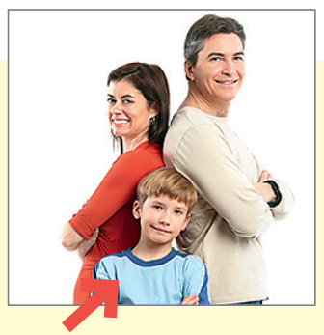

1 Listen and point. Repeat.
father
mother
daughter
son
twins

Slide 8
3
Practice

Slide 9

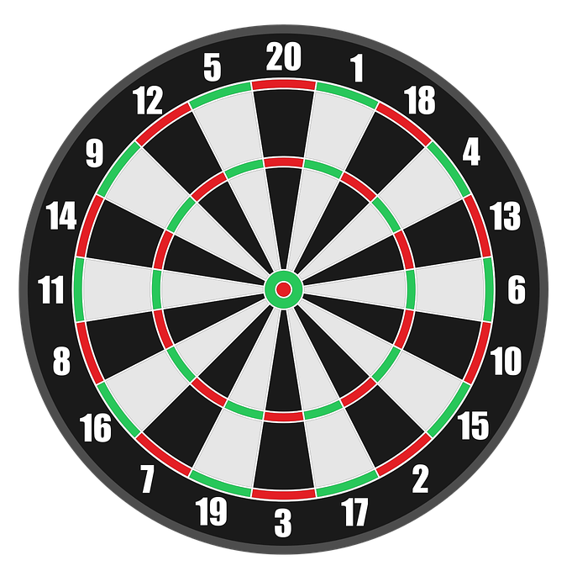

4
Production
Game: Dart Board
Look and answer
PLAY

Slide 10
5
Assessment

Slide 11
UNIT 1: Family and Friends
LESSON 1 – PERIOD 1
What we learnt today
Vocabulary:
father
mother
son
daughter
twins
Structure:
She‘s my mother.
He’s my father.

Slide 12
Thank you & goodbye!

