Slide 1















Unit 1: My family
and friends
Lesson 1. Task 1 2 3

Slide 2


Presentation
2

Slide 3




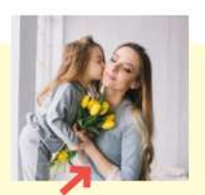
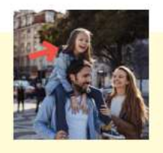


1 Listen and point. Repeat.
father
mother
daughter
son
twins

Slide 4
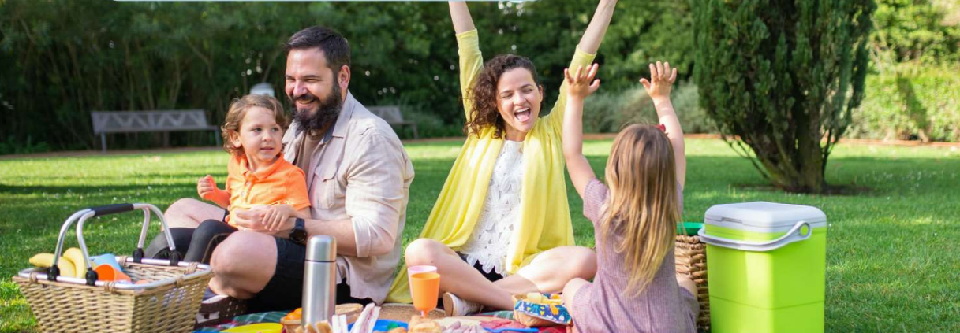


2 Listen and read, write.
Tom : Look! This is my family.
We’re going on a picnic in the park.
Jack :That’s great! Who is he ?
Tom : He’s my father.
Jack : And who is she ?
Tom :She’s my mother.
Jack : Wow! She’s young.
Notes:
Bổ sung. Write tỏng tiêu đề

Slide 5
3
Practice

Slide 6

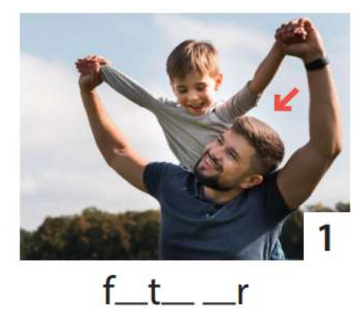
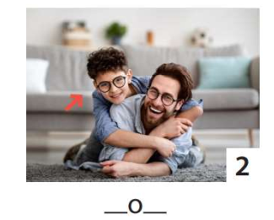
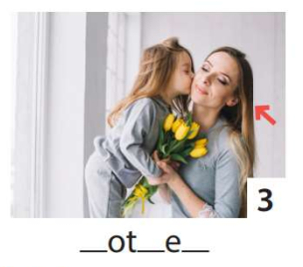
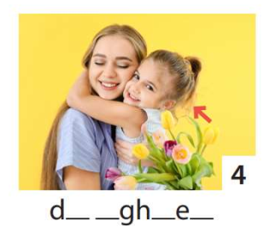
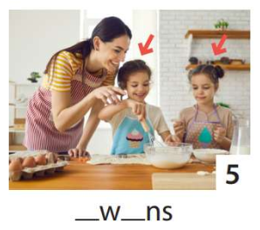
3 Write . Point and say.
1
2
3
4
5
He’s my father.
He’s my son.
She’s my daughter.
She’s my mother.
They’re twins.

Slide 7
WEDNESDAY, 9 September, 2023
UNIT 1: Family and Friends
LESSON 1 – PERIOD 1
What we learnt today
Vocabulary:
father
mother
son
daughter
twins
Structure:
She‘s my mother.
He’s my father.

Slide 8




Thank you & goodbye!

