Slide 1

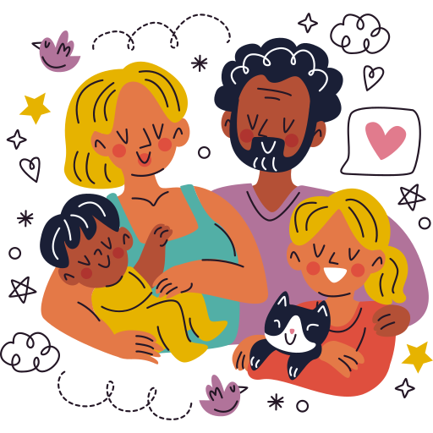
Unit 1:
FAMILY AND FRIENDS
Lesson 1 – Task 1, 2, 3

Slide 2

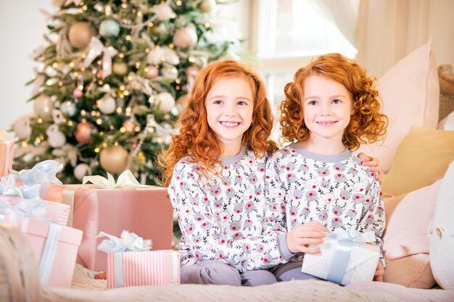
Listen and read.
Carla
Both
Lorena
Both Carla and Lorena are tall with curly hair. They’re clever. They’re crazy about building and making new things. These twins are best friends.
Lorena is quiet. She’s got two good friends but she’s often with her sister, Carla.
Carla and Lorena are twins. They’re nine years old. They’re the same in many ways.
But they’re different in many ways, too.
Carla is loud. She talks a lot. She’s got lots of friends. She’s funny, too.

Slide 3

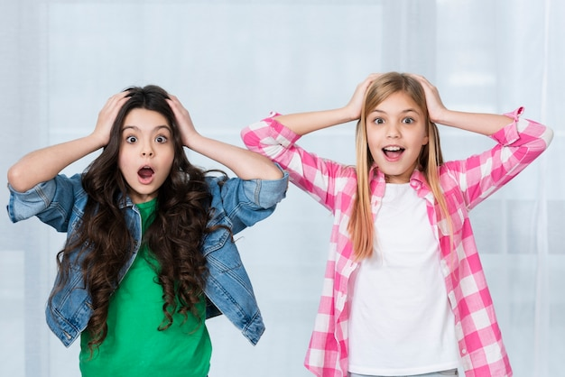
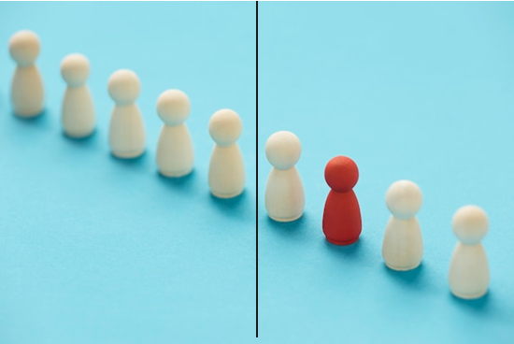
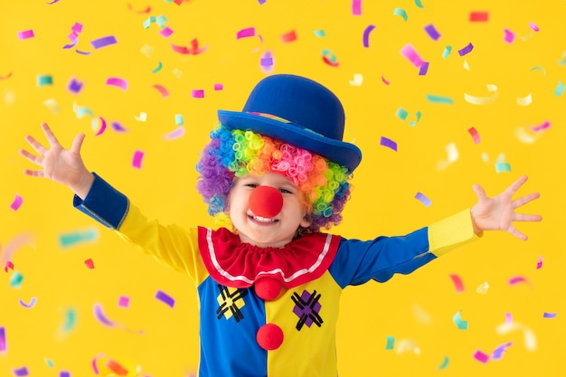



Listen, point and repeat.
clever crazy about different funny loud quiet
same

Slide 4

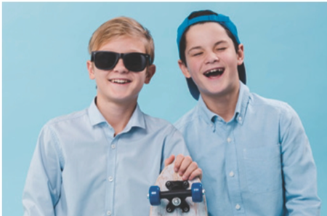
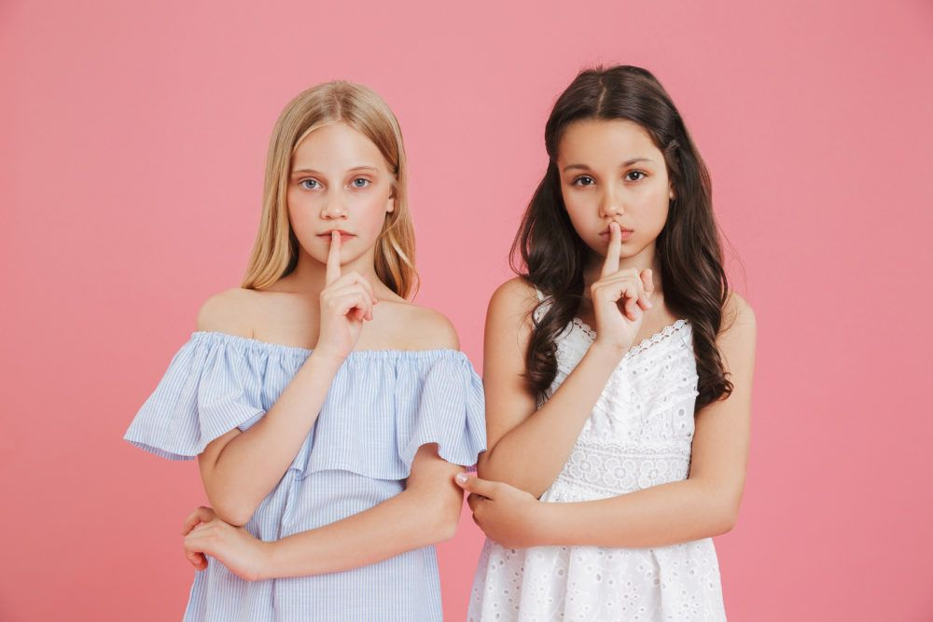
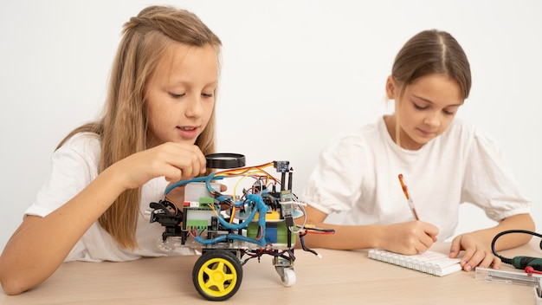
1 Lorena and Carla / clever
2 Bella and Tom / loud
3 Lucas and Noah / funny
5 Mia and Bee /
crazy about technology
4 Mary and Lily / quiet

Slide 5
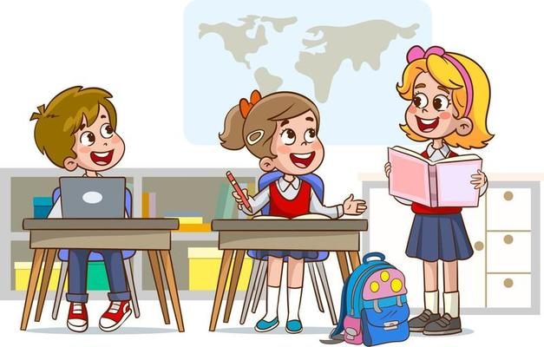
There are four people in my family. My mother is clever. My father is funny. Both mother and father are kind.....
Let’s talk about your family.

Slide 6
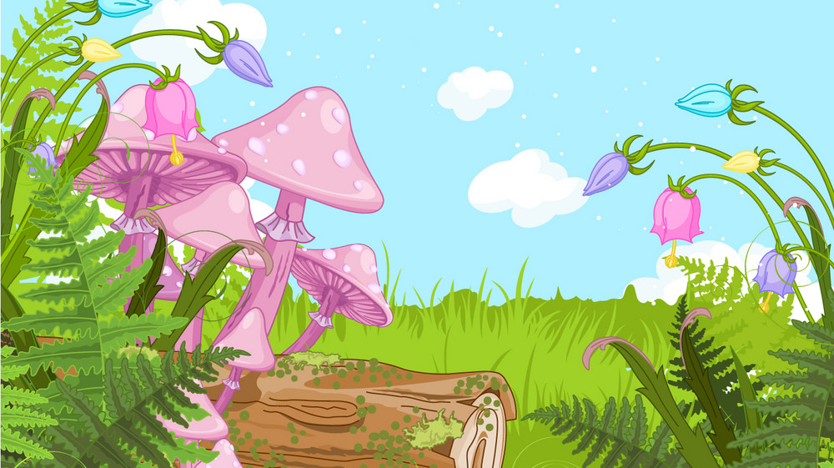
Unit 1: Family and friends
Lesson 1 – Part 1,2,3
What have we learnt today?
Vocabulary:
clever, crazy about, different, same, quiet
Structure:
Both Lorena and Carla are clever.

