Slide 1
Unit 13
WHAT DO YOU DO
IN YOUR FREE TIME?
Lesson 3

Slide 2
Warm-up

Slide 3


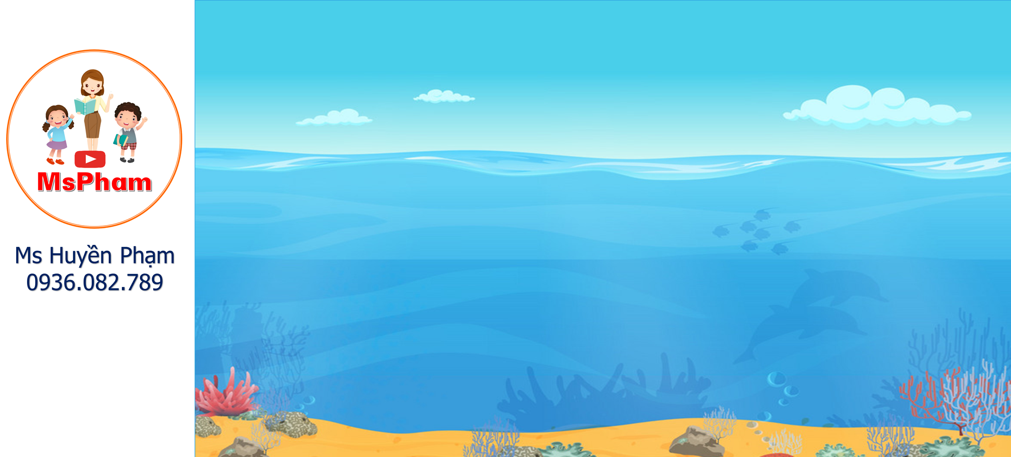
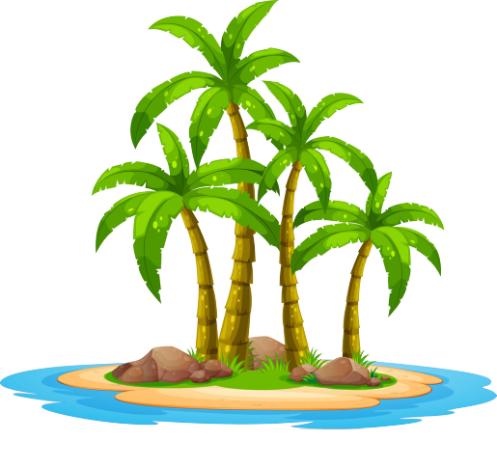
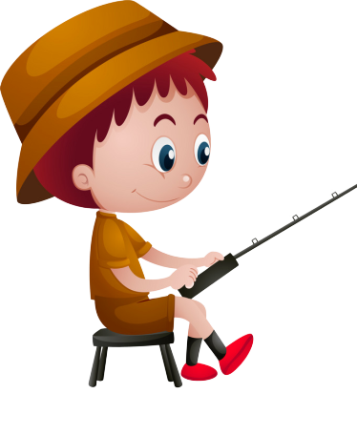
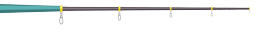

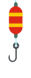

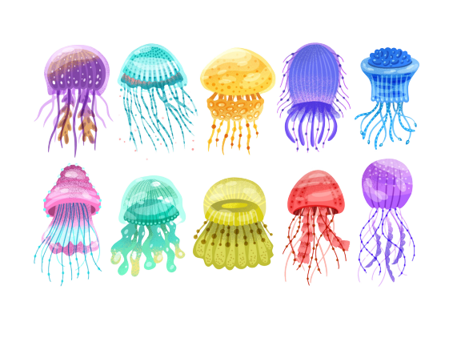

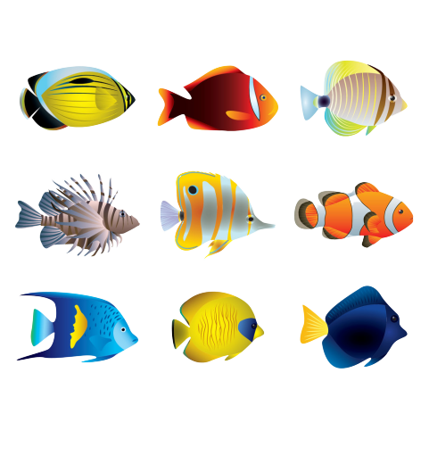


GO FISHING
Game
PLAY
EXIT

Slide 4










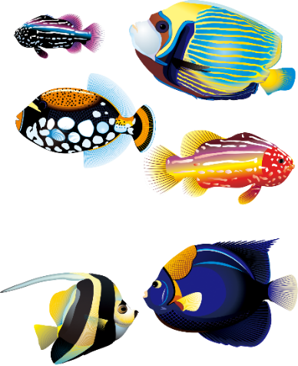

0
Score:
13
12
EXIT
11
14
7
8
15
1
6
9
2
5
3
10
4

Slide 5

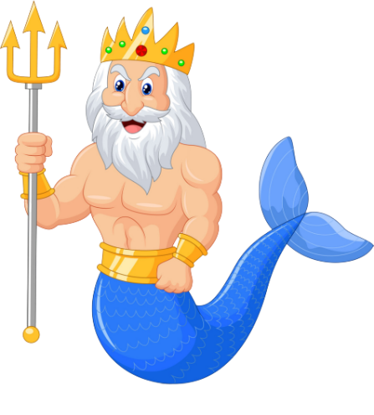


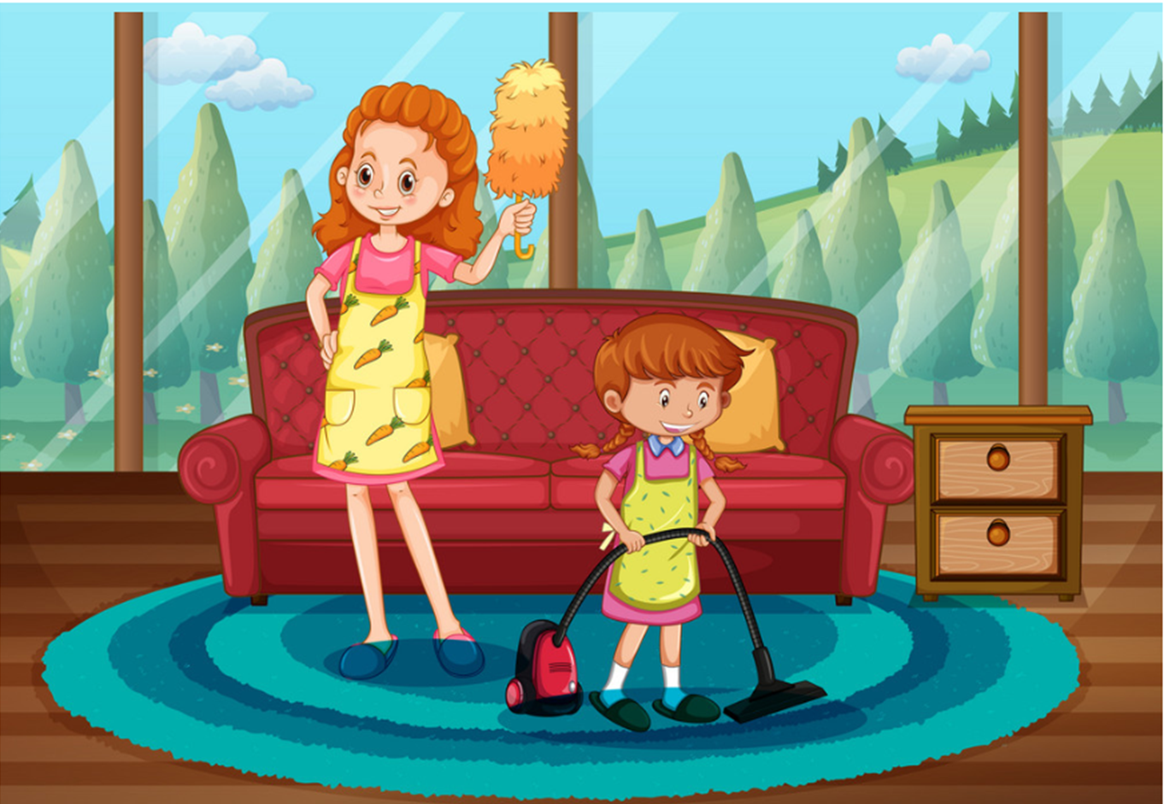
A
I cleans my house.
What do you do in your free time?
B
I cleanes my house.
C
I clean my house.
D
You clean my house.

Slide 6
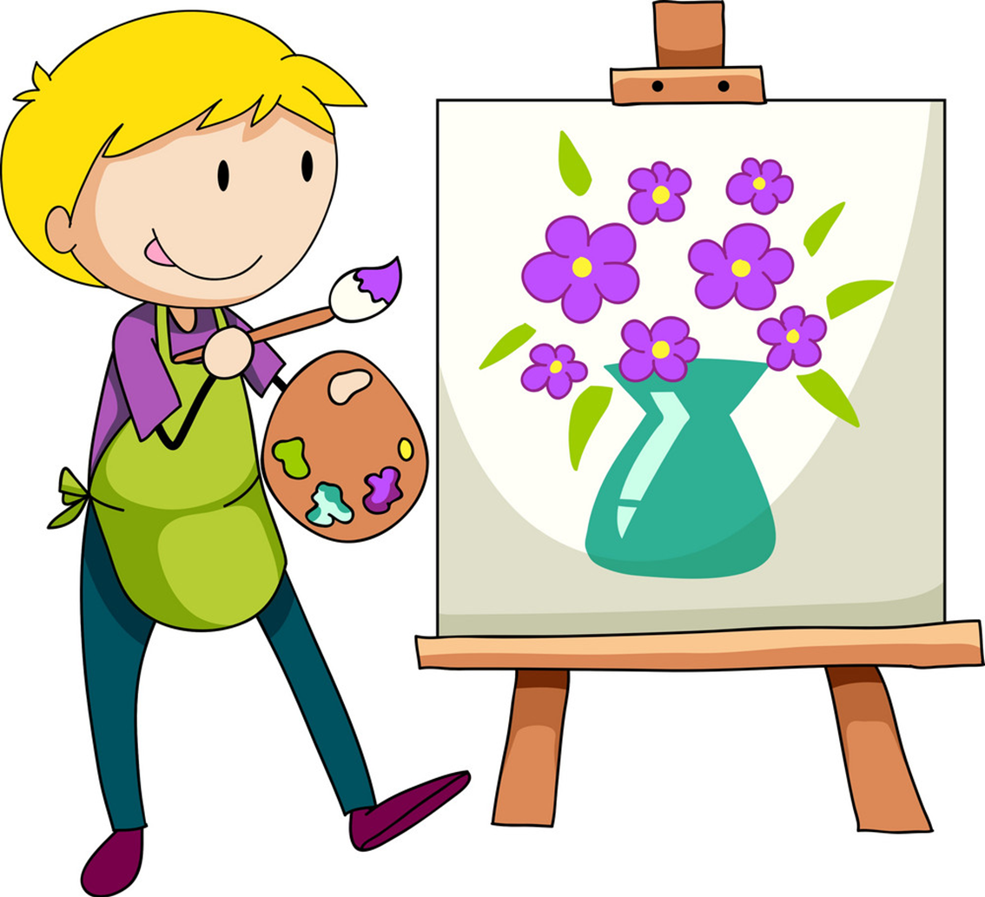
A
What do he do
_____________ in his free time?
He draws pictures.
B
What does he do
C
What do she do
D
What does she do

Slide 7
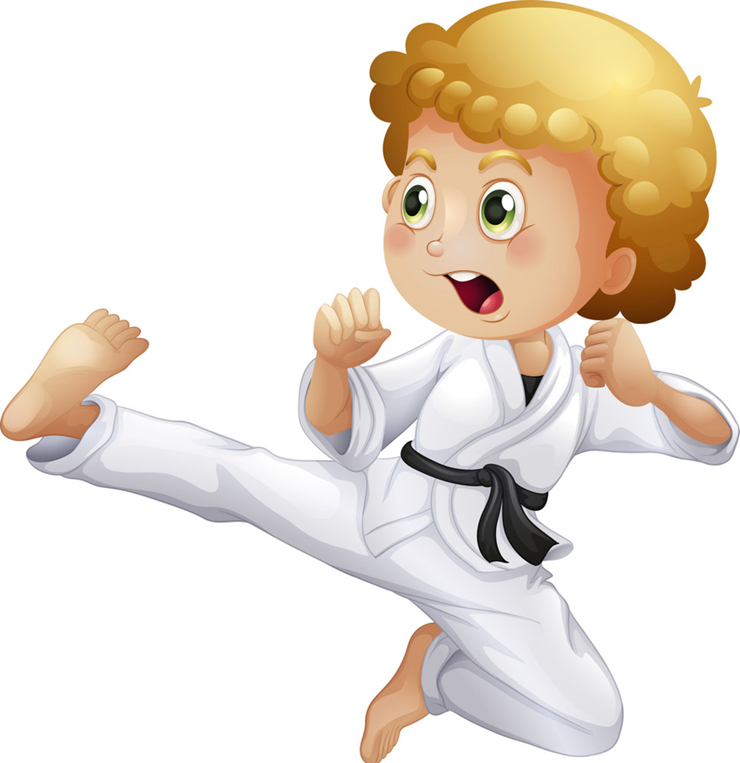
A
does karate
What do you do in your free time?
I _____________.
B
do karate
C
dos karate
D
deos karate

Slide 8
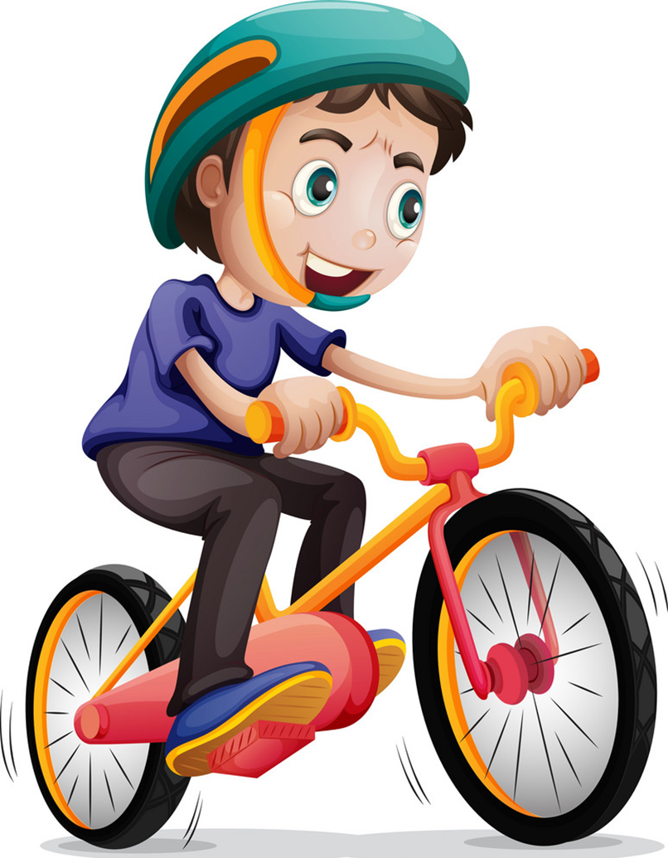
A
What do you do
in your
______________ free time?
He rides his bike.
B
What do you do
in his
C
What do he do
in his
D
What does he do
in his

Slide 9

A
surf the Internet
What does you brother do
in his free time?
- He_______________.
B
surfes the Internet
C
surf the Internets
D
surfs the Internet

Slide 10
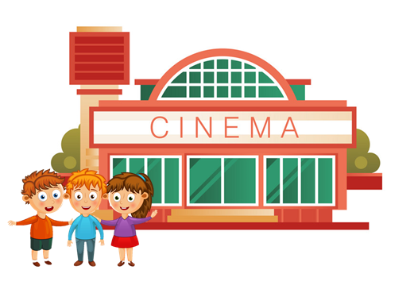
What does your friend do
in her free time?
- She goes to the cinema.
A
True
B
False
C
By
D
Next to

Slide 11
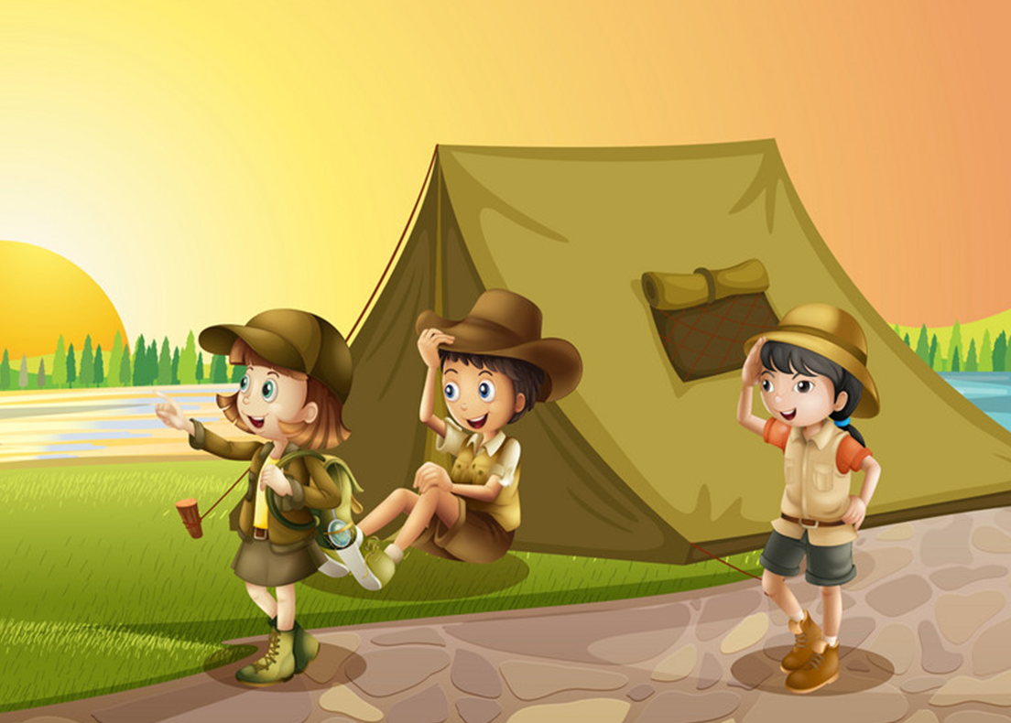
What do you do in your
free time?
- I go camping.
A
True
B
False
C
Should
D
May

Slide 12
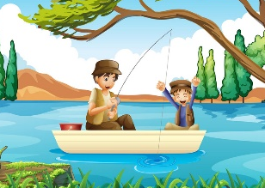
What do your father do
in his free time?
- He goes fishing.
A
True
B
False
C
Play
D
Watch

Slide 13
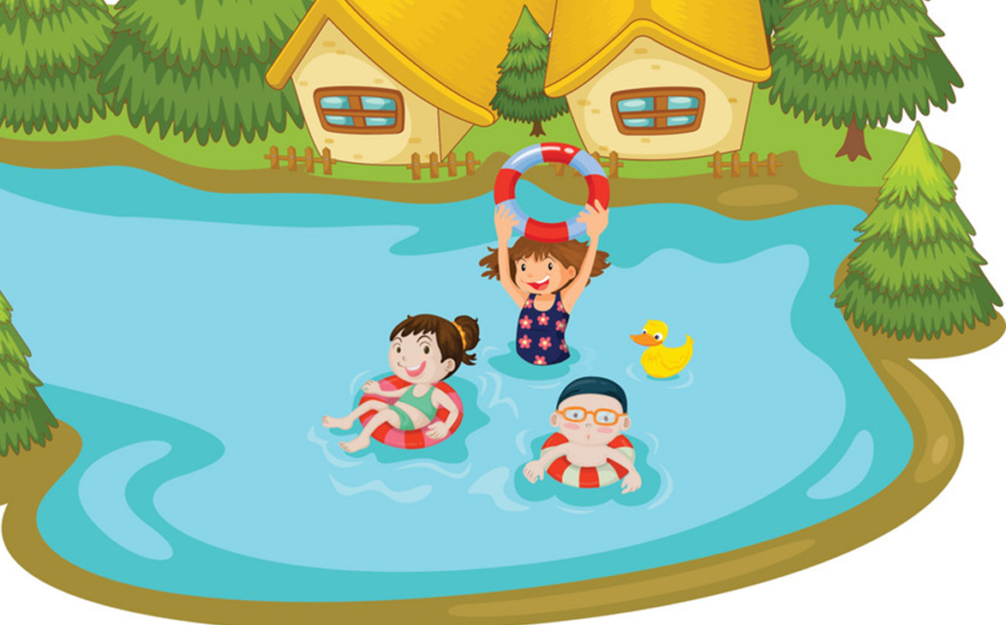
What does your sister do
in her free time?
- She go swimming.
A
True
B
False
C
Play
D
Watch

Slide 14
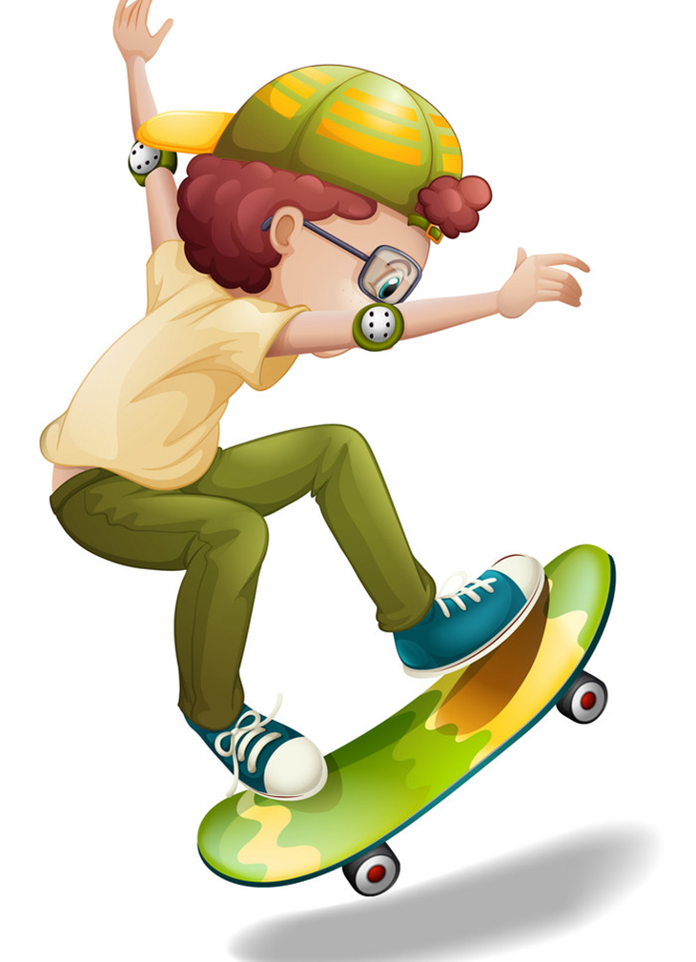
_____ two black cats.
What does you brother do
in his free time?
- He goes skating.
A
True
A
There is
B
False
B
There are
C
Should
C
Play
D
May
D
Watch

Slide 15
Pronounciation

Slide 16

1. Listen and repeat
1. | What do you do in your free time? ↷ I surf the Internet. ↷
2. | What does he do in his free time? ↷ He listens to music. ↷
3. | What does she do in her free time? ↷ She goes shopping. ↷
4. | What do they do in their free time? ↷ They go camping. ↷

Slide 17
2. Listen and circle a or b. Then say the sentences aloud.
1. What do you do in your free time? I ________.
a. clean the house b. watch cartoons
2. What does she do in her free time? She ______.
a. goes skating b. goes fishing
3. What does he do in his free time? He ________.
a. does karate b. goes to the cinema
4. What do they do in their free time? They ________.
a. work in the garden b. go shopping

Slide 18
REVIEW

Slide 19
Model sentence
What do you do in your free time?
I ______________________.
ride my bike
surf the Internet
do karate
draw pictures
clean the house
go to the cinema

Slide 20
Model sentence
What does your ________ do in ____ free time?
She/he ______________________.
surfs the Internet
go fishing
go swimming
clean the house
go to the cinema
go camping
do karate
go skating

Slide 21
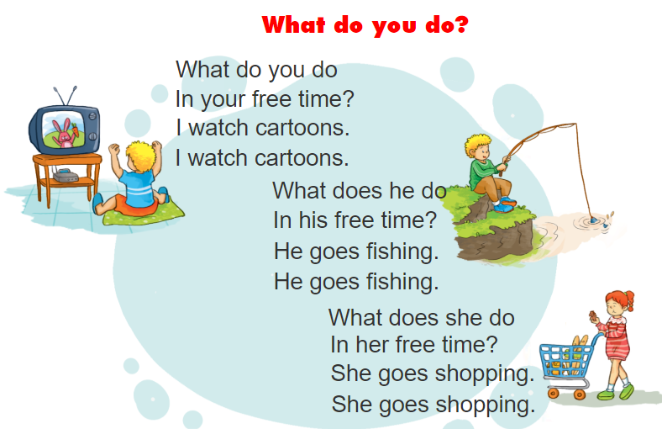


3. Let’s chant

Slide 22
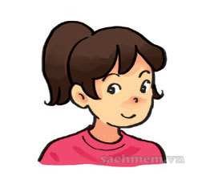
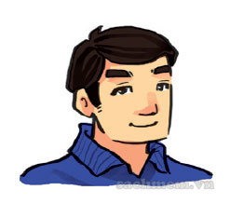
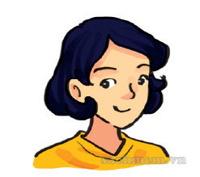

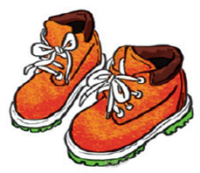
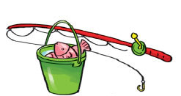
4. Read and match.
My name is Lien. In my free time, I often go camping with my family. The camp is in the forest near the Red River. We go there by bus in the morning. My father likes fishing in the river. My mother likes drawing. She often draws pictures of the camp. I often go hiking in the forest because I like sports. We return home late in the evening. We enjoy camping very much.
1
2
3
a
b
c

Slide 23
5. Write about what your family do at weekends.
My name is _________________.
At weekends, I often _________________.
My father _________________.
My mother _________________.
My brother/sister _________________.

Slide 24
6. Project
Interview two classmates about what they do in their free time
Name | Activities

Slide 25
THANK YOU!

