Slide 1





















Review 4
Part 3: Video

Slide 2










1.Warm-up

Slide 3


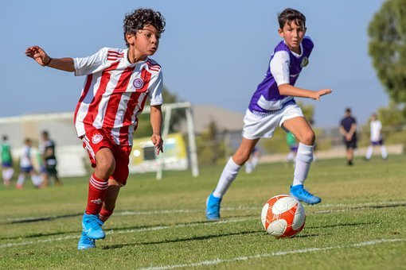



Tick the word with its picture.
ride a bike
play football
watch TV

Slide 4
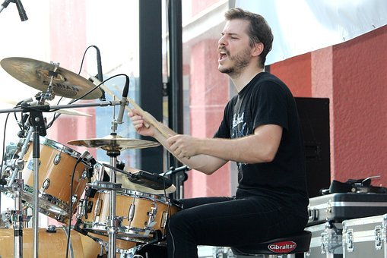
Tick the word with its picture.
play
the drum
play
football
play
the guitar

Slide 5
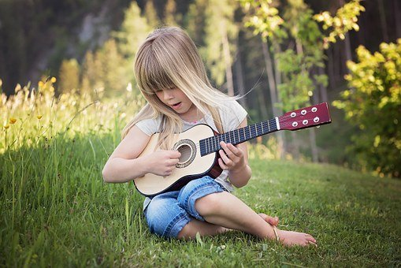

Tick the word with its picture.
play
the guitar
play
game
play
volleyball

Slide 6
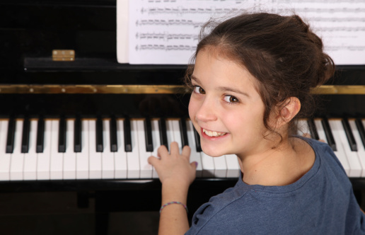
Tick the word with its picture.
play
basketball
play
tennis
play
the piano

Slide 7
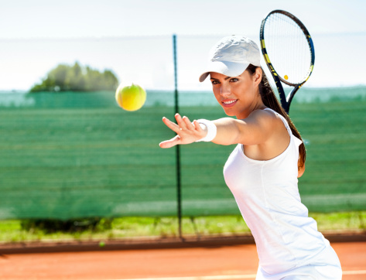
Tick the word with its picture.
play
hockey
play
tennis
fly a kite

Slide 8
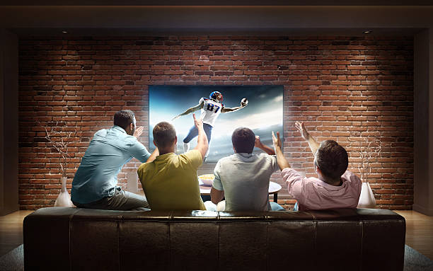

Tick the word with its picture.
speak english
sing a song
watch tv

Slide 9
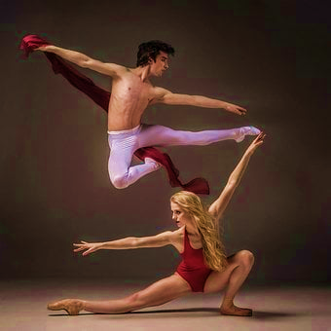
Tick the word with its picture.
dance
sing
watch

Slide 10
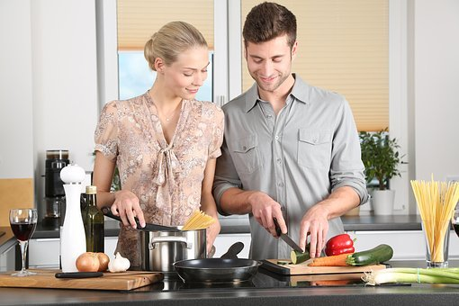
Tick the word with its picture.
hit
cook
draw

Slide 11

Tick the word with its picture.
colour
kick
read

Slide 12
2.Review

Slide 13



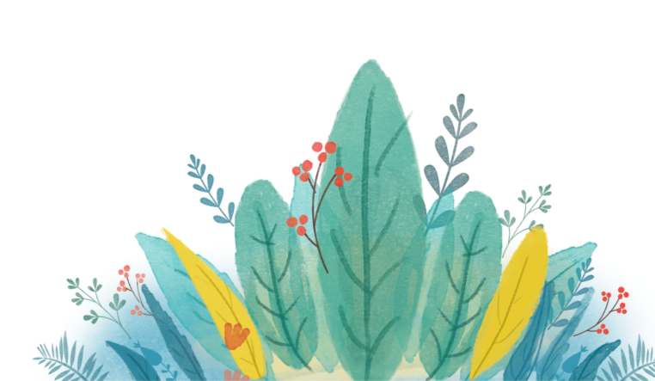

1 Circle your hobbies.
read
cook
play tennis
dance
play
the guitar
play football

Slide 14


Slide 15



2 Circle what you can see in the video.
Playing football
cooking
dancing
Watching TV
reading

Slide 17

3 Tick T for True or F for False
1, A boy is reading a book.
2, The football team has boys and girls.
3, The dance class is a ballet lesson.
4, A girl is teaching her dad to cook.
5,The football teams wear green
and orange .
T
F
T
F
T
F
T
F
T
F

Slide 18




GO FISHING

Slide 19








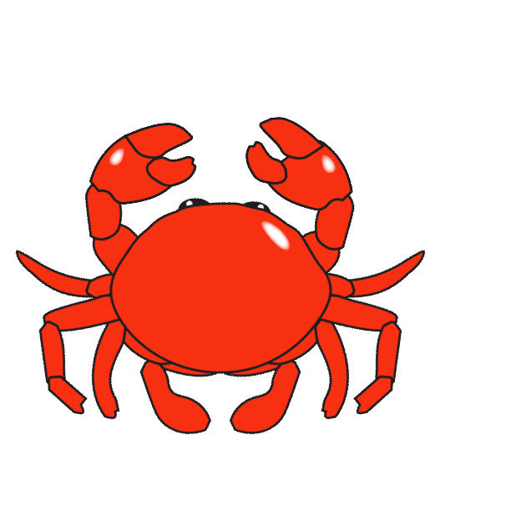

Slide 20


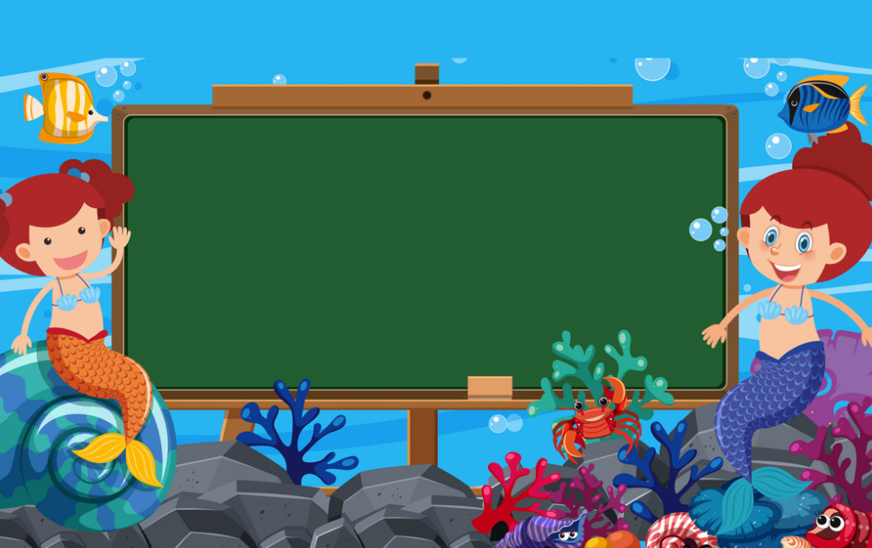

Q1
Choose the correct answer.
He can …..
A. plays the drum.
B. play drum.
3 stars
C. play the drum.
Back
Back

Slide 21
Q2
Choose the correct answer.
He can …..
A. dance
B. dances
C. dancing
4 stars
Back
Back

Slide 22
Q3
Look and speak what she she can do.
s
She can play the piano.
5 stars
Back
Back

Slide 23
Choose the correct answer.
Q4
s
My sister’s…..
A. writing a book
B. reading a book.
C. colouring a book
3 stars
Back
Back

Slide 24
Q5
Choose the correct answer.
They …………football.
A. ‘m playing
B. ‘s playing
2 stars
C. ‘re playing.
Back
Back

Slide 25
Q6
Arrange to make a sentence.
The ball / catch/ ‘re running/ They / to.
A. ‘re they running to catch the ball.
B. They’re running to catch the ball.
C. The ball’re running to catch they.
6 stars
Back
Back

Slide 26
3.Extra activity

Slide 27











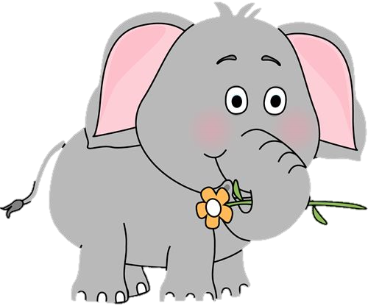



Task 1: Draw picture.
I can draw an elephant.
An elephant can pick a flower.

Slide 28


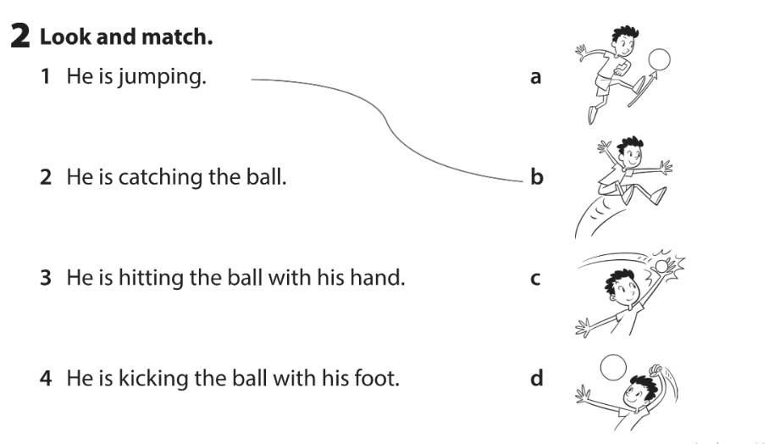
Task 2: Look and match.
2

Slide 29
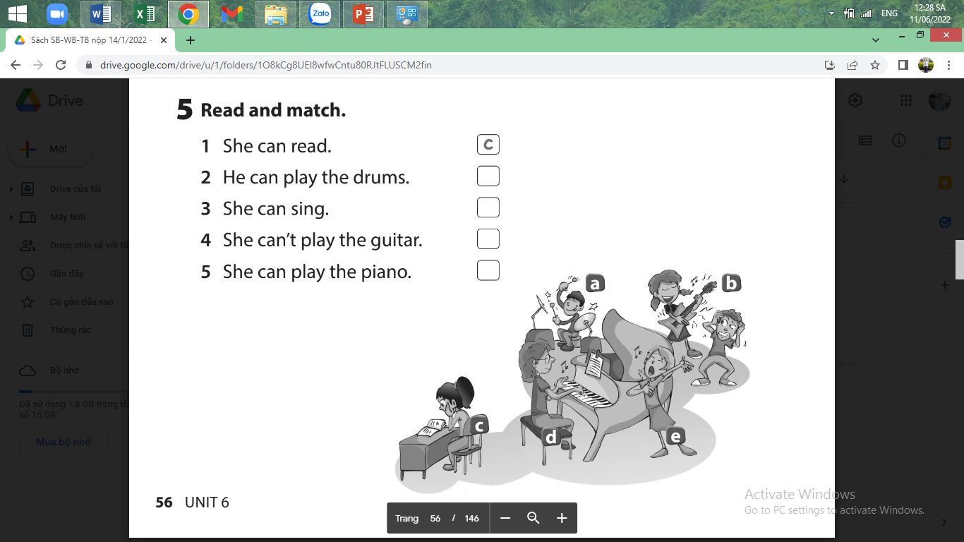
Task 3: Look and fill in the box
2
a
e
b
d

Slide 30




Thank you & goodbye!

