Slide 1



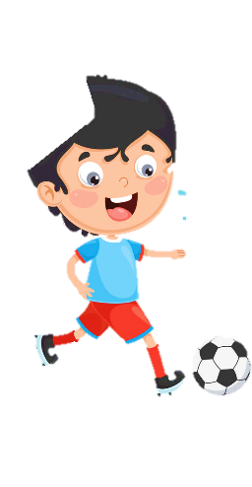












Thanh Am Primary School
Welcome to English class
Teacher: Ngoc Khue
Notes:
Để nguyên trang bìa như này, chỉ thay đổi tên bài trong quá trình làm. Logo của sách Wonderful World

Slide 2







Notes:
Để nguyên trang bìa như này, chỉ thay đổi tên bài trong quá trình làm. Logo của sách Wonderful World

Slide 3

Unit 7 My Favourite Sport
FUN TIME AND PROJECT
Notes:
Lỗi trình bày

Slide 4


01
Warm Up
SWIMMING RACE

Slide 5








1
2
Exit
Notes:
Divide class into 2 teams, the team which swim to “ FINISH” will win.
Press “ Lifebuoy” to the question and answer. If sts answer correctly, press the boy to swim forward.

Slide 6
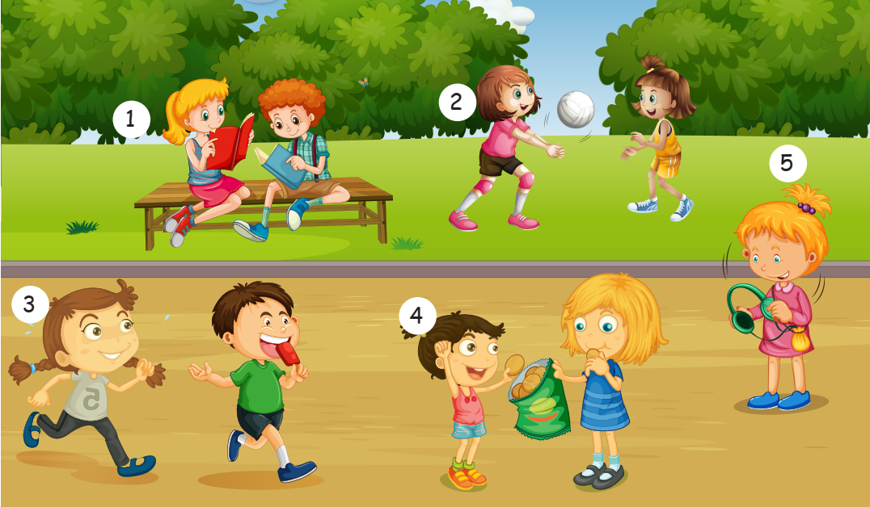
How many people are there in the picture ?
- Nine.
NEXT

Slide 7

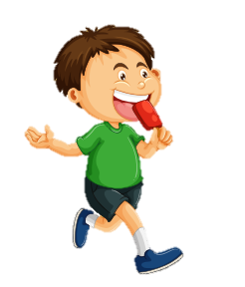
What is he eating ?
He is eating an ice cream.
NEXT

Slide 8
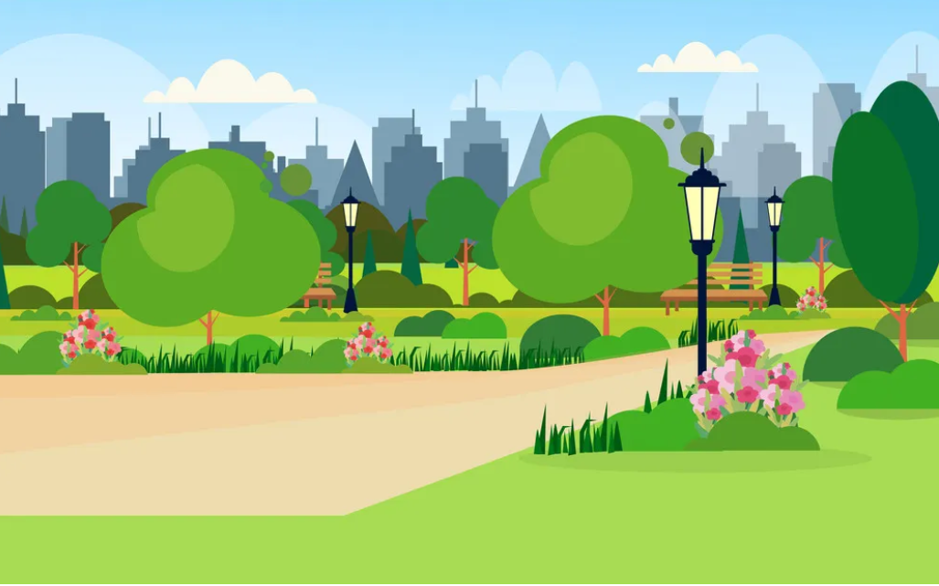

Is she swimming ?
A. No, she isn’t.
B. Yes, she is.
NEXT
Notes:
K có slide đáp án

Slide 9


Is she jumping ?
A. Yes, she is.
B. No, she isn’t.
NEXT

Slide 10
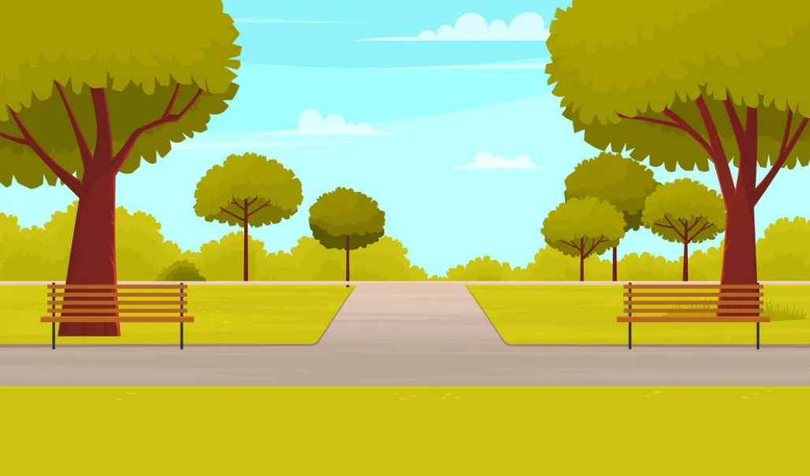
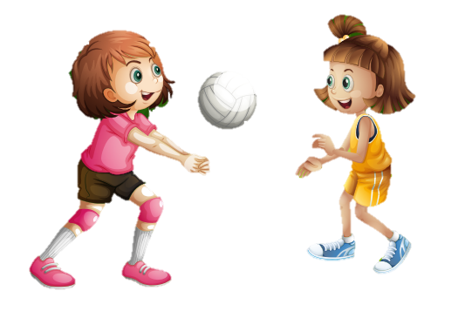
She ………...playing basketball.
isn’t
A. is
B. isn’t.
NEXT

Slide 11
Practice
02

Slide 12
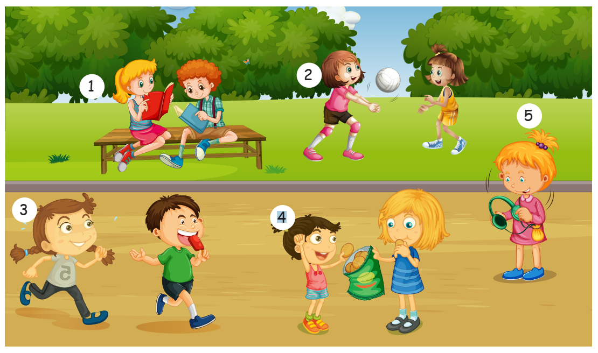

Look and describe the picture.
Notes:
Đảo lên trên trước khi viết

Slide 13
Task 1. Look and write
Notes:
HOẠT ĐỘNG TƯƠNG TÁC TỪ SLIDE 12 -> 17

Slide 14
She’s reading.
1. _______________(reading)

Slide 15
She isn’t kicking the ball.
2. ___________________(kicking the ball)

Slide 16
3. ___________________(running)
She is running.

Slide 17
She isn’t singing.
4. _______________(singing)

Slide 18
She isn’t dancing.
5. _______________(dancing)

Slide 19
Project
03

Slide 20
My favourite sports
PR JECT
Draw some sports you like.
Tell the class about them

Slide 21
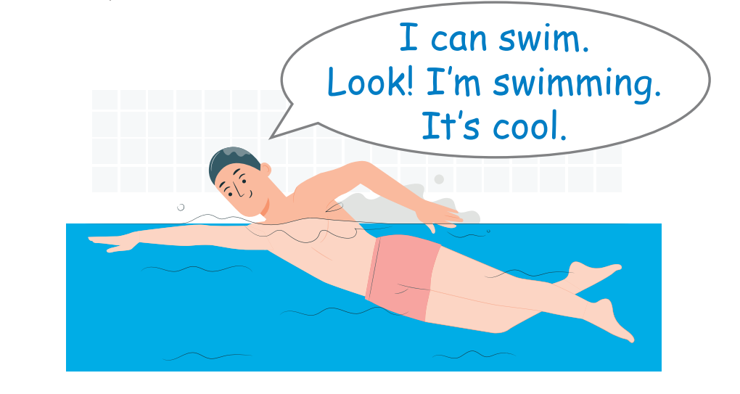

Slide 22
Assessment
04

Slide 23
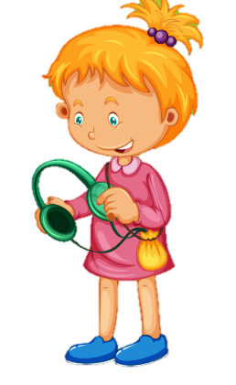
Look and write :
1. I ……………………a book with Peter.
2. He ……………………an ice cream.
3. Nhi……………………………………
4. She ……………………to music.
am reading
is eating
is running
is listening
4
2
1
3

Slide 24
Thank you

